Slide 1
Getting the Dirt on Soils or
Why is Soil important
Presented by Name, Position
Member/Fellow of the Soil Science Society of America
Notes:
A key part of landuse planning and development (which may also include land conservation and preservation) is the ability to evaluate the site and the soils on it. This evaluation is often the first data collected outside the office.

Slide 2
What are 4 things we
cannot live without?

Slide 3
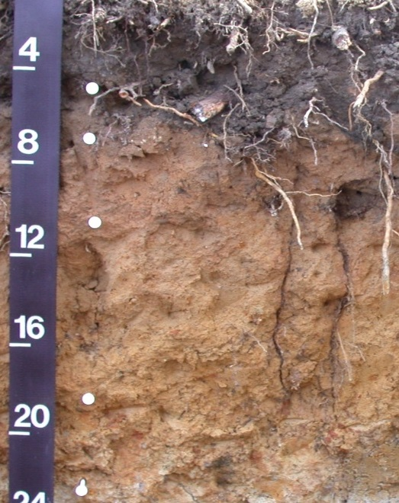
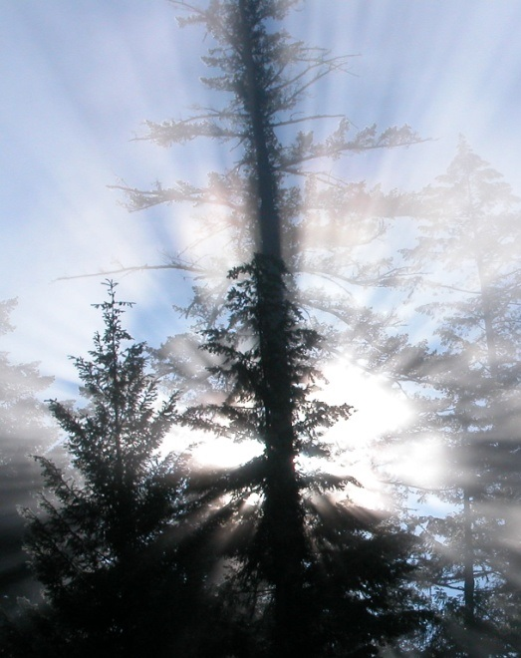
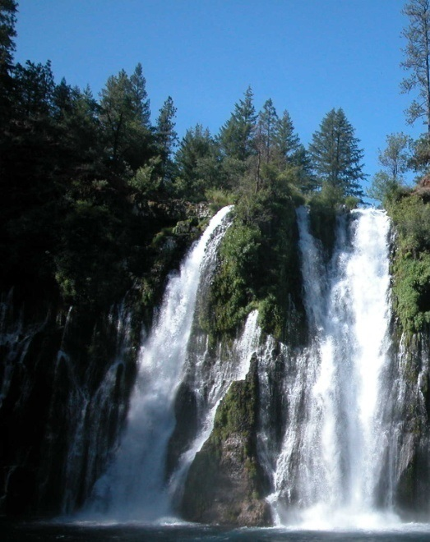
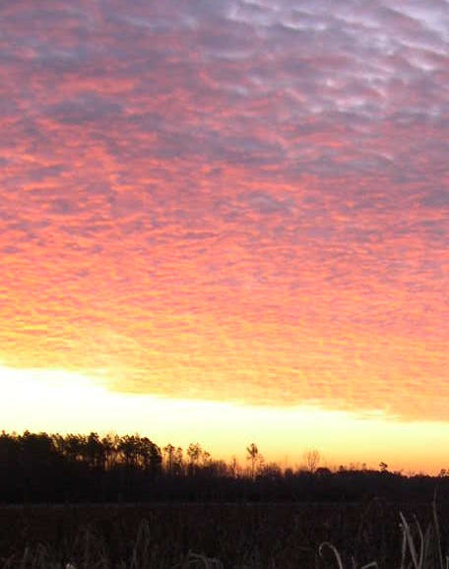
Soil
Air
Water
Sunlight

Slide 4
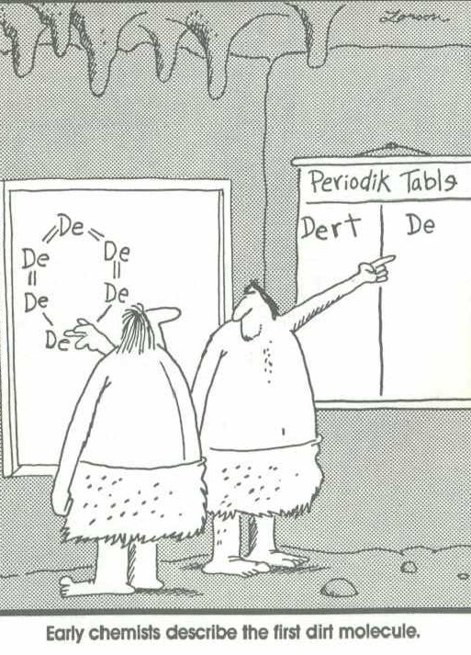
Does Soil =
Dirt?
Notes:
What is a soil? What does it mean to you? Does it have and special meaning to you? Before answering these questions consider what you see in the soil.

Slide 5
NO!
Dirt is the stuff under your fingernails
or that you sweep off the floor
Notes:
NO, dirt is a four letter word we will not use in this module. It is as state above. Soil is so much more than just dirt.

Slide 6
Soil Facts
Topsoil is the most productive layer
Five tons of topsoil spread over an acre is only as thick as a dime
Soil supplies water and nutrients for plants
Most of our food comes from soil
It can take more than 500 years to form one inch of topsoil
Notes:
What is a soil? What does it mean to you? Does it have and special meaning to you? Before answering these questions consider what you see in the soil.

Slide 7
Soil Facts
An acre of corn gives off 4000 gallons of water a day in evaporation
Soil Scientists have identified over 22,000 different soils in the U.S.
Erosion of soil clogs rivers and lakes
Soil influences the life spans of roads
Notes:
What is a soil? What does it mean to you? Does it have and special meaning to you? Before answering these questions consider what you see in the soil.

Slide 8
Soil Facts
Soil is alive….
1 gram of soil contains up to a billion bacteria
There many thousands of types of bacteria in soil
15 tons of soil per acre pass through earthworms each year
Notes:
What is a soil? What does it mean to you? Does it have and special meaning to you? Before answering these questions consider what you see in the soil.

Slide 9
Soil Facts
Soil is the largest single wastewater treatment unit in North Carolina
4 million North Carolinians rely on soil to treat and disperse wastewater
Soil is extremely effective at wastewater treatment
Best of all…
Notes:
What is a soil? What does it mean to you? Does it have and special meaning to you? Before answering these questions consider what you see in the soil.

Slide 10
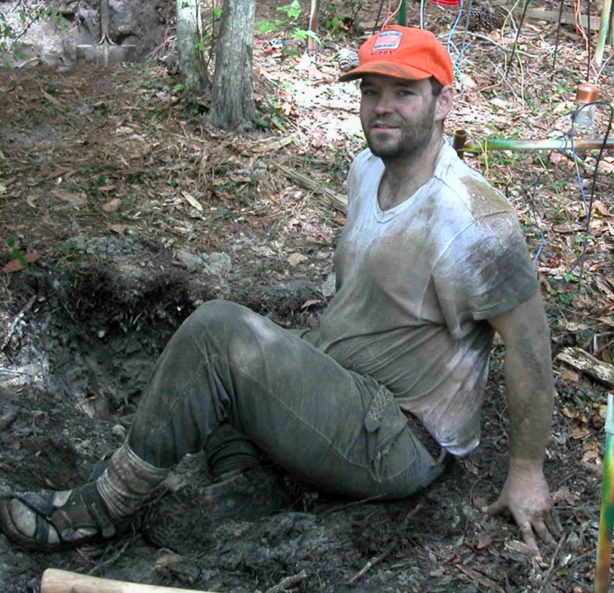
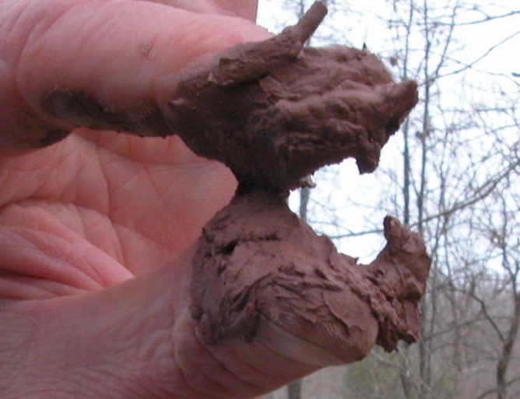
Soil makes great mud pies
…and is just plain fun!

Slide 11
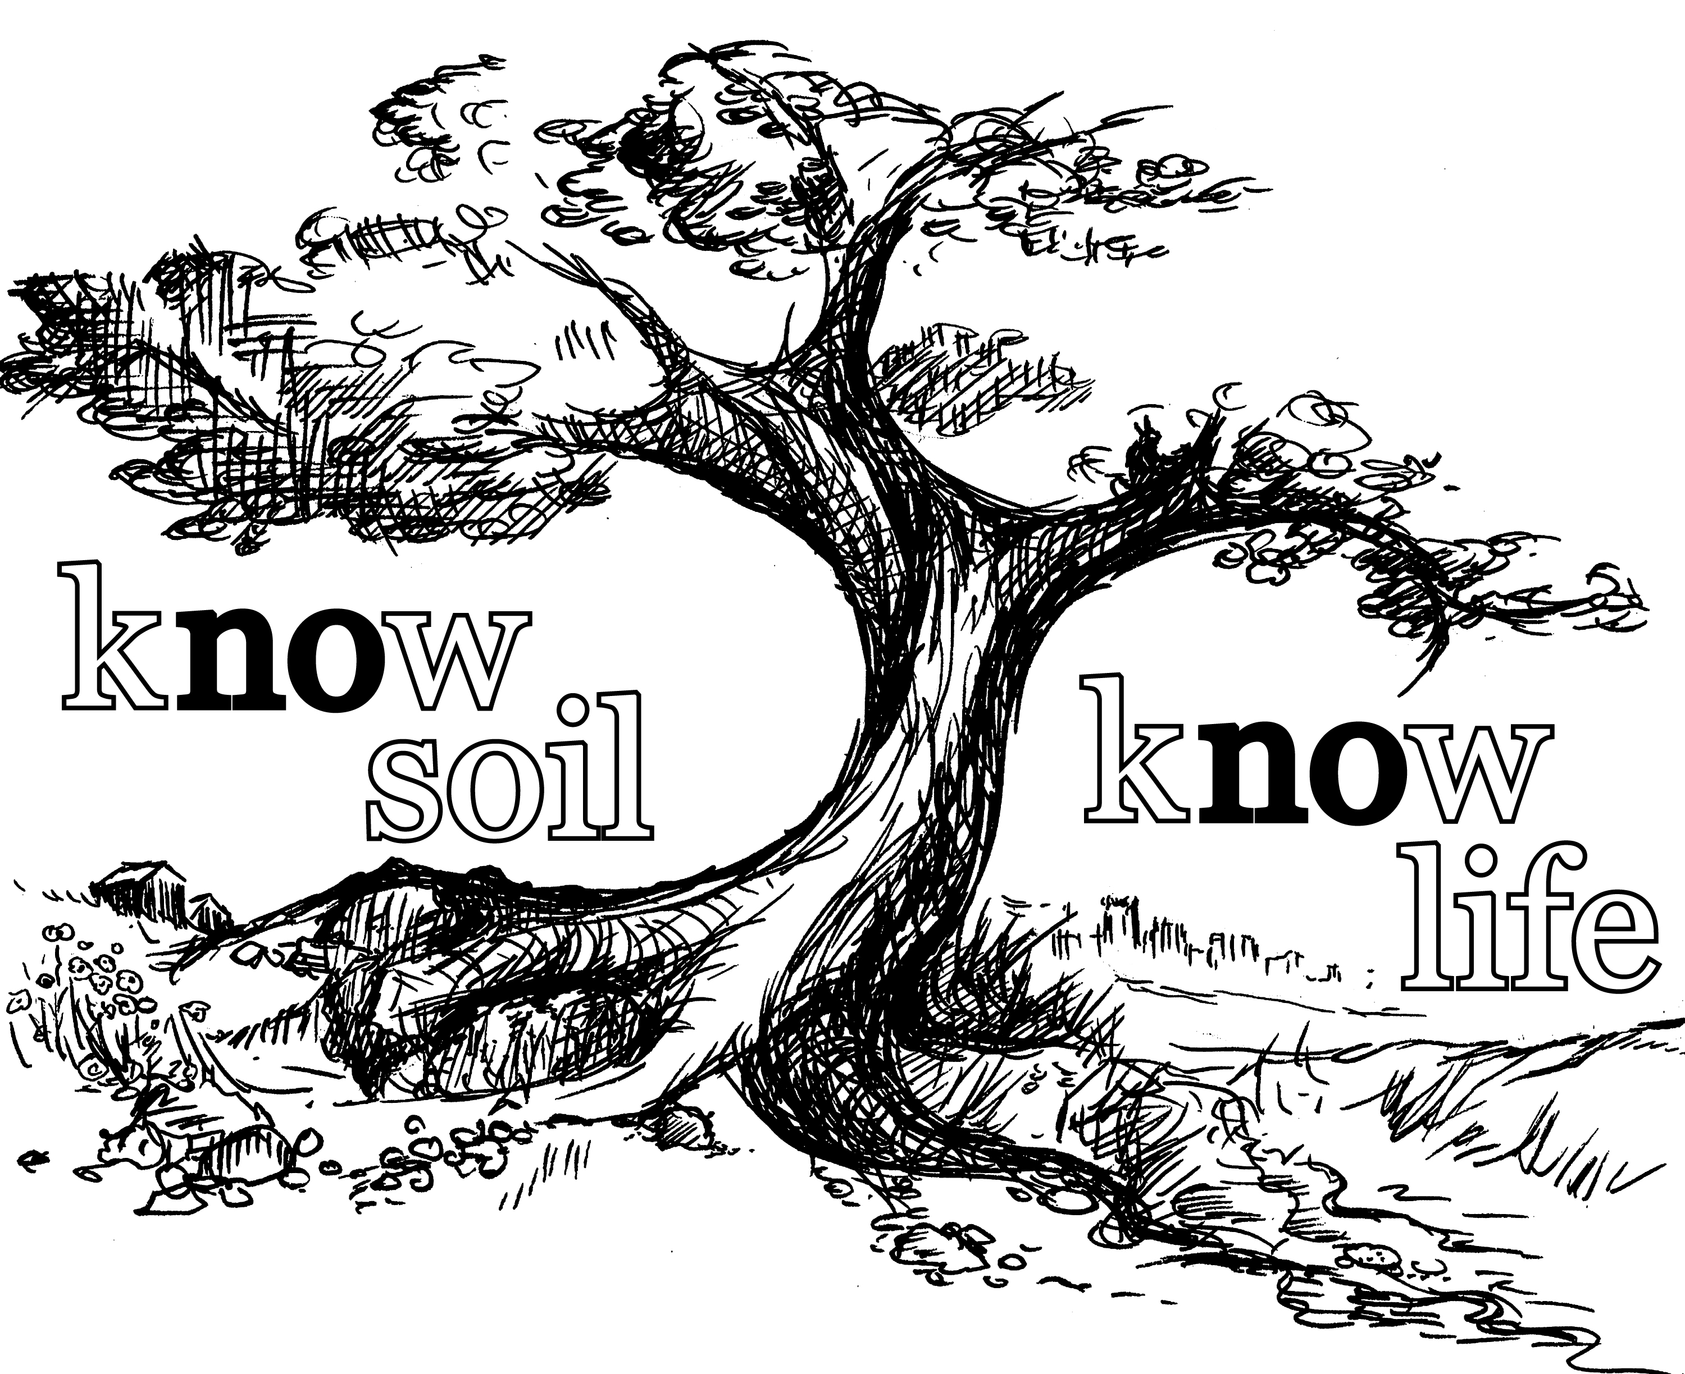

Slide 12
The UN Declared 2015 as the International Year of Soils (IYS) to bring more attention to this important natural resource. The Soil Science Society of America celebrates IYS and is happy to bring you this presentation. We hope you take the time to learn more about soils at the many resources listed at the end of this presentation, as you learn more about how…
Soils Sustain Life

Slide 13


Thank you for listening!
For further information, visit:
Soils.org/discover-soils – information about all things soil!
Soils4teachers.org – Lesson plans, activities, etc. for teachers
Soils4kids.org – activities for the K-12 audience
Follow us on facebook.com/iheartsoil
Soils sustain life!

