Slide 1
When Soil Won the Nobel Prize in Medicine
Notes:
The Nobel Prize in Medicine or Physiology has been awarded 104 times between 1901 and 2013. In 1916 the prize was awarded to Watson, Crick and Wilkins for their work on the structure and significance of DNA.
But in 1952, the soil was an important player in the Nobel Prize awarded that year.

Slide 2
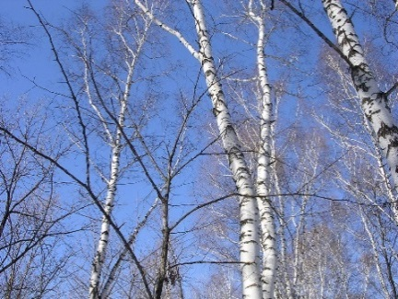
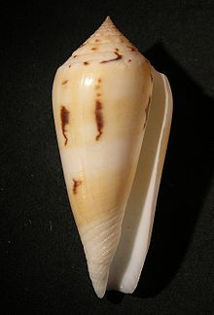
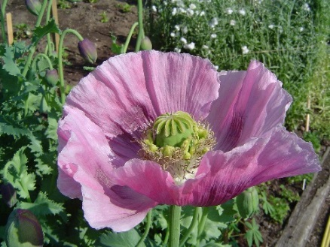
Your favorite Pharmacy is full of medicines that originally came from natural sources
Native Americans used the bark of willow and birch trees for headaches because they have the active ingredient in aspirin (salicin)
Marine cone snails (Conus species) produce a poison that is used as a pain medication
The opium poppy is the source of morphine
Wikipedia commons
Wikipedia commons
Wikipedia commons
Notes:
Throughout the ages humans has used nature as their medicine cabinet. The ancient Greeks and Native Americans understood that the bark of willow and birch trees could be used to relieve headaches. That is because the barks contains salicylic acid which is chemically related to the active ingredient in today’s aspirin.
The marine cone snail is a venomous creature. But now its venom is being used as a pain medication that some say can be 100 times more potent than existing pain medications; including morphine.
And speaking of morphine, it comes from the opium poppy seed pod and has been used as a powerful tool to relieve pain…while also being the main psychoactive chemical found in opium.
The list of medications is long and their mode of action is impressive. <See this site for more examples: http://publications.nigms.nih.gov/medbydesign/chapter3.html#c1;>
Of the 1,184 new drugs that were approved between 1981 and 2006, 705 were from or based on chemicals found in nature.
Soil is one of the places we can find new medicines because of the tremendous biodiversity of microbes found in the soil.

Slide 3
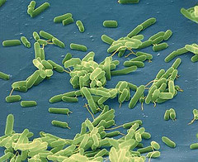
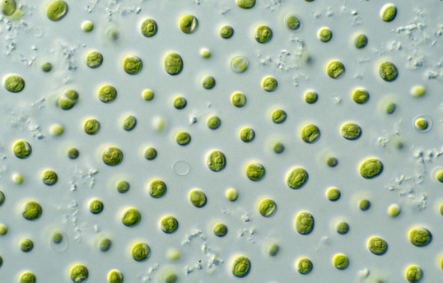
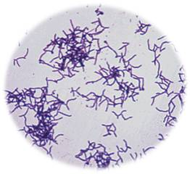
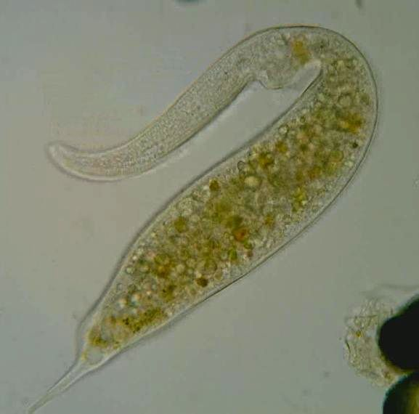
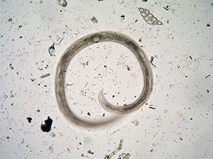
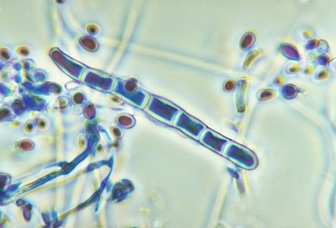
Biodiversity of the soil overwhelms any form
of above-ground biodiversity
One gram of soil contains
100 million to 3 billion bacteria
100,000 to 1 million actinomycetes
100,000 to 1 million fungi
1000 to 1 million microalgae
1000 to 100,000 protozoa
10 to 100 nematodes
1000 to 100,000 other invertebrates
10,000 to 50,000 species
Bacteria
Cesar Harada, http://creativecommons.org/licenses/by-nc-sa/4.0/legalcode
Microalgae
Wikipedia commons
Actinomycetes
Wikipedia commons
Nematodes
Protozoa
Fungi
A. Robertson and M. Minor, Massey University http://soilbugs.massey.ac.nz/images/nematode3.jpg
Wikipedia commons
Wikipedia commons
Notes:
When we consider total ecosystem biodiversity, the biodiversity found above-ground is, at best, a footnote to that found underground. <Read the number/amount of organisms in a gram of soil>. Large soil biodiversity means a high potential for finding new soil-based medicines.

Slide 4
The soil microbes are there to perform a variety of services (i.e. processes that benefit the ecosystem)
Such as:
Decomposing organic matter that reaches the ground from plants (without them we would soon have organic matter piling up on the ground that would be over our heads)
Upon decomposing wastes, they cycle the nutrients in the waste making them available to other plants
Some fix nitrogen from the atmosphere so plants can use that form as an essential nutrient
Some give roots better access to soil nutrients (mycorrhizal association of roots and fungi)
James Nardi, U of Illinois Press, used with permission
Notes:
Biodiversity is an ecosystem service, i.e. a benefit that the ecosystem provides to society. The biodiversity allows soil organisms to perform a variety of necessary soil functions. They decompose organic matter, physically breaking down leaves and branches that fall to the ground. Without them we would be under tons of organic matters sitting on the soil surface.
As they decompose the organic matter they release nutrients that can be reused by the plant to promote their growth and life cycle.
Some of these organisms can pluck the plant nutrient, Nitrogen, right of the air as nitrogen gas and “fix” it in a form that the plant can use.
There is even a symbiotic root-fungus relationship called ‘mycorrhizae’ that allows the fungus to scavenge nutrients far from the plant root and provide that nutrient to the plant. In return the plant give the fungus its energy source to live.

Slide 5
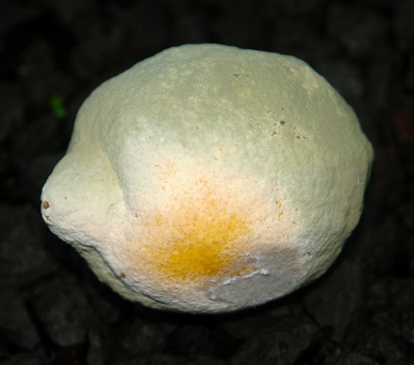
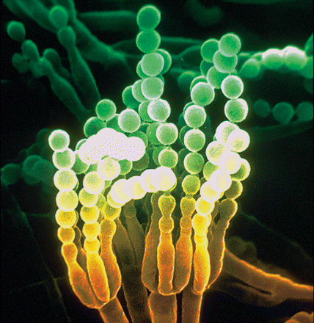
Microbes Produce Antimicrobials
These organisms, in order to survive, have developed mechanisms to protect themselves from each other in the form of antimicrobials
An antimicrobial chemical is a chemical that kills microbes or inhibits their growth.
One of the earliest came from a mold called Penicillium which was discovered when it was found growing on bread.
The natural habitat of molds, like Penicillium, is SOIL
Scientists have been able to capitalize on some of these organisms to develop medicines. In the case of Penicillium, the mold yielded the famous antibiotic – Penicillin
Soil is the source of many medicines due
to its remarkable microbial biodiversity
Scott Nelson, Creative Commons, http://creativecommons.org/licenses/by-nc-sa/4.0/legalcode, no changes made
The Penicillium mold growing on a lemon
Seifert KA, Samson RA, deWaard JR, Houbraken J, Levesque CA, Moncalvo JM, Louis-Seize G, Herbert PDN. 2007. Prospects for fungus identification using CO1 DNA barcodes, with Penicillium as a test case. PNAS 104(10): 3901-3906. Copyright (2007) National Academy of Sciences, U.S.A.
Penicillium spores
Notes:
Because of the large biodiversity and the large populations, soil organisms have evolved ways to protect themselves from each other by producing antimicrobials – chemicals that inhibit the growth of or kill other microbes. A good example of this is the mold called Penicillium. The soil is the habitat of many molds like Penicillium. After Penicillium was found growing on bread and inhibiting the growth of a bacteria one of the most famous antibiotics, Penicillin, was developed.
Look to the soil as a continuing source of medicines

Slide 6
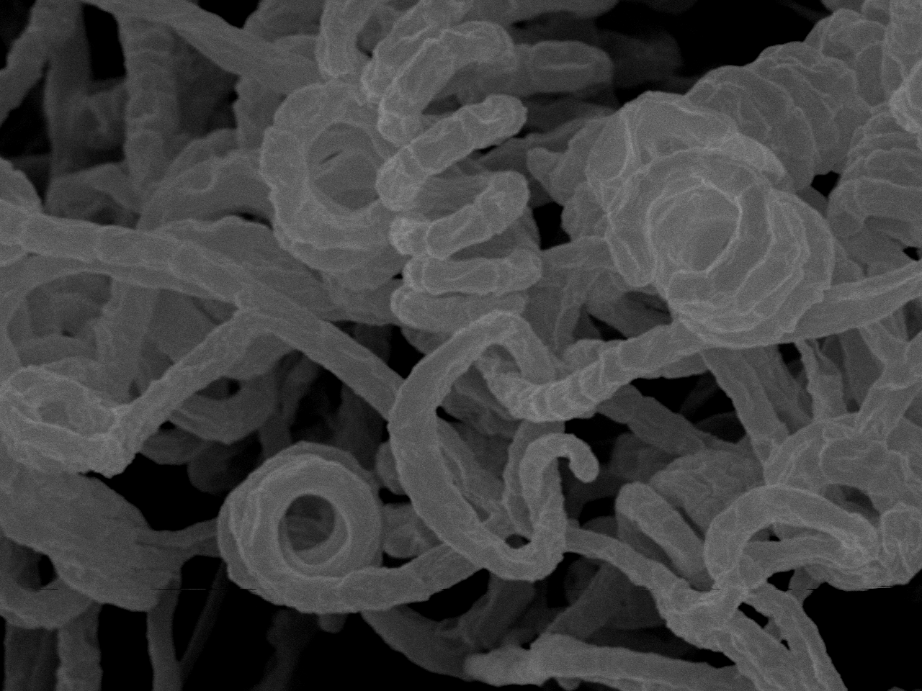

Streptomyces - The Genus that is the
work horse for producing antibiotics
Streptomyces venezuelae
Streptomyces avermitilis
Source of Chloramphenicol, antibacterial first to be produced in large scale
Nematicide (Ivermectin)
Insecticide (Abamectin)
Streptomyces platensis Migrastatin; anticancer
http://avermitilis.ls.kitasato-u.ac.jp/images/spores.jpeg
with permission from Prof. Haruo Ikeda, Kitasato University
Streptomyces noursei –
Antifungal
Notes:
One genus of microbes called Streptomyces is a work horse when it comes to producing anitbioitics. S. venezuelae is the source of a chemical called Chloramphenicol, which was the first antibiotic to be produced in large scale. S. avermitilis has produced a chemical, Ivermectin, that kills nematodes in the soil called and produced an insecticide (Abamectin). S. noursei fights fungal infections while S. platensis produced the chemical Migrastatin which an anti-cancer agent.
But these are just a few of the antibiotics produced from soil biodiversity.

Slide 7
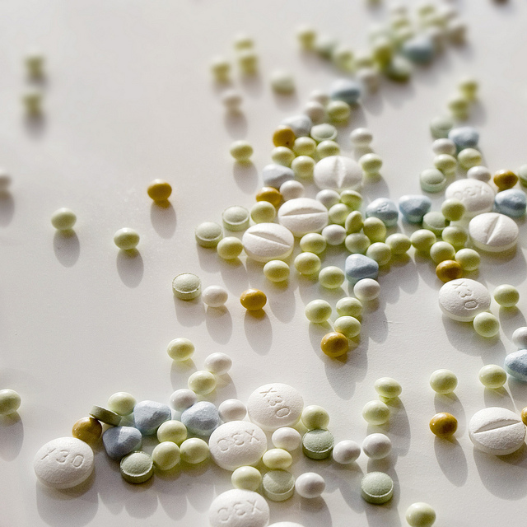
Over 500 antibiotics have been cultured from soil microbes
Examples: Cultured only from Streptomyces
Chloramphenicol – antibacterial, used in gray baby syndrome, WHO List of Essential Medicines
Daptomycin – antibiotic against Gram-positive organisms
Fosfomycin - broad-spectrum antibiotic
Lincomycin - antibiotic against actinomycetes and mycoplasmas
Neomycin - used as a crème or orally. It can kill bacteria in the intestines and is a preservative in vaccines
Puromycin - a non-selective protein synthesis inhibitor
Tetracycline - broad spectrum bactericide
Clavulanic acid - used to block bacterial resistance
Ivermectin - widely used to control nematodes and anthropods (parasites)
Bleomycin - anticancer drug
Bialaphos - natural herbicide
Creative Commons, Takl Steve, http://creativecommons.org/licenses/by-nc-sa/4.0/legalcode; no changes made
Notes:
Over 500 antibiotics have been cultured from soil microbes. This slide gives an example of some more of those that came from the Streptomyces bacteria.

Slide 8
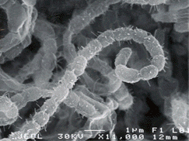
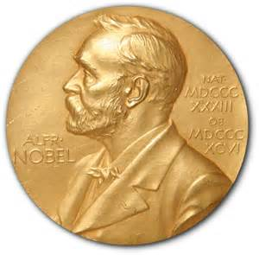
Soil wins the Nobel Prize!!!
Streptomyces griseus
Nobel Prize Winner
1952
Dr. Selman Waksman and his students cultured Streptomycin from a soil borne microbe:
First chemical that was a cure for tuberculosis
Bactericidal antibiotic
On the World Health Organization’s List of Essential Medicines
Also a pesticide for crops and a bactericide for animals
http://dbm.rutgers.edu/stateMicrobe.php ; with permission from M. Haggblom, Department of Biochemistry and Microbiology, Rutgers University
Notes:
The soil has been such a treasure trove of antibiotics that in 1952 it was instrumental in winning the Nobel Prize for Medicine. Dr. Selman Waksman and his students working at Rutgers University developed the methodology for screening microbes for their antimicrobial capabilities. They isolated 15 antibiotics. The one which brought his group the most fame was streptomycin, which was the first medicine that effectively treated tuberculosis. Streptomycin is now on the World Health Organization’s List of Essential Medicines.

Slide 9
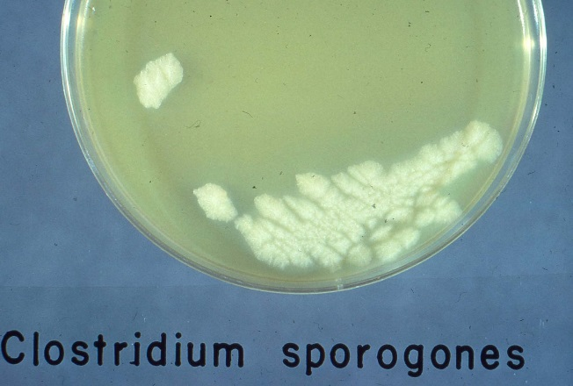
With only a very small percentage of the microbes in the soil having been identified
The future will see more medicines as science discovers more about soil microbes
Future Potential
Clostridia sporogenes -- Anticancer agent?
A bacterium that thrives in low oxygen environments
The center of tumors is one of those environments
Scientists at the Universities of Nottingham and Maastricht are developing it to kill cancer cells of tumors without harming healthy cells
http://www.microbeworld.org/index.php?option=com_jlibrary&view=article&id=3200; The Wistreich Collection of the American Society for Microbiology
Notes:
Only a very small portion of the soil microbes have been identified and evaluated for the production of antimicrobial agents. Can the soil play a role in another Nobel Prize? Maybe a cure for cancer?
Clostridium sporogenes is a bacterium that lives in low oxygen environments….like in a tumor. Scientists are developing it to kill cancer cells in tumors without harming healthy cells.

Slide 10
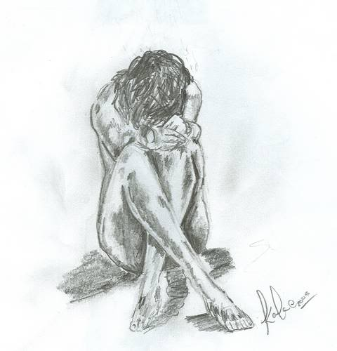
Mycobacterium vaccae – an Antidepressant?
It is thought to stimulate the production of serotonin in mice when ingested
Seratonin is a chemical produced in the brain and intestines and scientists believe it is involved in balancing one’s mood.
A lack of serotonin brings on depression, so this organism may act as an antidepressant.
http://media.photobucket.com/user/faracroft/media/depression.jpg.html?filters[term]=depression&filters[primary]=images&filters[secondary]=videos&sort=1&o=2
Notes:
Seratonin is a chemical that our brains and intestines produce. Scientists believe that it is important in determining one’s “mood”. A lack of serotonin can bring on depression.
Mycobacterium vaccae has been shown to stimulate the production of serotonin in mice. Might it be a useful anti-depressant in the future?

Slide 11
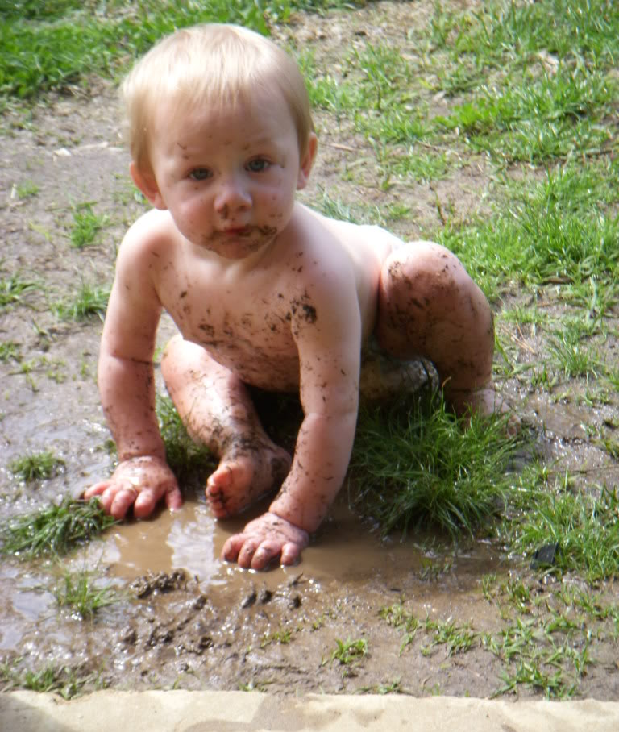
Playing in the soil helps vaccinate
children against diseases by exposing
them to the biodiversity that is present
http://media.photobucket.com/user/Wheelman66/media/MIXPIX/clint.jpg.html?filters[term]=dirty child&filters[primary]=images&sort=1&o=66
Notes:
Today’s children have a high incidence of allergies and asthma. Scientists believe that part of the reason is expressed through the “Hygiene Hypothesis”: i.e. we live in a world with antimicrobial soaps and cleaners, have a city versus farm existence and have lost the contact with the many microbes that we find in nature.
One point of view is that we can strengthen our children’s immune system by letting them play in the soil and get dirty. Children exposed to germs in their first year are less likely to have allergies and asthma.

Slide 12
What else might be discovered in the soil in the future
and
Who will do it?
Notes:
Ask the questions and promote discussion.

Slide 13
The UN Declared 2015 as the International Year of Soils (IYS) to bring more attention to this important natural resource. The Soil Science Society of America celebrates IYS and is happy to bring you this presentation. We hope you take the time to learn more about soils at the many resources listed at the end of this presentation, as you learn more about how…
Soils Sustain Life

Slide 14

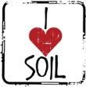
Thank you for listening!
For further information, visit:
Soils.org/discover-soils – information about all things soil!
Soils4teachers.org – Lesson plans, activities, etc. for teachers
Soils4kids.org – activities for the K-12 audience
Follow us on facebook.com/iheartsoil
Soils sustain life!

