Slide 1
Good sports need good soil –
Texture matters

Slide 2
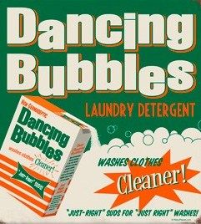
Notes:
Most of us don’t think much more about soil in connection to sports, other than that we need to wash “dirt” from our clothes.

Slide 3
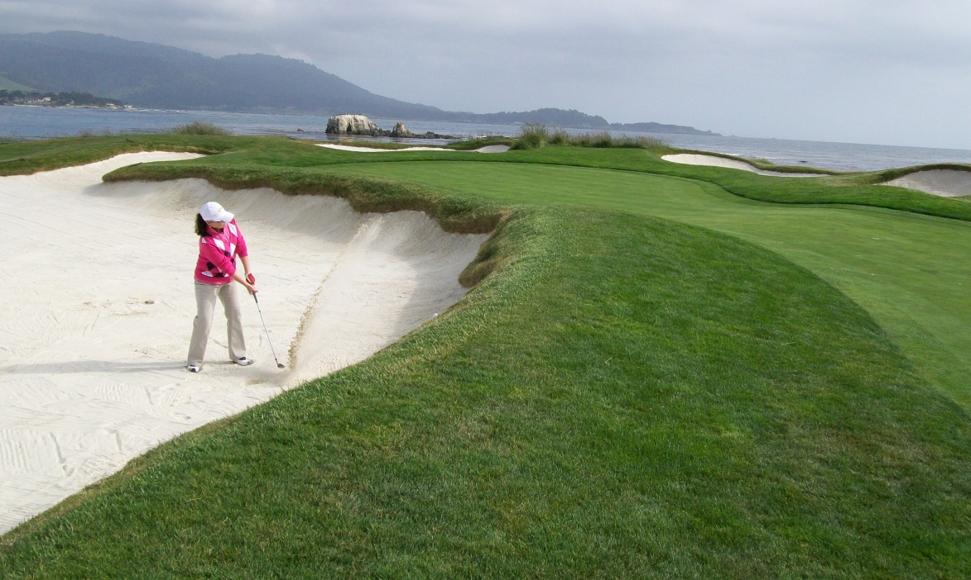
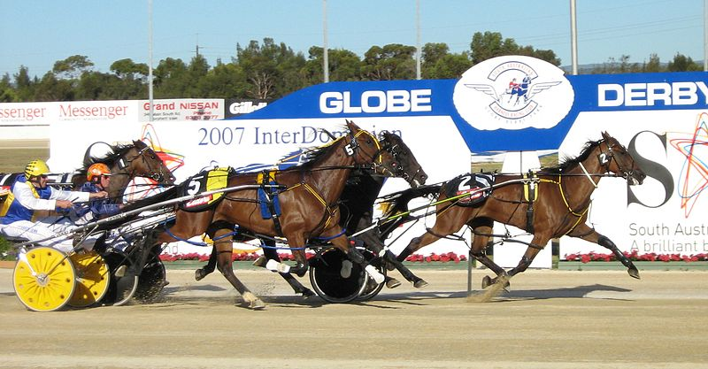
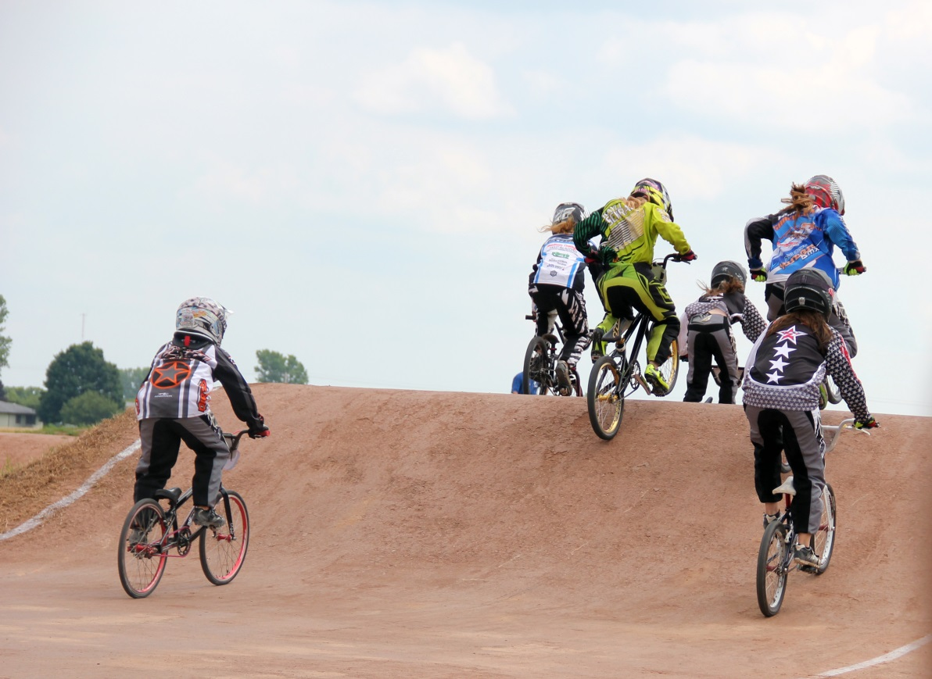
Notes:
But soil is critically important to a variety of sports – it provides for safe, exciting fun!

Slide 4
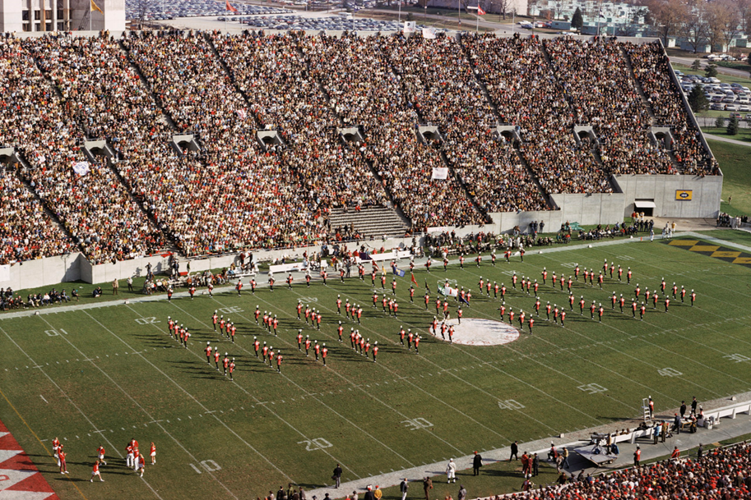
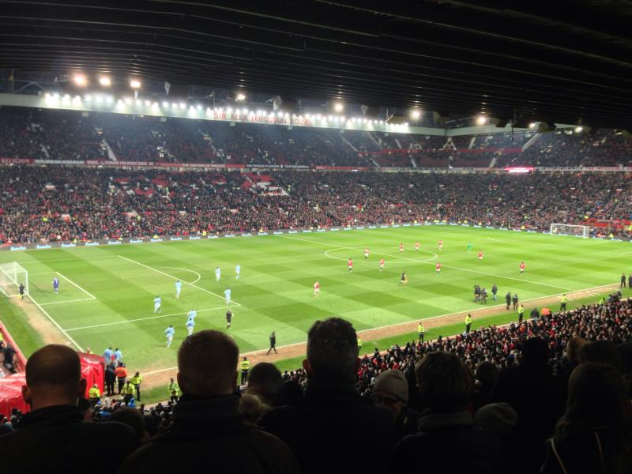
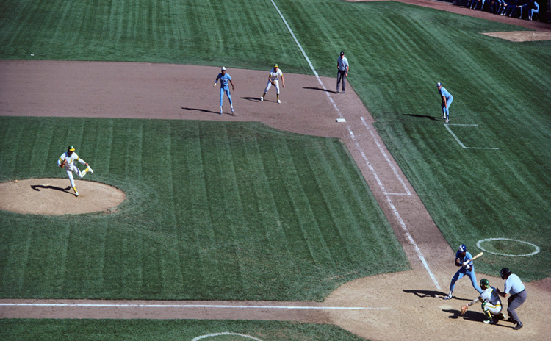
Notes:
And not just individual sports but thousands of folks enjoy sports more because someone took the time to get the soil right!

Slide 5
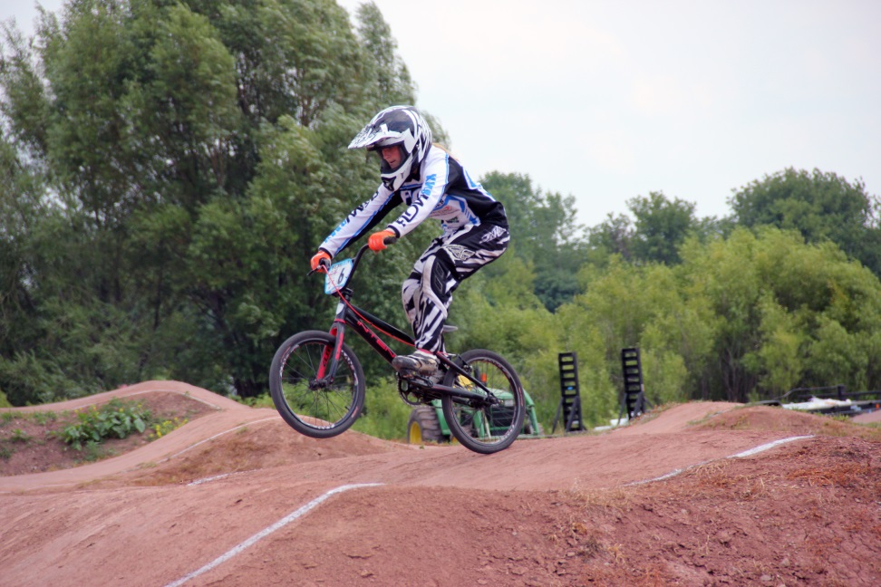
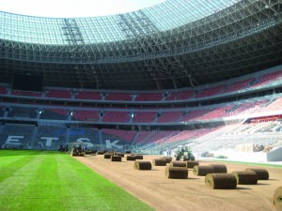
How is soil important for sports?
As a running/playing surface
For growing a playing surface
natural turf
Notes:
Let’s explore this link a bit more. How is soil used in sports?

Slide 6
As a running/playing surface
Horse racing
Dirt bike racing/BMX
Dirt Track/stock car racing
Cross-country running
Tennis (clay courts)
Notes:
Here are some examples of sports where the playing surface is bare soil.

Slide 7
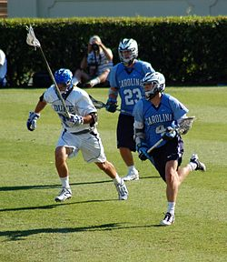
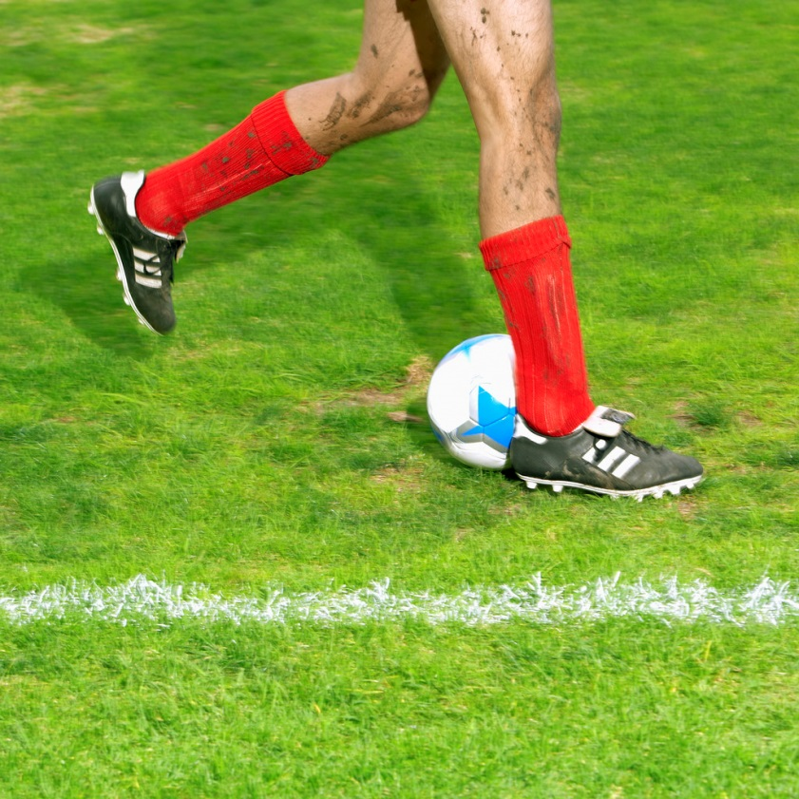
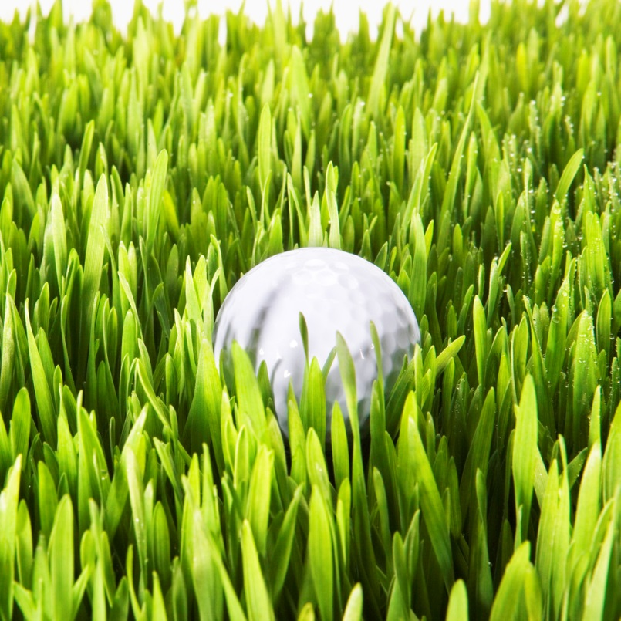
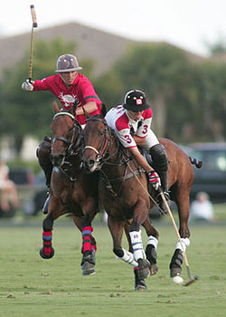
As a growing medium for turf
Notes:
And soil is also important for so many sports where the quality of the turf matters. To grow good grass turf, which is safer for players, and to maximize its durability, its important to get the soil in which it grows right! Can you think of other sports not pictured here which rely on good turf? Even artificial turf requires the right medium to anchor and provide support.
Images from wikipedia or clip art, except for NZ AllBlacks – from their web page.

Slide 8
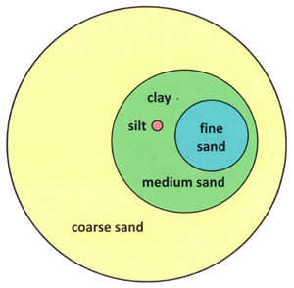
What kind of soil is best for my sport?
Soil texture
Sand
Silt
Clay
Notes:
The texture of the soil is important to consider for sports. So we’ll spend a bit of time talking about soil texture and why it matters.
What is soil texture? The particles of the soil have different sizes from very small to relatively large. The smallest particles are clay particles, while sand particles are the largest. The little dot next to the word clay represents the size of a clay particle, in proportion to the other size classes. Note that the clay is a dot on this graph and the largest sand grain is about 1000 times larger than the clay particle.

Slide 9
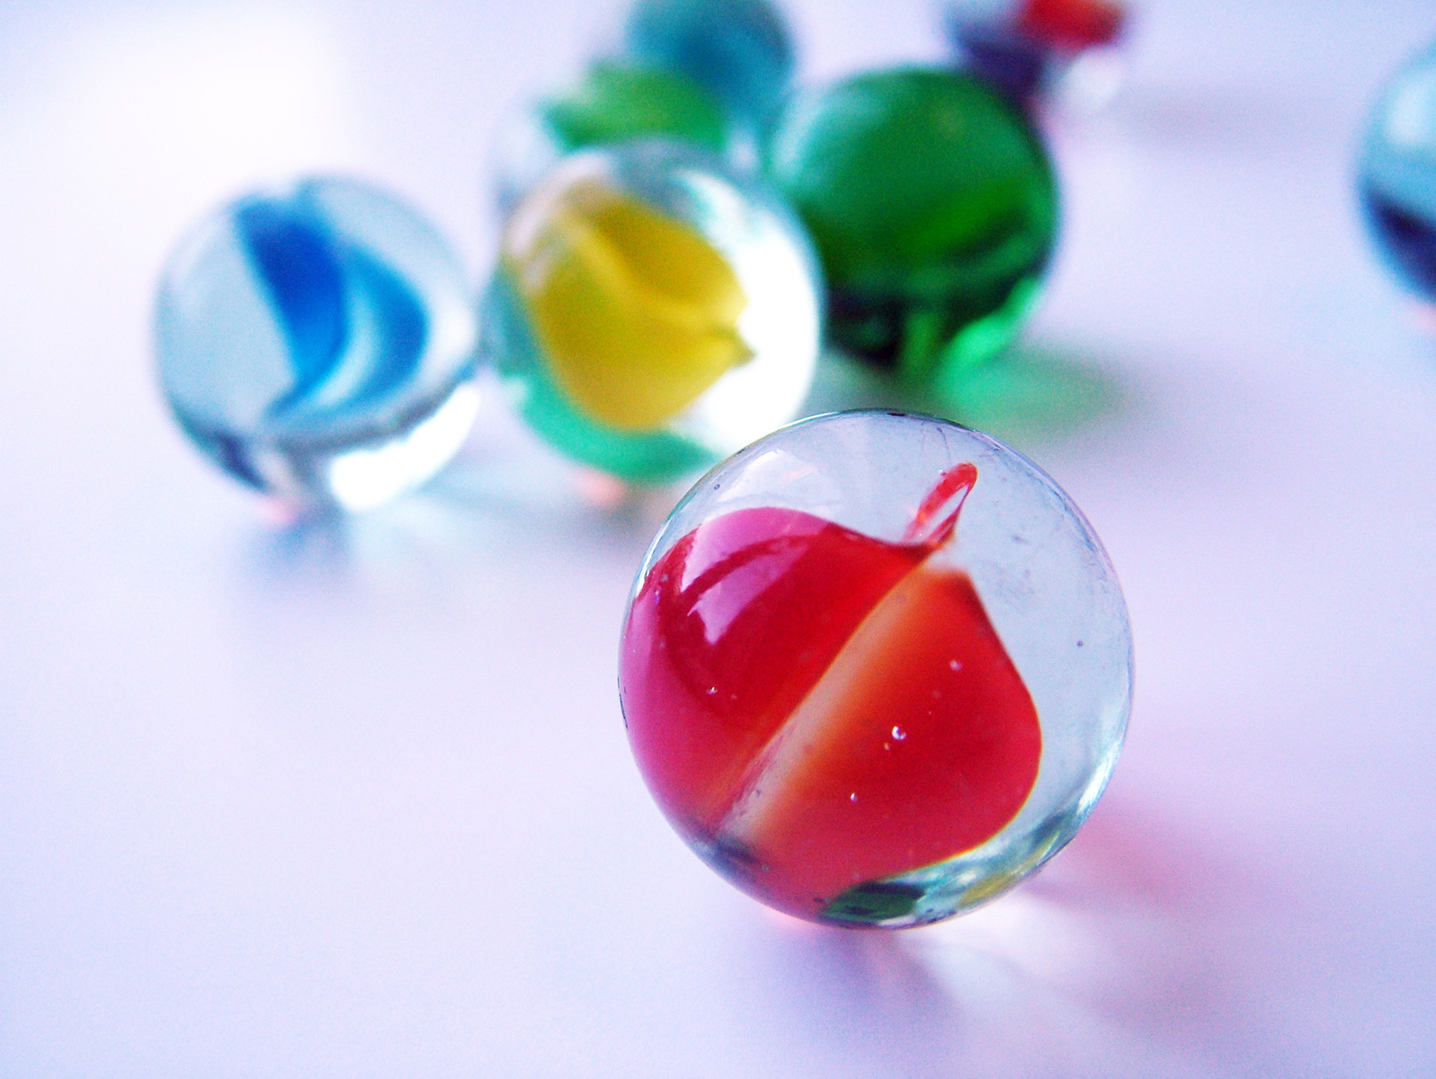
Notes:
If a clay particle is the size of a single marble ,
http://www.courtdimensions.net/baseball-field/index.php

Slide 10

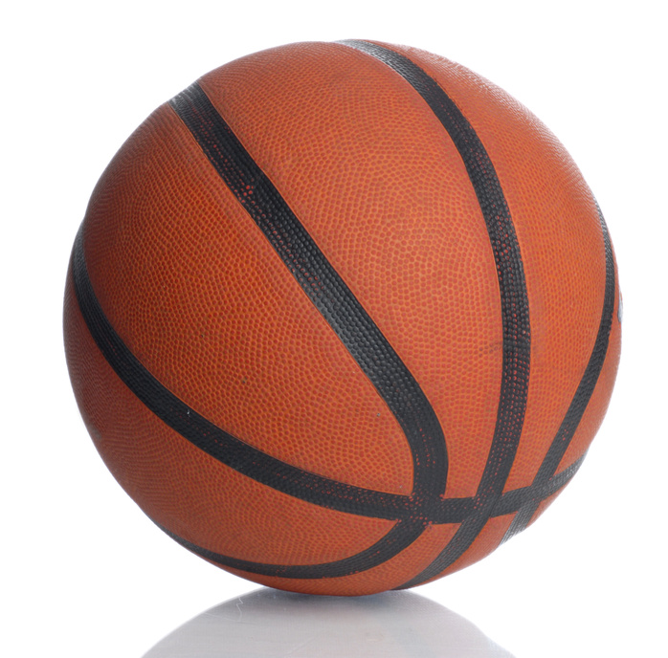
Notes:
If a single marble is the size of a clay particle, then the silt particle would be the size of a basketball
http://www.courtdimensions.net/baseball-field/index.php

Slide 11
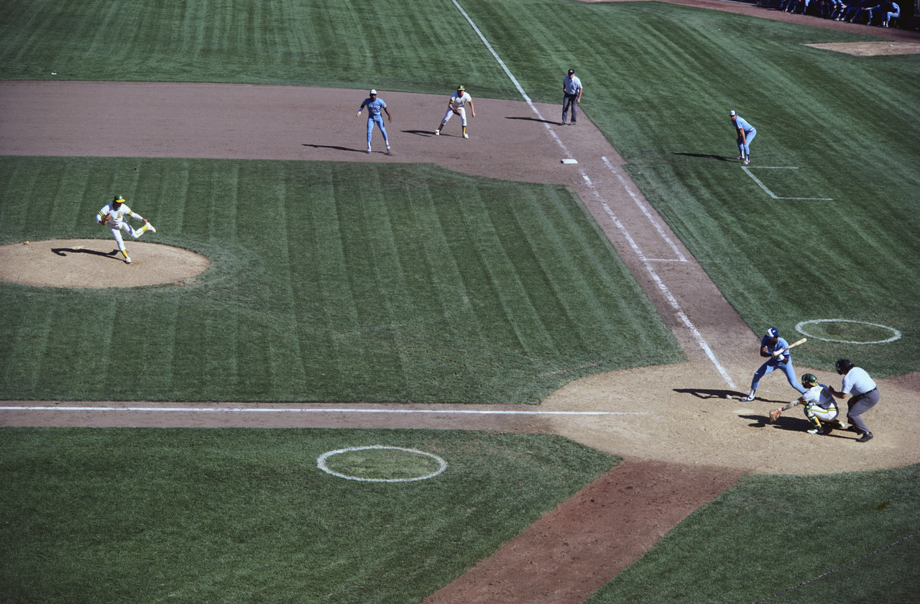
Notes:
If a single marble is the size of a clay particle, then the silt particle would be the size of a basketball, and the coarse sand particle would be about half the distance you’d have to run to get to first base in baseball.
These 3 images are from clipart in Office.com
http://www.courtdimensions.net/baseball-field/index.php
Take a break here for a demonstration – either hand around soils of different textures or do something like this jar test.

Slide 12
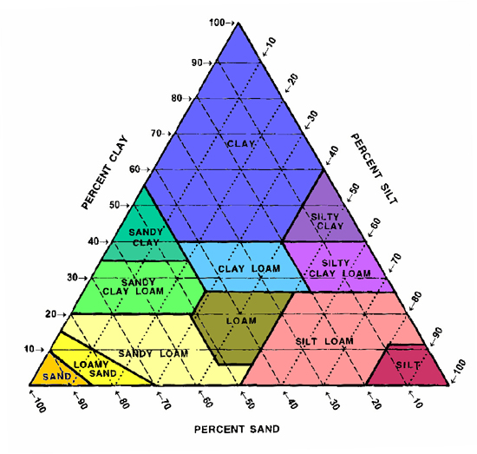
Why does soil texture matter?
Notes:
So soil texture describes the relative composition of sand, silt and clay. By knowing something about the texture of a soil, we know more about its properties and how to manage it.

Slide 13
Why does soil texture matter?
Athlete’s Performance
  Speed
  Maneuverability
Safety of the athlete
Durability of the sports field/track
Management and maintenance costs
  Water holding capacity
  Resiliency of turf
Notes:
There are many reasons why the soil texture of your sports field matters. An athlete needs to be able to run quickly (think of horse racing, or football) and maneuver (field hockey, soccer) – to be able to participate at his/her best. So the running surface matters. Its also important for maximize the safety of the athlete.
Durability of the sports field matters – what if the texture was wrong for this sand trap, and all the sand blew away? Or what if the sand trap was full of clay and the ball got stuck in mud?
Finally, using the right soil as base for your sports field can save in maintenance costs.

Slide 14
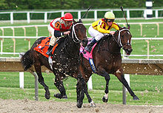
What happens to a race horse if …
Surface is too soft, or too sticky ?
Too hard?
Too dry and dusty?
Notes:
What happens to a million dollar race horse if the track surface is not right?

Slide 15
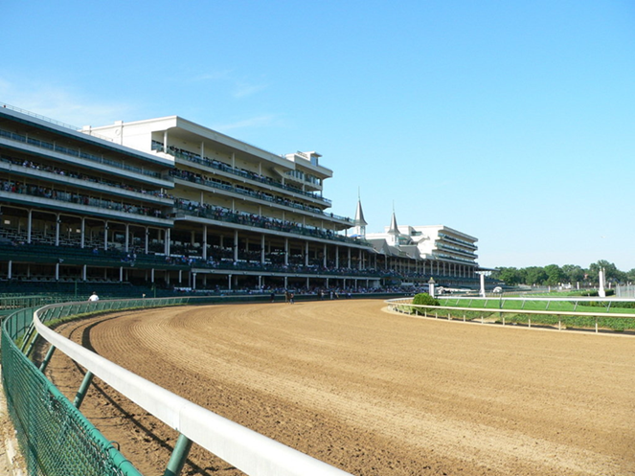
Churchill Downs Main Track
The Run for the Roses takes place on:
3 inches sandy loam cushion
5 inches sandy loam compacted
12 inches clay base
24.5 inches sandy loam/natural soil
Notes:
This is the texture and profile of the Main Track at Churchill Downs -- this is believed to be ideal for horses to race on – it maximizes speed and minimizes injury to the horses.
photo: http://www.city-data.com/picfilesc/picc30621.php

Slide 16
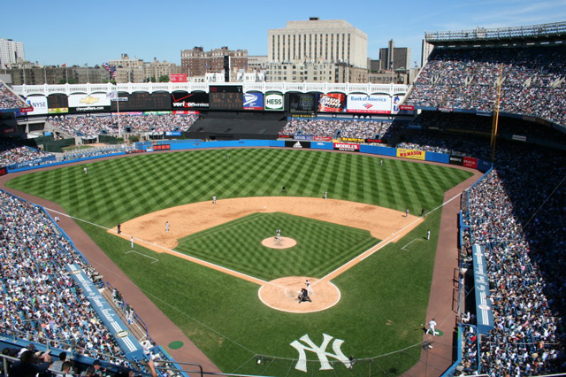
Baseball diamonds
Soil is found :
Warning track
Pitcher’s Mound
Baseline
Infield turf
Outfield
Notes:
And baseball uses bare soil and natural turf in a baseball diamond. And each of these is a different type of soil compound.
Photo is from http://joelofreso.com/2010/06/new-york-yankee-stadium-old-and-new/
http://www.ultimate-baseball-field-renovation-guide.com/baseball-dirt-maintenance.html

Slide 17
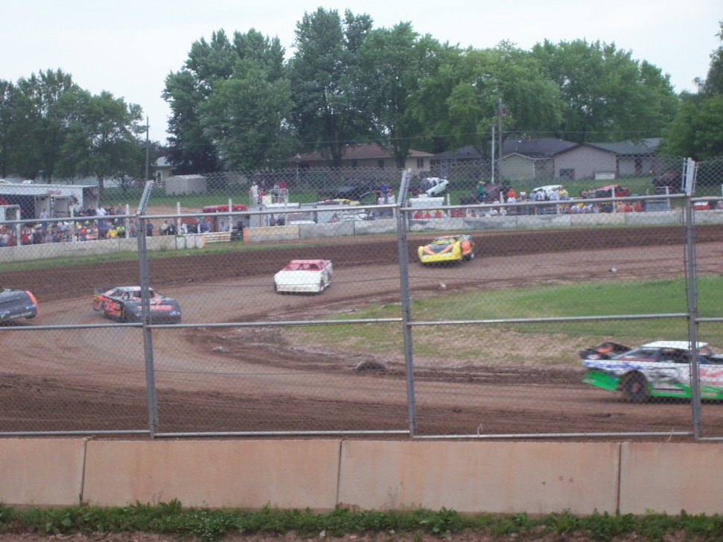
“Dirt” track auto racing
Clay base
Around 30% clay is preferred , to keep surface tacky.
Organic materials (wood chips, decomposed hay,) can be added to help soil retain moisture.
Notes:
Dirt track racing is the single most common form of auto racing in the United States.
As many as 1500 dirt tracks in the US.
photo credit: "DirtTrackRacingLateModels" by Original uploader was Royalbroil at en.wikipedia - Originally from en.wikipedia; description page is/was here.. Licensed under Creative Commons Attribution-Share Alike 2.5 via Wikimedia Commons - http://commons.wikimedia.org/wiki/File:DirtTrackRacingLateModels.jpg#mediaviewer/File:DirtTrackRacingLateModels.jpg

Slide 18
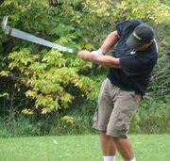
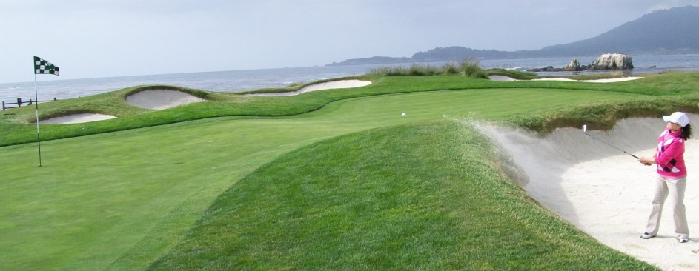
Golf courses need good soil
USGA Specifications for a putting green:
topsoil mixture (minimum thickness of 12 inches )
above an optional 1.5-2 inch coarse sand layer
above a 4 inch layer of washed pea gravel (¼ to 3/8 inches diameter)
Over the 4 inch tile drain imbedded in native soil or fill material.
Notes:
The USGA Specifications for constructing a putting green consist of a topsoil mixture with a minimum thickness of 12 inches, above an optional 1 1/2 to 2 inch coarse sand layer that is sometimes referred to as the "choker layer", which is above a 4 inch layer of washed pea gravel that has a particle size diameter of ¼ to 3/8 inches, which covers the 4 inch tile drain imbedded in the subgrade of native soil or fill material. This discussion will deal only with the 12 inch topsoil mixture.
Photo credits: Frank Mams, Davis Morris

Slide 19
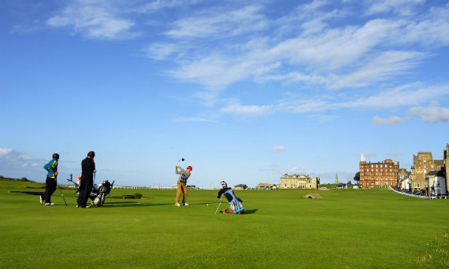
Golf courses need good soil
For trap sand, the range is from 1.0 to 0.25 mm, which is sand ranging from coarse to medium.
Maintenance includes topdressing with sand, (including fine sands), and aerating the soil and turf.
Notes:
The USGA recommends that sand for topdressing should range from 1.0 to 0.15 mm, which would be sand ranging from coarse to fine. For trap sand, the range is from 1.0 to 0.25 mm, which is sand ranging from coarse to medium. Trap sand should be slightly coarser than topdressing sand as the fine fraction is recommended to be omitted in trap sand.
Source: http://www.tiftonsoillab.com/html/1.html
Sports Fields: A Manual for Design, Construction and Maintenance by Jim Pulhalla, Jeff Krans, and Mike Goatley.
Photo: http://www.visitscotland.com/cms-images/5x3-large/golf/old-course-st-andrews

Slide 20
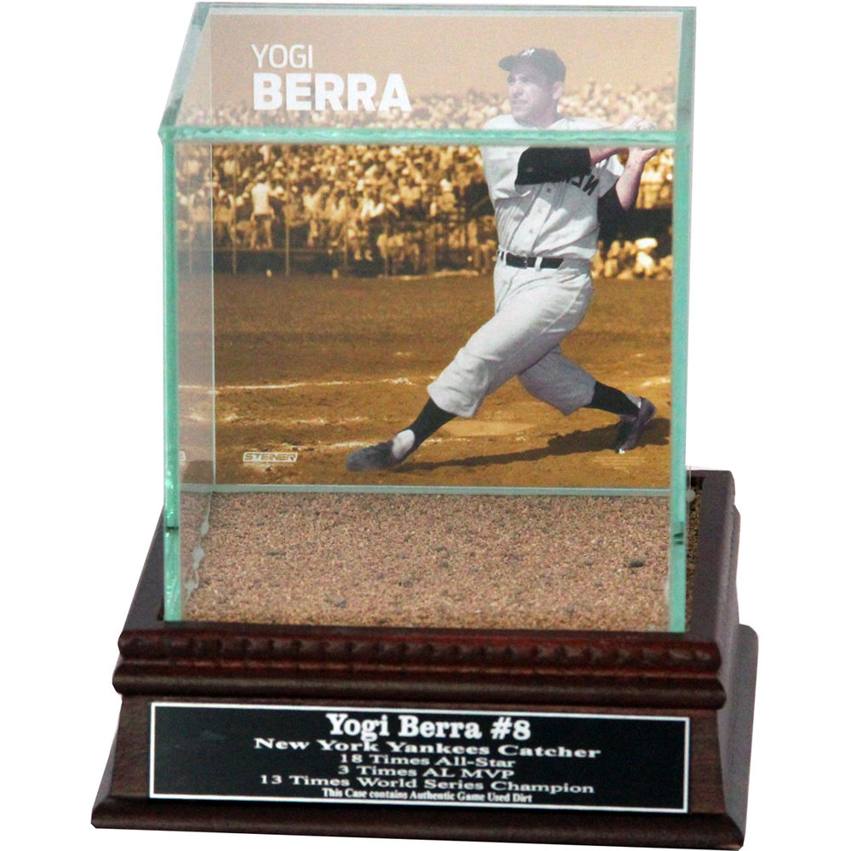
Conclusions
Soil is Important for sports.
Getting the soil right adds value to your favorite game.
And even has value as a collectible!
Yankee stadium “dirt”
Notes:
In conclusion, getting the soil right adds value to your favorite sport, and even has value as a collectible! This is official Yankee stadium dirt in a collectible display case, with Yogi Berra’s photo and name plate.
For sale on-line.
Available at http://www.skymall.com/yogi-berra-swinging-background-glass-single-baseball-with-yankee-stadium-authentic-dirt-nameplate/SSM1159.html?utm_content=24R&gclid=CKiopO6fhMICFZSPfgodZ7IAsQ&utm_medium=cse&utm_campaign=comparison&utm_source=googlebase&pnr=24R

Slide 21
The UN Declared 2015 as the International Year of Soils (IYS) to bring more attention to this important natural resource. The Soil Science Society of America celebrates IYS and is happy to bring you this presentation. We hope you take the time to learn more about soils at the many resources listed at the end of this presentation, as you learn more about how…
Soils Sustain Life

Slide 22


Thank you for listening!
For further information, visit:
Soils.org/discover-soils – information about all things soil!
Soils4teachers.org – Lesson plans, activities, etc. for teachers
Soils4kids.org – activities for the K-12 audience
Follow us on facebook.com/iheartsoil
Soils sustain life!

