Slide 1
Getting the Dirt on
Your State Soil
Presented by Name, Position
Member/Fellow of the Soil Science Society of America

Slide 2
Step 1. State Soil Website
www.nrcs.usda.gov/wps/portal/nrcs/detail/soils/edu/?cid=stelprdb1236841

Slide 3
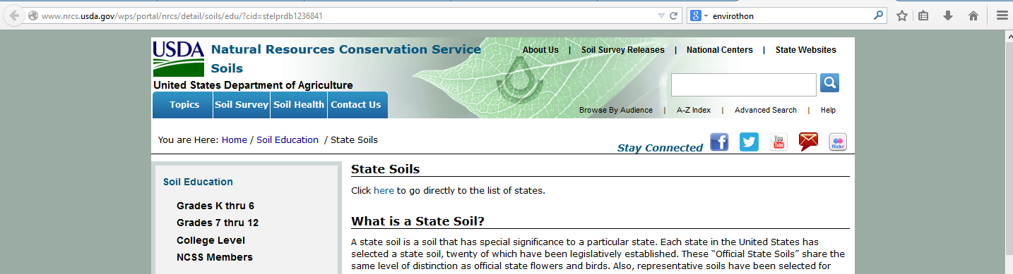
Notes:
Screen shot of USDA-NRCS State Soil page. Click where arrow points “here” to see list of state soils or scroll down on the page.

Slide 4
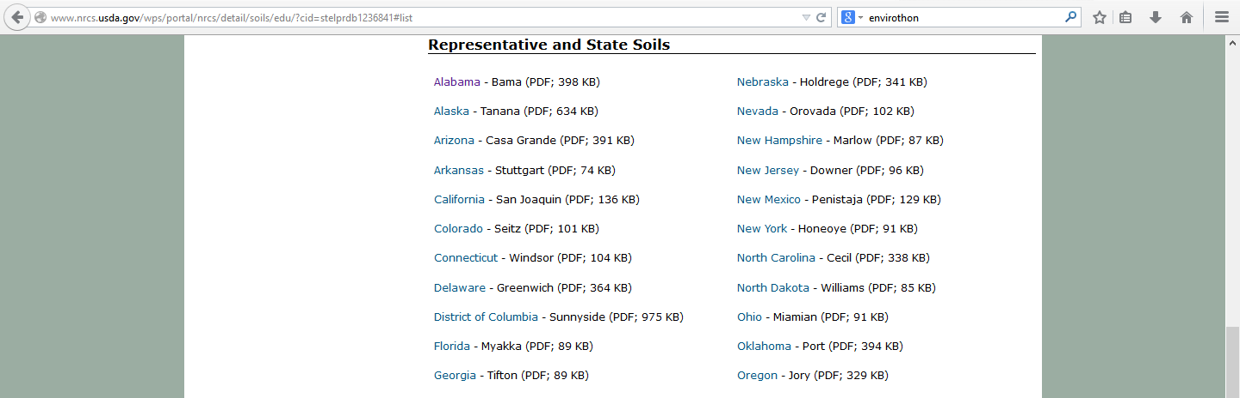
Notes:
Click on State name to download the USDA-NRCS State Soil as a PDF file.

Slide 5
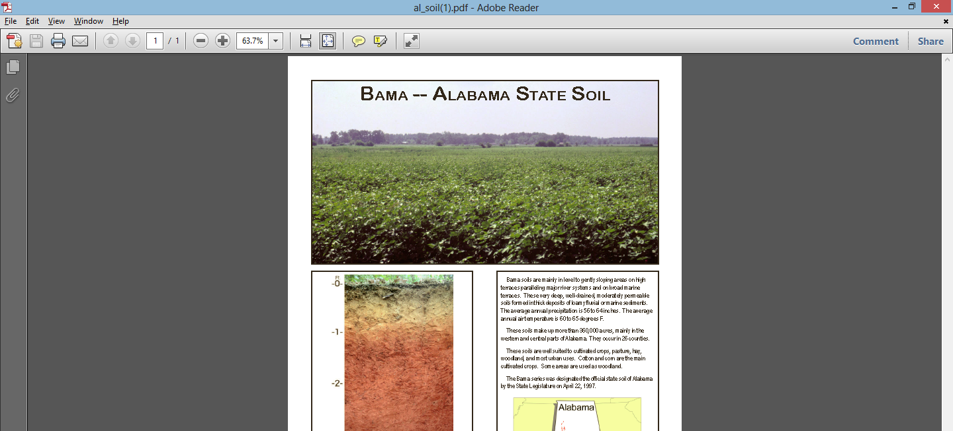
Example – Alabama State Soil – BAMA Series
Notes:
Open downloaded file with Adobe Reader. All state soil fact sheets follow the same basic format. Landscape photo at top; soil profile photo with general color of layers at left; facts in paragraphs at right with distribution map at bottom right.

Slide 6
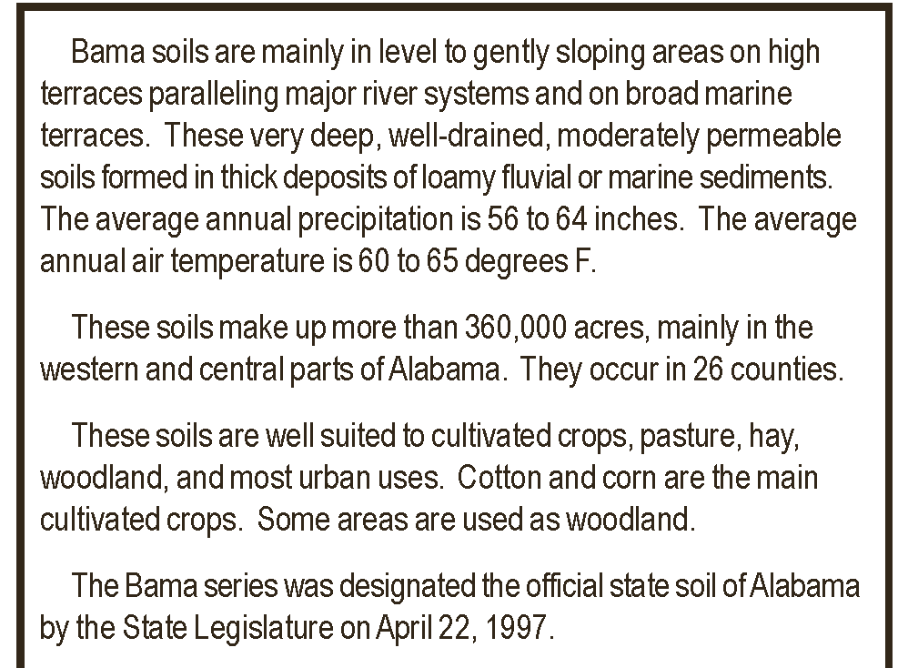
Informational Paragraph
Landscape
Drainage, permeability
Parent material
Climate
Extent and acreage
Land uses
Official Status
Notes:
Lots of information is given in these short paragraphs. The answers to the questions asked in the lesson plan can for the most part be found here. Additional slides demonstrate how to use the Official Soil Description (OSD) search tool to find more information about the sate soil or any of the 17000+ soil series mapped in the USA.

Slide 7
Step 2: More dirt on Soil Series
Use this web site: https://soilseries.sc.egov.usda.gov/osdname.asp
Type in the name of the soil series in the box and hit enter
Notes:
Note that you can put in any name in the box and the search engine will look for best match. Multiple matches may come up. To investigate further click on the one that you want to view the Official Soil Description for.

Slide 8
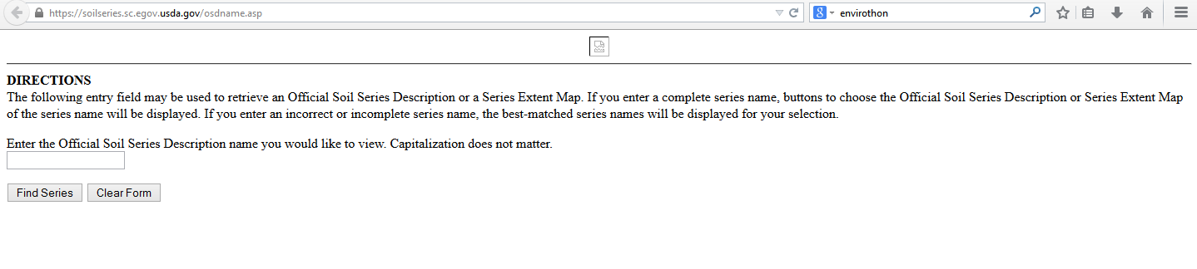
Official Soil Description search site
TYPE IN SERIES NAME HERE. For example BAMA
Once typed in, click here to run search
Notes:
Type in the series name here. The format is not case sensitive.

Slide 9
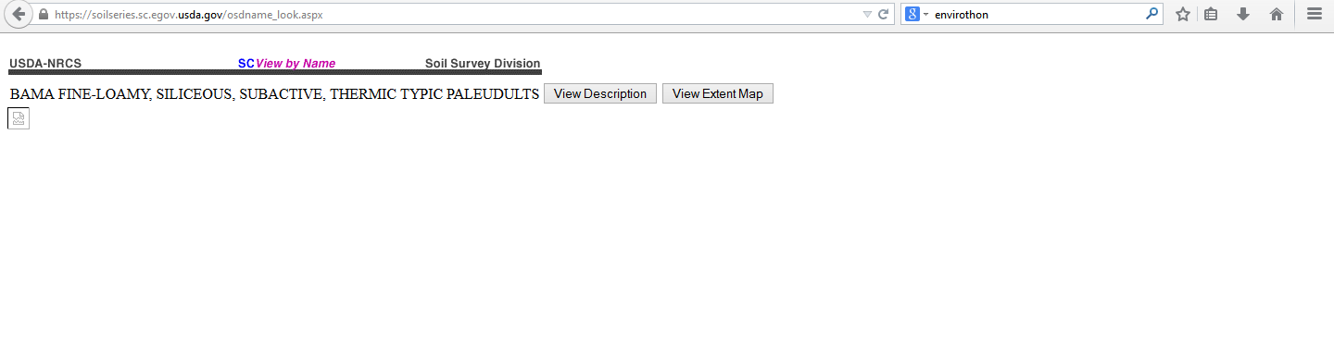
Result for BAMA
Click here to see the full soil description and taxonomy

Slide 10
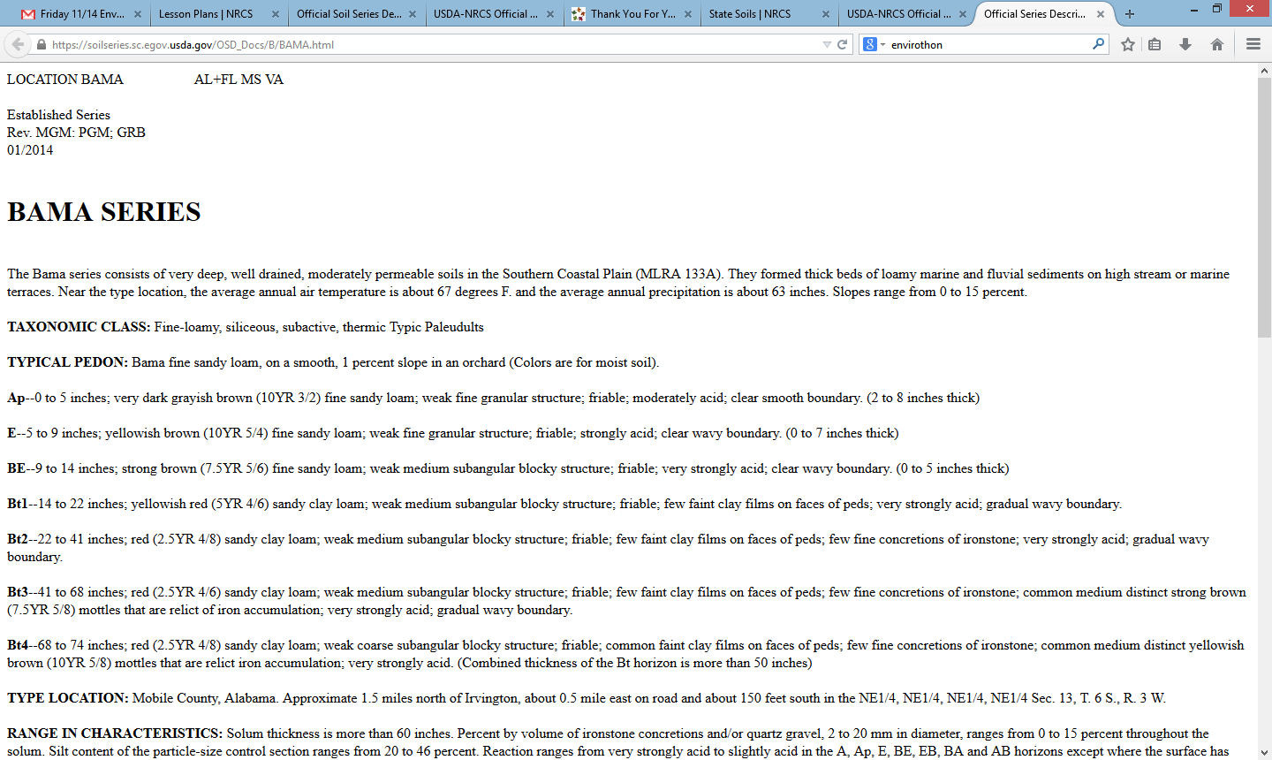
BAMA Soil Series Description
States where the series is mapped
General information about the series – drainage, climate, parent materials slopes, landscapes
Notes:
There is a lot of information listed here most of which is more than any K12 student or even the general public needs. The information is there to help soil scientists and other professionals identify the specific soil series and to make interpretation about its potential land use. In the remaining slide we will point out a few specific things that may be of general interest.

Slide 11
BAMA Soil Series Description (cont.)
Taxonomy
Typical soil profile description
Location where this description was made

Slide 12
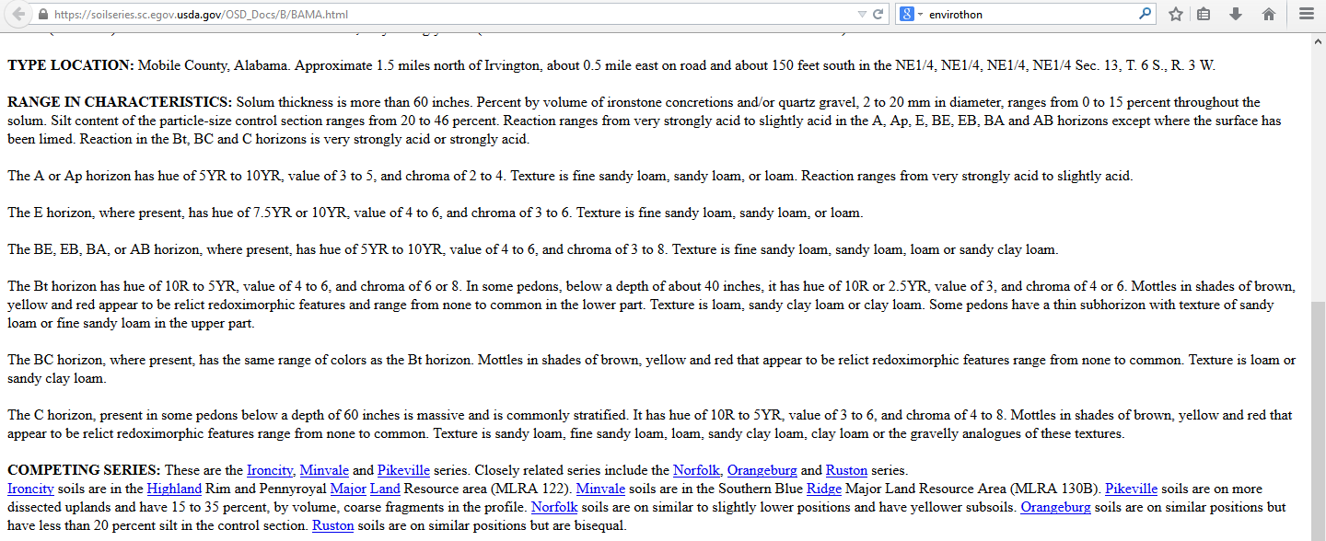
BAMA Soil Series Description (cont.)
Allowable difference within the Series
Similar soil series
Notes:
Within a series a certain amount of variability is accepted. The “Range” paragraphs specifies the acceptable ranges for key properties.
A series is a member of a similar family or group of soils. The “Competing” paragraph lists several of these and highlights the general differences. Note that there is a hyperlink to each of the competing series mentioned.

Slide 13
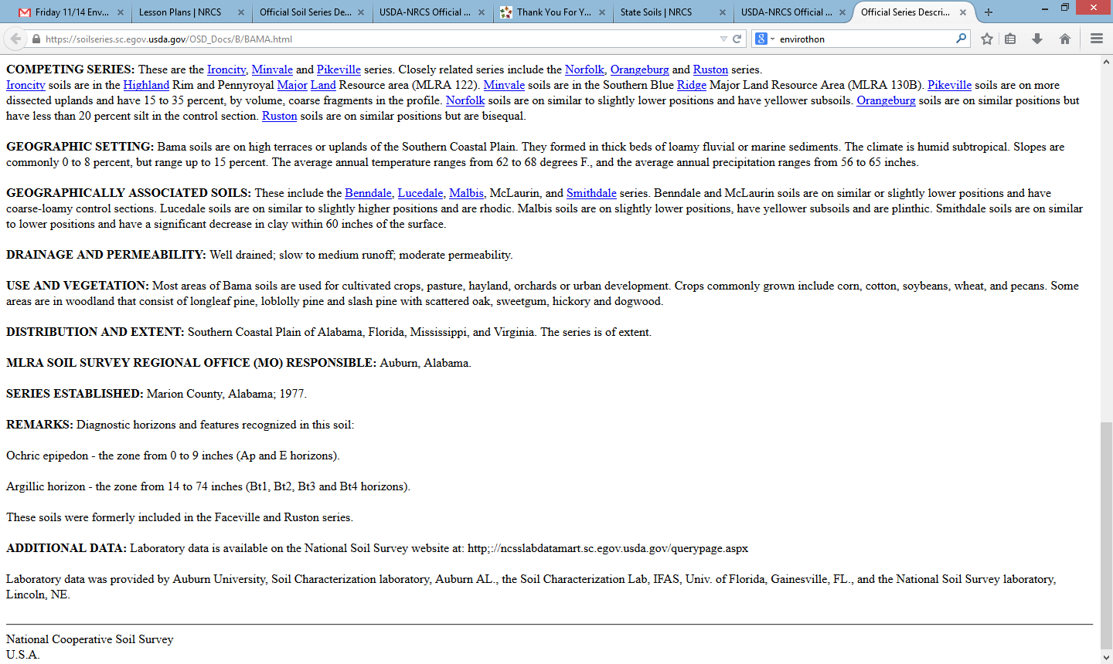
BAMA Soil Series Description (cont.)
Landscape and climate
Soils on landscape
Drainage and permeability

Slide 14
BAMA Soil Series Description (cont.)
Use and Vegetation
General distribution
First mapped

Slide 15
Step 3: Additional fun with Official Soil Description
Type in your name (first, last, nickname) and see how many series are similar to it
Your school name
Find the soil series your school is built on
Find the soil series your house is built on

Slide 16
The UN Declared 2015 as the International Year of Soils (IYS) to bring more attention to this important natural resource. The Soil Science Society of America celebrates IYS and is happy to bring you this presentation. We hope you take the time to learn more about soils at the many resources listed at the end of this presentation, as you learn more about how…
Soils Sustain Life

Slide 17


Thank you for listening!
For further information, visit:
Soils.org/discover-soils – information about all things soil!
Soils4teachers.org – Lesson plans, activities, etc. for teachers
Soils4kids.org – activities for the K-12 audience
Follow us on facebook.com/iheartsoil
Soils sustain life!

