Slide 1
Soils Support Civilization
Presented by

Slide 2
Great Civilizations – Built Due to Soil
Mesopotamia
Nile
Mayan
“Green Revolution”

Slide 3
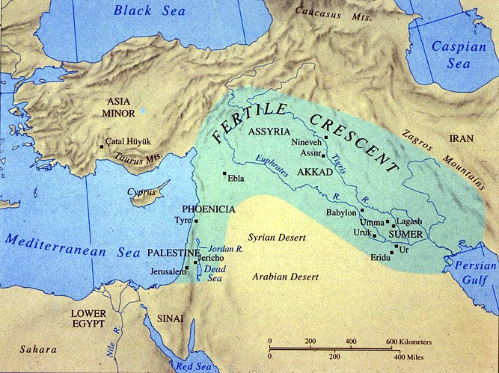
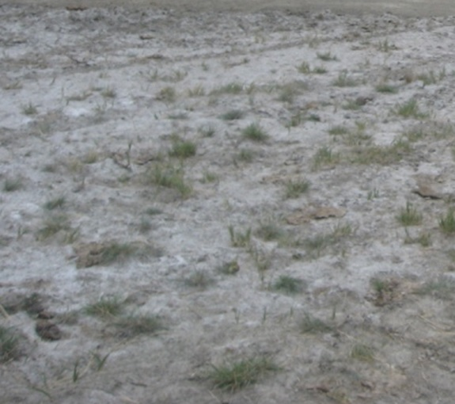
Mesopotamia
2300 BC
Fertile Crescent
Built around the fertile soils between the Tigris and Euphrates
“Land Between Rivers”
Irrigated Agriculture
Destroyed by Salts
Source: https://bftaxhelp.wordpress.com/about-property-taxes/history-of-property-taxes/ancient-mesopotamia/

Slide 4
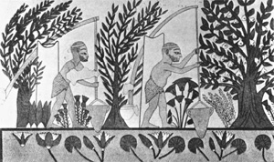
Nile River
2200 BC
Soils was foundation for Agriculture
Continual flooding deposited thick fertile soil
Known as Kemet “Black Lands”
Agriculture was responsible for survival, growth and economic success
Source: http://www.rivervalleycivilizations.com/nile.php

Slide 5
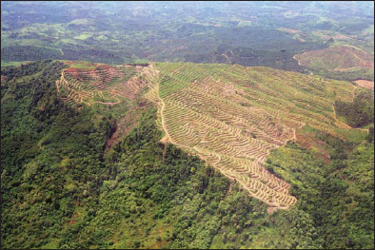
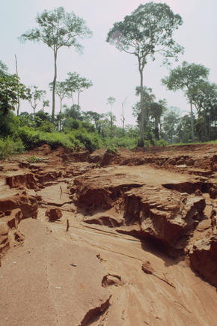
Mayan
500 BC
Deforested for cities and crops
  Initial high soil fertility
  Rapid decrease in productivity due to poor soil fertility
Mayan Collapse
  Soil Erosion
  Land Degradation
Source: http://www.fao.org/docrep/011/i0440f/i0440f02.htm
Source: www.worldwildlife.org

Slide 6
Green Revolution
Modern Day
Improved Agricultural Practices
  Soil Management
  Plant Genetics
  Increased Yields
Challenges

Slide 7
Green Revolution Challenges
Soil Salinity
  Australia
  California
Deforestation
  South America
  Africa
  Southeast Asia
Urban Sprawl
  United States
Land Degradation
  Worldwide
Erosion

Slide 8
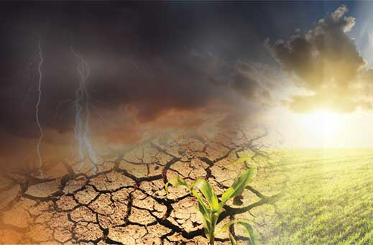
Healthy Soils Support Agriculture
Provide and hold water
Provide and release nutrients
Protect environments by:
  Filtering water
  Storing water
  Storing nutrient
  Storing carbon

Slide 9
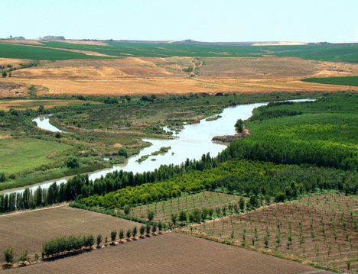
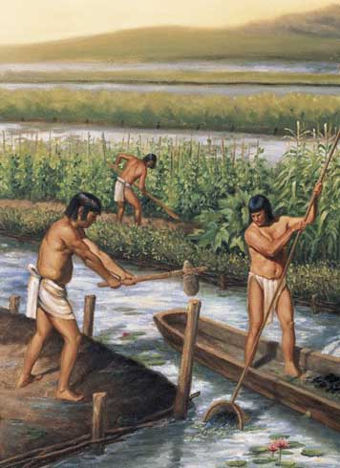
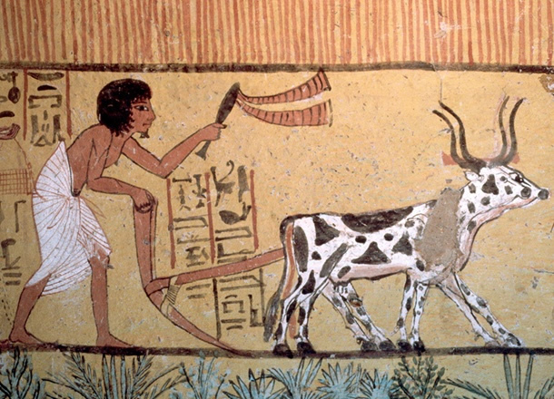
Agriculture Support Civilizations
Source: http://www.ancientmesopotamians.com/ancient-mesopotamia-crops.html
Source: www.socialphy.com
Source: www.khanacademy.org
Notes:
Egyptian petroglyphs of farming: www.khanacademy.org
Mayan farming illustration: www.socialphy.com
Meso.: http://www.ancientmesopotamians.com/ancient-mesopotamia-crops.html

Slide 10
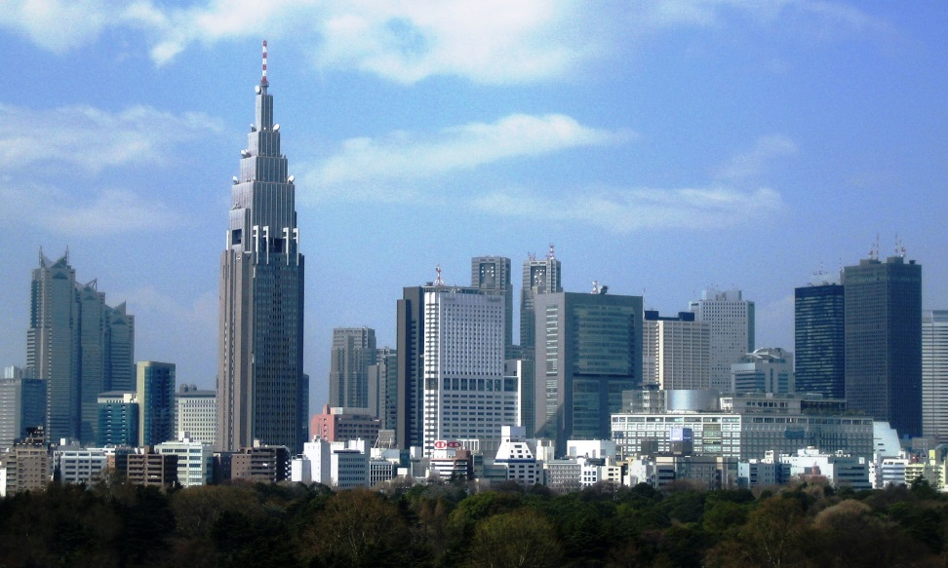
No Soil … No Civilizations
Great Civilizations have been supported and destroyed based on soil quality.
Without healthy soils a healthy civilization cannot survive

Slide 11
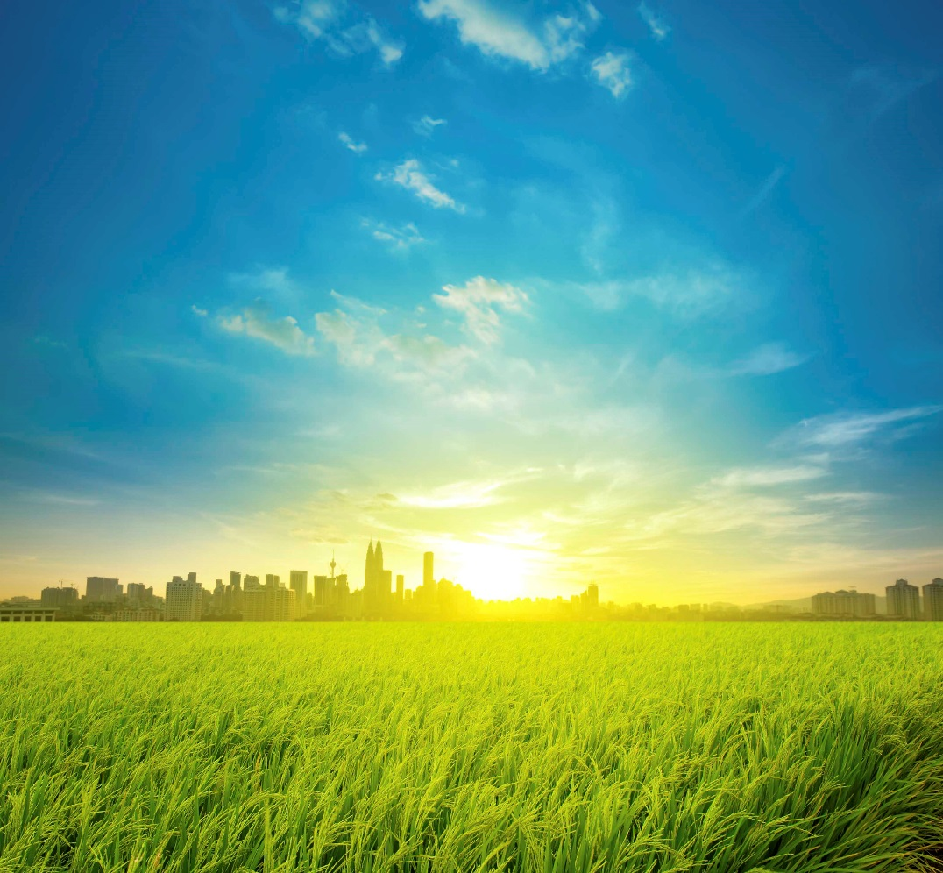
No Soil … No Civilizations
“A nation that destroys its soil destroys itself” – Franklin D. Roosevelt

Slide 12
Sources
http://education-portal.com/academy/lesson/what-is-the-green-revolution-definition-benefits-and-issues.html#lesson – Green Revolution
http://www.nrcs.usda.gov/wps/portal/nrcs/detailfull/national/water/quality/tr/?cid=nrcs143_010914 – Soil Salinity References

Slide 13
The UN Declared 2015 as the International Year of Soils (IYS) to bring more attention to this important natural resource. The Soil Science Society of America celebrates IYS and is happy to bring you this presentation. We hope you take the time to learn more about soils at the many resources listed at the end of this presentation, as you learn more about how…
Soils Sustain Life

