Slide 1

You Eat Dirt!
Soil, Food, and Health

Slide 2

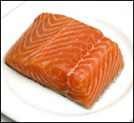
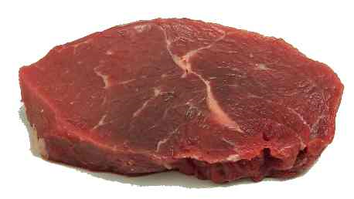
Healthy bodies need lots of nutrients.
That’s why we need to eat a diversity
of foods.

Slide 3

He’s Eating Dirt!
Everything in that juicy burger came from the soil:

Slide 4

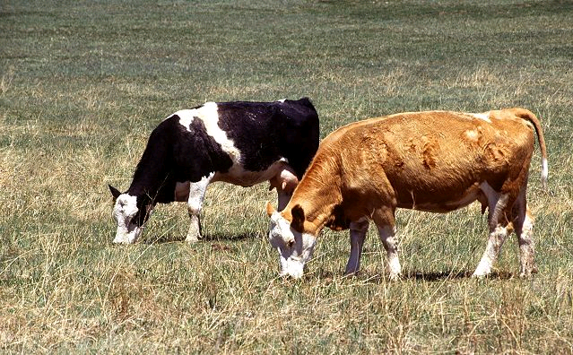
….. the beef
and cheese
come from cows
(that eat plants),

Slide 5
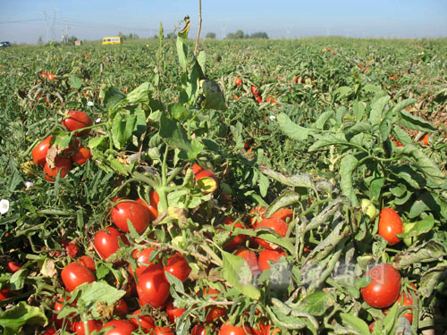
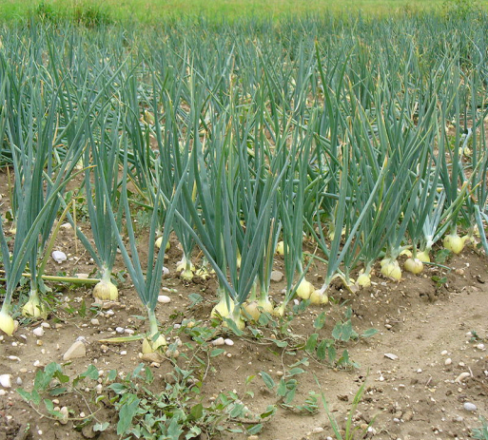
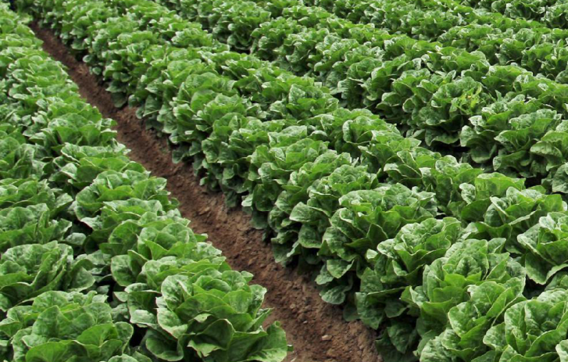
……. the tomatoes,
onions,
and lettuce……
Tomatoes Onions Lettuce

Slide 6
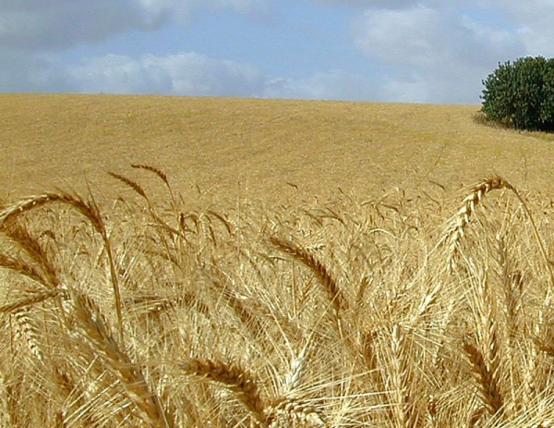
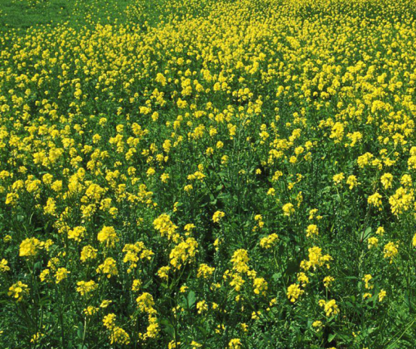
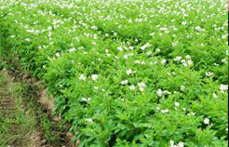
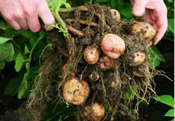
……and wheat for the bun …….
even the sesame seeds
came from the soil…..
Oh, and the
ketchup …(from tomatoes), mustard…(mustard seeds),
french fries…(potatoes)
Wheat Mustard potato

Slide 7
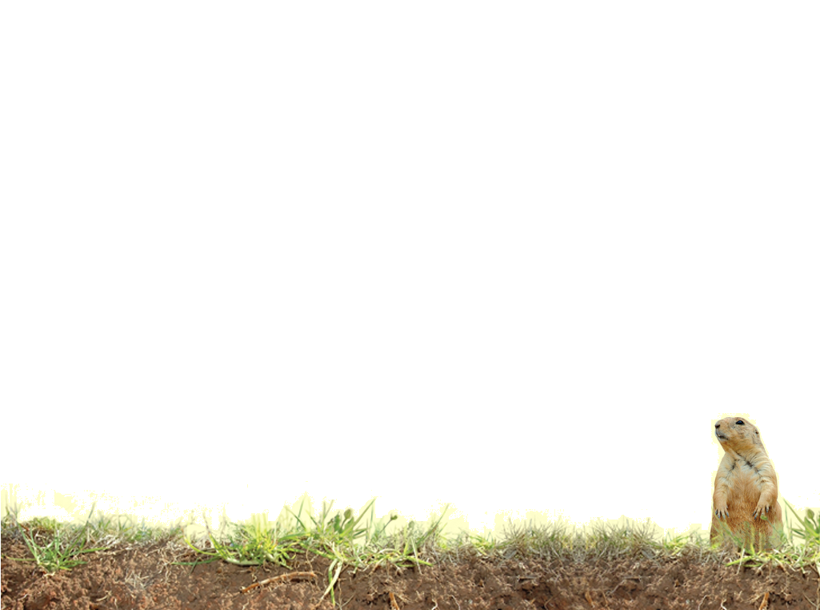
Vocabulary
Compost
Deficiency
Fertility
Fertilizer
Macronutrients
Minerals
Nitrogen
Nutrients
Phosphorus
Potassium
Uptake
Notes:
Definitions found in Scoop Book

Slide 8
Vocabulary
Calcium – macronutrient essential to plant growth and function, important to moving Nitrogen
Iron – micronutrient responsible for plant photosynthesis and growth
Magnesium – macronutrient essential to plant growth and phosphorus uptake
Micronutrients – essential nutrients not needed in a large amount, but still very important
Soil testing - the process to find out what kind of nutrients a soil has.
Notes:
Definitions not found in Scoop Glossary

