Slide 1
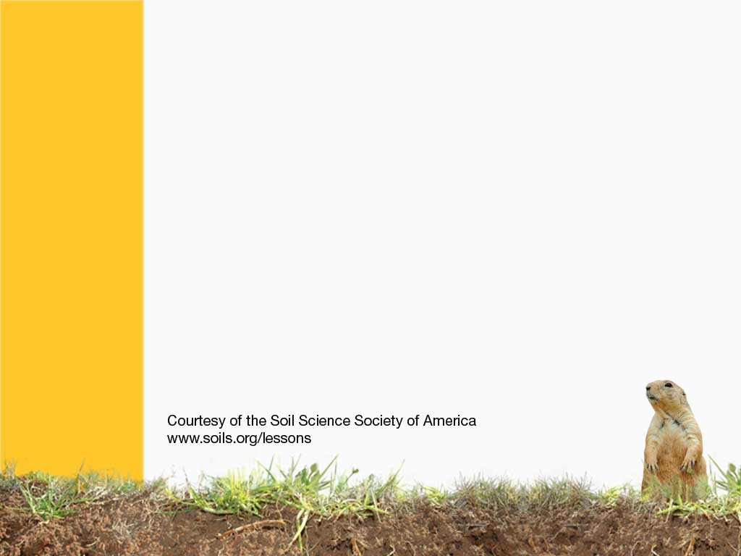
Wetland Soils
Natures Sponges

Slide 2
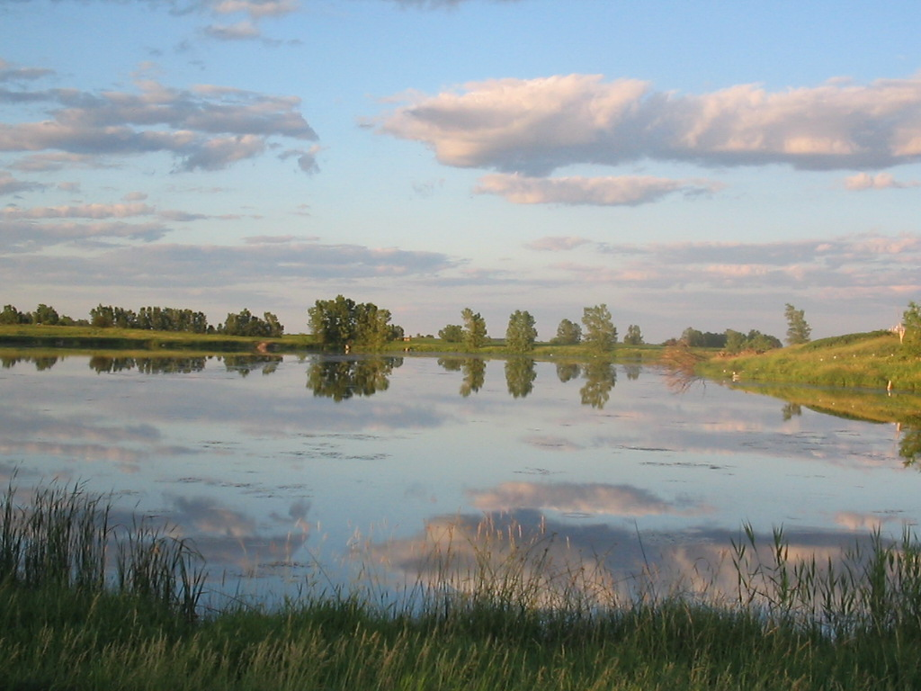
What is a WETLAND?
Notes:
What is a wetland, and where are they found? Wetlands occur in any type of climate, from really wet, to dry (as long as it allows water to remain in the soil), and can occur at any temperature (as long as soils aren’t frozen all year). Wetlands also occur above the permafrost layers of the tundras.

Slide 3
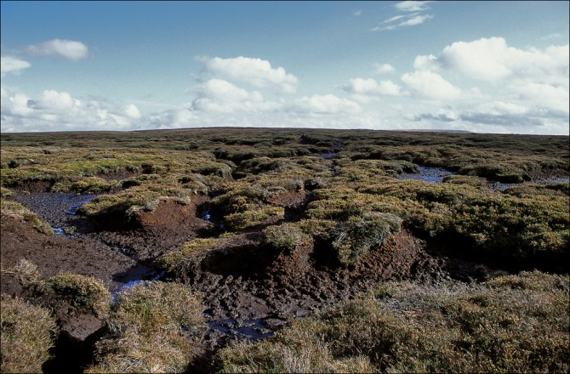
Peat Bogs: Poor Man’s Charcoal
Notes:
Wetlands have a lot of organic matter, these include peat bogs. Peat retains a lot of water, and lots of carbon. If they are dried, they are sort of like coal.

Slide 4
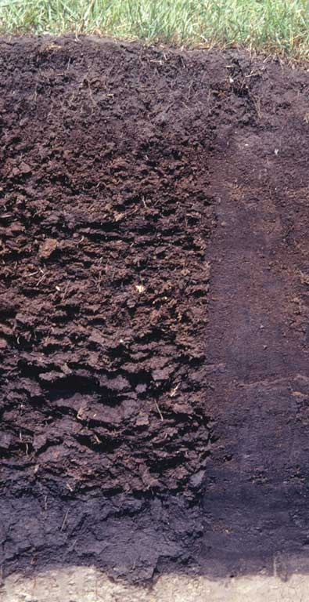
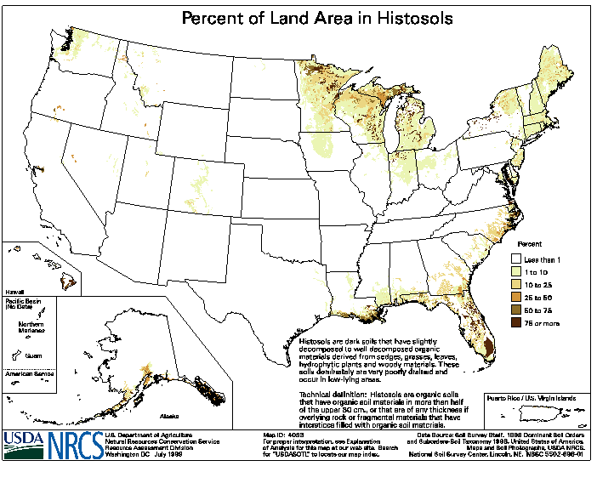
HISTOSOL
Organic, Wet
Notes:
Histosols - organic soils
http://soils.cals.uidaho.edu/soilorders/histosols.htm
Histosols are soils that are composed mainly of organic materials. They contain at least 20-30% organic matter by weight and are more than 40 cm thick. Bulk densities are quite low, often less than 0.3 g cm3.
Most Histosols form in settings such as wetlands where restricted drainage inhibits the decomposition of plant and animal remains, allowing these organic materials to accumulate over time. As a result, Histosols are ecologically important because of the large quantities of carbon they contain. These soils occupy ~1.2% of the ice-free land area globally and ~1.6% of the US.
Histosols are often referred to as peats and mucks and have physical properties that restrict their use for engineering purposes. These include low weight-bearing capacity and subsidence when drained. They are mined for fuel and horticultural products.

Slide 5
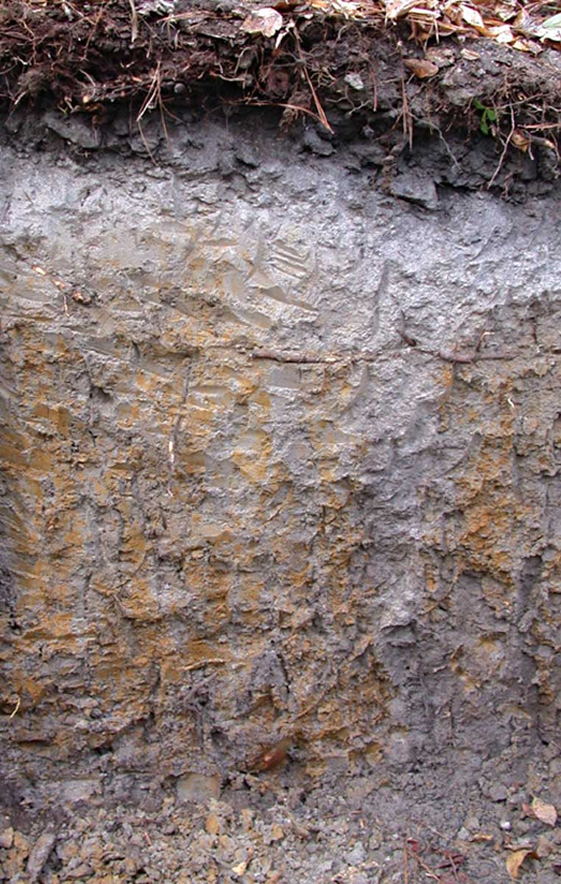
What are
hydric soils???
Hydros = water in Latin
Surface layers are usually BLACK
The subsoil is GRAY, and has freckles of bright ORANGE and REDS.
Some very wet soils may even be BLUE, GREEN, or PURPLE!!!
Notes:
Hydric Soils are fascinating, what are they? What causes the different colors? Oxygen weathering

Slide 6
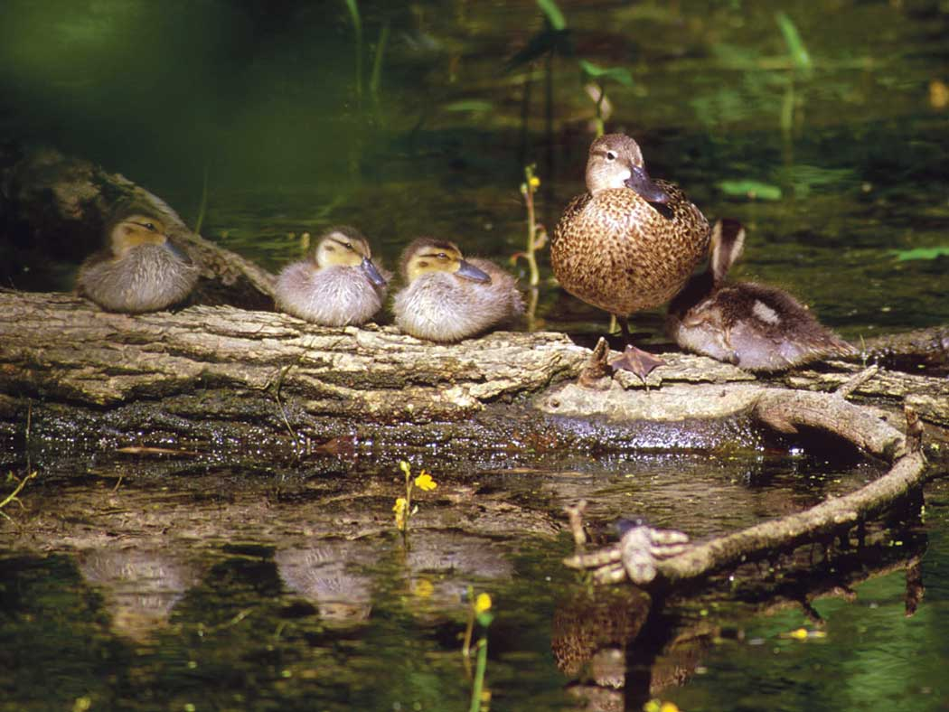
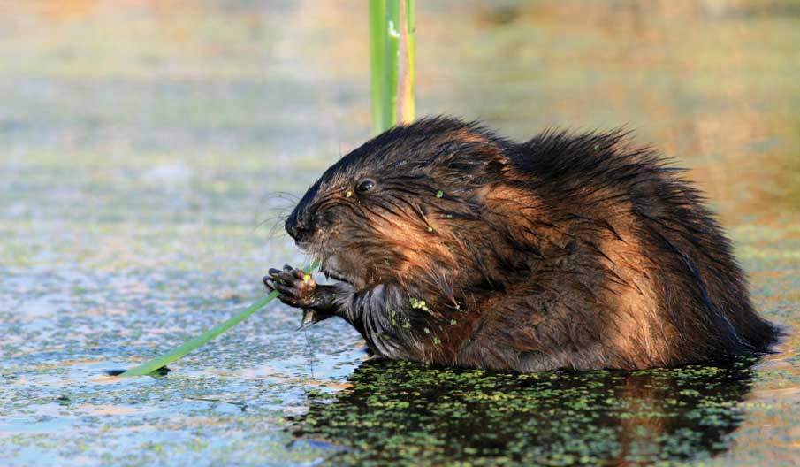
Wetlands cover less than 1% of the earth, yet provide refuges to over 100,000 different types of animals
Notes:
Wetlands have all sorts of bacteria (anaerobic ones). Wetlands also host more than 200 species of birds, alligators, beavers, thousands of insect types, fish

Slide 7
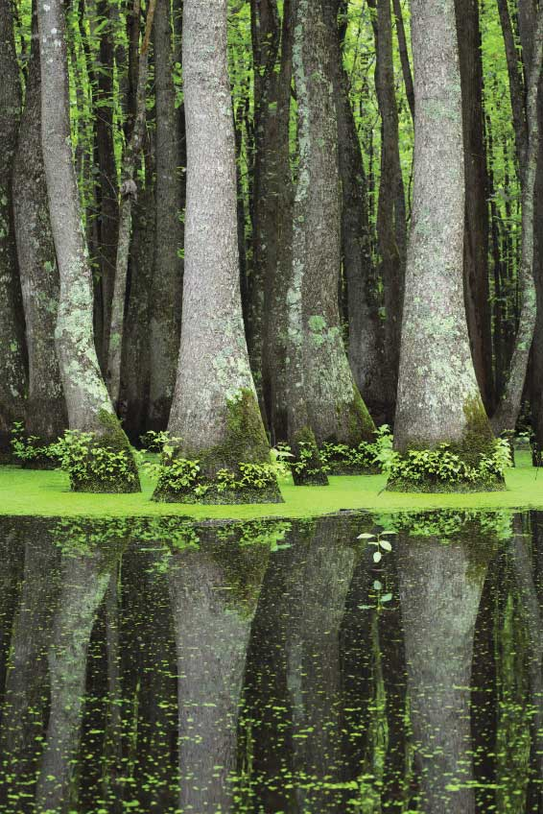
Wetlands have lots of bacteria, including some that do not need to breathe oxygen.
There are rushes, reeds, and water loving trees like mangroves.
Notes:
There are also a lot of diverse plant types, cypress trees, reeds, lily pads, etc.

Slide 8
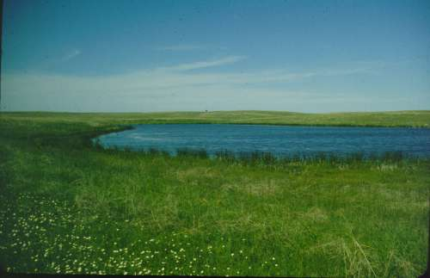
Where do wetlands form?
Notes:
Most wetlands are found in low lying areas and pothole depressions. They are all poorly drained, and remain wet all year. There are also wetlands called ephemiral wetlands, which are wetlands for only part of the year.

Slide 9
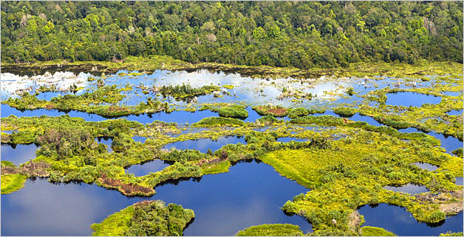
Wetlands are a sponge, and soak up pollutants. Wetlands reduce nitrate (a pollutant) by 80%.
Notes:
Nitrogen gets soaked into wetland systems, and stays there instead of going to the sea. Wetlands also help control flooding.

Slide 10
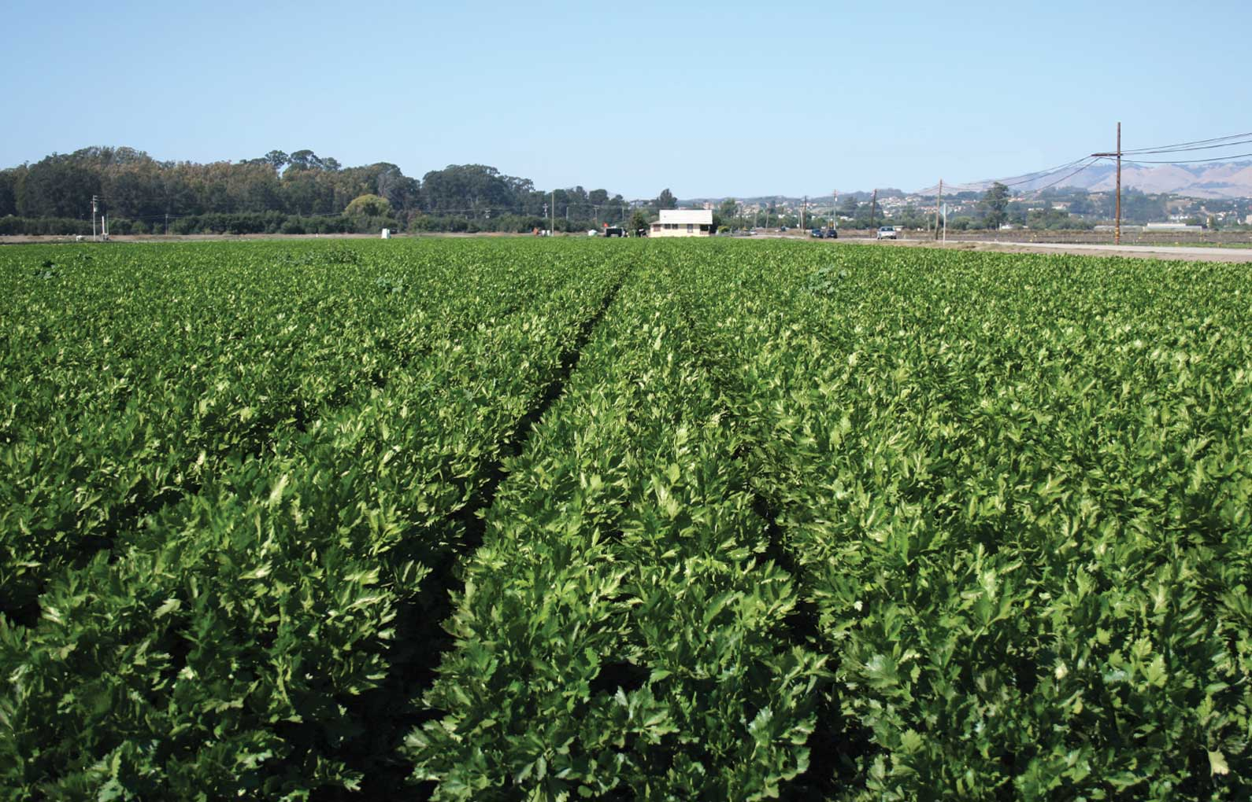
Why would you drain a wetland?
Notes:
When drained, wetland areas can make awesome farmland, but there are problems. In the last 100 years, half of the worlds wetlands have disappeared. Wetlands were seen as wasted space of stagnant water and a breeding ground for mosquitoes. We did not know that they were important.

Slide 11
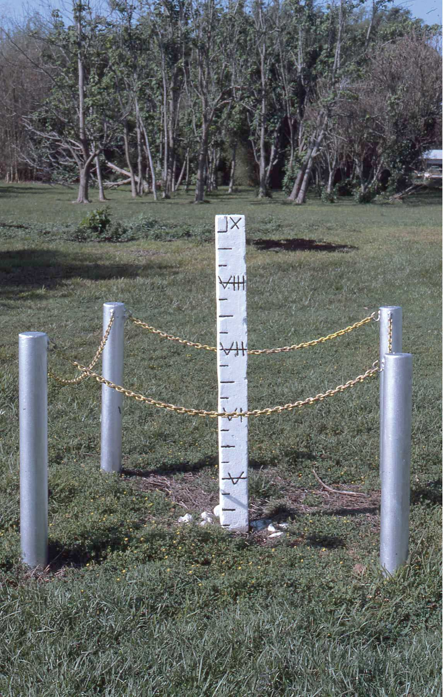
If wetlands are drained, the water in them starts to evaporate, and the ground starts to sink, like a drying sponge.
There is also an increase risk of flooding.
Notes:
Risk of flooding increases, but the soils also dry out and shrink like a wet sponge. This is difficult to build on.

Slide 12
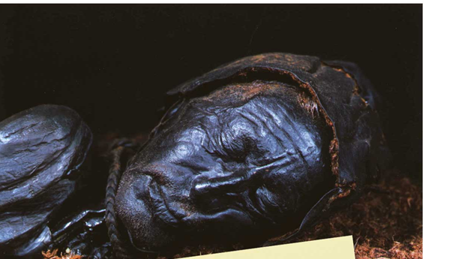
In 1950, while harvesting PEAT for fuel, two Danish man found a 2000 year old body, skin and all.
How is this possible?
Notes:
Peat people preserved in bogs… Peat is acidic, and has other special properties that slow down bacteria. Because of this, organisms decompose slowly.

Slide 13
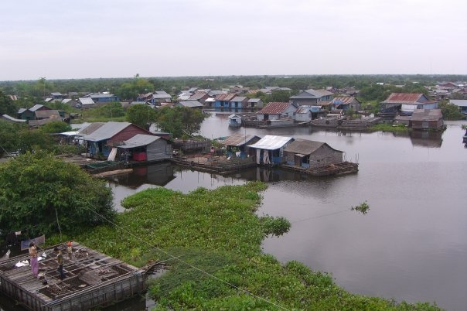
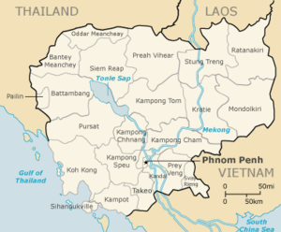
Tonle Sap: Wetlands for Life
Floating Village in Tonle Sap, Cambodia
www.youtube.com/watch?v=K2QPXQ-eqGA&feature=related
Notes:
Example of Tonle Sap, in Cambodia: It is one of the largest wetlands in the world. Most of the year, the Tonle Sap river flows into the Mekong River into the sea. When the rainy seasons starts upstream in the Mekong, there is just so much water, that the Tonle Sap River floats backwards, into the lake, and the lake doubles in size.

Slide 14
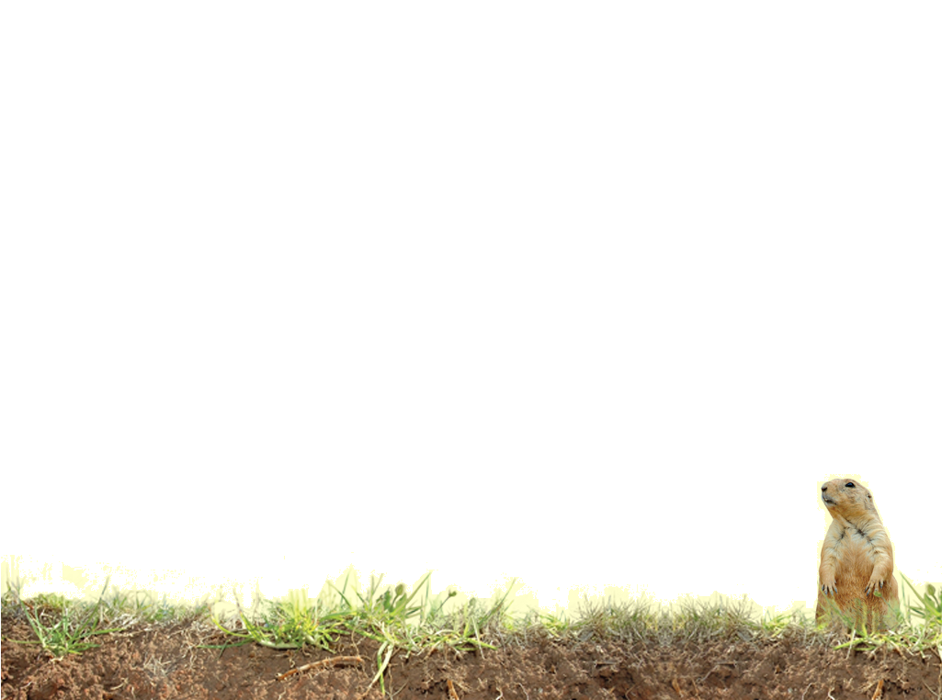
Vocabulary
Wetland
Peat
Notes:
These words are defined in Soil! Get the Inside Scoop

Slide 15
Vocabulary
Histosols - organic soils
Hydric soils – soils that have properties of being waterlogged.
Notes:
These words are not defined in Soil! Get the Inside Scoop. The definitions are below.

