Slide 1
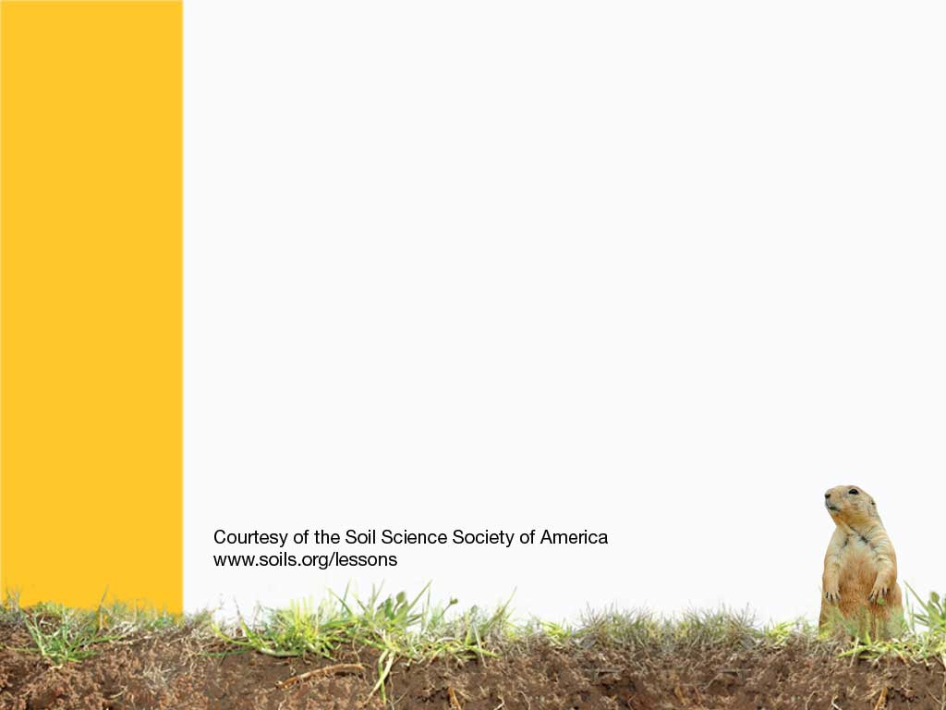
Tundra Soil
Soils found at high elevation or high latitude
Notes:
Tundra soils are found in very cold locations such as at high elevation in the mountains or at high latitudes such as near the north or south poles. In many locations, a permanently frozen layer (called permafrost) remains year-round. Soils with permafrost occupy less than 13% of the worlds’ land surface but store more than 30% of the world’s terrestrial carbon.

Slide 2
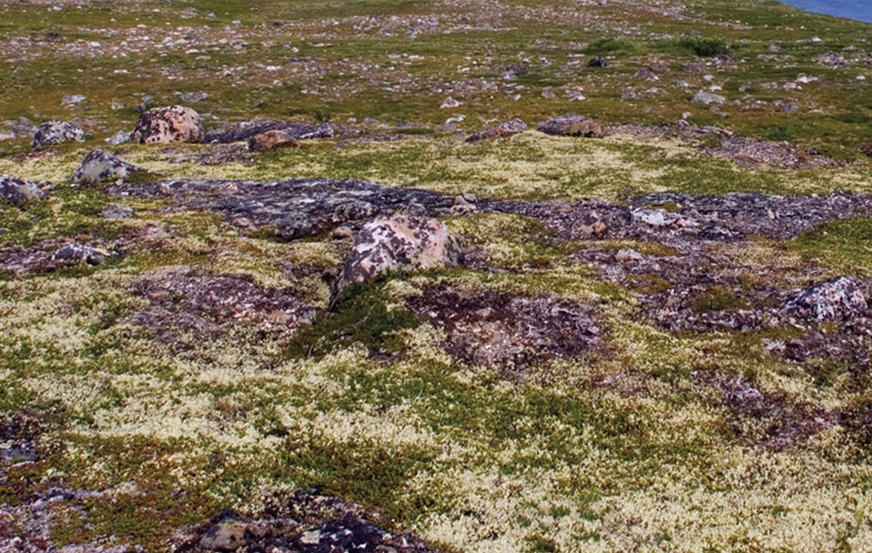
Tundra comes from the Finnish
tunturia, which means barren
or treeless land. However, the
tundra is not really barren. A
diversity of low growing plants
– including a few dwarf trees
– have adapted to the tundra’s
frozen soil, harsh winters, and
short growing season.
Notes:
What is the origin of the word “tundra”?

Slide 3
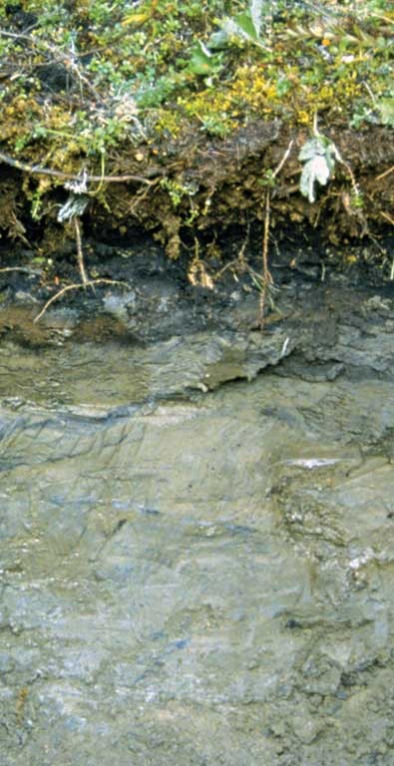
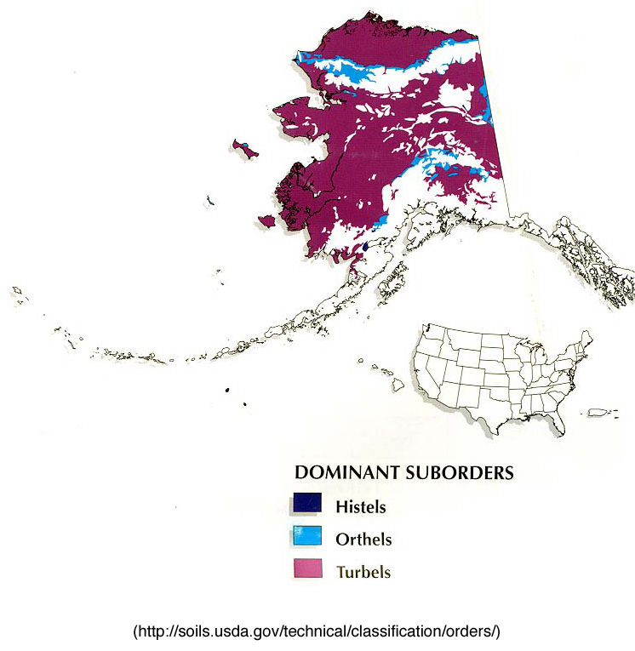
Gelisol
Frozen
Notes:
Gelisols - soils with permafrost
http://soils.cals.uidaho.edu/soilorders/gelisols.htm
Gelisols are soils of very cold climates that contain permafrost within 2 meters of the surface. These soils are limited geographically to the high-latitude polar regions and localized areas at high mountain elevations. Because of the extreme environment in which they are found, Gelisols support only ~0.4% of the world's population - the lowest percentage of any of the soil orders.
Gelisols are estimated to occupy ~9.1% of the Earth's ice-free land area and ~8.7% of the US. Although some Gelisols may occur on very old land surfaces, they show relatively little morphological development. Low soil temperatures cause soil-forming processes such as decomposition of organic materials to proceed very slowly. As a result, most Gelisols store large quantities of organic carbon - only soils of wetland ecosystems contain more organic matter. Gelisols of the dry valleys of Antarctica are an exception - they occur in a desert environment with no plants and consequently contain very low quantities of organic carbon.
The frozen condition of Gelisol landscapes makes them sensitive to human activities.

Slide 4
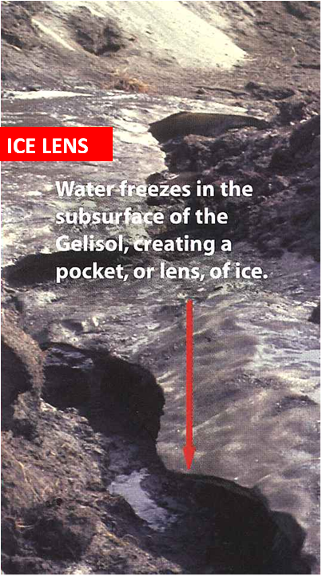
Notes:
In addition to the subsoil being permanently frozen, ice lens are often present. Here the surface soil has eroded away leaving behind the exposed ice lens.

Slide 5
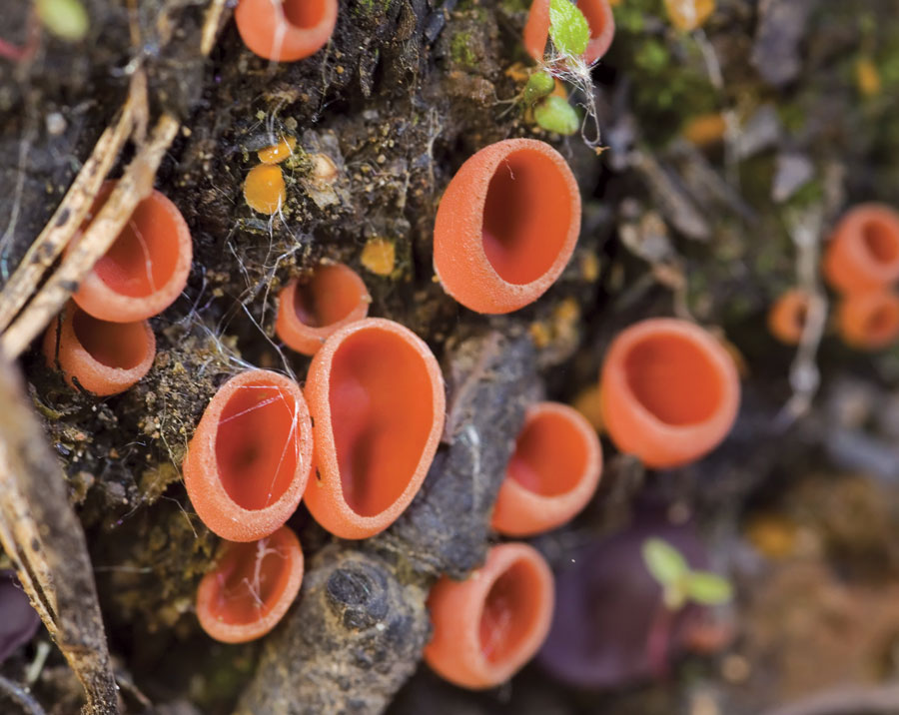
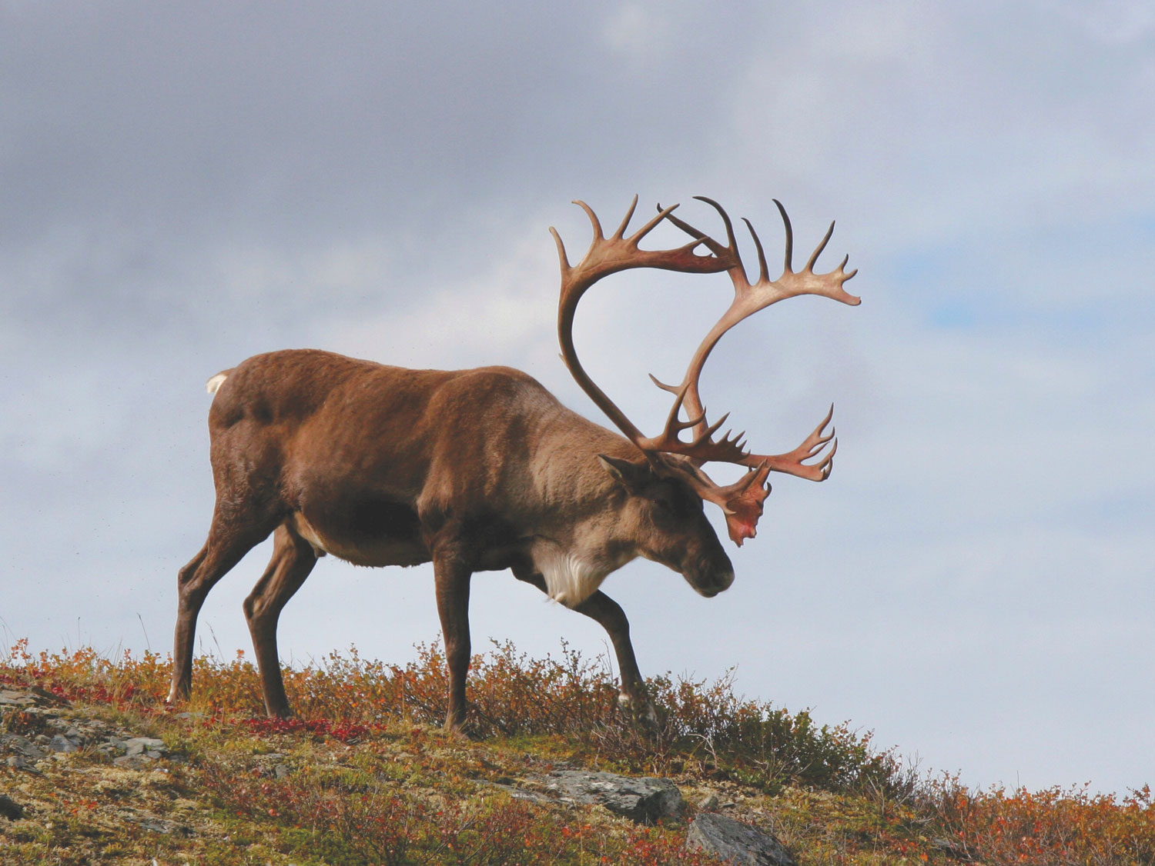
Tundra: Teeming with Life
Lichens =>
<= Caribou
Notes:
Caribou migrate across the relatively flat tundra. Because of the permafrost, water does not readily drain through the soil and the ground gets very soggy in the summer, making it a perfect place for mosquitoes and other insects to breed. Also, smaller plants and fungi (as shown on the right) commonly grow on the soil surface.

Slide 6
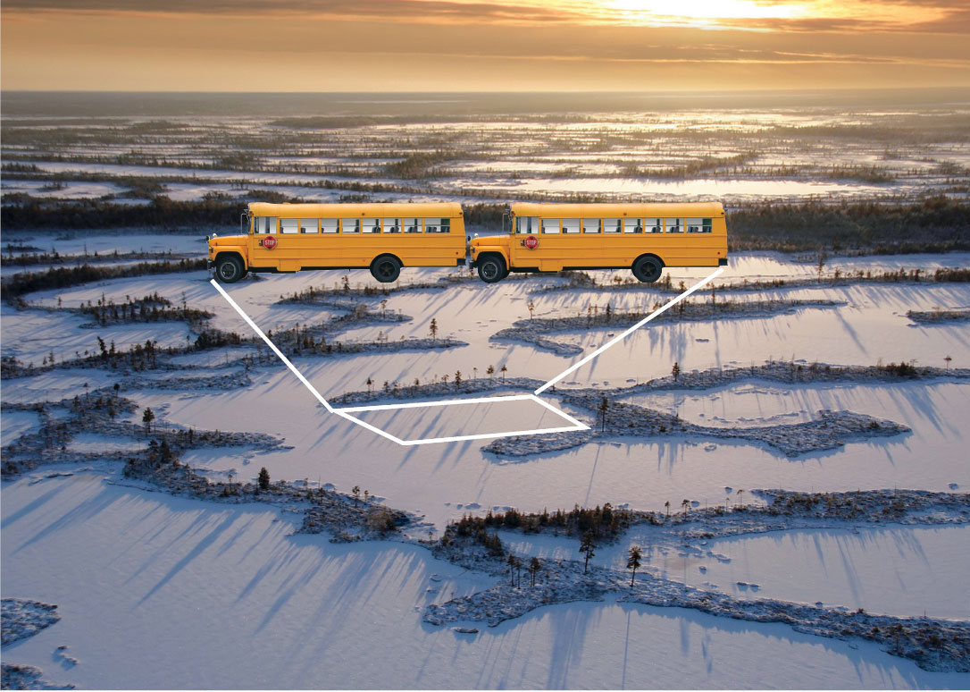
How does freezing and thawing create patterns in the ground?
Notes:
Patterned ground may form in tundra soils. Water fills cracks in the soil, freezes, and shapes the soil into polygons—a geometric shape with at least three sides. Polygons can range in size from one meter up to 30 meters across as shown here by the two school buses parked end-to-end.

Slide 7
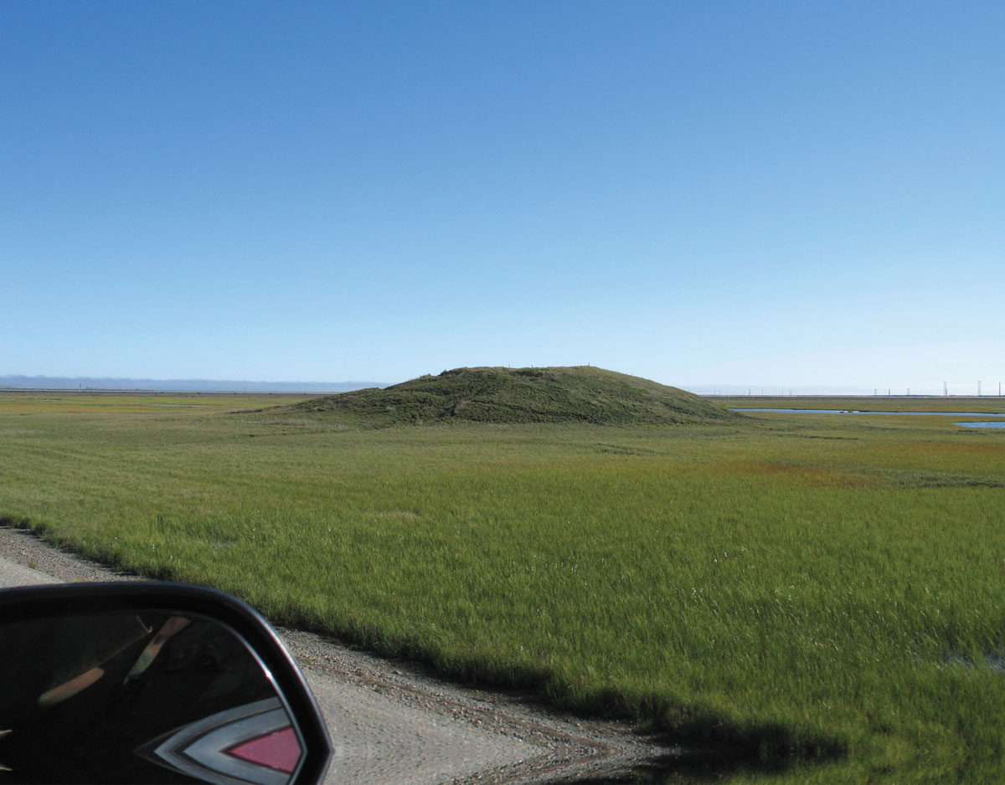
What is a pingo?
Notes:
Pingo is an Eskimo word for a cone-shaped hill of soil. Pingos form when an underground pond of water freezes, expands, and pushes the soil upward. They can rise as tall as a 20-story building. Soils on pingos are better drained than surrounding soils and often have different plants and animals associated with them.

Slide 8
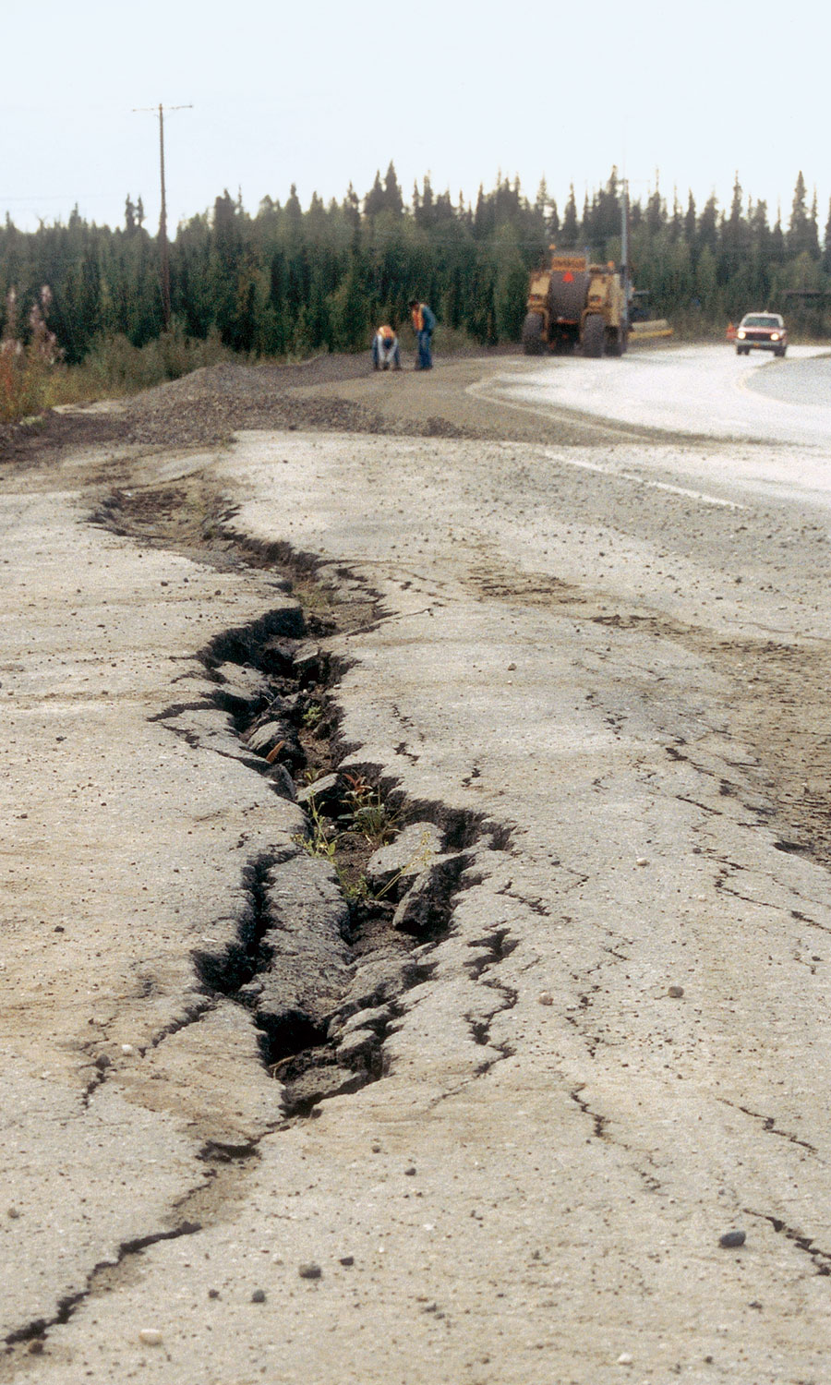
Building Challenges
Freeze/Thaw Cracking
Notes:
Building on permafrost soil is tricky. If the permafrost thaws, the ground is no longer supported by the ice underneath and can shift. Roads often buckle and house foundations sink. In many places the Alaskan pipeline was elevated to avoid the heat from the oil thawing the permafrost and causing the pipe to buckle and possibly break.

Slide 9
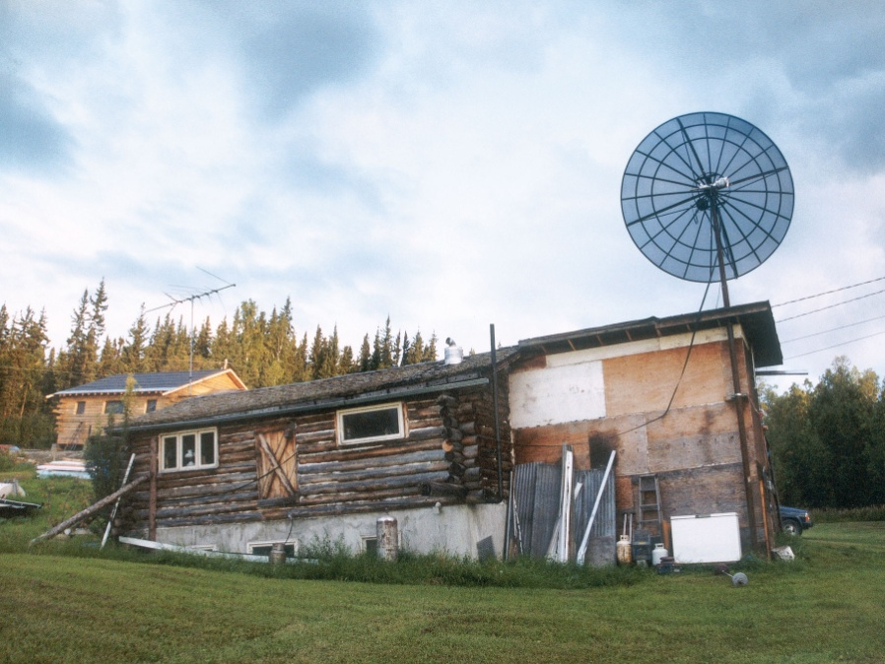
Sinking Houses
Notes:
The heat from a home can also cause the permafrost to melt. Here an Alaskan homeowner has built a new house to replace the one claimed by sinking permafrost. The air space under the new house will circulate cold air to keep the permafrost from melting and maintain a stable foundation.

Slide 10
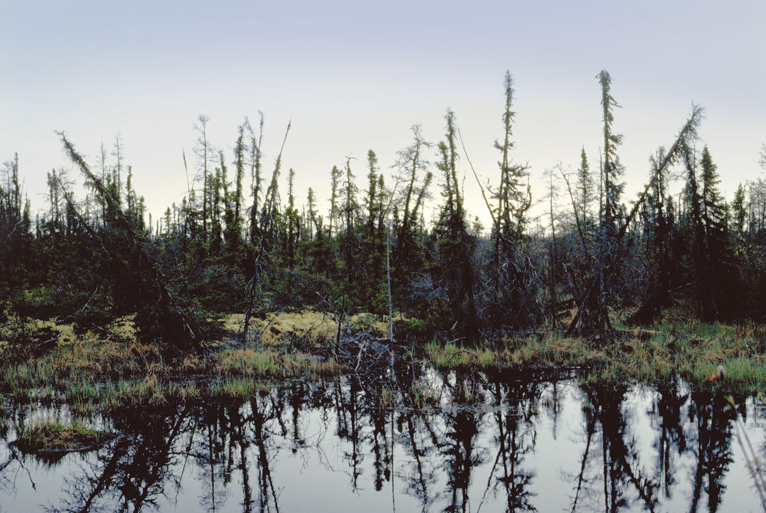
Notes:
Further south (in the northern hemisphere), the vegetation grows taller in tundra soils as shown here but the tress often tilt at various angles due to repeated freezing and thawing of the surface soil. Also, permafrost in the subsoil prevents trees from growing deep roots to stabilize them.

Slide 11
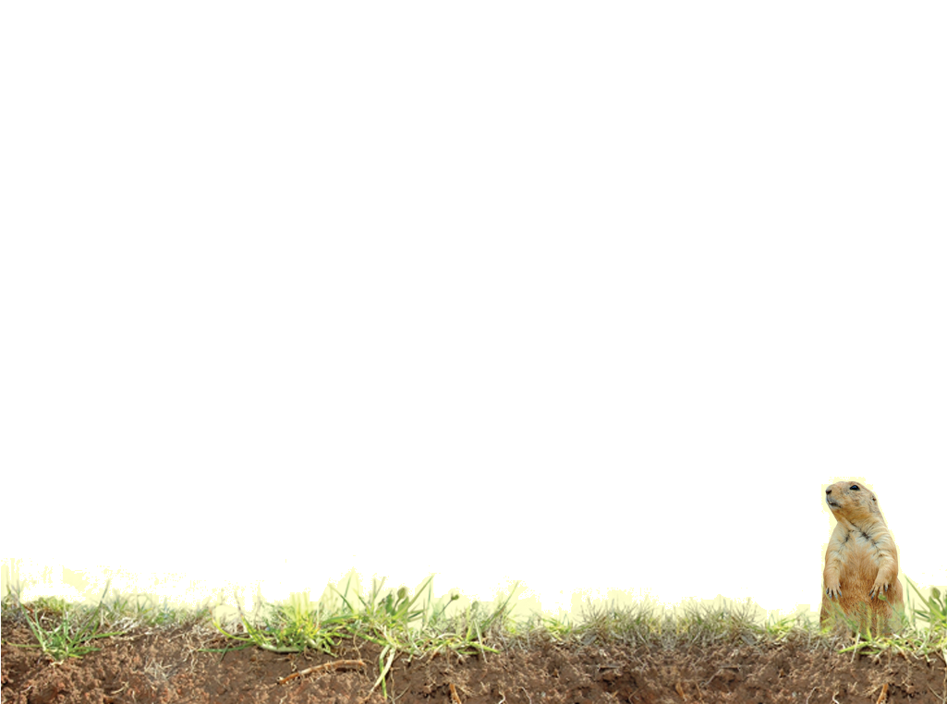
Vocabulary
Gelisols - soils with permafrost
ice lens – moisture collects in the soil, and when it freezes, soils get wedged apart
Pingos- an underground pond of water freezes, expands, and pushes the soil upward.
Patterned ground - Water fills cracks in the soil, freezes, and shapes the soil into interesting patterns
Notes:
These definitions are not in Soil! Get the Inside Scoop

