Slide 1
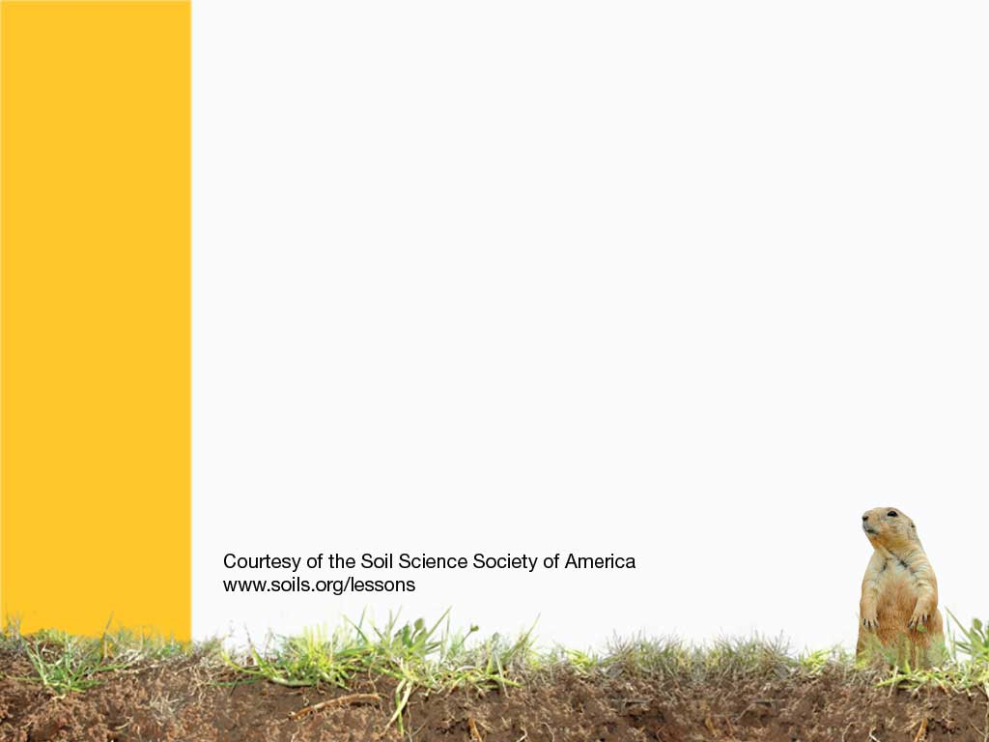
Tropical Soils
Notes:
Tropical Soils are found in conditions where it is very hot, and humid, with a lot of rainfall. A lot of these soils are found around the equatorial regions from 23.5o North and South. These soils are often very deep, and are some of the oldest soils in the world. There are tropical regions in South East Asia, Central and South America.

Slide 2
Lush growth on top, but not fertile soil…
Tropical soils are found under very hot conditions, and high yearly rainfall.
They are the worlds oldest soils. They are so old, that they are RUSTY!
These soils have little ORGANIC MATTER, and very little NUTRIENTS!

Slide 3
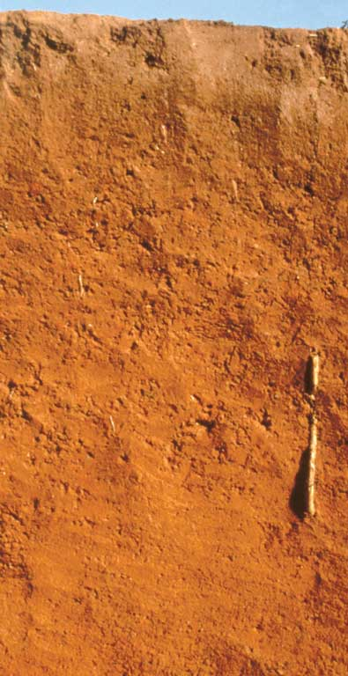
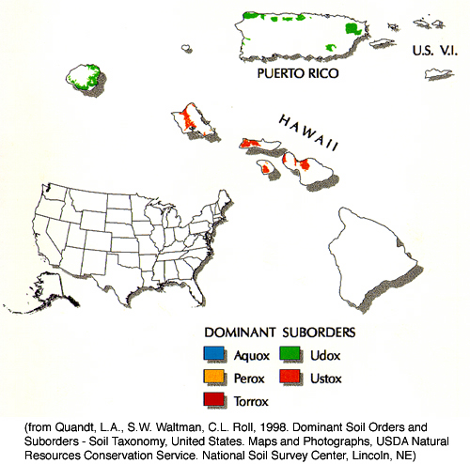
OXISOL
Very Weathered
Notes:
Oxisols - very weathered soils of tropical and subtropical environments
http://soils.cals.uidaho.edu/soilorders/oxisols.htm
Oxisols are very highly weathered soils that are found primarily in the intertropical regions of the world. These soils contain few weatherable minerals and are often rich in Fe and Al oxide minerals. Oxisols occupy ~7.5% of the global ice-free land area. In the US, they only occupy ~0.02% of the land area and are restricted to Hawaii. Most of these soils are characterized by extremely low native fertility, resulting from very low nutrient reserves, high phosphorus retention by oxide minerals, and low cation exchange capacity (CEC). Most nutrients in Oxisol ecosystems are contained in the standing vegetation and decomposing plant material. Despite low fertility, Oxisols can be quite productive with inputs of lime and fertilizers.

Slide 4
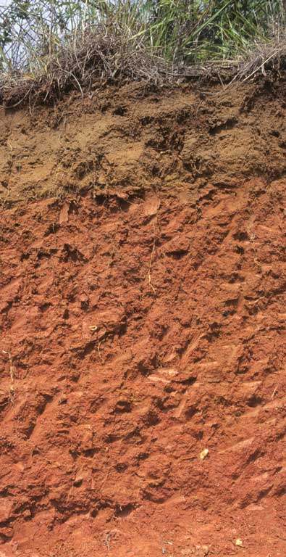
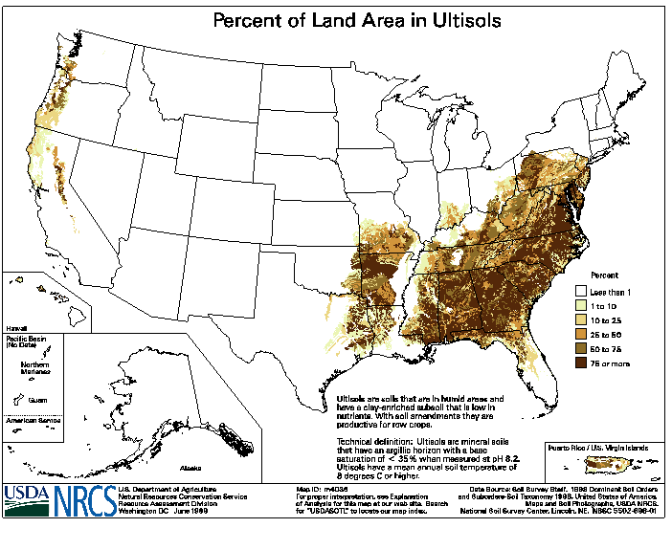
ULTISOL
Weathered
Notes:
Ultisols – acidic, strongly leached, older soils
Can you tell where they clay layer starts?
http://soils.cals.uidaho.edu/soilorders/ultisols.htm
Ultisols are strongly leached, acid forest soils with relatively low native fertility. They are found primarily in humid temperate and tropical areas of the world, typically on older, stable landscapes. Intense weathering of primary minerals has occurred, and much Ca, Mg, and K has been leached from these soils. Ultisols have a subsurface horizon in which clays have accumulated, often with strong yellowish or reddish colors resulting from the presence of Fe oxides. The 'red clay' soils of the southeastern United States are examples of Ultisols.
Ultisols occupy ~8.1% of the global ice-free land area and support 18% of the world's population. They are the dominant soils of much of the southeastern US and occupy ~9.2% of the total US land area.
Because of the favorable climate regimes in which they are typically found, Ultisols often support productive forests. The high acidity and relatively low quantities of plant-available Ca, Mg, and K associated with most Ultisols make them poorly suited for continuous agriculture without the use of fertilizer and lime. With these inputs, however, Ultisols can be very productive.

Slide 5
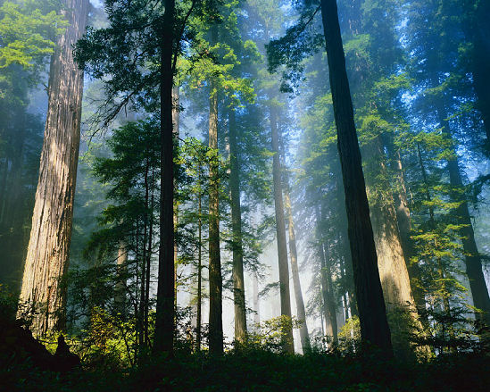
Tropical forests
Notes:
Tropical Jungles

Slide 6
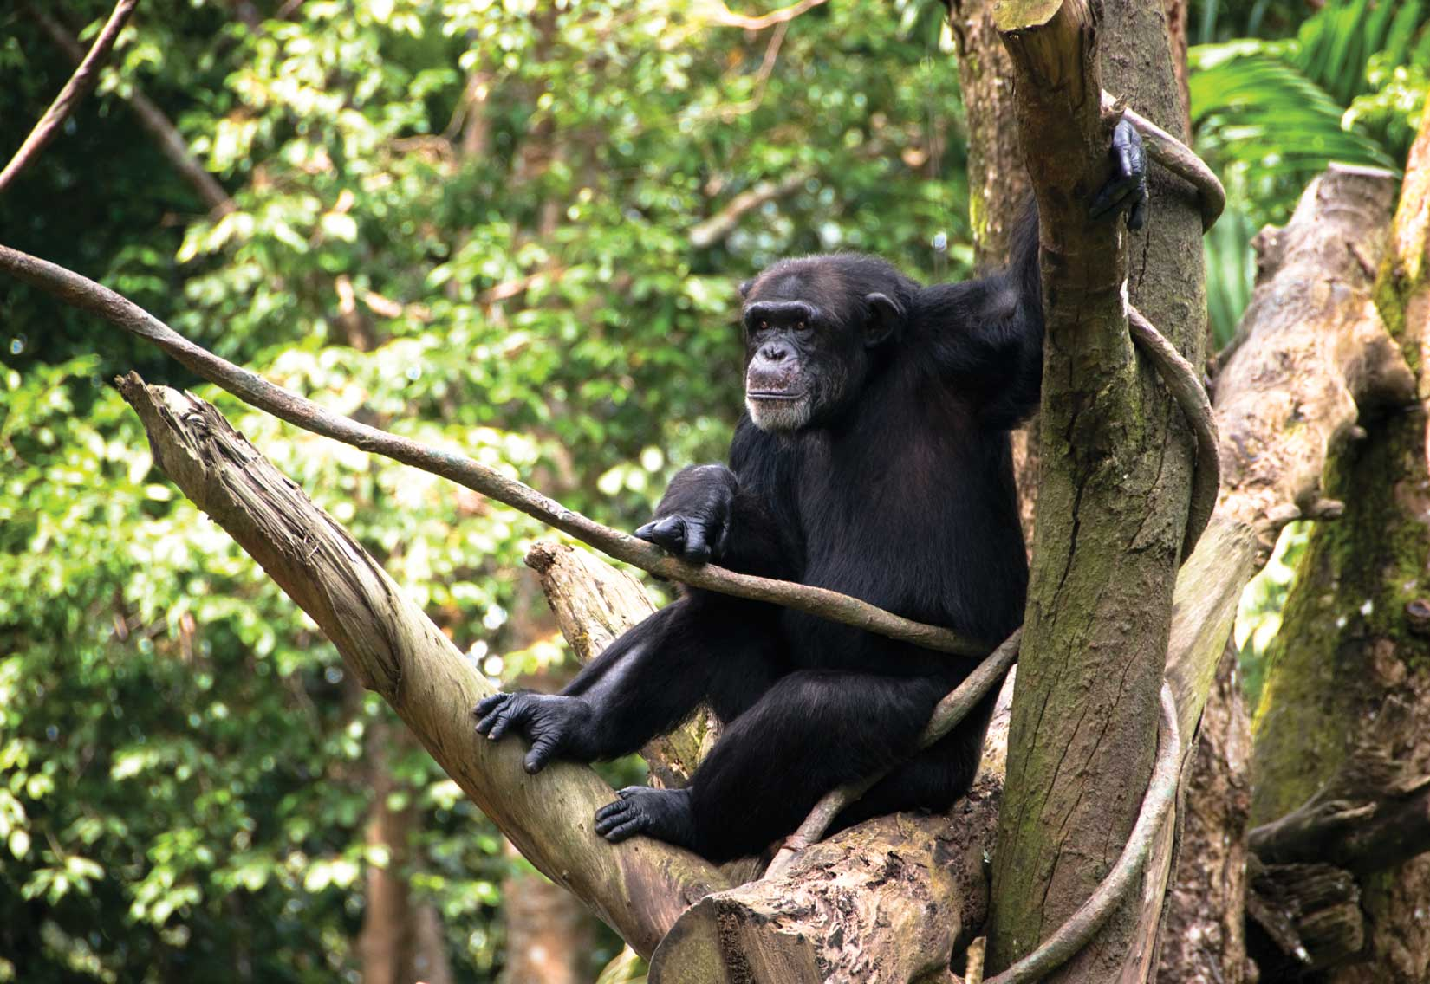
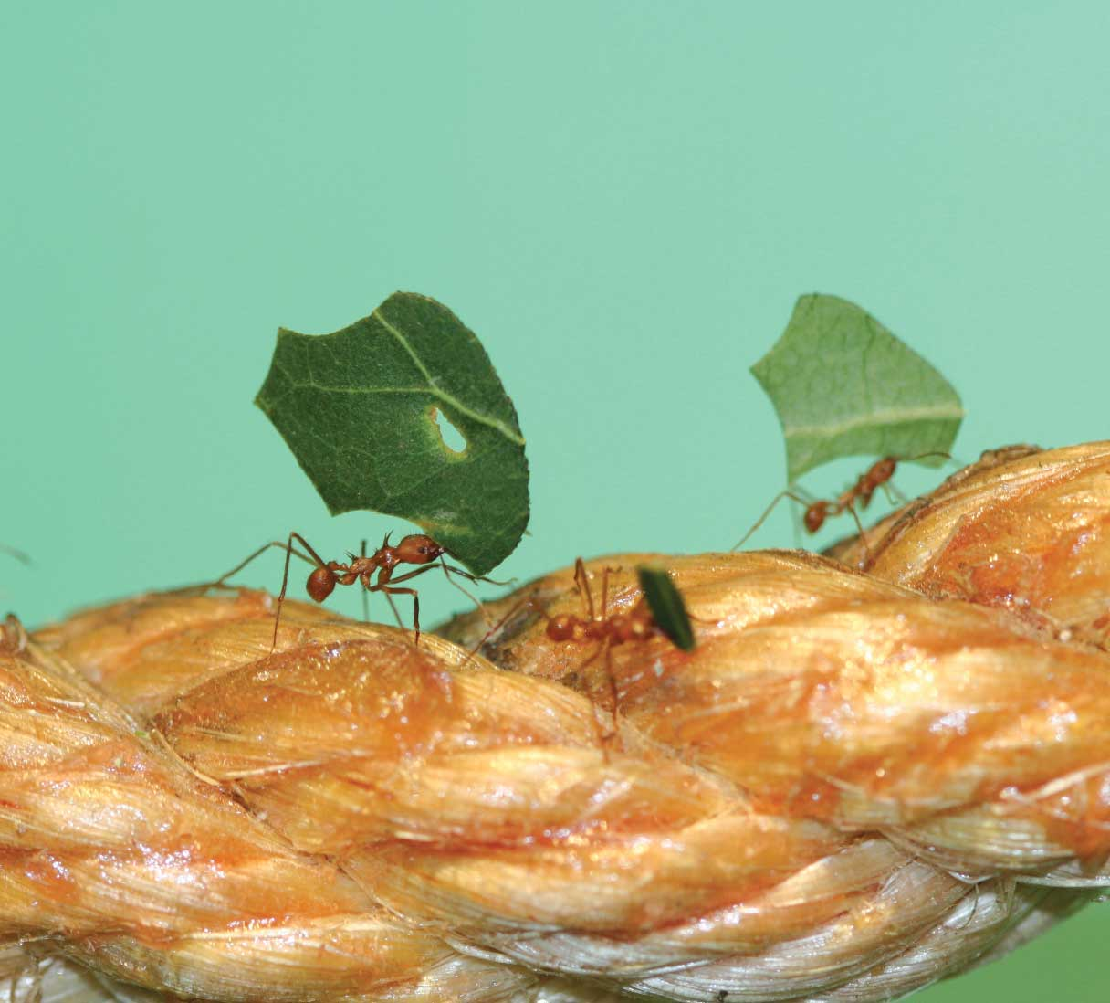
Tropical forests have over 150 species of trees in one football field…
There is a LOT of different organisms!
Notes:
There is a lot of life to be found in tropical jungles…

Slide 7
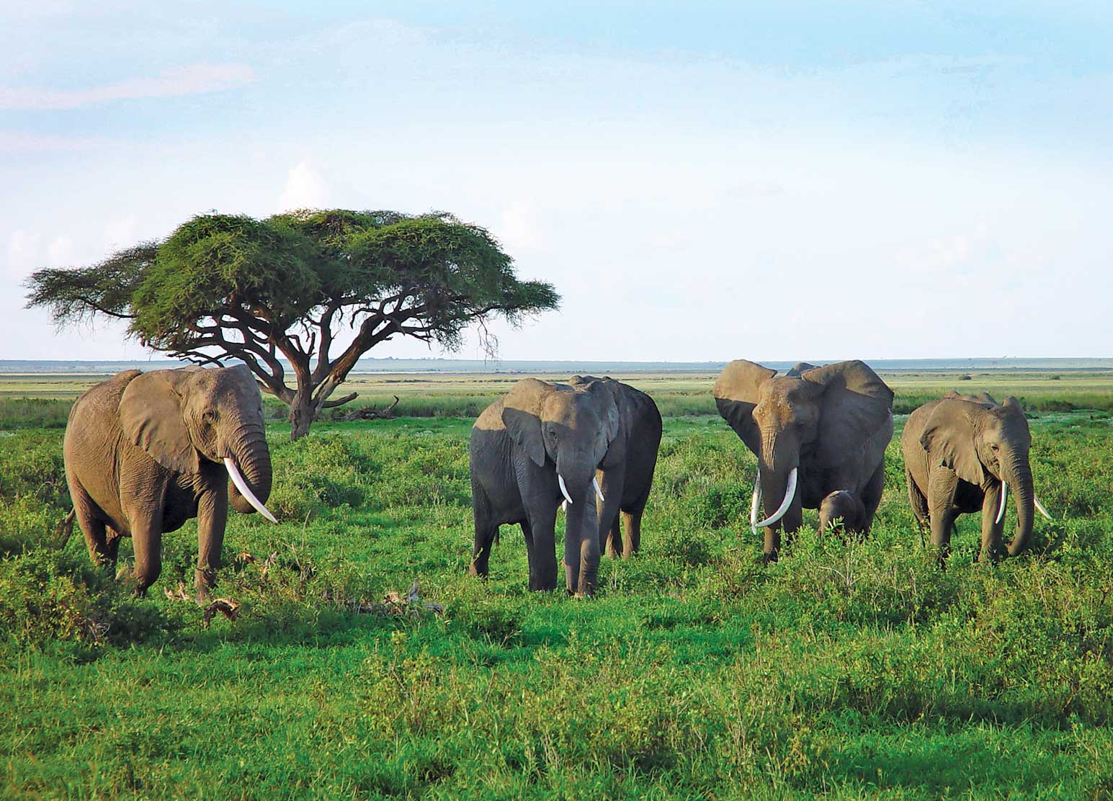
Savannah Plains
Notes:
Not Just jungles, areas including the savannah in Africa. Grasslands in hot areas where the soil is very developed.

Slide 8
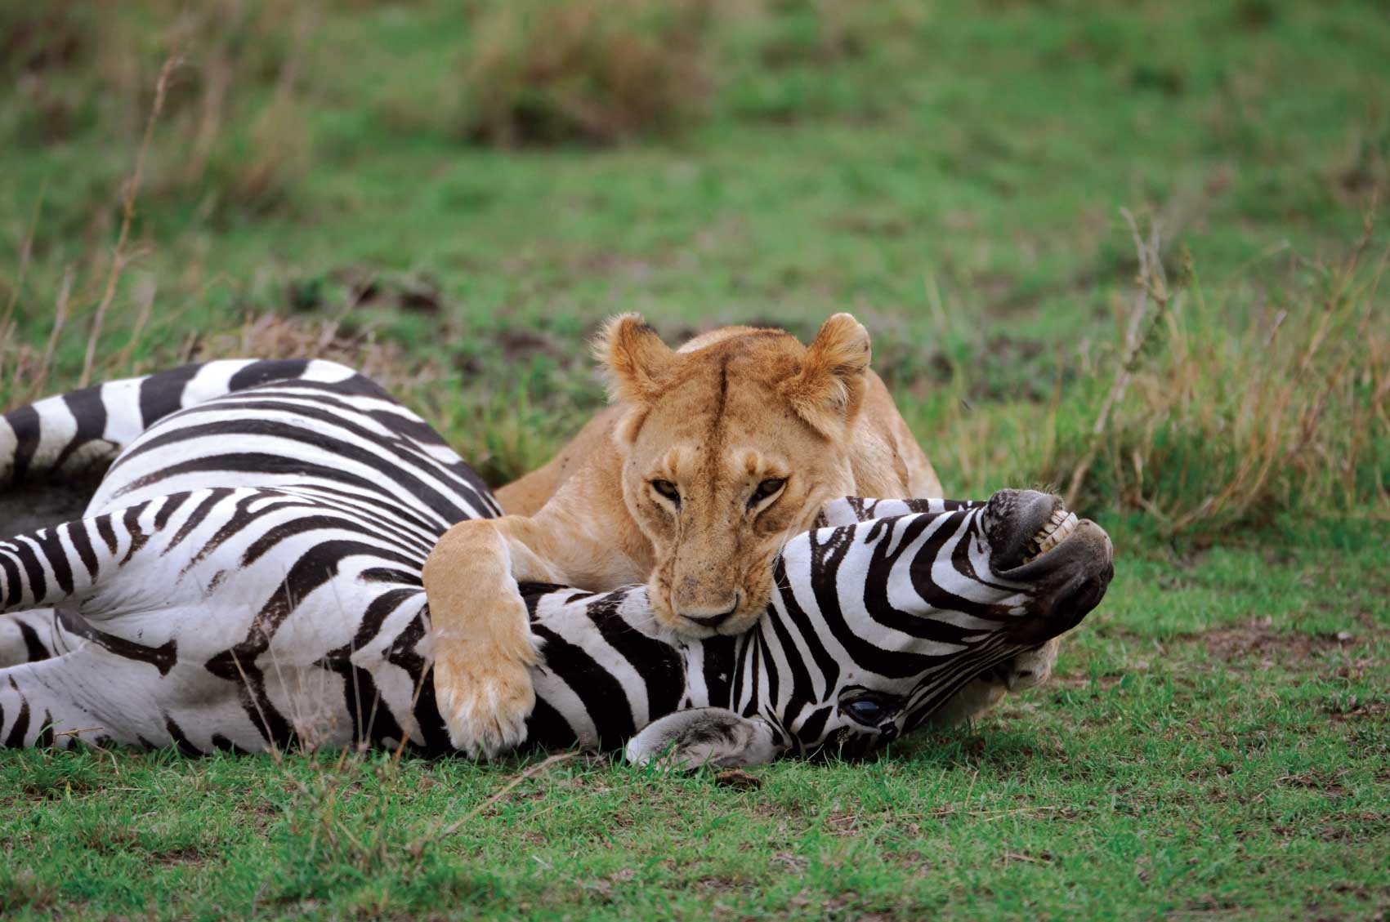
What kind of animals live in the Savannah?
Notes:
There are a lot of animals and insects in the area as well.

Slide 9
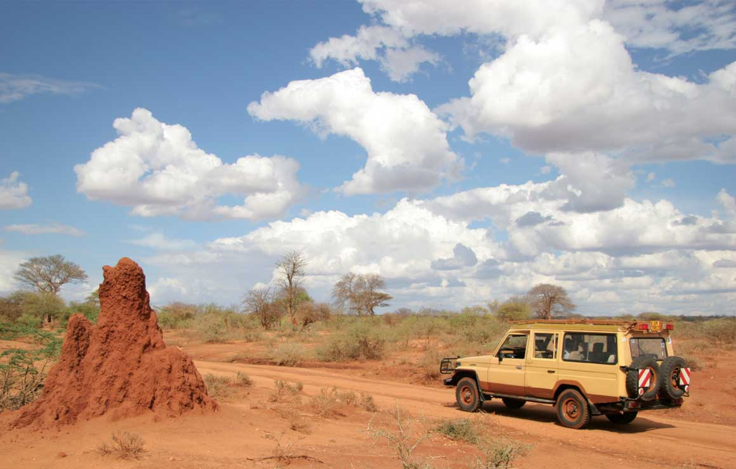
Termites are tropical earthworms…
Notes:
Termites, the earthworms of the tropics

Slide 10
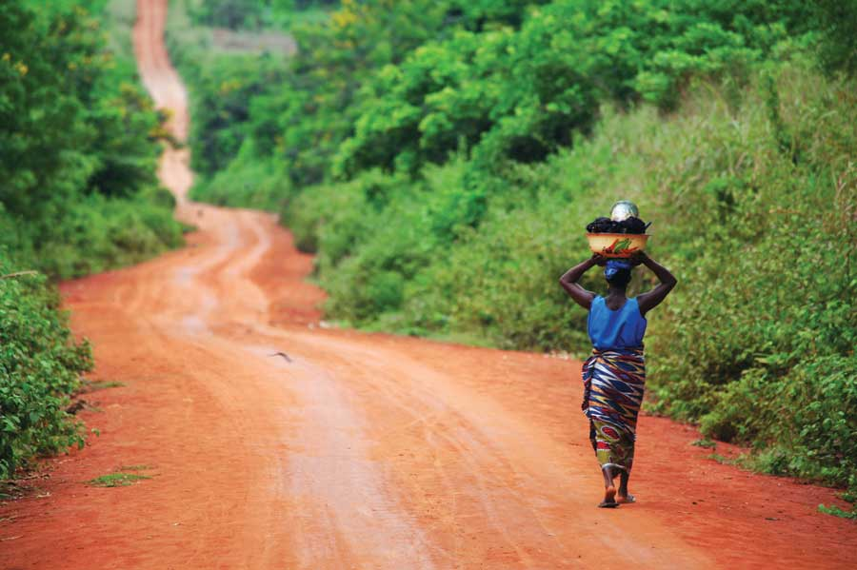
Rainforests can be FLAT
Notes:
Soils in the tropics can be very flat

Slide 11
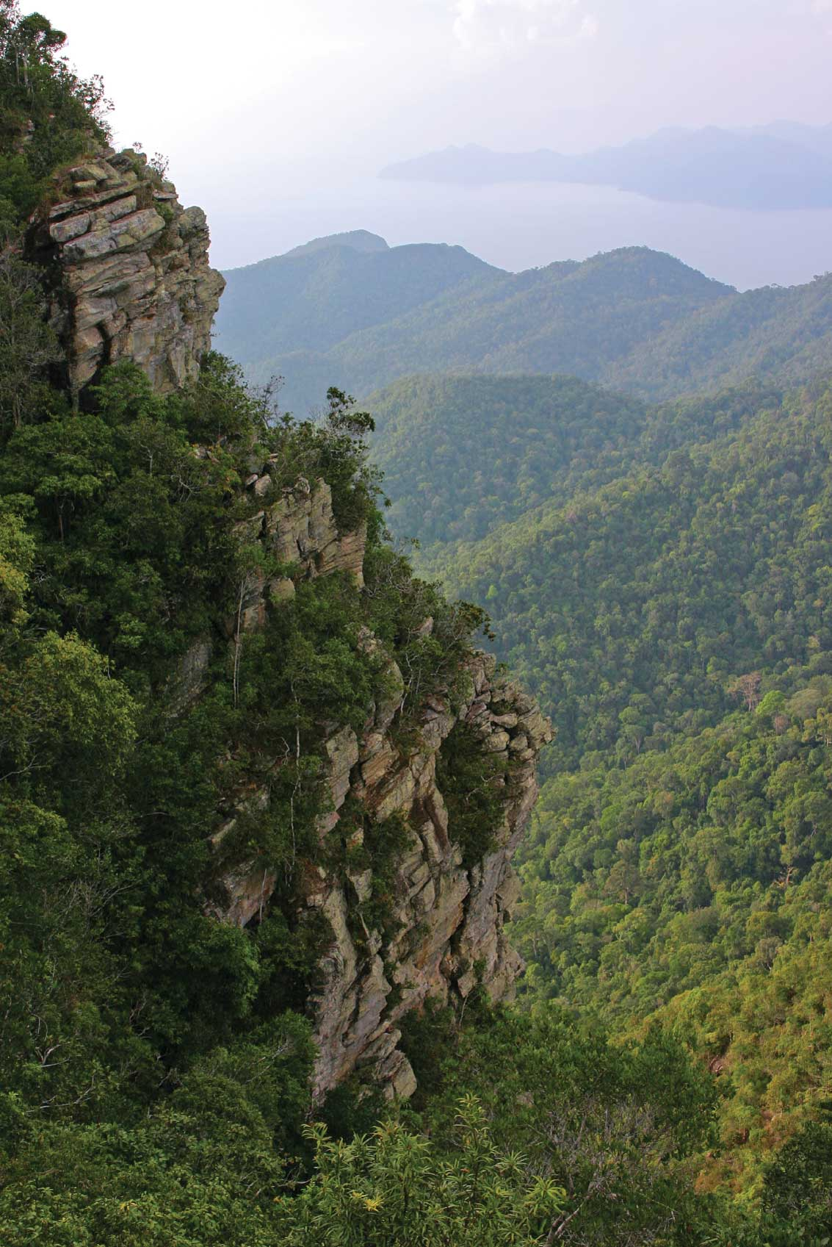
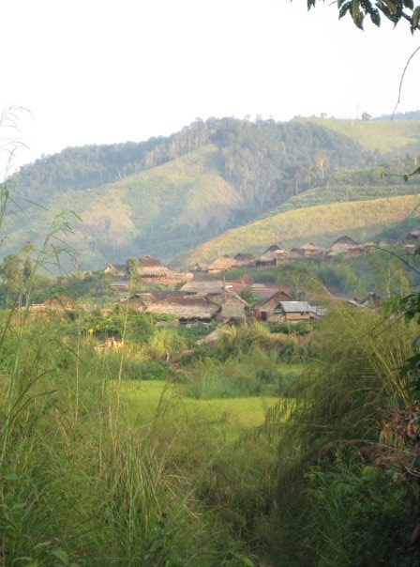
Or hilly, depending on where they are.
Notes:
Or be incredibly hilly… depending on the location.

Slide 12
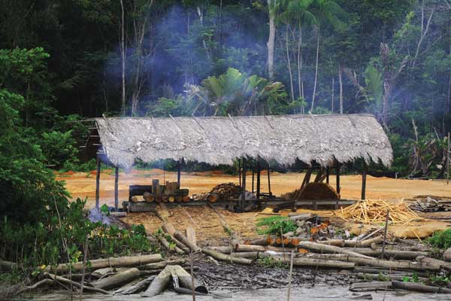
Forests are often CUT to produce grazing area and for fuel:
This releases CARBON DIOXIDE
Notes:
To mangage these unfertile soils, there are several management styles, including slashing and burning… also known as swidden agiculture. This means that trees are cut down, the ground burned, and farmed for a few years. Then, the people cut the next patch and move on. If the soil is not TOTALLY exhausted of nutrients and the forest is allowed to regrow (leaving several years between when it was used or cut down), this can be sustained. But, there are now too many people in that area of the world, and soils are not allowed to regrow. Then the soil is wasted.

Slide 13
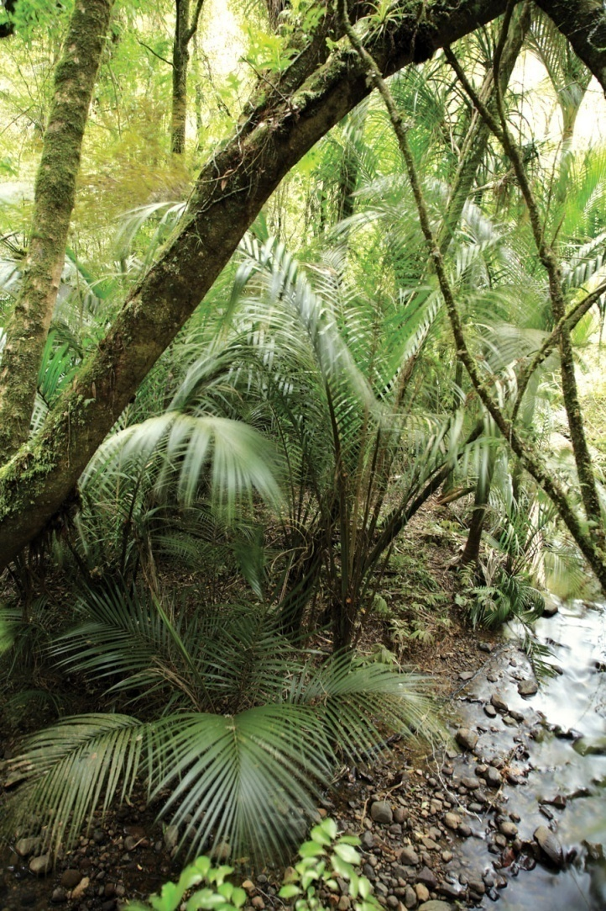
A plot of cleared ground is only good for
A FEW YEARS!
There is not a lot of nutrients, and crops cannot grow well. Farmers need to clear more land.
Without trees, tropical soils dry out and become desert like. They have very little organic matter to hold soil in place.
Soil just becomes dirt!
Notes:
However, if there are too many people, and the land doesn’t get to recover, the soil turns to dirt, and there is nothing that can be done.

Slide 14
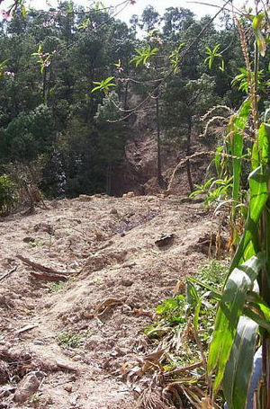
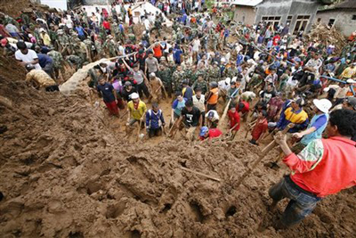
Bad management creates LANDSLIDES!
Why are LANDSLIDES dangerous?
Notes:
Also, if the land is very sloped, and the forests are cleared, then landslides can occur. Landslides kill people, bury crops, and can make roads impassable.

Slide 15
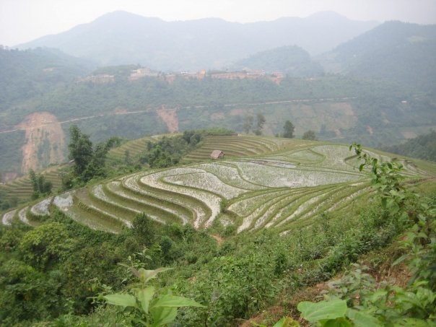
Humans can do things to manage fertility and erosion!
Notes:
Humans have been known to do things, like terracing to prevent erosion. In the hill tribes in southeast asia, rotate crops, and rice is not grown every year. People have been living and farming in these areas since the beginning of time, and with proper management, they can go a long way to feeding everyone.

Slide 16
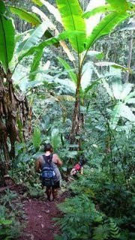
Soil Scientists sometimes need to hike through the jungle to study tropical soils.
Notes:
Soil scientists need to travel cross country to help with sites…

Slide 17
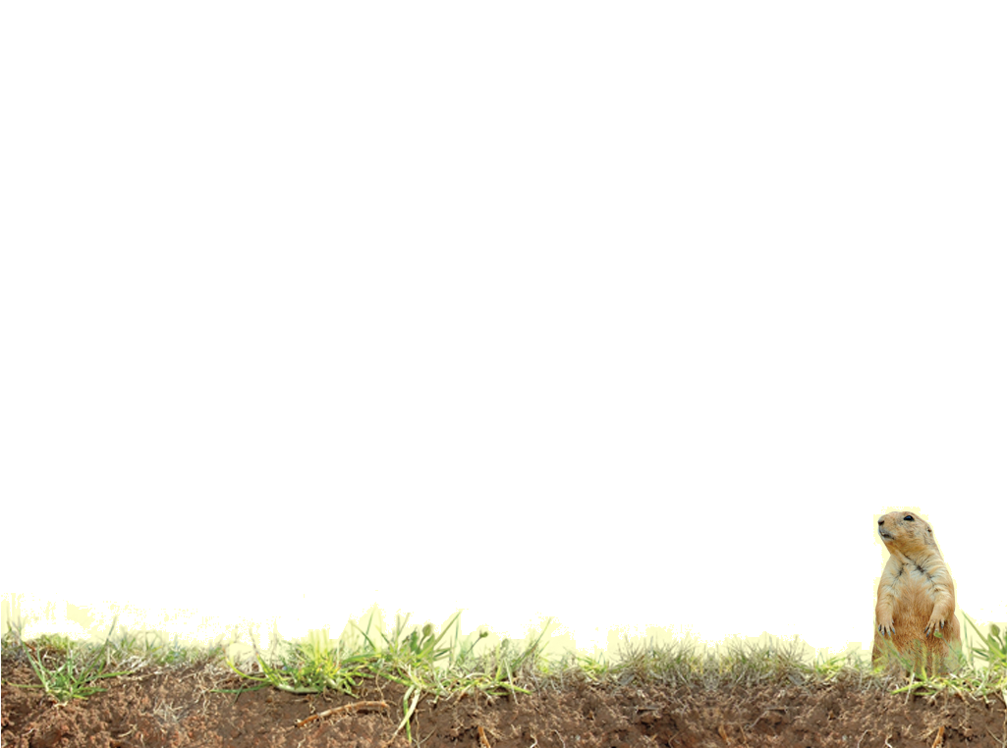
Vocabulary
Organic matter
Nutrients
Fertility
Erosion
Notes:
These words are defined in Soil! Get the Inside Scoop

Slide 18
Vocabulary
Ultisols – acidic, strongly leached, older soils
Oxisols - very weathered soils of tropical and subtropical environments
Landslide- rapid movement of soils downhill
Clear cut – removing all of the trees from a surface area
Notes:
These words are not defined in Soil! Get the Inside Scoop. The definitions are below.

