Slide 1
Soils Need Nutrients Too

Slide 2
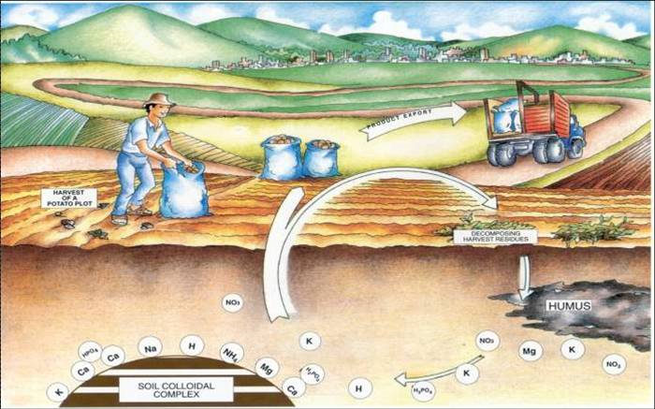
KEEPING SOILS FIT
Most soils have a large supply of nutrients. But when soils are continually used for growing food, nutrients are removed when the crop is harvested.
That is why farmers must add nutrients to their soils
Notes:
Describe how plants tell us their nutrient needs
Plant nutrient deficiency symptoms
Soils can be tested for their nutrient content

Slide 3
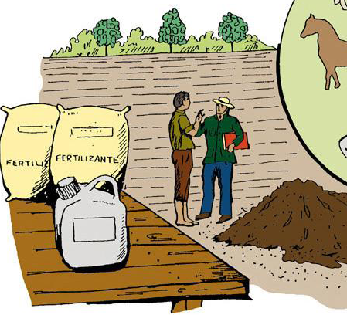
KEEPING SOILS FIT
Nutrients can be added from a variety of sources—organic matter (manure), chemical fertilizers, and even by some plants as they grow.
Fertilizer
Manure
Notes:
How do we add nutrients to soil?
Fertilizer nutrients
Organic nutrients

Slide 4
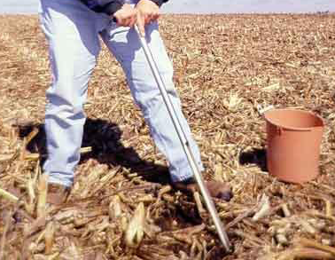
KEEPING SOILS FIT
…… before adding fertilizers, farmers often have their soils tested.
That way they know which nutrients—and how much—to apply.
If too little is added, crops will not produce as well. If too much is added, excess nutrients can run off fields or leach down through the soil and pollute streams and groundwater.

Slide 5
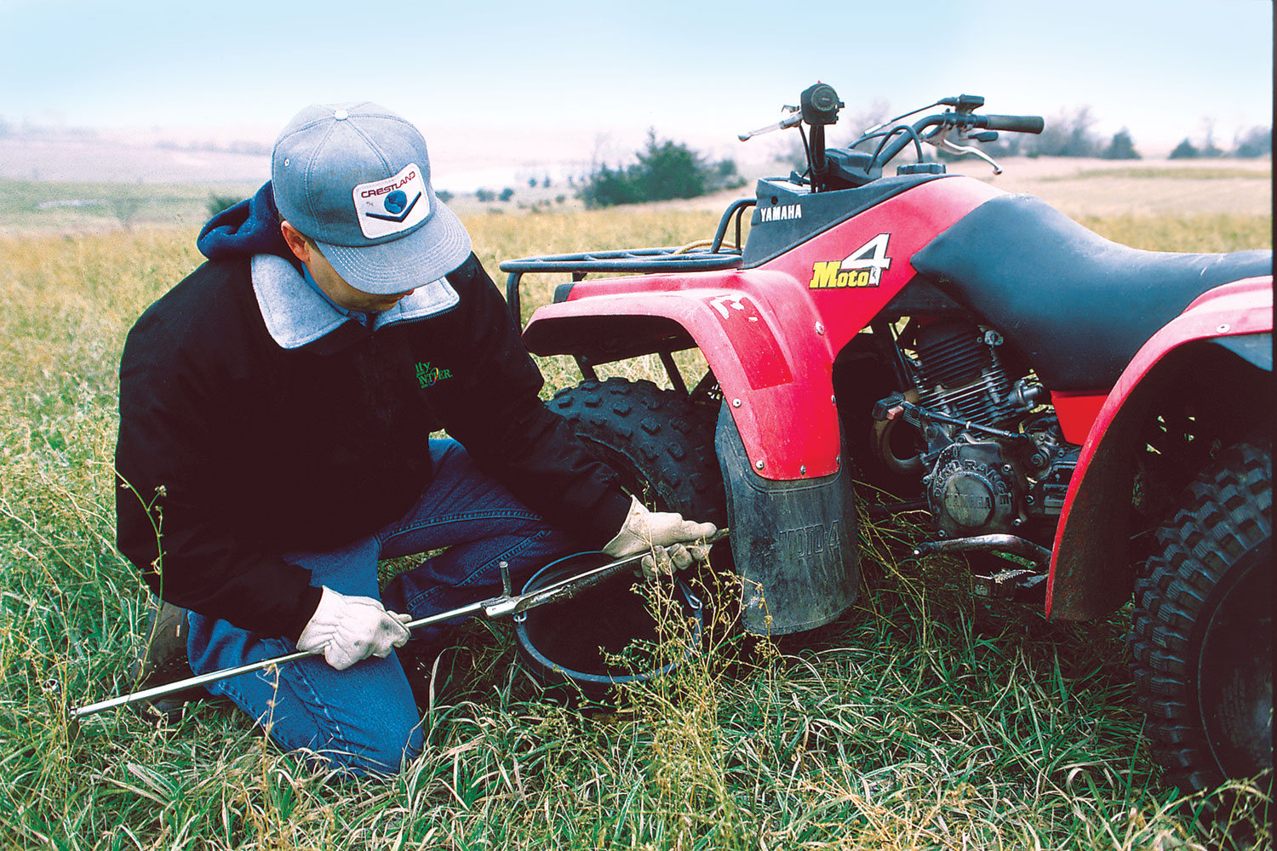
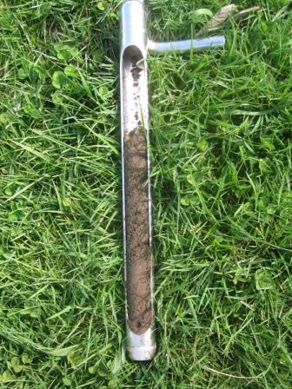
Soil samples are being taken from this pasture to determine how much fertilizer is needed to grow grass for animal grazing .

Slide 6
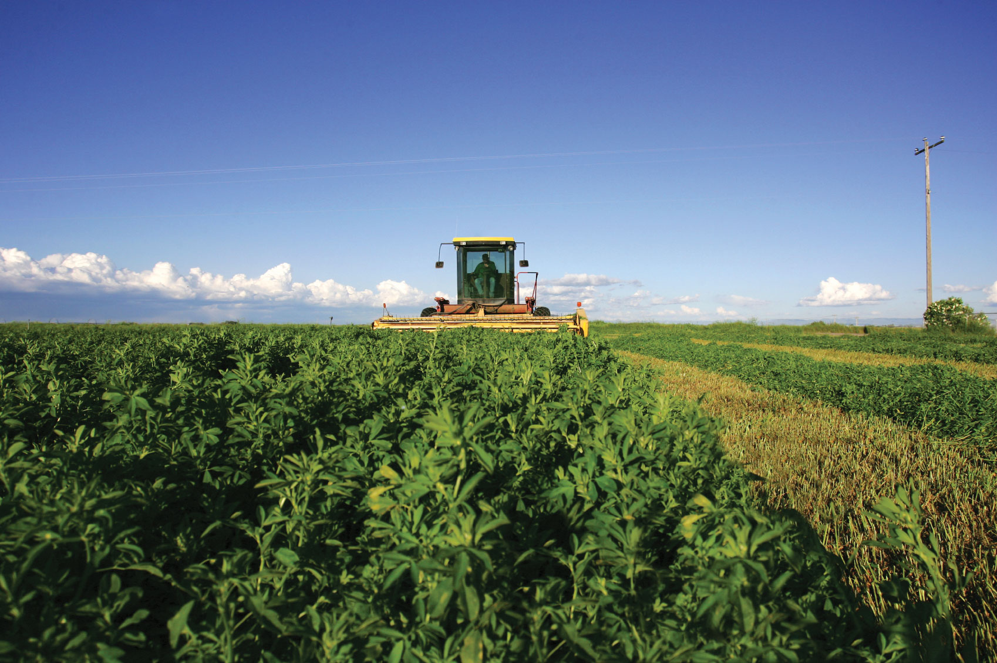
As the alfalfa in this field grows, it adds nitrogen to the soil. Bacteria in the plant’s roots remove nitrogen from the air and then release it into the soil.

Slide 7
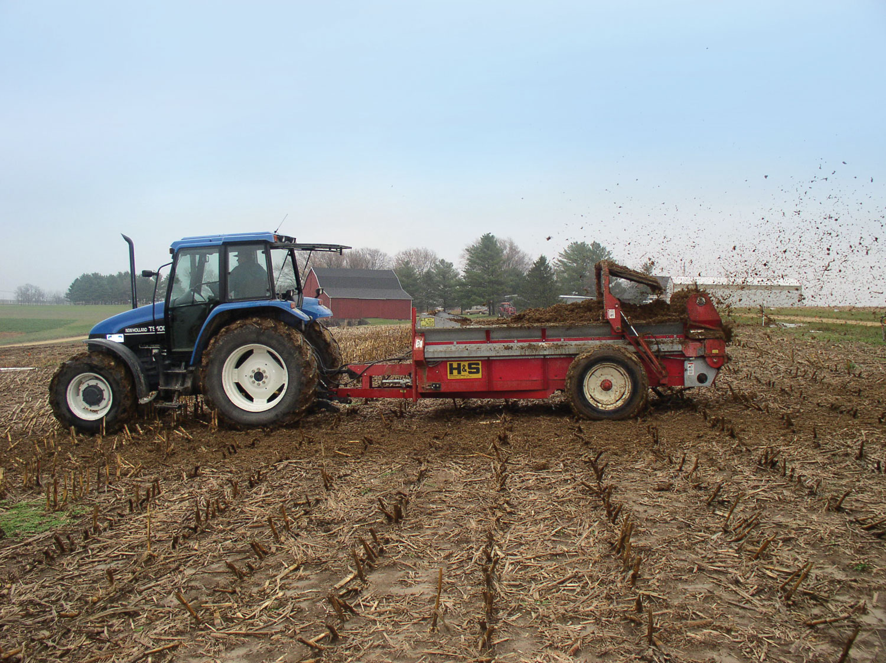
Compost made from animal wastes (manure) makes an excellent organic fertilizer, as does sludge from sewage treatment plants.

Slide 8
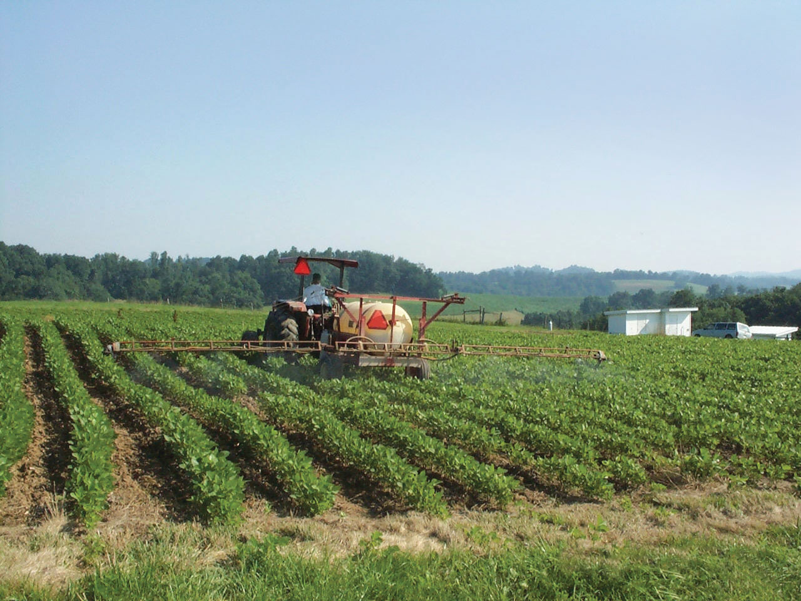
Nitrogen from the atmosphere can be processed into fertilizer.
Earth’s atmosphere is 78% nitrogen.

Slide 9
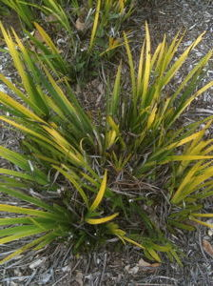
Soil Fitness Test
Plants can lack nutrients
just as we can.
If a soil does not provide enough nutrients, crops will not grow well.
So soil scientists test the soil to determine its fertility.
They can also tell a lot about a
soil’s fertility by just looking at a crop for
symptoms of nutrient deficiencies.

Slide 10
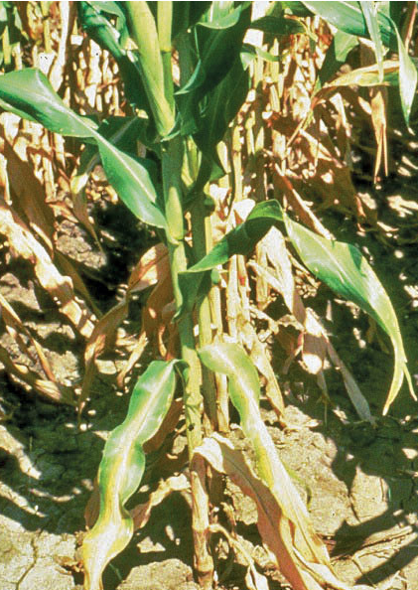
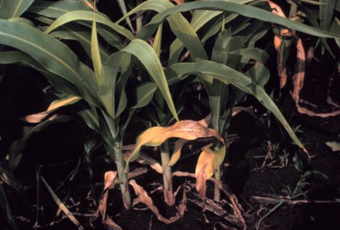
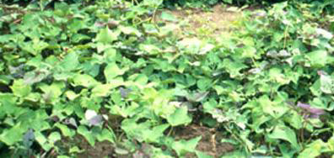
Nitrogen Deficiency
Yellowing of leaves, first seen in younger leaves. Stunted growth.
Corn
Sweet Potato

Slide 11
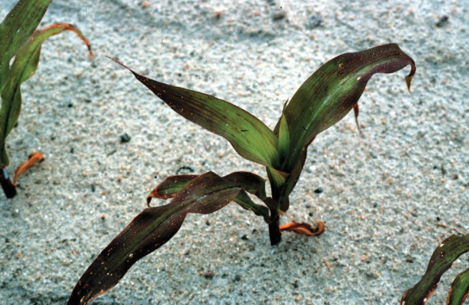
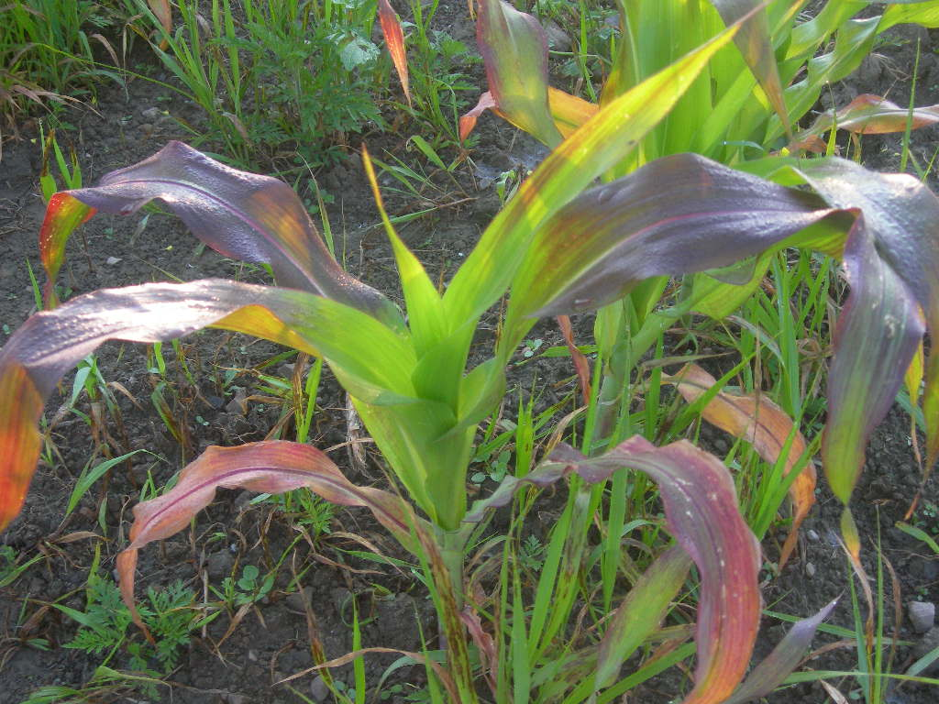
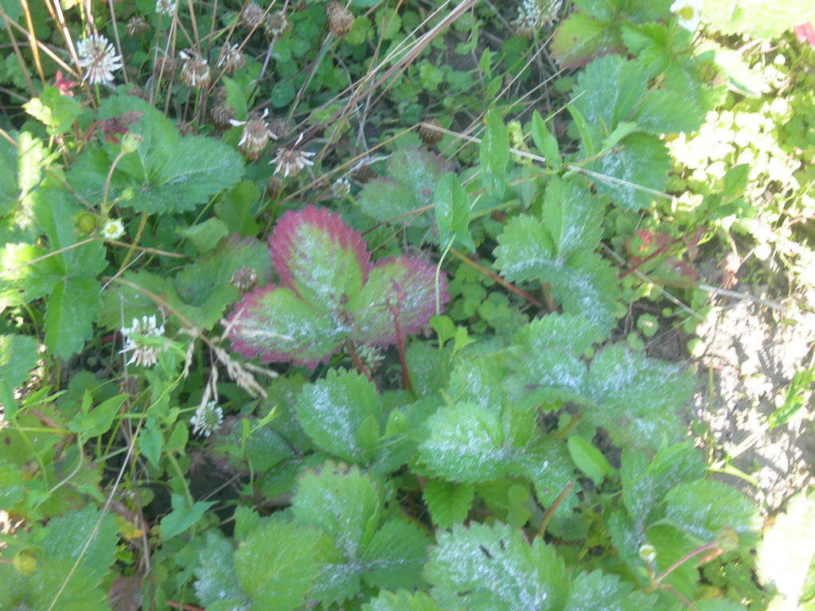
Phosphorus Deficiency
Stunted growth, dark bluish green leaves, purple veins on underside of leaves
Corn
Strawberry

Slide 12
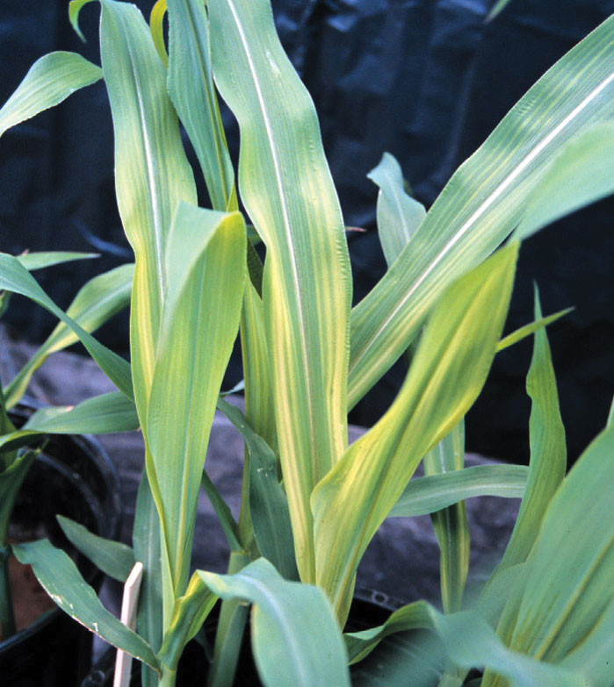
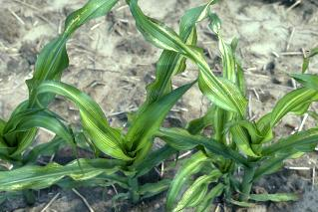
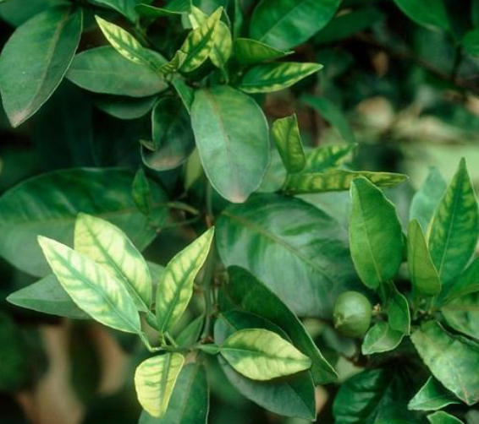
Zinc Deficiency
Yellow, light green-white
coloring, plants are stunted
Corn
Citrus

Slide 13
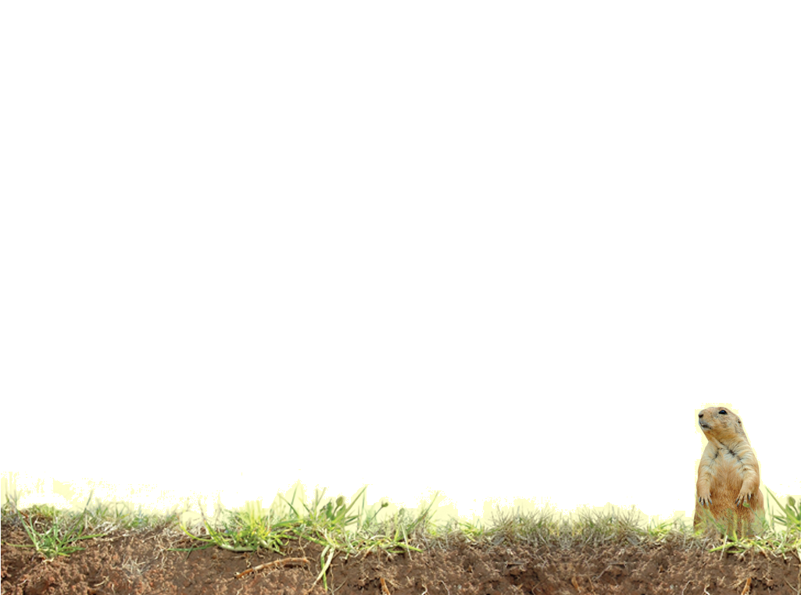
Vocabulary
Compost
Deficiency
Fertility
Fertilizer
Macronutrients
Minerals
Nitrogen
Nutrients
Phosphorus
Potassium
Uptake
Notes:
Definitions found in Scoop Book

Slide 14
Vocabulary
Calcium – macronutrient essential to plant growth and function, important to moving Nitrogen
Iron – micronutrient responsible for plant photosynthesis and growth
Magnesium – macronutrient essential to plant growth and phosphorus uptake
Micronutrients – essential nutrients not needed in a large amount, but still very important
Soil testing - the process to find out what kind of nutrients a soil has.
Notes:
Definitions not found in Scoop Glossary

