Slide 1
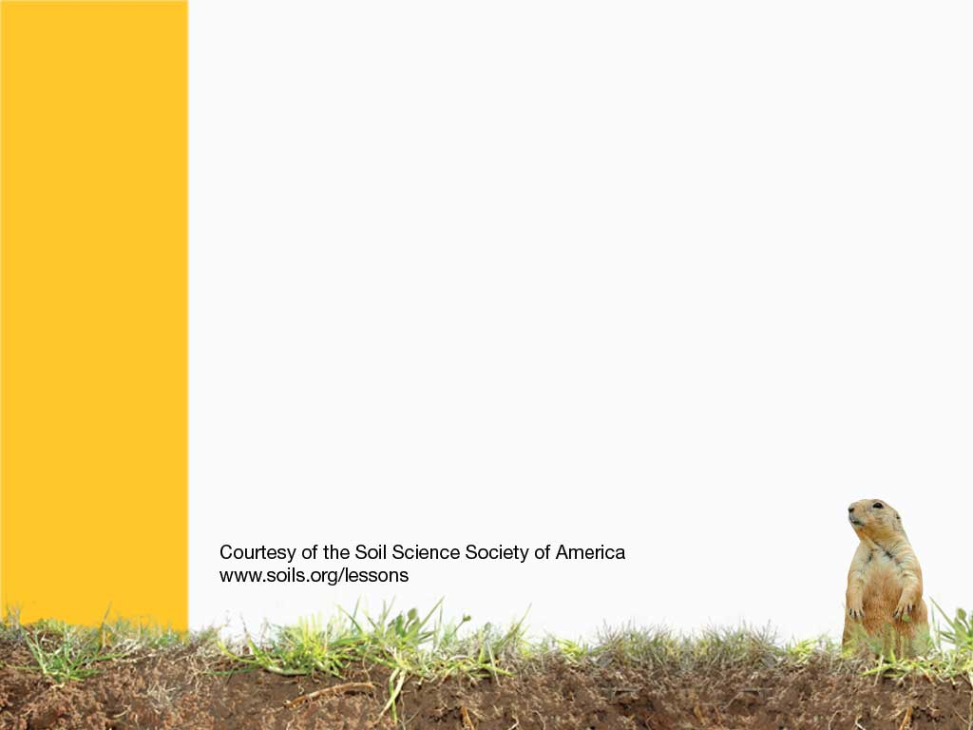
Sizing Up Soils

Slide 2
If you have ever made a mud pie or sandcastle, you know:
Each type of SOIL you touch feels different…
BECAUSE
SOIL has different TEXTURES
Notes:
Soil has texture

Slide 3
Soil TEXTURE
Is the PERCENTAGE of
SAND
SILT
and
CLAY
particles
Notes:
What are the different particles that make up soil?
Sand, Silt, and Clay
How is a sandy soil different from a clay soil?
Clay soils tend to not let water infiltrate very fast, and they remain wetter longer. Sandy soils are much bigger then clay soils, and lets water drain through very quickly. Plants need water, so in a sand, they cannot get the water they need to drink. In a clay, plants sometimes get TOO much water, and they can also die.

Slide 4
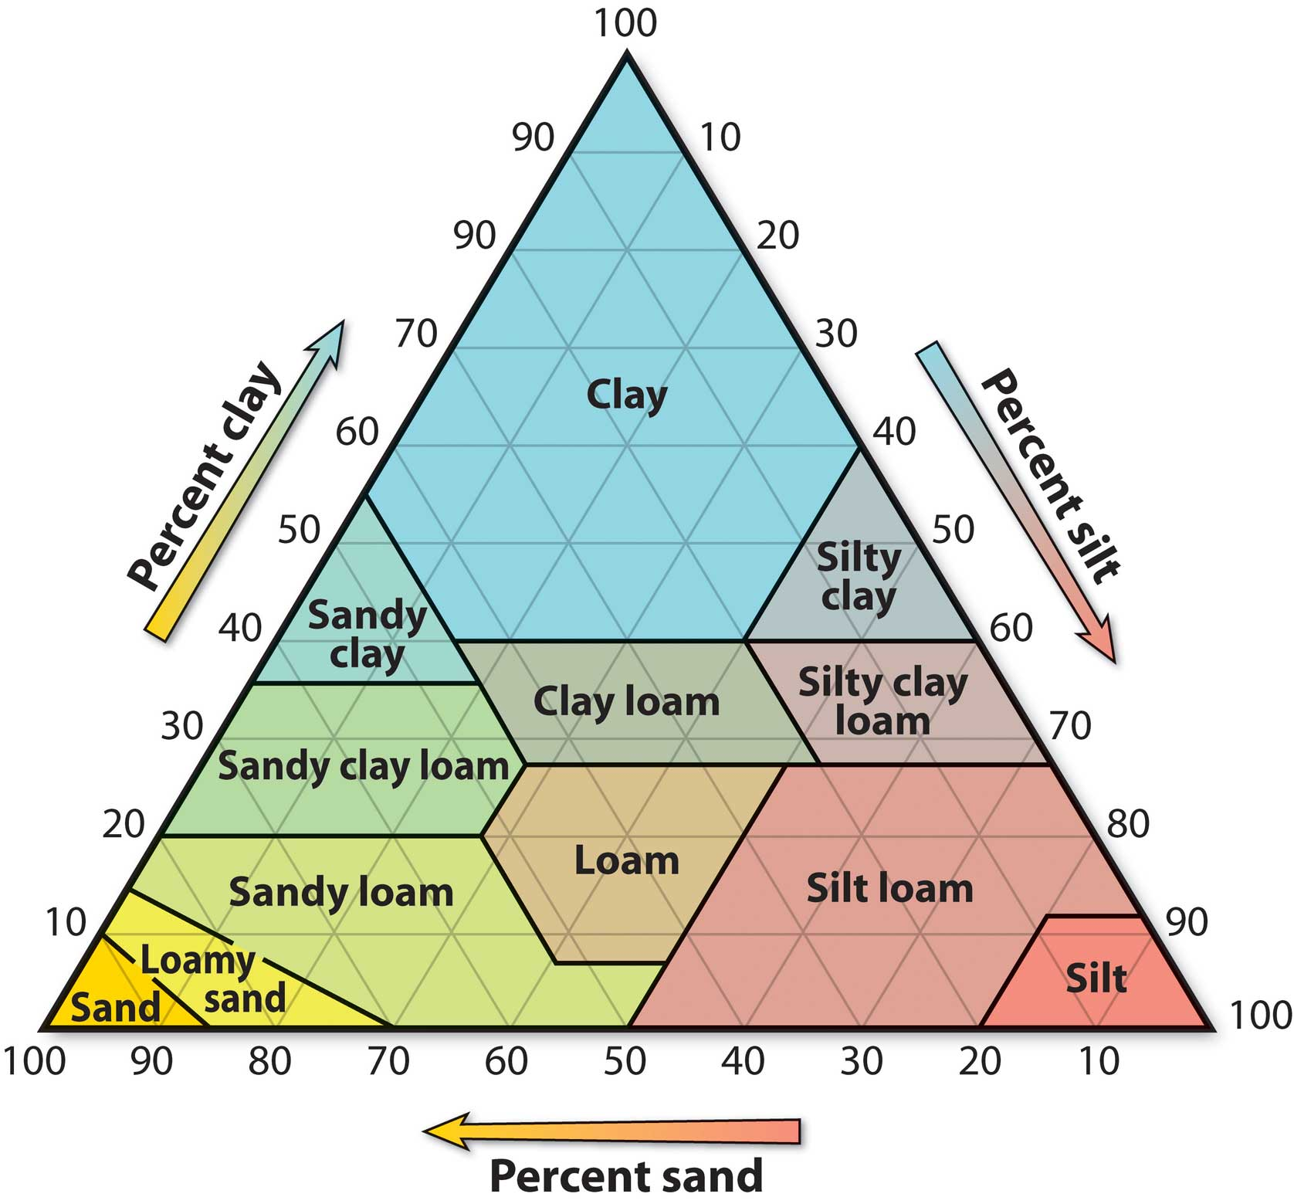
Soil TEXTURE can be found using a TEXTURE TRIANGLE
Notes:
The three different particles combined together at different ratios into a triangle shape to create 12 different soil textures.

Slide 5
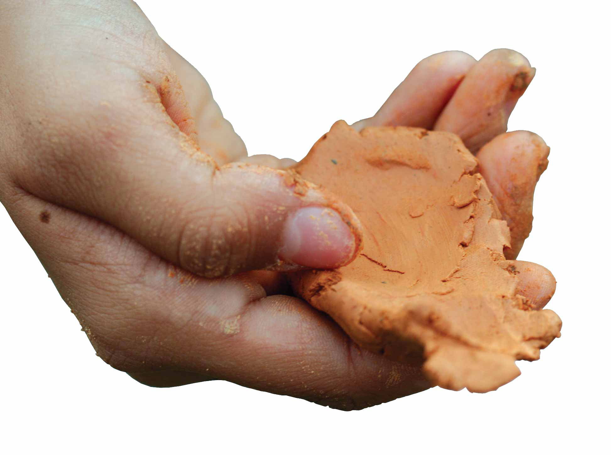
The best way to learn this is to get out and FEEL many different types of soil.
Notes:
You can feel texture, and guess what is in the soil. What does sandy soil feel like? Gritty vs Slippery

Slide 6
All of these PARTICLES fit together in different ways…
They form the
BUILDING BLOCKS of soil
This is the soil’s STRUCTURE…
And they come in different SHAPES called PEDS
Notes:
Soil has many different types of structure. Peds are the clumps of soil that form building blocks of structure. In between PEDS, there are PORES, which are spaces between the peds. Pores are very important for moving water through the soil, and having space to grow roots through the soil.

Slide 7
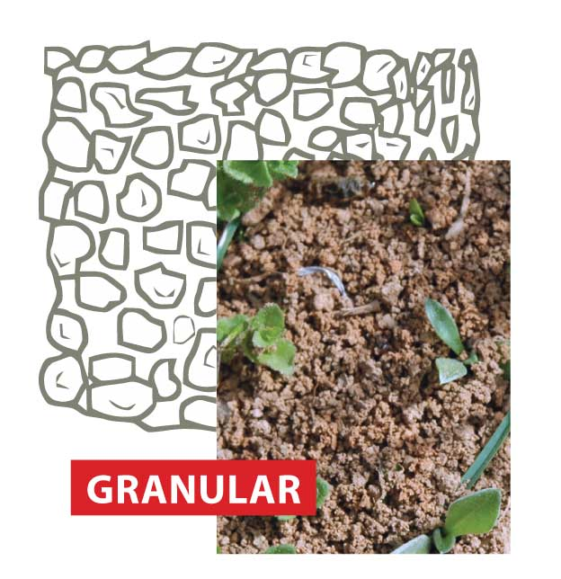
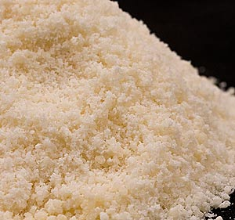
Granular soil structure…
… looks like Parmesan Cheese
Notes:
Makes the best farmland! This has lots of pores, and is found in great gardening soil. This is the most desirable soils to have on the soil surface. Looks like cookie crumbs or parmesan cheese.

Slide 8
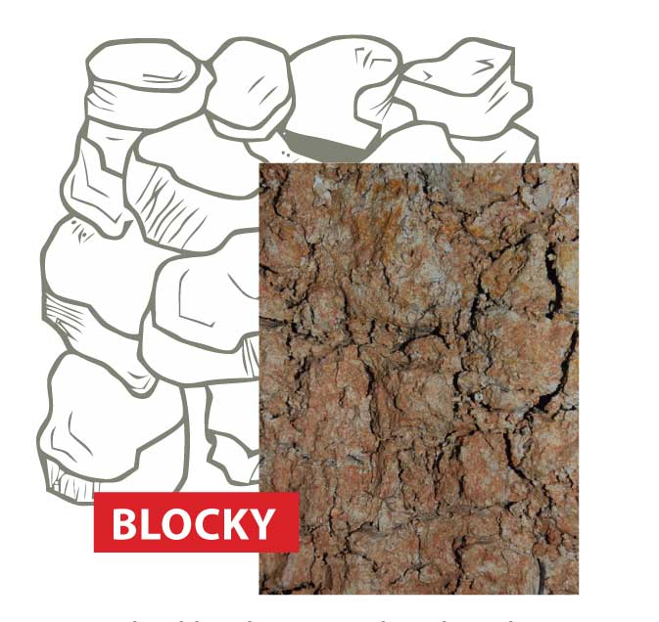
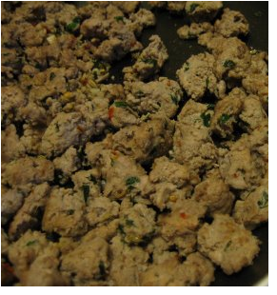
Blocky soil structure…
… looks like Italian sausage
Notes:
These shapes are cube like, and either have sharp or smooth edges. They are commonly found in the SUBSOIL.

Slide 9
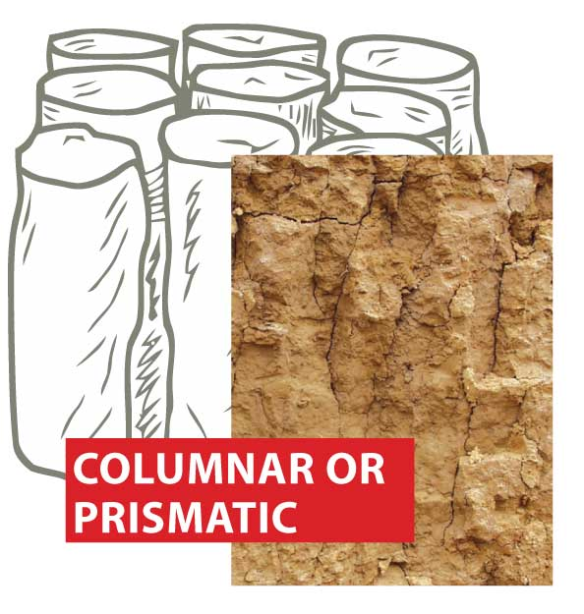
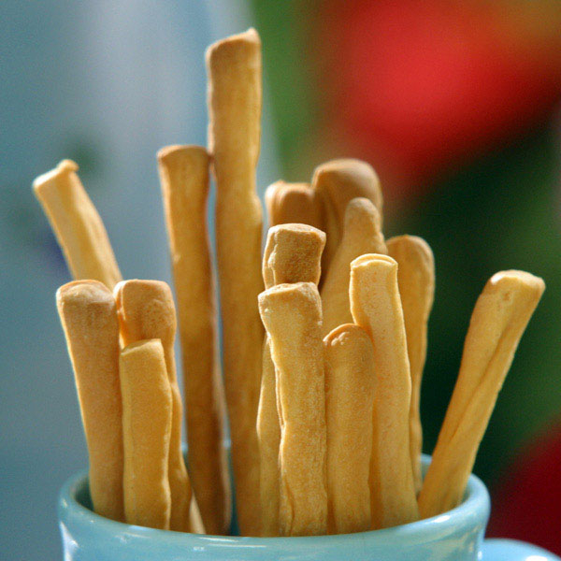
Columnar or Prismatic Structure…
… look like breadsticks
Notes:
These peds are tall vertical shapes, and they have less pores then the blocky structure.

Slide 10
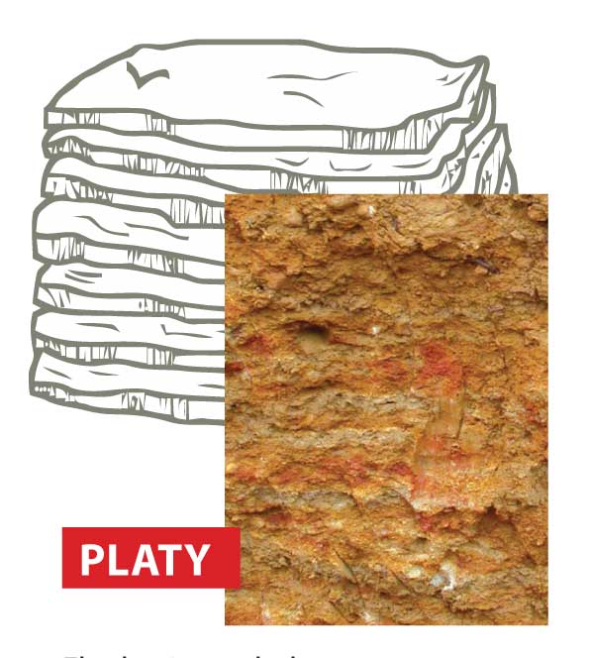
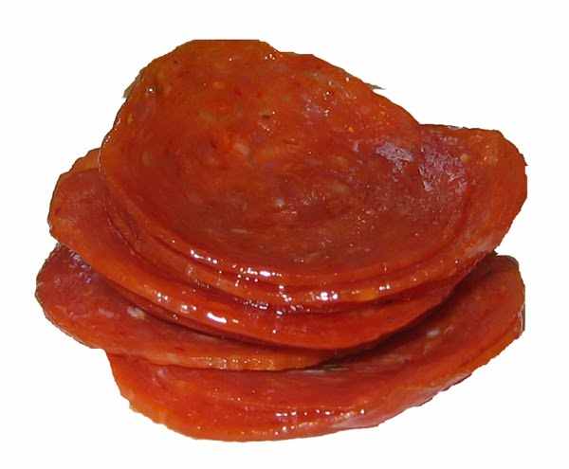
Platy Structure…
… look like a stack of pepperoni’s
Notes:
These are flat horozontal plates. Water can move slower through the plates in comparison to the blocks, especially if there is a lot of clay.

Slide 11
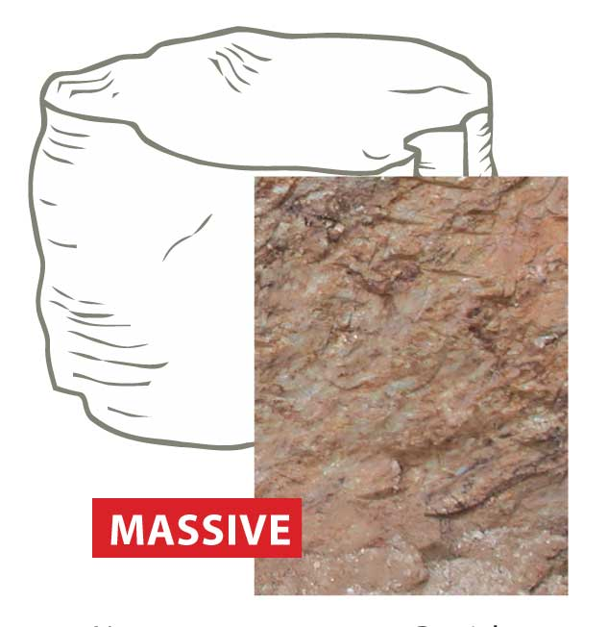
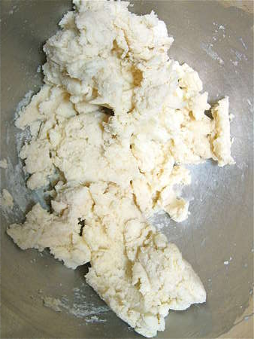
Massive Structure…
… looks like uncooked pizza dough
Notes:
Not very useful for farmland. This can happen if a clay soil is repeatedly squished and crammed together until there are very little or no pores. Water cannot move through this layer, and it usually means soil is in a really bad shape. This can sometimes be found at construction sites.

Slide 12
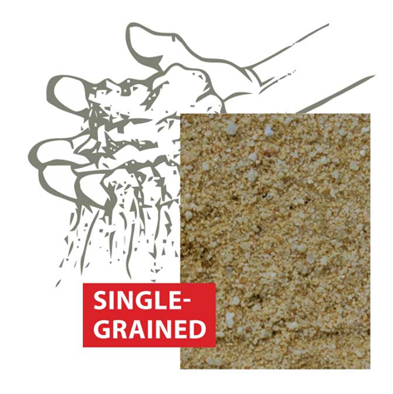
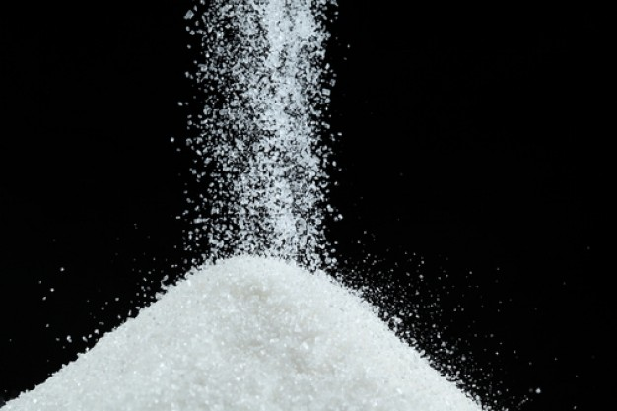
Single Grained Structure…
… is like a pile of salt
Notes:
This soil has no peds, and looks like a sandbox, or piles of salt. All particles usually stay separate. This can be found at the local beach, or on sand dunes.

Slide 13
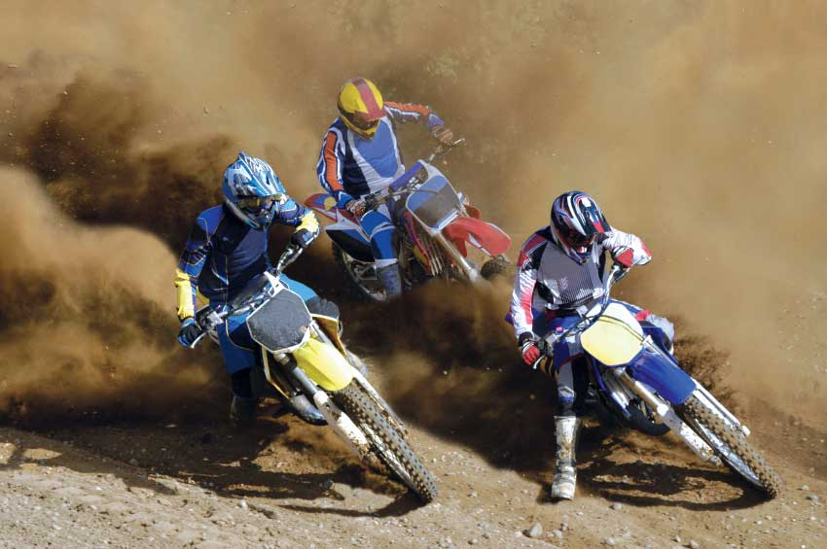
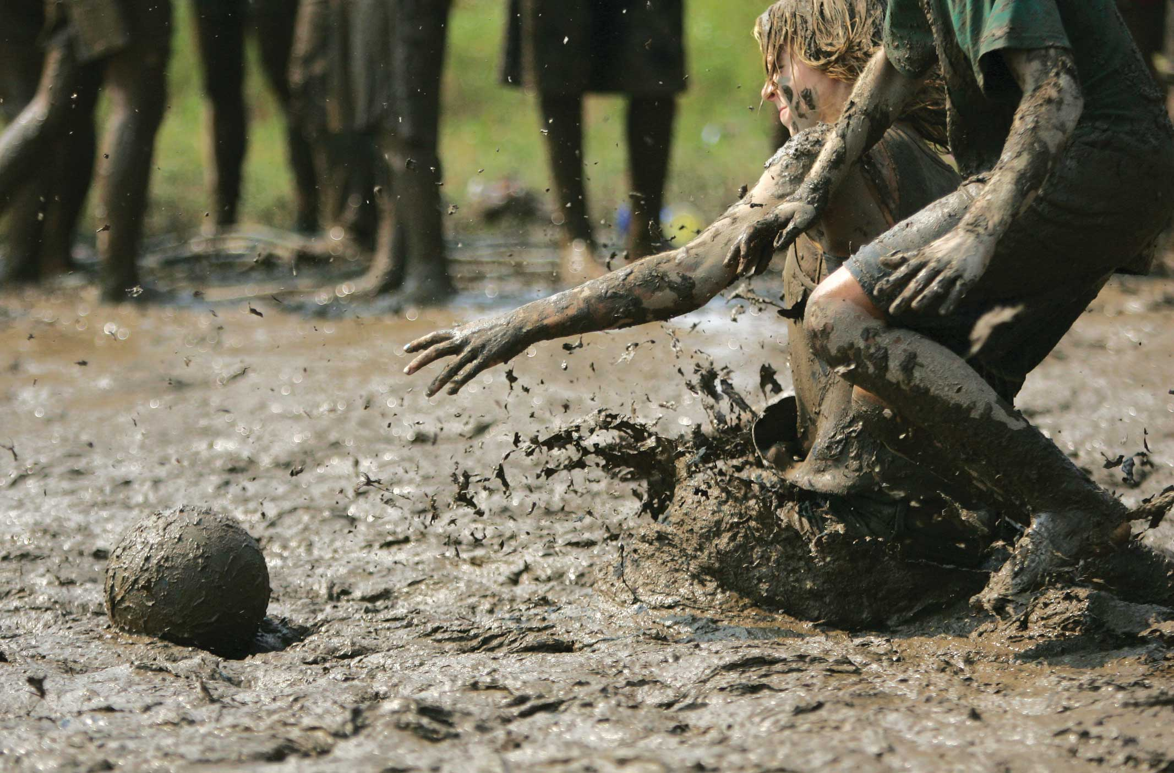
Soils can be damaged
BY HUMANS!
TRAFFIC destroys structure
Clay soils do not DRAIN WELL, water pools on the SURFACE, and structure gets destroyed
Notes:
Soils can be damaged. Clay soils can get messy, and sandy soils drain well, but move easy, which is why people should avoid playing sports on wet fields.

Slide 14
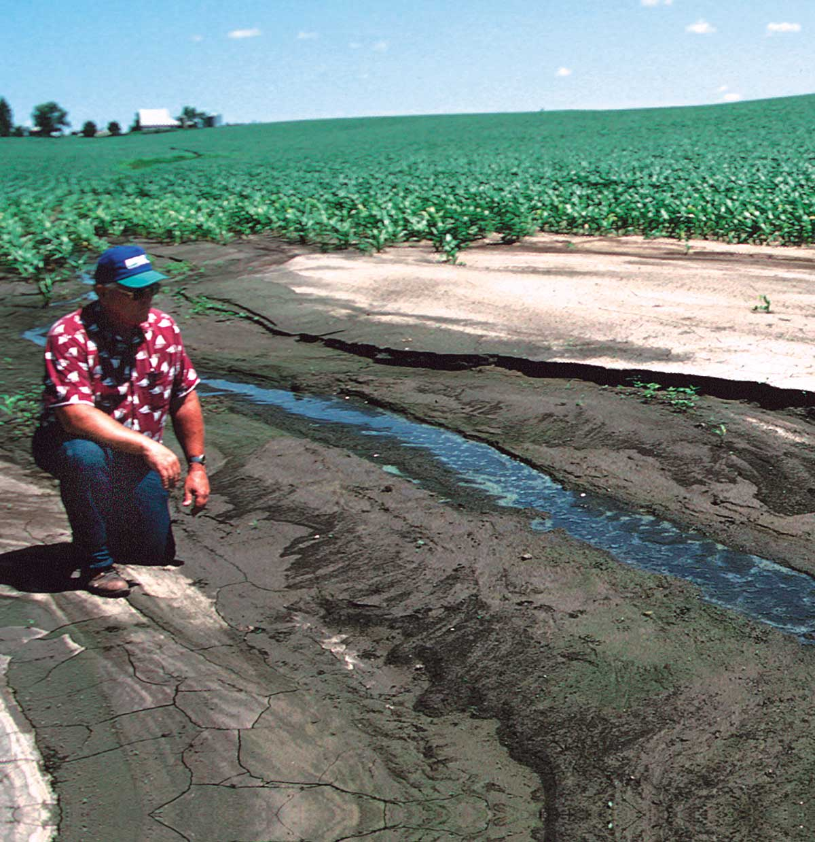
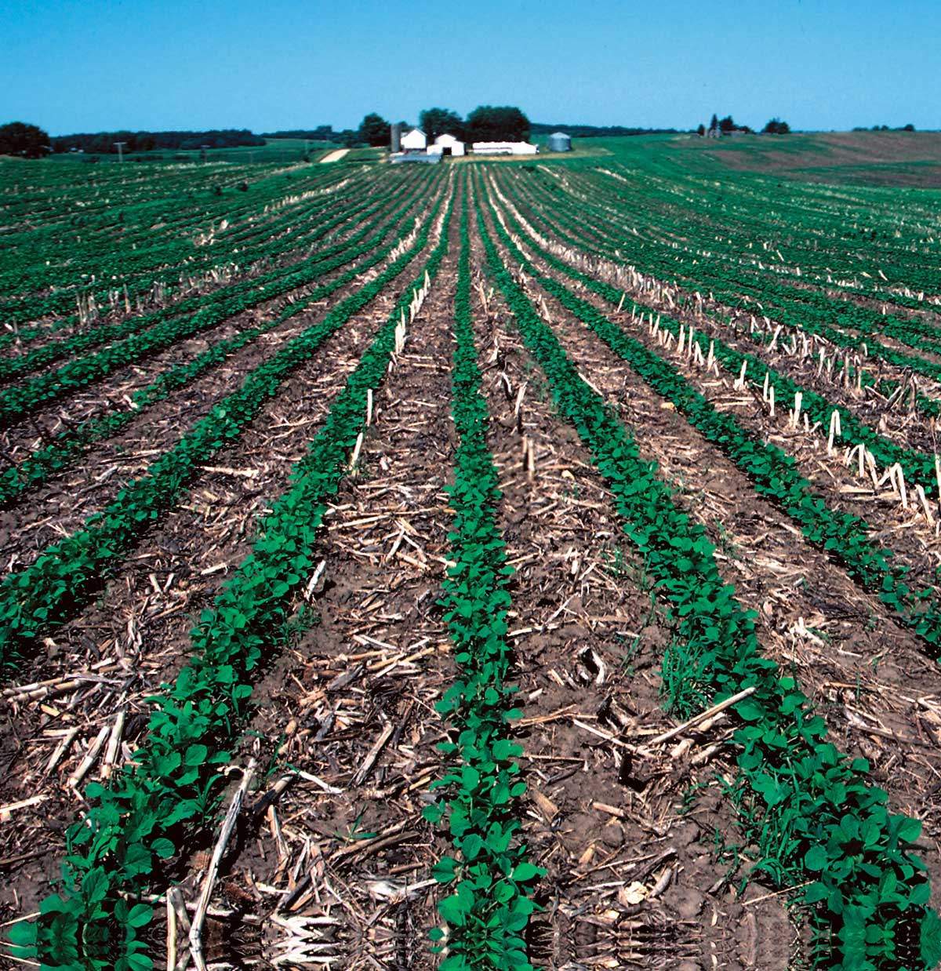
Good STRUCTURE = Healthy Soils
Keep It Covered!
Notes:
Humans change soil. Good Structure = healthy soil. KEEP IT COVERED. The best way to keep soils healthy is to keep them covered. What benefits does this provide?
Erosion control: There are more roots to hold the soil down. Rain does not strike the surface of the soil, carrying with it loose soil particles.
Extra Plant Roots: Not only do they provide roots to hold soil in place, when they die, plant roots contribute to the creation of ORGANIC MATTER. Organic matter has ENZYMES that function as a glue to hold soil structure together.
Why would you not keep them covered?
In some parts of the country, it causes the soil to be too wet in the sprig, especially under clay soils.
2. In some parts of the country, it is too cold, and soils take too long to warm up to get a decent crop in.

Slide 15
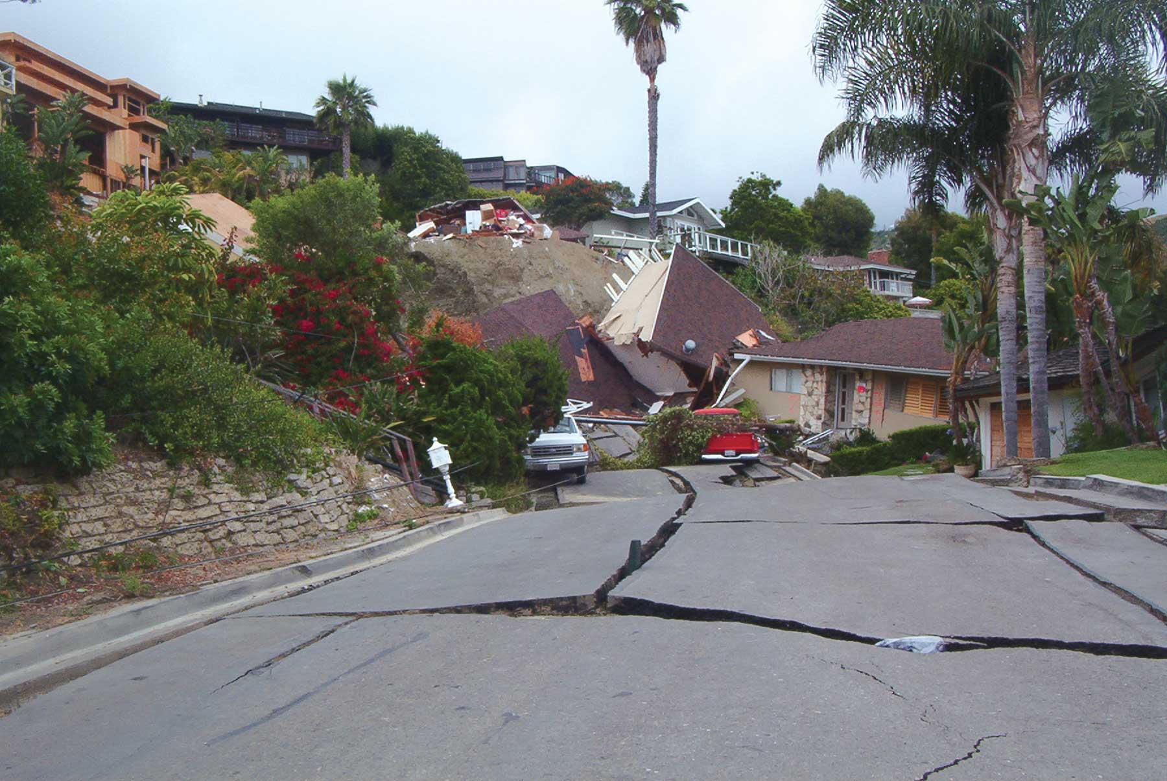
Notes:
Texture and structure work together to form behavior. We look at soil, and can decide where the best places are to build houses, AND avoid building houses or roads in areas that are likely to slide.

Slide 16
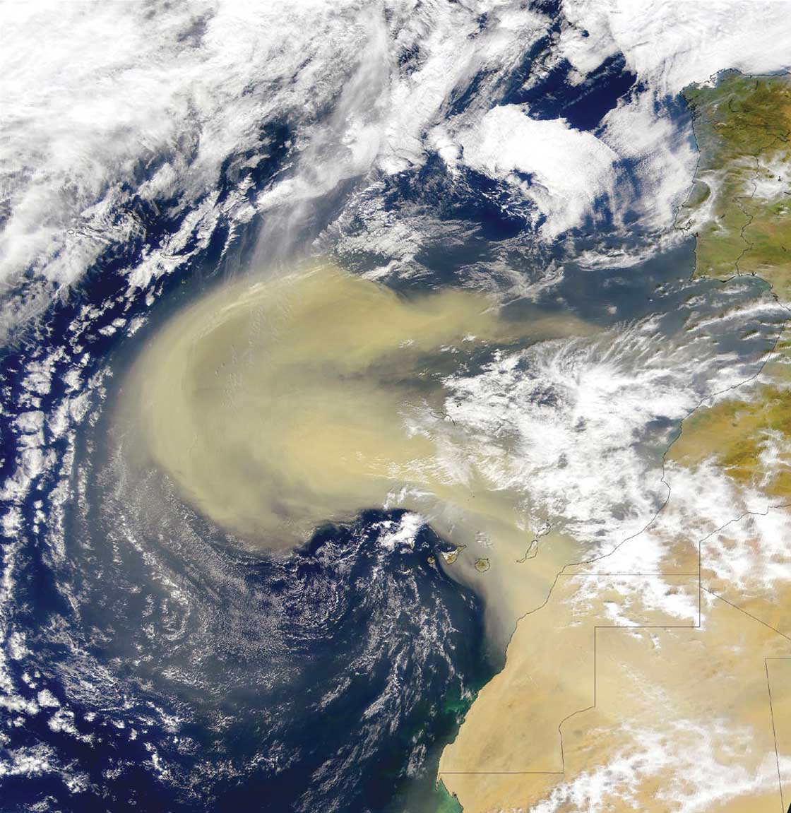
DUST across the sea!
Windstorms in the Sahara Desert carries dust thousands of miles across the Atlantic.
Why is this bad?
Why is this good?
Notes:
IT is good for people in the Amazon and Southeast US, as the Saharan dust adds nutrients and soils to the Amazon. It is bad for those in Africa, who lose these nutrients and their topsoils. Dust in the air also can cause diseases.

Slide 17
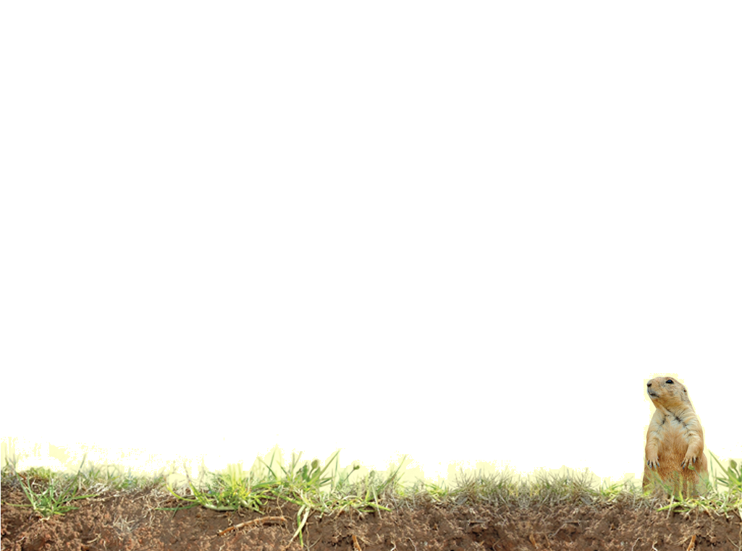
Vocabulary
Granular
Prismatic
Platy
Massive
Single Grain
Enzyme
Soil Texture
Soil Structure
Sand
Silt
Clay
Blocky
Columnar
Erode
Peds
Notes:
These words are defined in Soil! Get the Inside Scoop

Slide 18
Vocabulary
Soil particles – the individual building blocks that make up soil. The sand, silt, and clay
Soil traffic – any time a tractor, vehicle, or even a person moves over the soil surface and disrupts it.
Notes:
These words are not defined in Soil! Get the Inside Scoop. The definitions are below.

