Slide 1
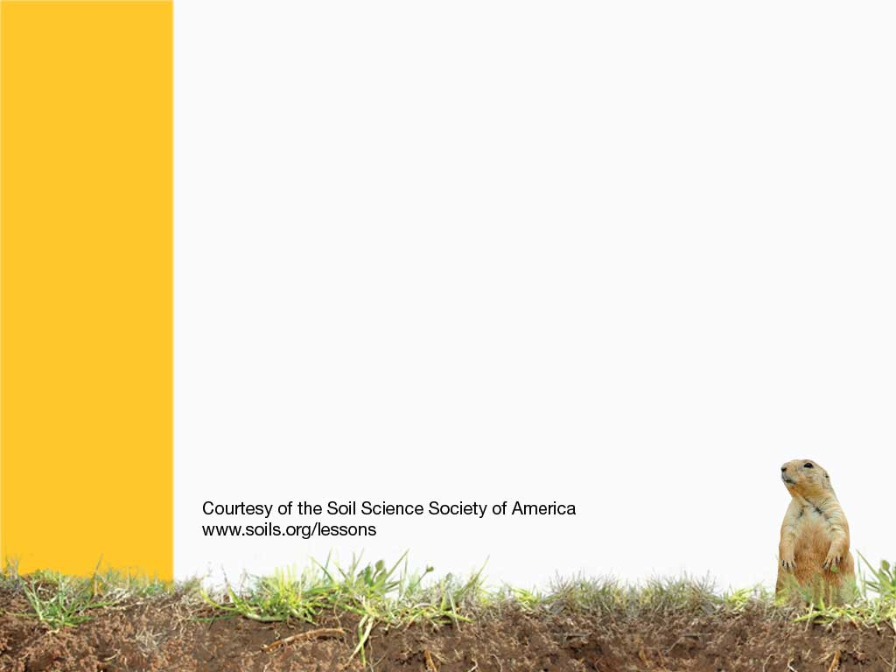
Soil is NOT dirt!
It is so much more than that…

Slide 2
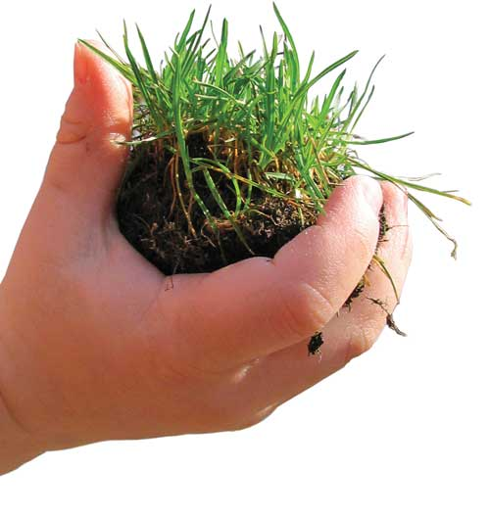
Dirt gets under our fingernails, and on our clothes…
…then what is SOIL?
How does it differ from dirt?
Notes:
Where do you find dirt and where do you find soil? That’s a big difference!
Which one is useful and which is not? We get rid of dirt but preserve soil.

Slide 3
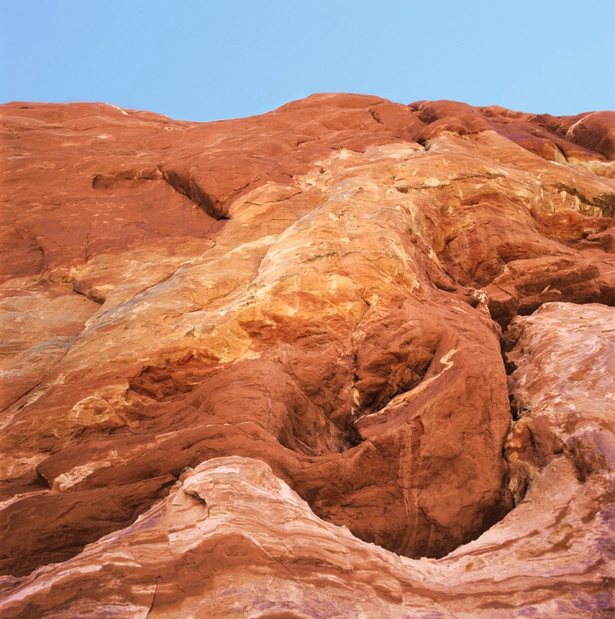
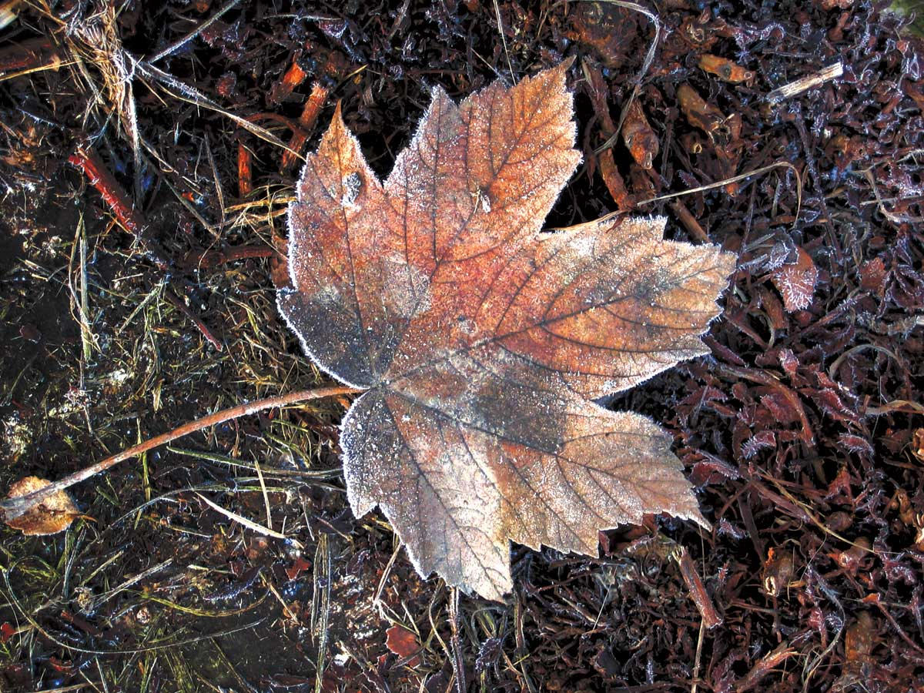
What is SOIL made up of?
MINERALS
from rocks
AIR
WATER
ORGANIC MATTER
Notes:
What on earth is soil? What is the soil made up of?
--- Minerals (from rocks)
--- Air (let’s gases get in and out of soil)
--- Water (keeps reactions going and makes/helps plants and organisms grow)
--- Organic matter (dead tissue of plants and countless organisms)

Slide 4
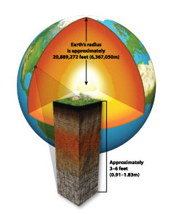
SOIL is the SKIN of the earth!
We can’t live without it
Most of our FOOD comes from plants in the SOIL.
Part of the OXYGEN we breathe comes from plants.
Most of the WATER we drink and use is cleaned by SOIL.
Notes:
Why is the soil so important to us? We cannot live without it.
Plants grow in soil and animals feed on these plants and we (or feed on both
Soil filters water to keep it clean.
We build on soil and with stuff from soil, like clay blocks, stones and rocks!
Plants growing in soil provide us with oxygen that we breathe.
Soil provides shelter for many animals and insects.

Slide 5
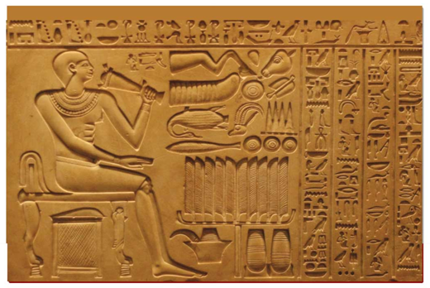
It is important to history and culture!
People worshipped gods or goddesses of soil.
Early laws were written on clay tablets.
Adam means soil or earth in Hebrew.
Notes:
People worshipped gods and goddesses of soil. Adam came from the soil, and the word Adam, in Hebrew, means soil, or earth.

Slide 6
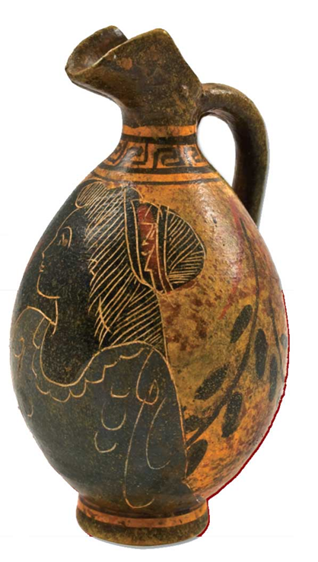
Clay has been used to make POTS and URNS.
Some were decorated with PAINTS from soil.
Notes:
People have shaped clay pots for a long time.

Slide 7
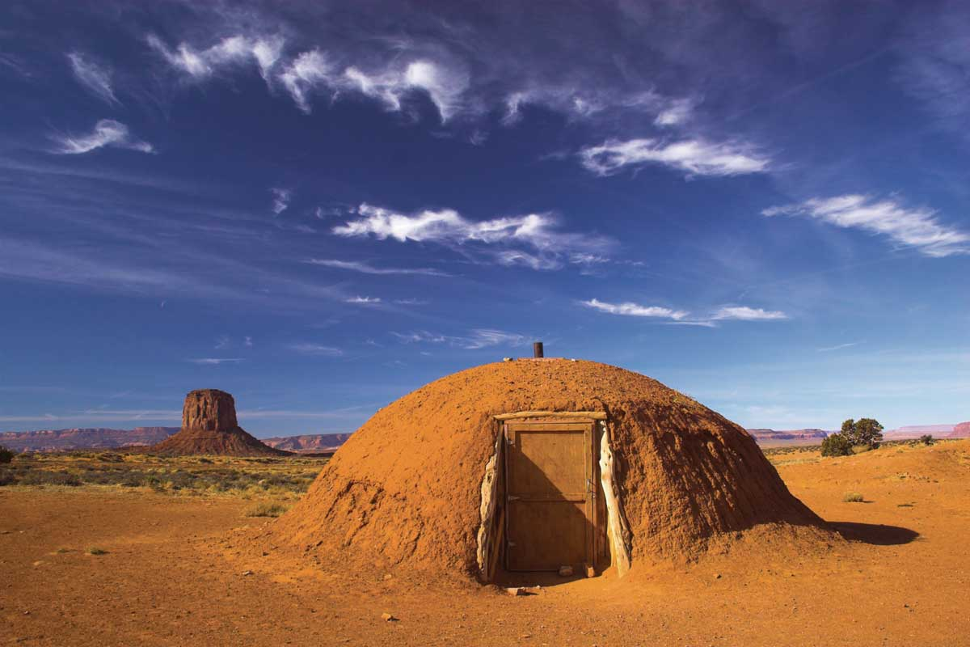
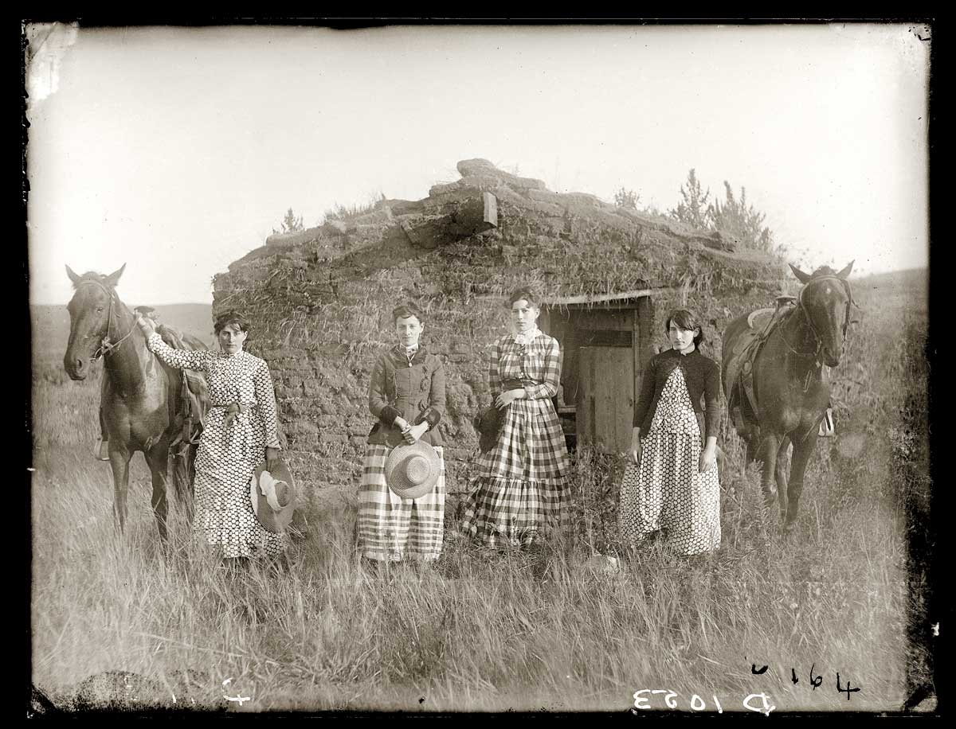
People have made houses out of soil for centuries.
This includes modern day bricks, concrete, and ceramic tiles, which all come from SOIL.
Earthen homes of the Navajo Nation
Prairie Houses out of SOD bricks
Notes:
We build our houses out of soil, sod. Brick and cement are also made out of soil in parts

Slide 8
Earth/Soil were some of the first words ever written.
Stories about soil, farming, and land management were some of the first things written down.
Earth/Soil usually means life!
Notes:
People can paint pictures of soil, and write and sing about soils. Earth and soils were some of the first words ever written. And has been used in books: Grapes of Wrath
Dracula
Paradise Lost
And poems by famous people like:
Isaac Newton
Charles Darwin
Benjamin Franklin

Slide 9
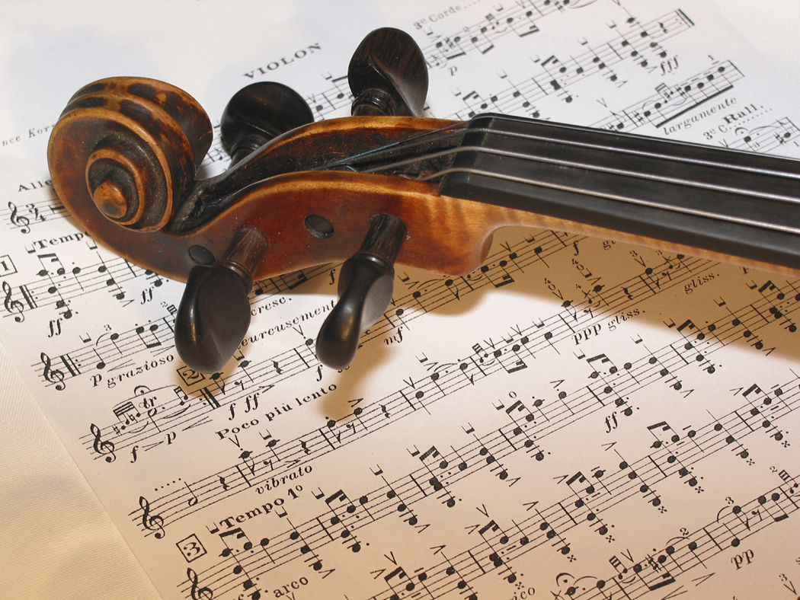
Songs and poems have also been written that mention soil.
Including folk music, rock music, country music, and bluegrass.
Notes:
From Scientists:
Soil Order Song: http://www.youtube.com/watch?v=NGTsl2rOywQ
Erosion Song: http://www.youtube.com/watch?v=ElzOll-zjHU&feature=related
Topsoil Song: http://www.youtube.com/watch?v=J6l2dMdAx5M&feature=related
Country Music:
Two Feet of Topsoil: Brad Paisley http://www.youtube.com/watch?v=EzwLSlosswY
Folk Songs:
Dust Bowl Children: Allison Krauss & Union Station http://www.youtube.com/watch?v=z9GvHSF0JYc
Dust Bowl Blues: Woody Guthrie http://www.youtube.com/watch?v=jQYKJaWuj0Y
Rock Music
Diggin in the Soil: Fury in the Slaughterhouse: http://www.youtube.com/watch?v=BSdZXTG1Q3M
Dust in the Wind: Kansas: http://www.youtube.com/watch?v=tH2w6Oxx0kQ&ob=av3e

Slide 10
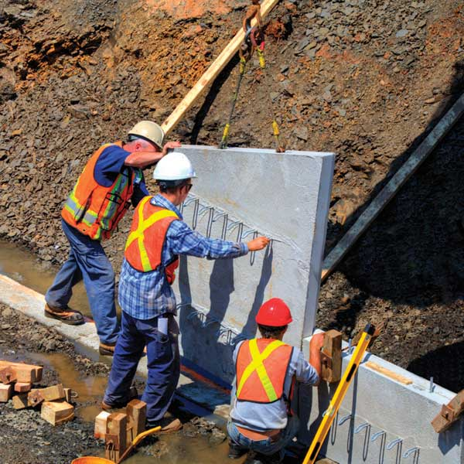
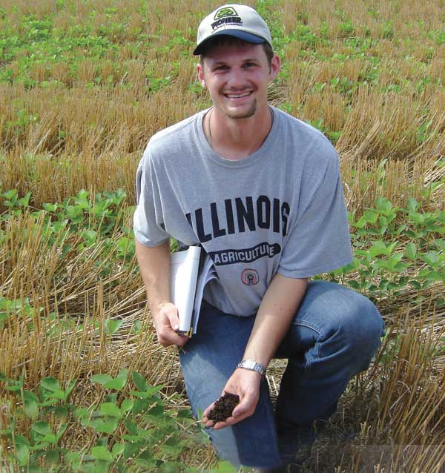
Why is soil IMPORTANT to…
Farmers?
Engineers?
Notes:
Soils are important in farming and engineering careers.

Slide 11
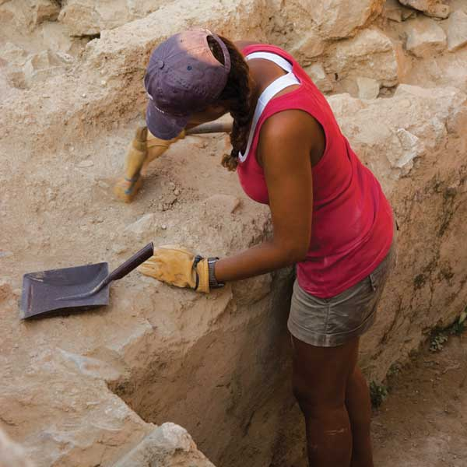
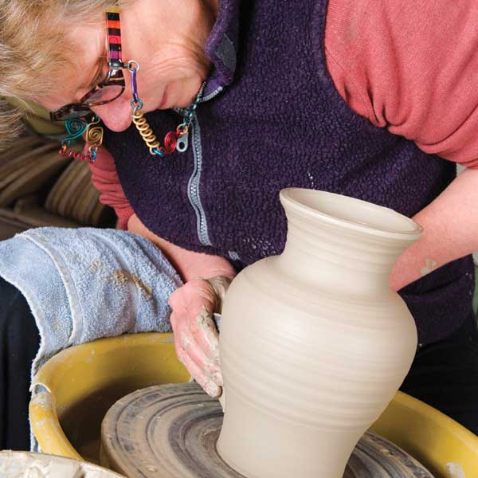
Artists and Potters?
Archeologists?
Notes:
Soil is important to archaeologists and potters

Slide 12
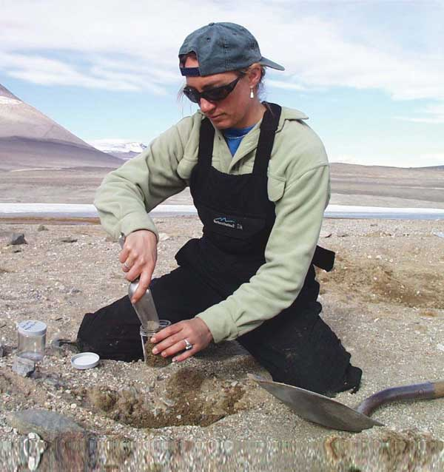
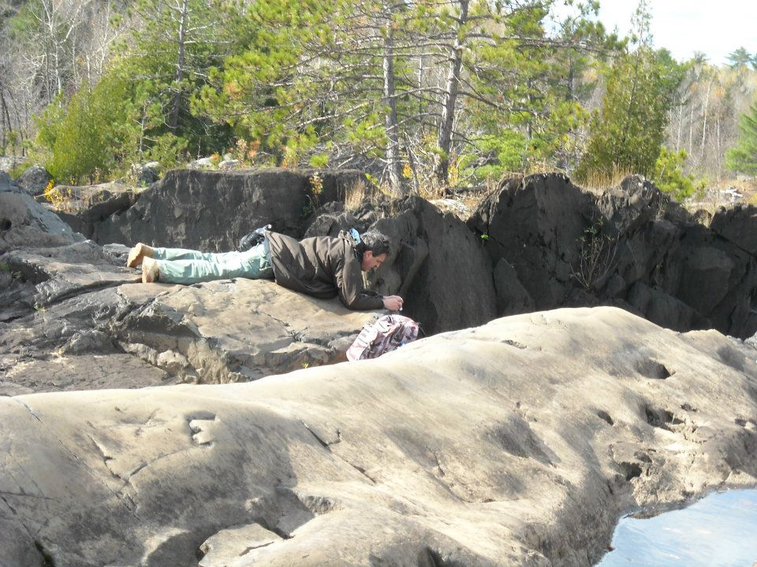
Geologists?
Ecologists?
Can you think of any other careers soils is important to?
Notes:
Soil is important to ecologists and geologists, and especially important to soil scientist.

Slide 13
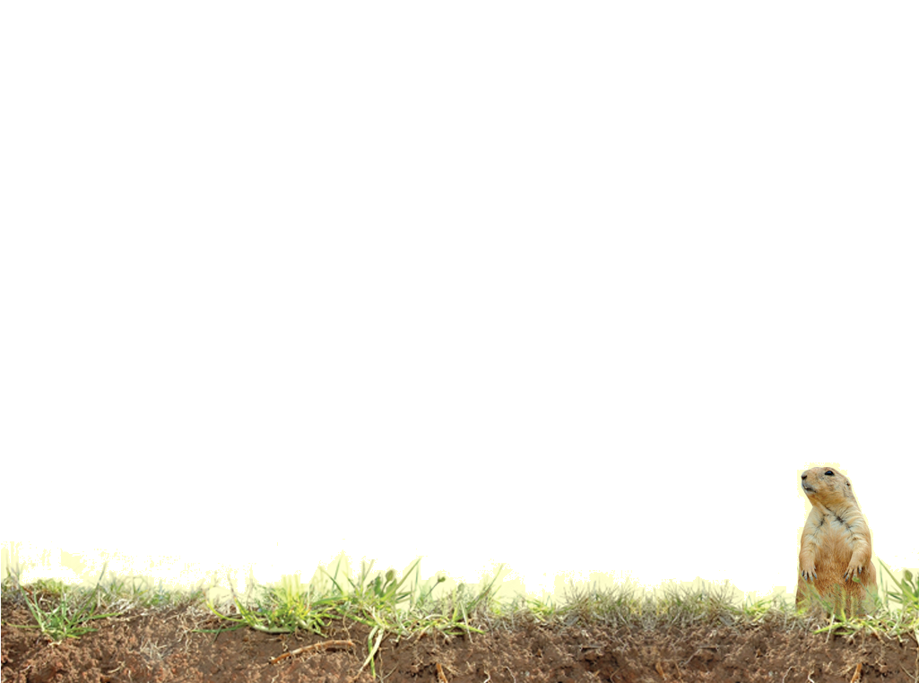
Vocabulary
Clay
Soil
Sod
Archeologist
Clay
Ecologist
Organic matter
Organisms
Minerals
Pedologist
Pores
Notes:
These words are defined in Soil! Get the Inside Scoop

Slide 14
Vocabulary
Geologist- a scientist who studies rocks, and how landscapes form
Soil Scientist – a scientist who studies soil, works with and knows much about soil.
Engineer – someone who went to the university to learn how to use science to design and make things that we can use, like building a house, car or toys.
Farmer – the person who makes a living by growing plants and raising animals for food.
Notes:
These words are not defined in Soil! Get the Inside Scoop. The definitions are below.

