Slide 1
Packed with Nutrients
Soil, Food, and Health

Slide 2
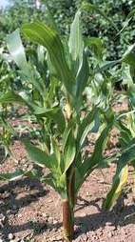
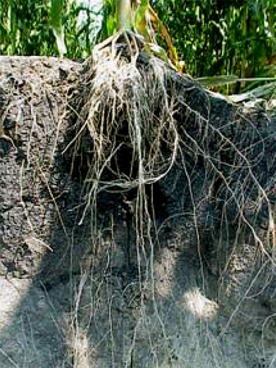
SOIL is the ultimate
source of nutrients
our bodies need
Nutrients come from plants growing in soil or from animals that eat plants.
As plant roots absorb water, they also
take in nutrients dissolved in the water
(nitrogen, calcium, iron, and others)
Notes:
How do plants get these nutrients? → plant roots take up water in the soil (soil water), nutrients are in soil water.

Slide 3
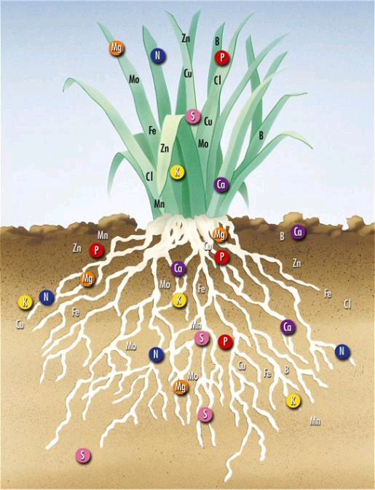
Notes:
Which mineral nutrients are important to plants?

Slide 4
Nutrient Facts: What is Good For Plants is Good for Us
Nutrient | For Plants | For Us
Nitrogen (N) | Leaf, stem, and root growth, green color (chlorophyll) | Proteins and amino acids needed for all our cells
Potassium (K) | Water Uptake, Improves Resistance to pests and disease | Healthy muscles and blood circulation
Calcium (Ca) | Leaf and root growth, cell division, nutrient uptake | Strong teeth and bones.
Magnesium (Mg) | Photosynthesis, activates enzymes | Heart and blood vessels
Phosphorus (P) | Flowers, fruits, and seeds. | Helps brain and nerves work
Sulfur (S) | Amino acids and photosynthesis | Amino acids and proteins for growth
Notes:
How do nutrients in plants provide nutrients to people?
Which nutrients needed by people?
What does a “nutrition label” tell you?
Where do animals used in human food get their nutrients

Slide 5
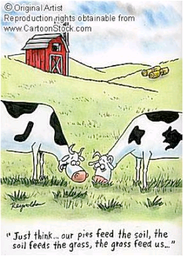
…..how do nutrients
get into the soil?
Nitrogen comes from organic sources.
Some nitrogen is released as organisms
decompose animal wastes and dead plants.
Notes:
Which nutrients in soil water come from organic materials in soil…from minerals in soil?

Slide 6
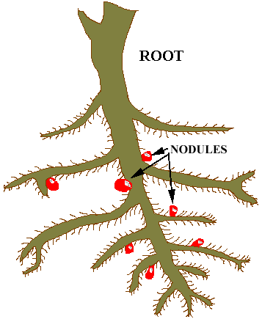
Some nitrogen comes from the atmosphere,
but only after bacteria converts it into Nitrogen forms that plants can use.
Bacteria in nodules attached
to roots (legumes)
N gas

Slide 7
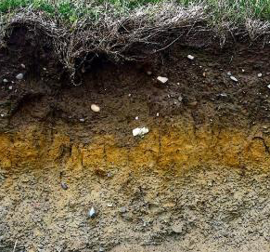
Other nutrients such as potassium, calcium,
and magnesium weather out from inorganic sources such as rocks.
Some nutrients like sulfur come from both organic and inorganic sources, including the atmosphere.

Slide 8
Vocabulary
Compost
Deficiency
Fertility
Fertilizer
Macronutrients
Minerals
Nitrogen
Nutrients
Phosphorus
Potassium
Uptake
Notes:
Definitions found in Scoop Book

Slide 9
Vocabulary
Calcium – macronutrient essential to plant growth and function, important to moving Nitrogen
Iron – micronutrient responsible for plant photosynthesis and growth
Magnesium – macronutrient essential to plant growth and phosphorus uptake
Micronutrients – essential nutrients not needed in a large amount, but still very important
Soil testing - the process to find out what kind of nutrients a soil has.
Notes:
Definitions not found in Scoop Glossary

