Slide 1
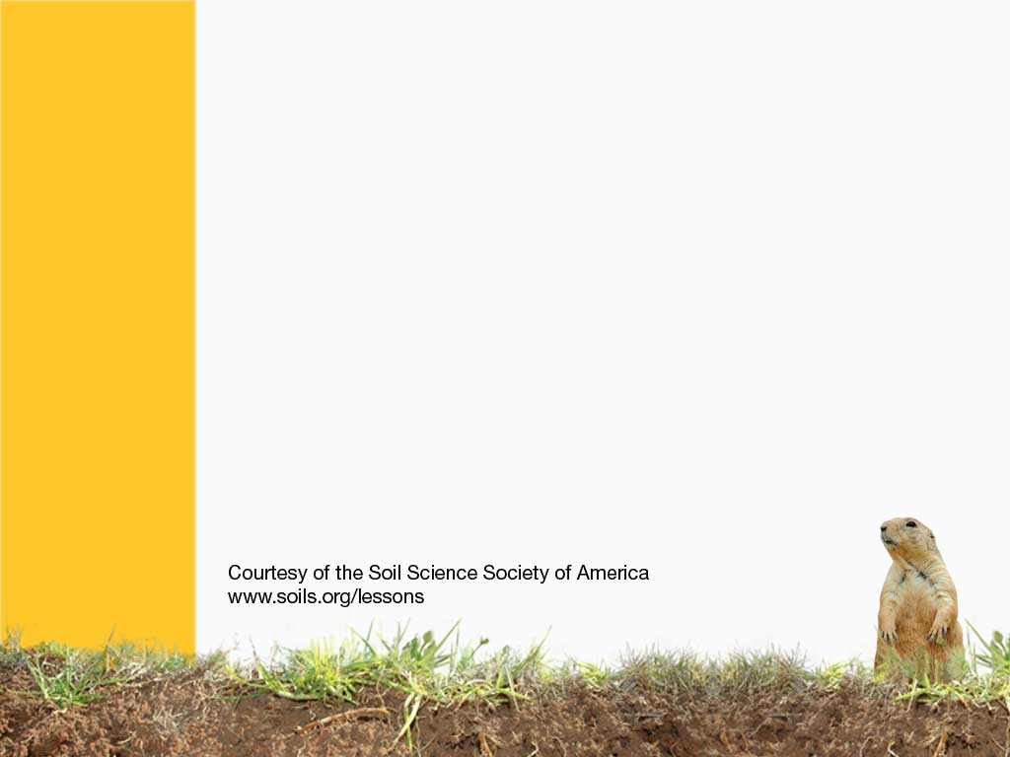
Yikes, It’s Alive!
An interesting feature of soil is its living biology—yes, it is alive.
Notes:
Soil is full of life. Scientists say that most fertile soils contain more living organisms in a handful of soil than there are people on planet Earth (approx. 7,000,000,000). This says that the majority are very small. In fact, most are so small you can’t see them without aid of a microscope.

Slide 2
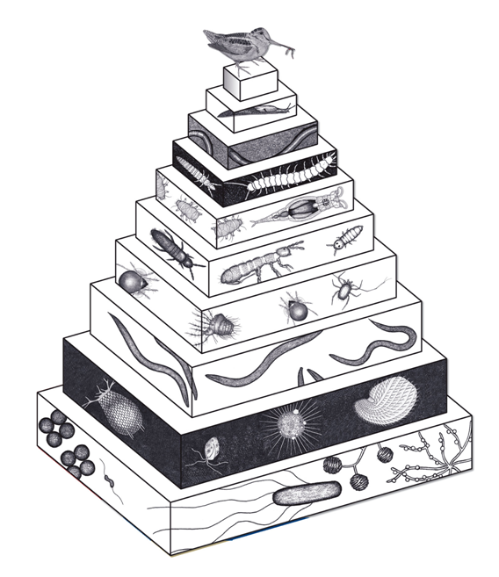
Biology Pyramid
Vertebrates (1)
Snails and Slugs (100)
Potworms and Earthworms (3,000)
Insects and Spiders (5,000)
Rotifers (10,000)
Springtails (50,000)
Mites (100,000)
Nematodes (5,000,000)
Protozoa (10,000,000,000)
Fungi (100,000,000,000)
Bacteria (10,000,000,000,000)
Notes:
This pyramid represents a food chain showing the diversity of living organisms found in most soils. The base has lots of organisms, which tend to be small and support life for organisms above. Upward through each level, fewer organisms remain until you get to the top with a single bird. The smallest organisms, it turns out, are the most abundant.

Slide 3
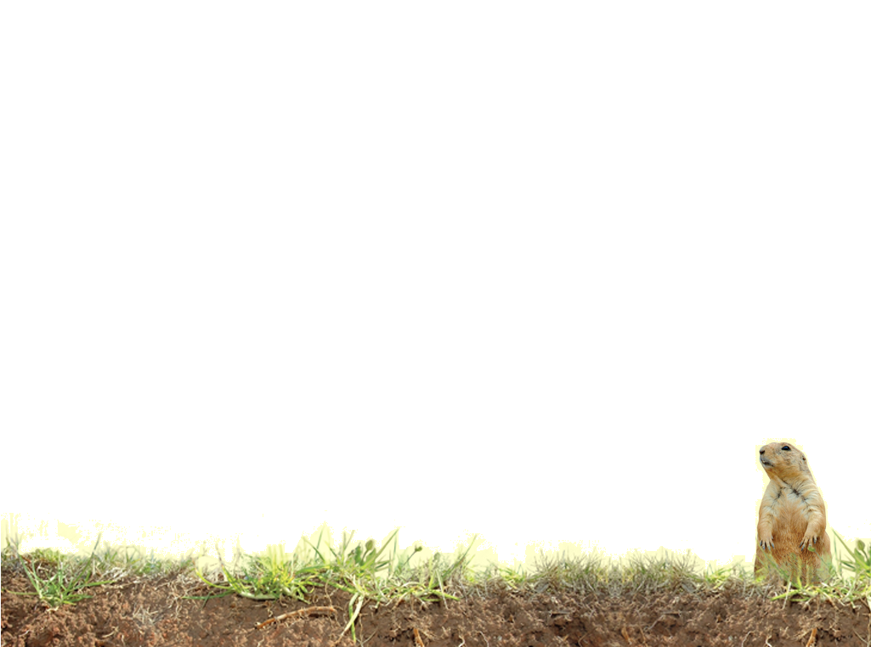
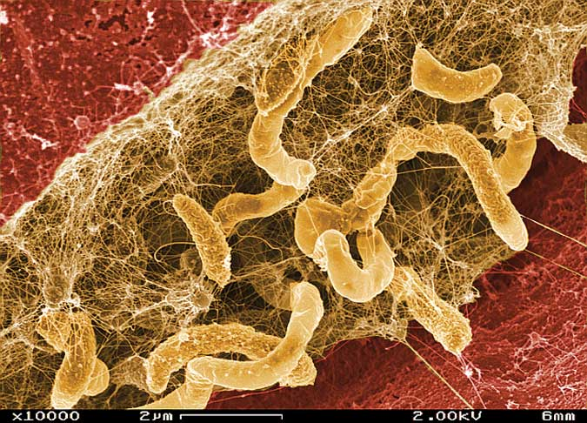
Under the Microscope
Bacteria
Notes:
Bacteria are some of the smallest of life forms, normally just 1 to 3 micrometers in length. They are rather complex, however, because each cell contains everything needed for life. Plants need bacteria to convert elements in the soil and air into nutrients that plants require for growth.

Slide 4
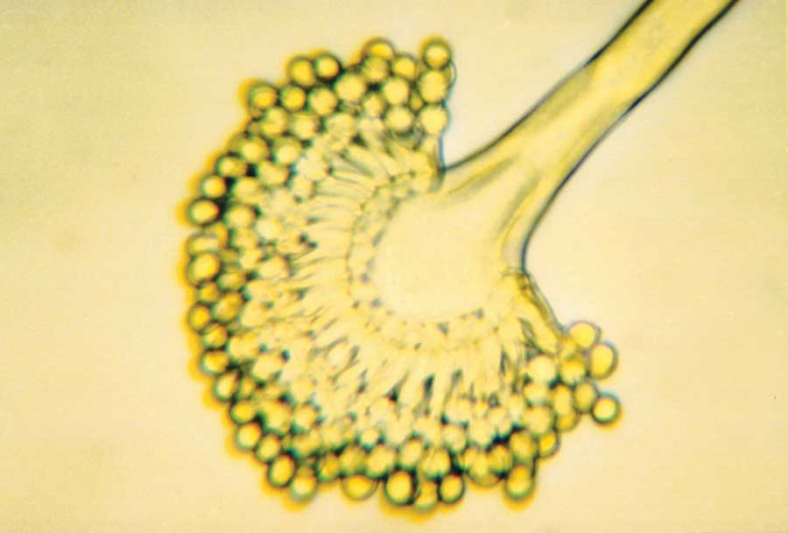
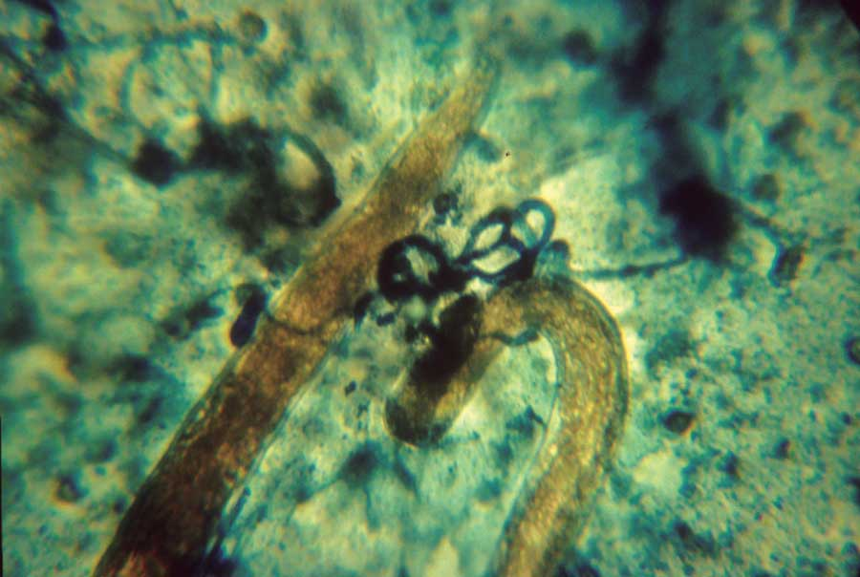
Under the Microscope
Fungi
Nematodes
Notes:
Fungi, including the common mushroom, are abundant in soil. A mushroom is only the above-ground portion of the fruiting structure of one type of fungus. Most of the organism is below ground. Most fungi are so small they cannot be seen without a microscope. They are important in cycling carbon and nutrients. Shown here is the fruiting structure (1000 magnification) of a Penicillium fungus. Each little round sphere, called a conidia, is like the seed of a plant and can give rise to another organism.
Not only do fungi decompose organic materials in the soil and recycle nutrients but some have unique ways of getting their food. This view shows a fungus that has developed a trapping structure (see the round circles) to capture nematodes. Nematodes are small worms, more numerous and diverse than earthworms, that are abundant in most soils. The nematodes (yellow) decompose organics in soil but some are parasitic on plants.

Slide 5
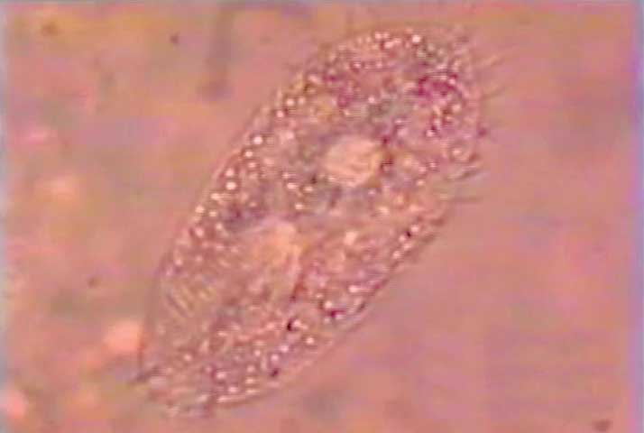
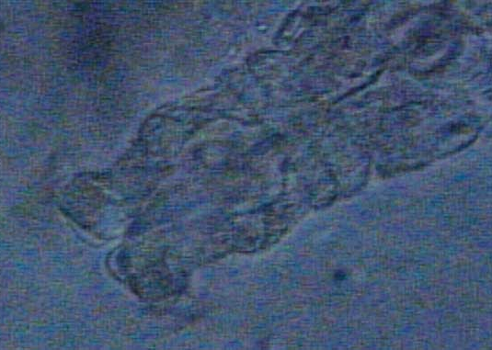
Under the Microscope
Protozoa
Rotifers
Notes:
Protozoa are single-celled organisms that feed mainly on bacteria and organic debris. Protozoa swim through water films in the soil to collect their food. Notice the fine hairs around this organism that allow it to swim. The organism in this photograph is magnified 1000 times.
A little larger than the protozoa are the rotifers. By whirling hair-like cilia on their head, they move water into their mouths where the bacteria and other food particles can be digested. This is a fascinating group to watch under a microscope.

Slide 6
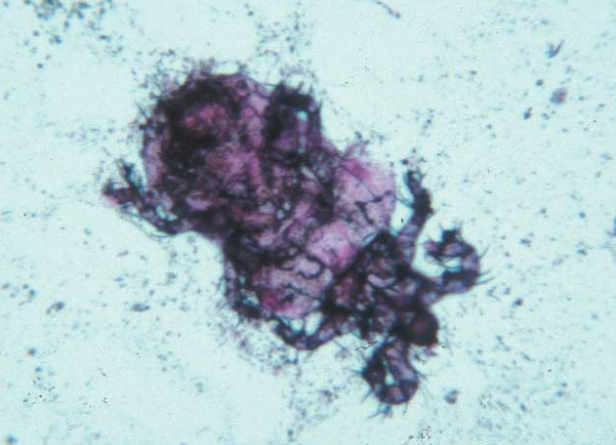
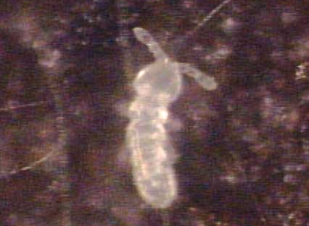
Under the Microscope
Mites
Spintails
Notes:
Mites chew plant debris into small pieces, which makes the debris available to smaller organisms. Some also feed on other mites, living fungi, or other soil organisms. Mites have eight legs and are related to spiders.
These cute little organisms are springtails, which get their name because they have a mechanism under their abdomen that allows them to ‘spring’ away from predators. They eat organic materials and often graze on fungal tissue.

Slide 7
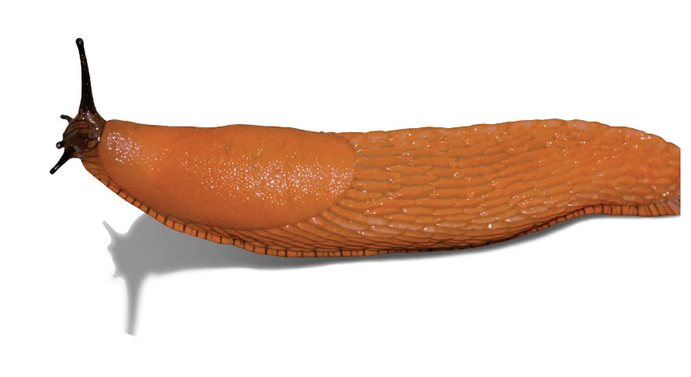
Bigger Organisms
Slugs
Notes:
Snails and slugs are larger organisms that we can find in garden or field soils. They secrete a slimy coating that keeps their bodies from drying out as they slither across the soil surface. They primarily eat vegetation and decaying organic matter.

Slide 8
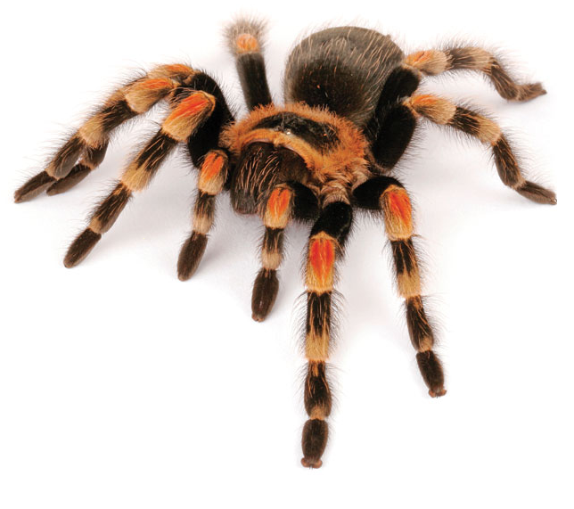
Bigger Organisms
Spiders
Notes:
Spiders seem always to be hunting for food. Some live below ground and hunt organisms that live at the soil surface. All spiders have eight legs.

Slide 9
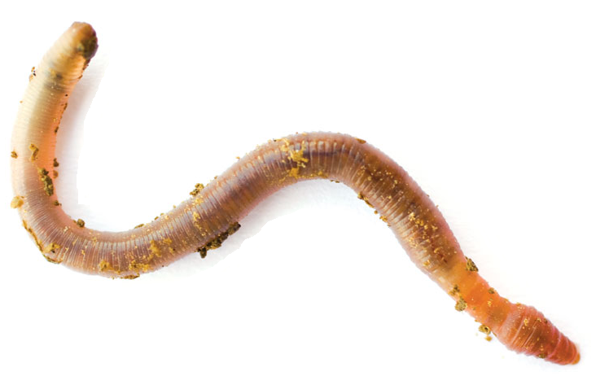
Bigger Organisms
Earthworms
Notes:
Earthworms are nature’s plow that dig and burrow through the soil. In the process they leave channels that are important for air and water to freely move into and through the soil. Their ‘manure’ (called casts) helps to fertilize the soil.

Slide 10
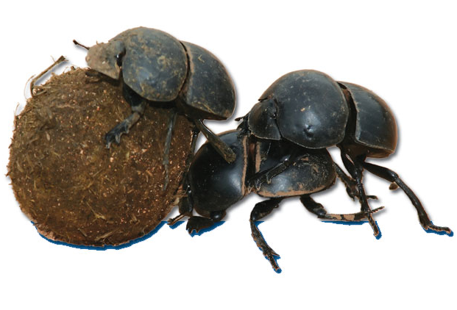
Bigger Organisms
Dung Beetles
Notes:
Dung beetles (dung is another word for manure) can readily be seen with the unaided eye. They decompose and bury the manure of mammals in soil where it decomposes more rapidly. Some will lay eyes in the buried manure to feed their young.

Slide 11
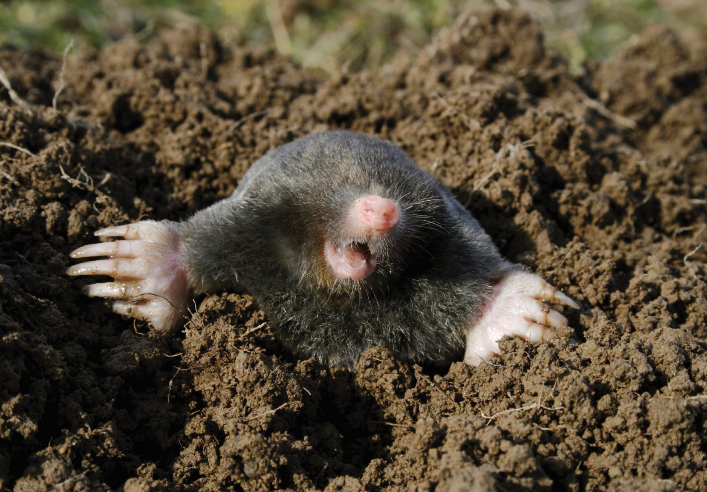
Bigger Organisms
Notes:
Dung beetles (dung is another word for manure) can readily be seen with the unaided eye. They decompose and bury the manure of mammals in soil where it decomposes more rapidly. Some will lay eyes in the buried manure to feed their young.

Slide 12
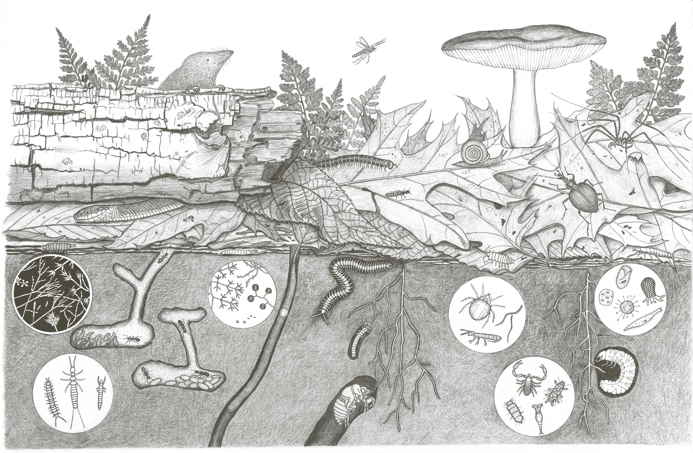
It’s Complicated…
Notes:
This is a complex visual that relates soil life to the real world. Each organism lives in close proximity with others and they often interact. All have their own place and function. Some are large and easily seen with the unaided eye and others have to be magnified by 1000 times just to see their general shape. Life in soil often depends on the death of a plant or another organism, and life results for the second organism as the first organism and its remains are decomposed. This is part of the carbon cycle.

Slide 13
Notes:
Photographs don’t do justice to living, breathing organisms. This website has video of various soil organisms. If you are connected to the internet, you should be able to click on either box above and go to the video site. Otherwise, use the link provided <http://www.agron.iastate.edu/~loynachan/mov/>). Enjoy!

Slide 14
Vocabulary
Decompose (Decomposition)
Fungus (plural Fungi)
Microbes
Microbiologist
Organisms
Notes:
Located in Scoop Book

Slide 15
Vocabulary
Bacteria -Single-celled organisms that are microscopic ranging in shape from spheres, rods, to spirals.
Earthworms -Long, thin segmented animals that burl through the soil aerating and enriching it.
Mites -Eight-legged animals too small to see with the unaided eye that feed on smaller organisms and soil organic matter.
Nematodes -Tiny, non-segmented worm-like organisms that mostly live on other organisms or soil organic matter.
Protozoa -Single-celled organisms larger than bacteria that move in water films and feed on bacteria and soil organic matter.
Rotifers-Microscopic animals found in many freshwater environments and in moist soil that move by swimming or crawling.
Springtails -Six-legged animals that often have a tail-like structure folded beneath the body that can be used for jumping when the animal is threatened.
Notes:
Not found in Scoop Glossary

