Slide 1
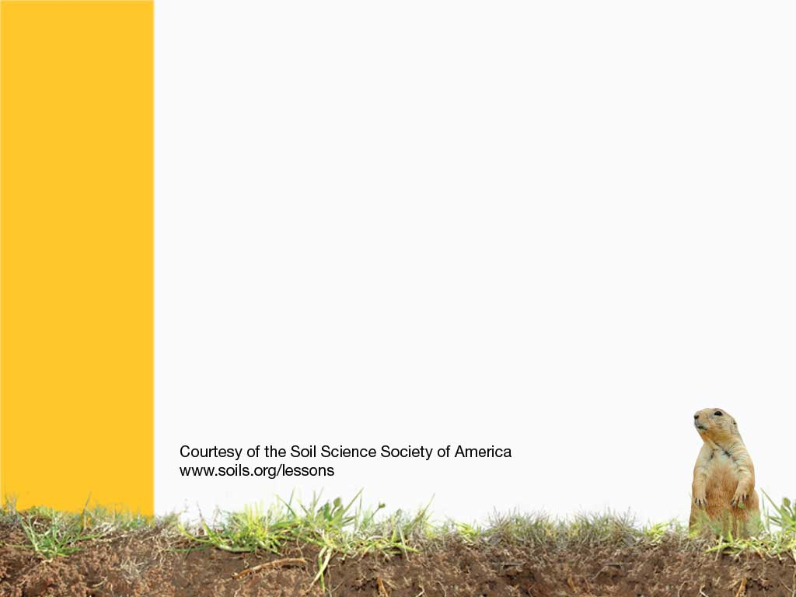
Prairie Soils
America’s Breadbasket

Slide 2
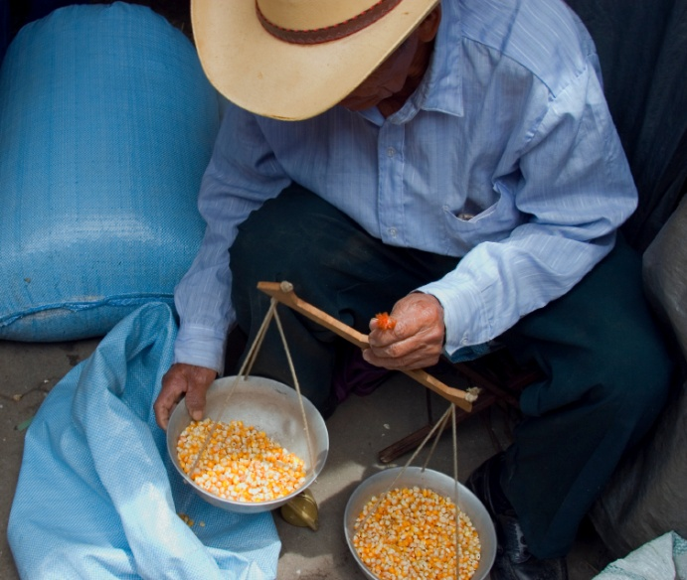
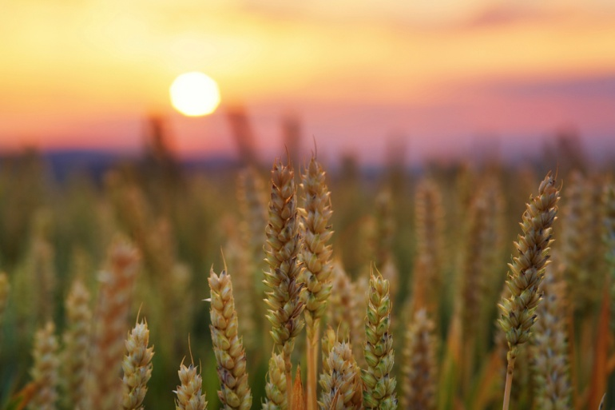
Most of OUR FOOD comes from the Prairies!
Including corn, wheat and soybeans…
Can you think of things that are made out of these products?
Notes:
The list of things made from corn, wheat and soybeans extends beyond the obvious, including anything made of leather (cattle) candy, ketchup, cat litter, most sodas, disposible diapers… etc. The list is long and extensive, and there probably won’t be a wrong answer.

Slide 3
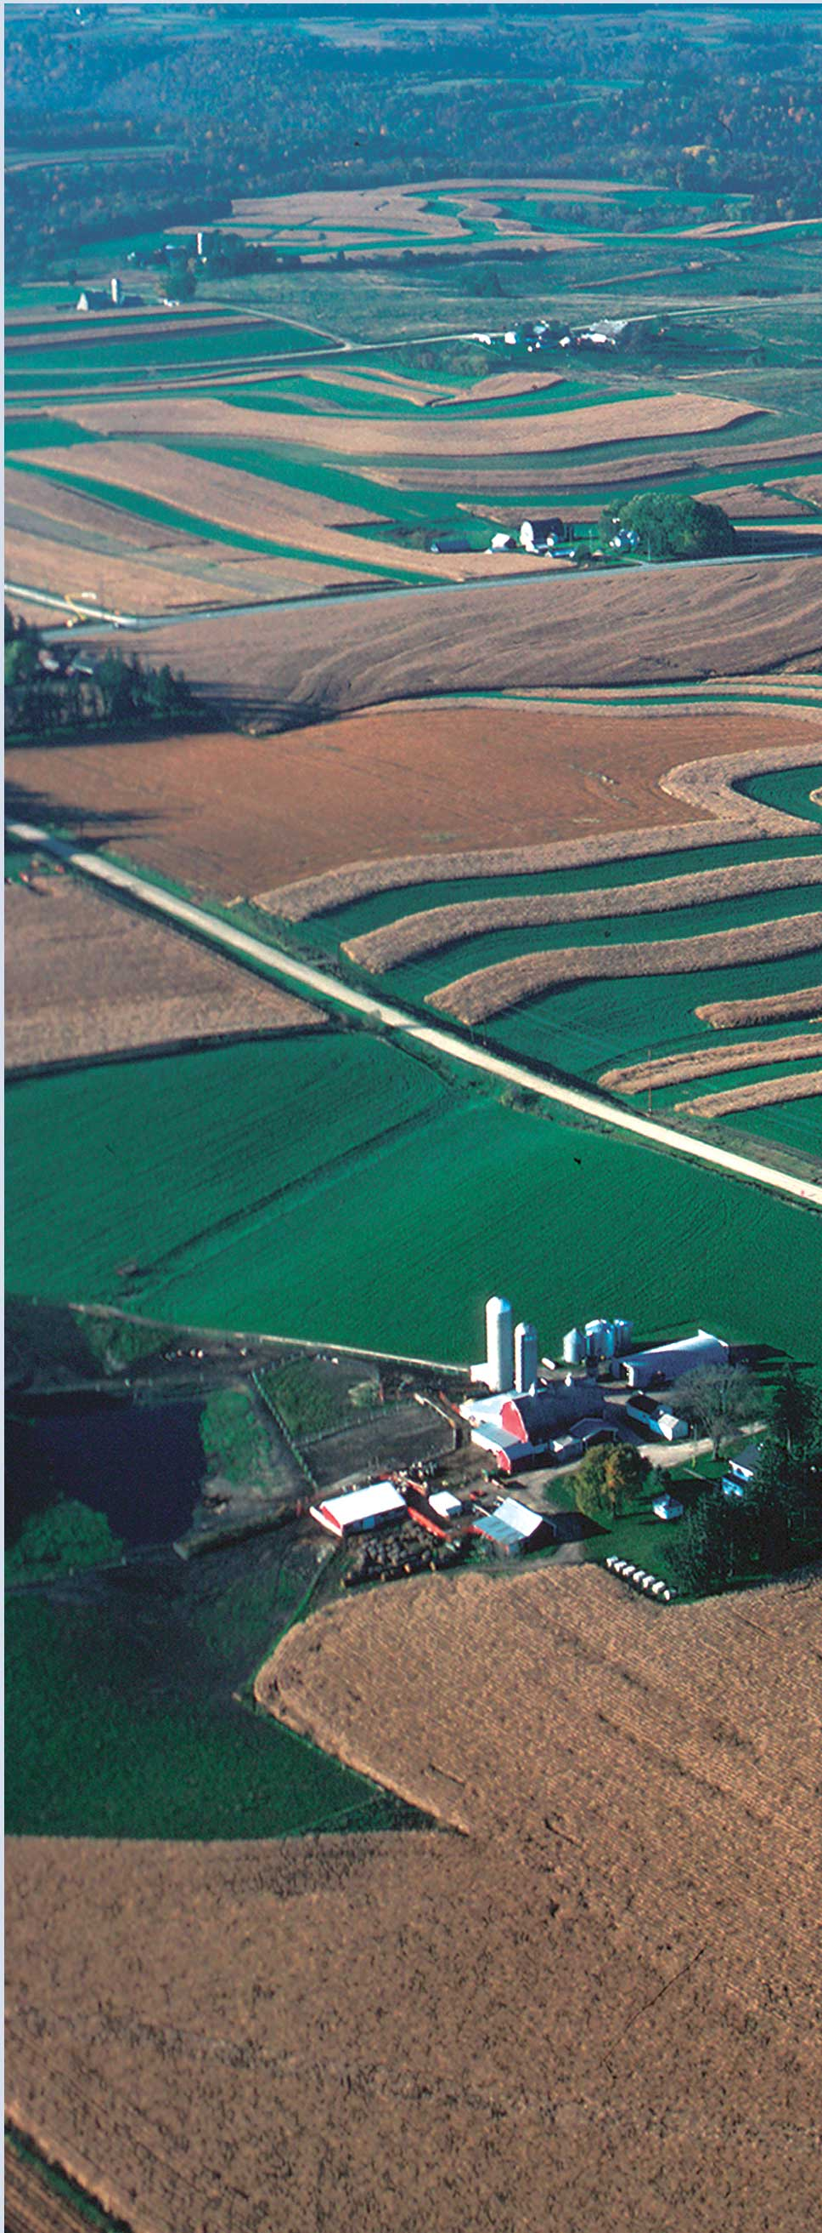
Prairie Soils are a type of GRASSLAND.
It is too DRY to be a forest, and too WET to be a desert.
Notes:
Prairie soils are a type of grassland formed under warm summers and cold winters.

Slide 4
So a diverse species of grasslands developed.
At the end of the year, grassland plants die back, but their leaves and roots remain, acting like a MULCH.
Why is this good for the SOIL?
Notes:
The mulch adds organic matter to the soil, which keeps soil fertile, and provides lots of nutrients to plants.

Slide 5
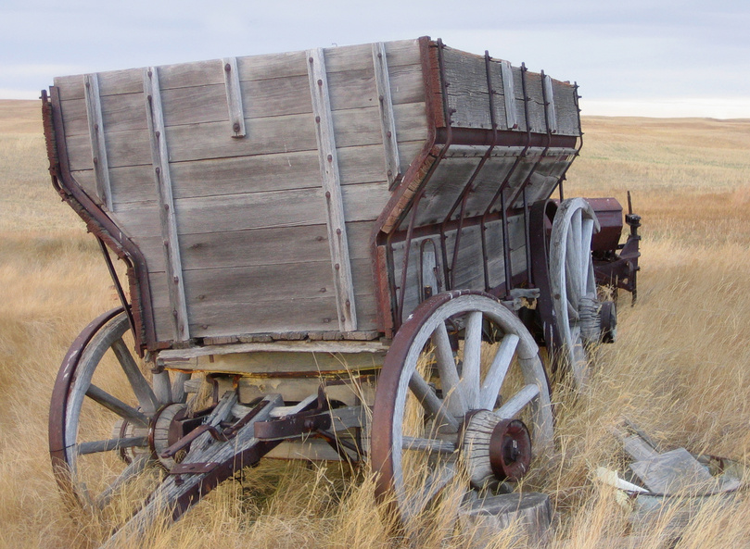
There are three types of prairie:
Short grass grows in the far western states that are dry, like Montana, and Colorado.
Tall grass grows where it is wet, like in Illinois and Iowa.
In states like North and South Dakota, the grasses are mixed.

Slide 6
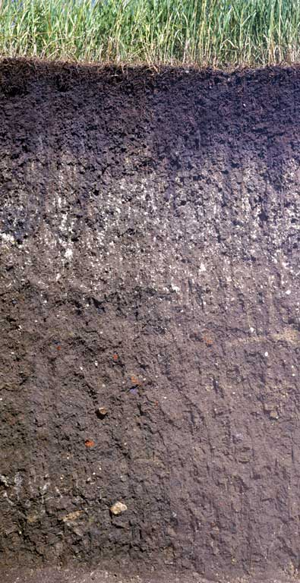
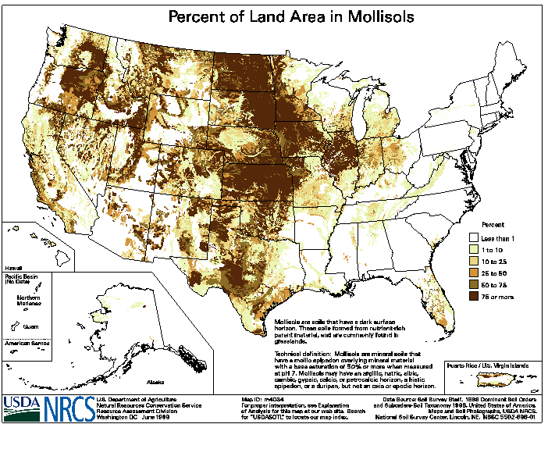
MOLLISOL
Deep, Fertile
TALL GRASS PRAIRIE
Notes:
Mollisols - grassland soils
http://soils.cals.uidaho.edu/soilorders/mollisols.htm
Mollisols are the soils of grassland ecosystems. They are characterized by a thick, dark surface horizon. This fertile surface horizon, known as a mollic epipedon, results from the long-term addition of organic materials derived from plant roots. Mollisols primarily occur in the middle latitudes and are extensive in prairie regions such as the Great Plains of the US. Globally, they occupy ~7.0% of the ice-free land area. In the US, they are the most extensive soil order, accounting for ~21.5% of the land area. Mollisols are among some of the most important and productive agricultural soils in the world and are extensively used for this purpose.

Slide 7
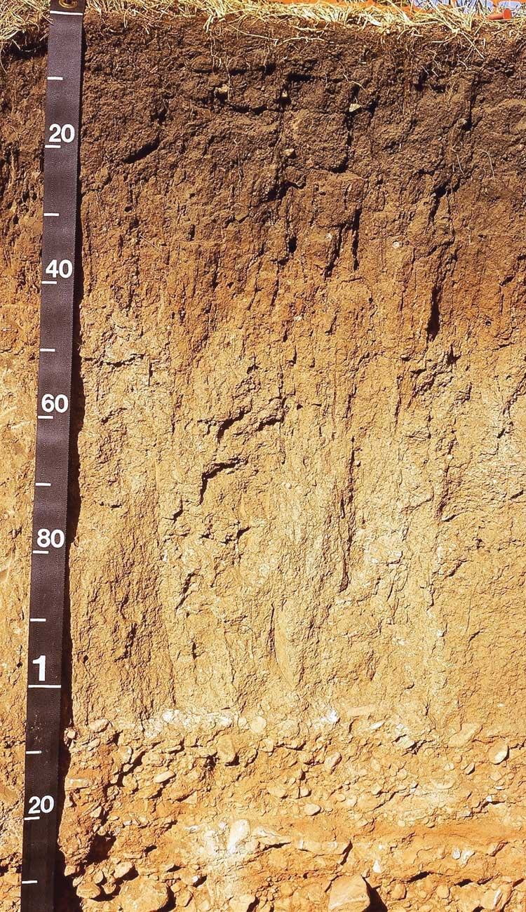
Mollis means SOFT in Latin, and these soils are RICH, DARK, and SOFT.
The taller the grass, the darker the soil.
Which state would have darker soil: Colorado, or Illinois?
SHORT GRASS PRAIRIE
Notes:
Illinois has darker soil.

Slide 8
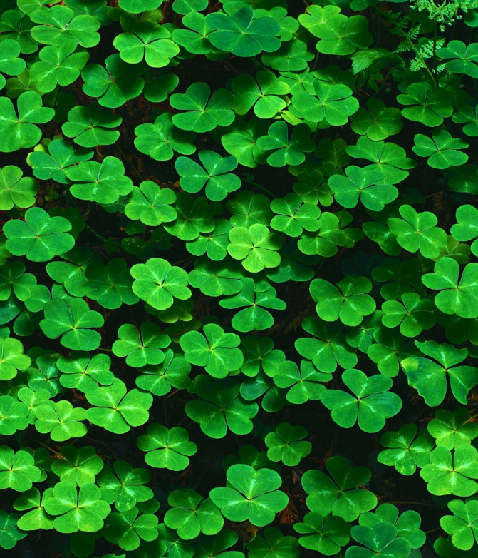
There are lots of organisms in grasslands:
Including wildflowers,
clovers, bacteria, fungi, and beetles

Slide 9
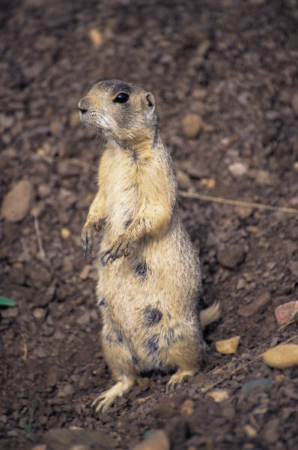
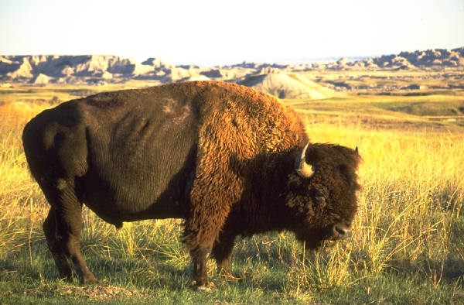
And animals like Prairie Dogs and Bison.
Can you name any others?
Notes:
Birds of all kinds, including hawks, wild mustangs, etc.

Slide 10
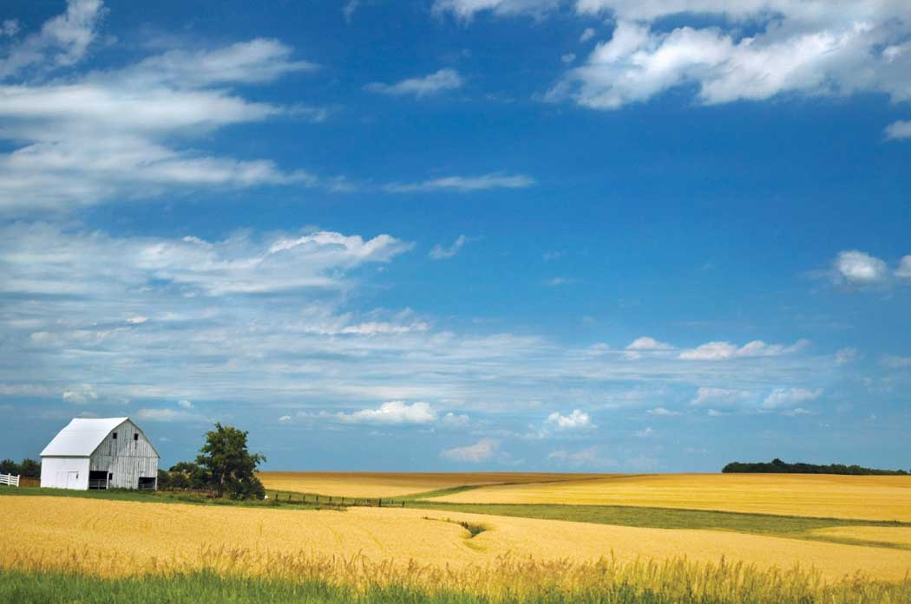
The prairies vary in relief from flat to having rolling hills

Slide 11
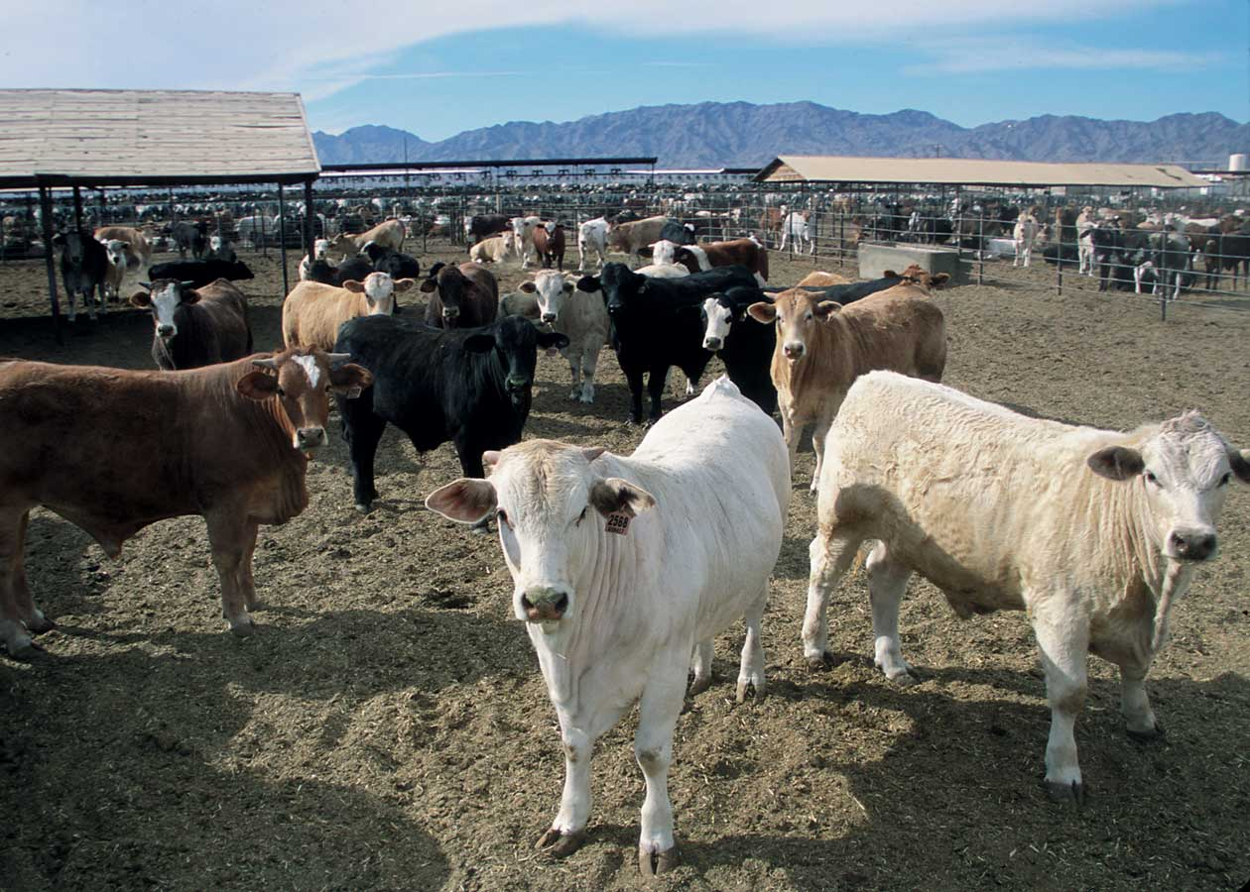
Most of our FOOD is grown here
And we need to keep the soils fertile.
Cattle produce meat and milk, but how can cattle help with fertility?
Notes:
Cattle manure, like that of pigs and poultry, makes a very good fertilizer.

Slide 12
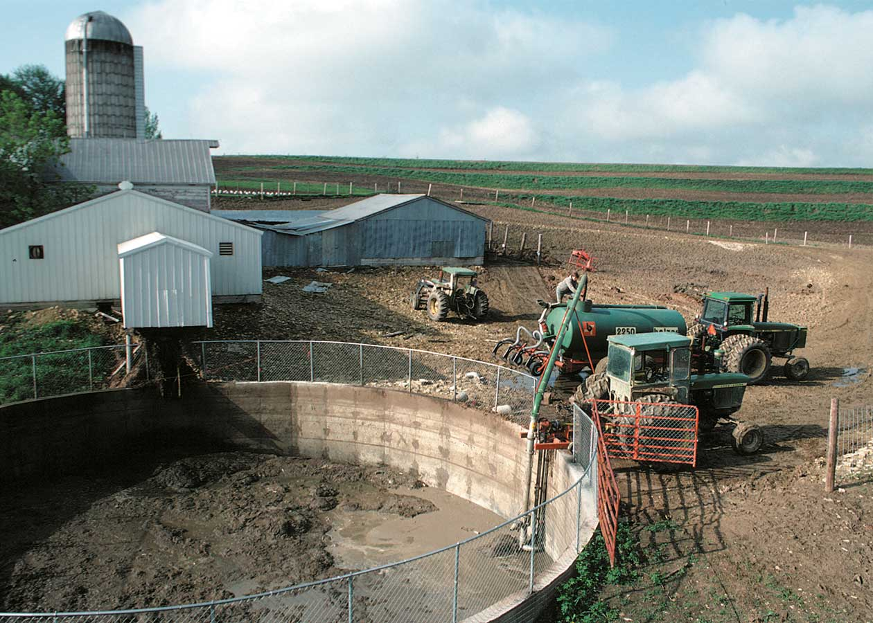
Manure is put into holding areas…

Slide 13
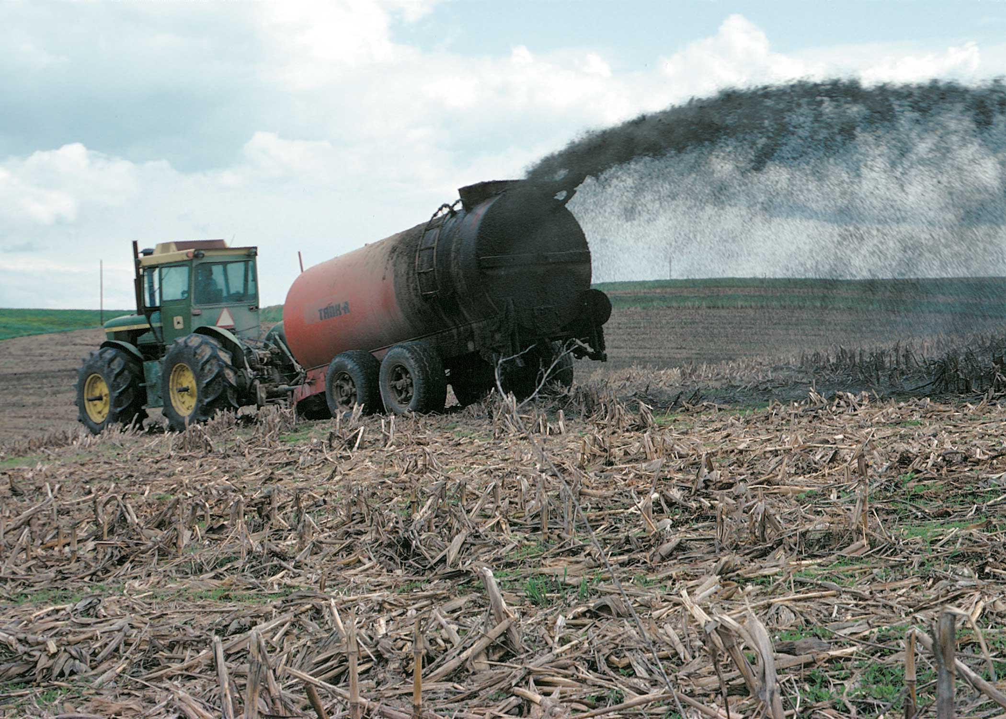
…and then spread onto crops. It contains MACRONUTRIENTS like nitrogen, phosphorus, and potassium

Slide 14
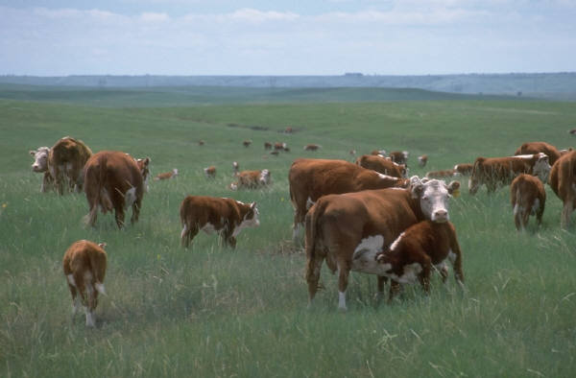
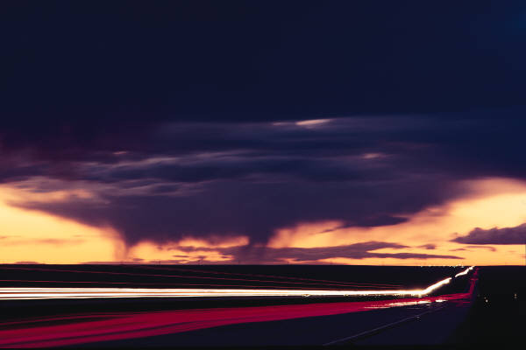
Some farmers make their own compost, by recycling manure and mixing it with plants
Why are nutrients important again?
What happens if there are too many nutrients?
Notes:
Nurtrients provide the plants with what they need to grow healthy and strong, but too many nutrients in the soil can cause environmental problems, especially water quality problems.

Slide 15
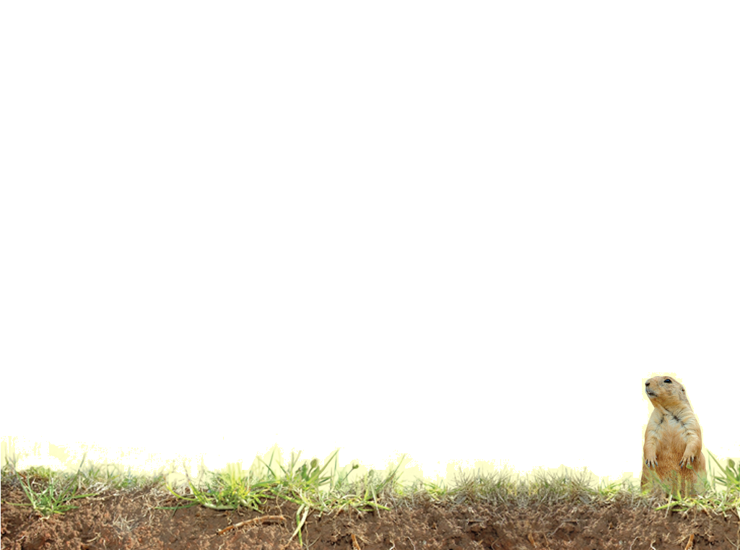
Vocabulary
CLORPT
Erode (erosion)
Groundwater
Horizon
Organic matter
Organisms
Parent material
Productive
Relief
Runoff
Sediment
Slope
Topsoil (A horizon)
Notes:
These words are defined in Soil! Get the Inside Scoop

Slide 16
Vocabulary
Eolian – Parent materials deposited by wind with more than 5% sand
Prairie – Grasslands that form in climates too dry to be a forest and too moist to be a desert.
Loess – Parent materials deposited by wind with less than 5% sand
Notes:
These words are not defined in Soil! Get the Inside Scoop. The definitions are below.

