Slide 1
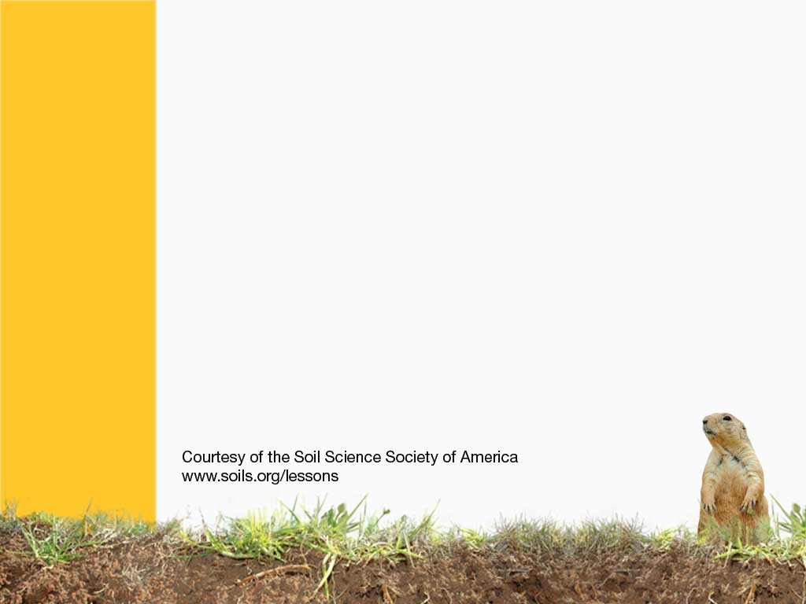
Forest Soils

Slide 2
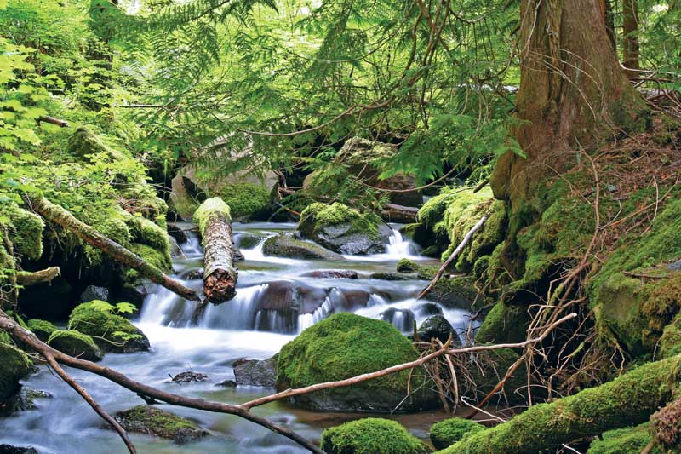
Notes:
Pine forests between tree forests.

Slide 3
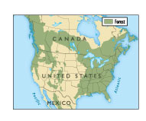
Forests used to cover the Eastern half of the United States, and most of southern Canada.
Most forests are not too hot, or not too cold, and have moderate amounts of precipitation.
Notes:
There are several different kinds of forests. These temperate rainforests form under Goldilocks conditions, not too hot or too cold. They have moderate temperatures (some are warmer then others), and under moderate rainfall conditions.

Slide 4
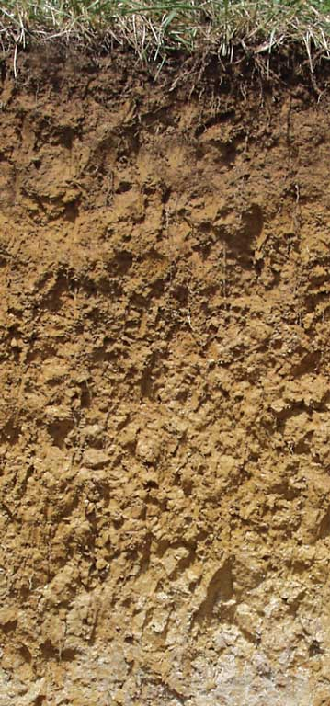
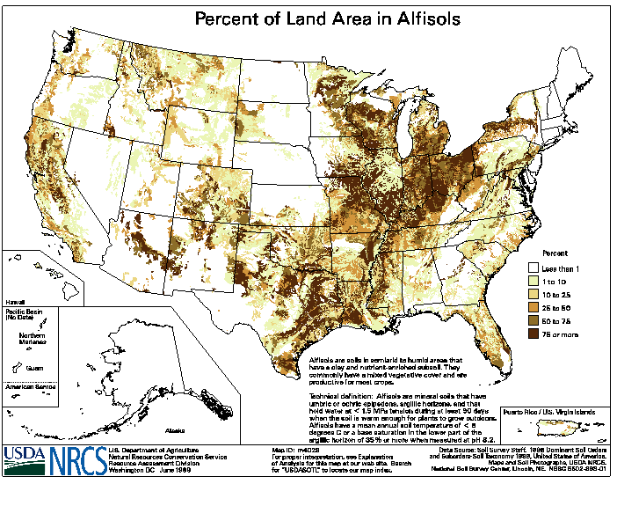
ALFISOL
Moderately Weathered
Notes:
Alfisols - moderately leached soils often found in temperate forests
http://soils.cals.uidaho.edu/soilorders/alfisols.htm
Alfisols are moderately leached soils that have relatively high native fertility. These soils have mainly formed under forest and have a subsurface horizon in which clays have accumulated. Alfisols are primarily found in temperate humid and subhumid regions of the world.
Alfisols occupy ~10.1% of the global ice-free land area. In the US, they account for ~13.9% of the land area. Alfisols support about 17% of the world's population.
The combination of generally favorable climate and high native fertility allows Alfisols to be very productive soils for both agricultural and silvicultural use.

Slide 5
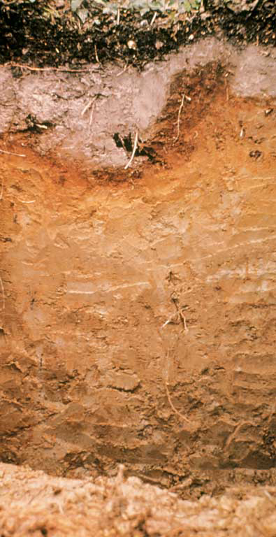
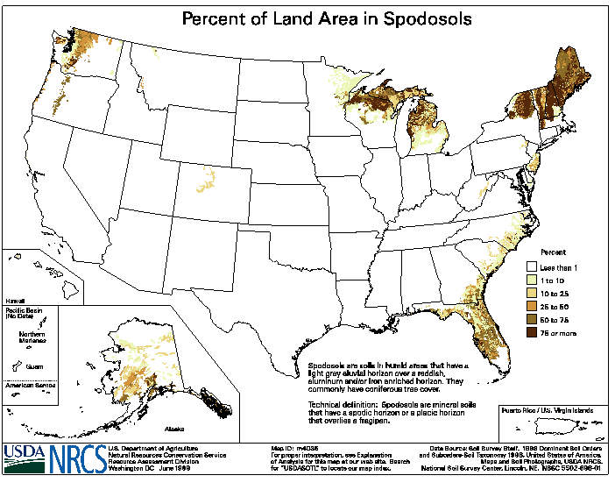
SPODOSOL
Sandy, Acidic
Notes:
Spodosols – acidic, sandy forest soils under conifers
http://soils.cals.uidaho.edu/soilorders/spodosols.htm
Spodosols are acid soils characterized by a subsurface accumulation of humus that is complexed with Al and Fe. These photogenic soils typically form in coarse-textured parent material and have a light-colored E horizon overlying a reddish-brown spodic horizon. The process that forms these horizons is known as podzolization.
Spodosols often occur under coniferous forest in cool, moist climates. Globally, they occupy ~4% of the ice-free land area. In the US, they occupy ~3.5% of the land area.
Many Spodosols support forest. Because they are naturally infertile, Spodosols require additions of lime in order to be productive agriculturally.

Slide 6
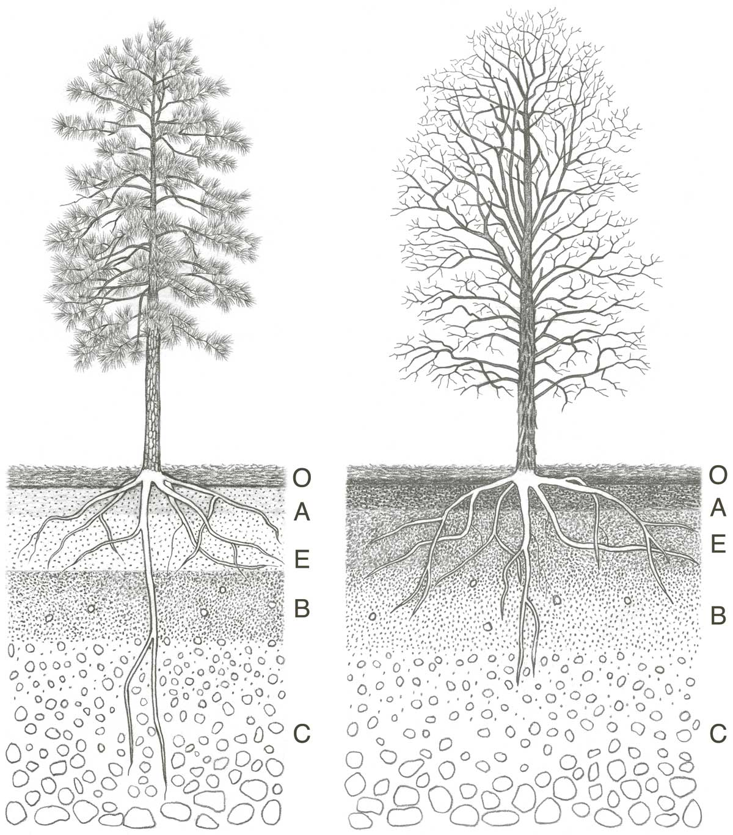
There are two main types of forests.
Pine forests have ashy white layers (E horizons) and are called Spodosols.
Deciduous forests have soils called alfisols, and are not as leached. But clay accumulates in the SUBSOIL.
Notes:
There are two major different types of forests, coniferous forests, and deciduous forests.

Slide 7
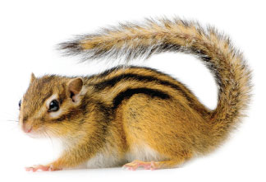
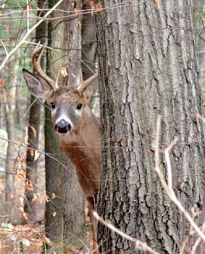
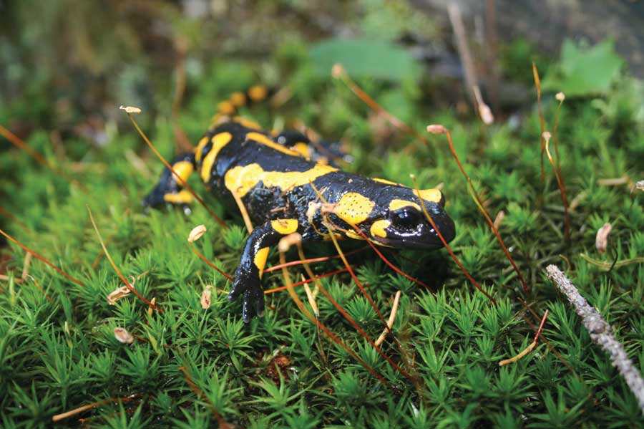
There are a lot of organisms in the woods.
Like salamanders, chipmunks, squirrels, and deer.
There are a lot of TREES, mosses, fungi and bacteria.
Notes:
There are lots of different organisms in the forest, including deer, trees, squirrels, salamanders, and racoons.

Slide 8
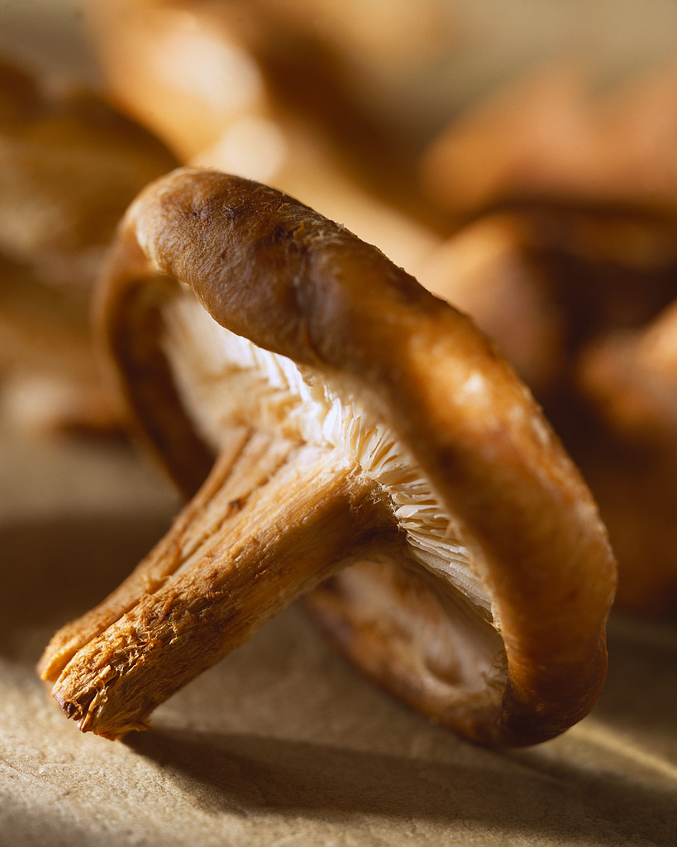
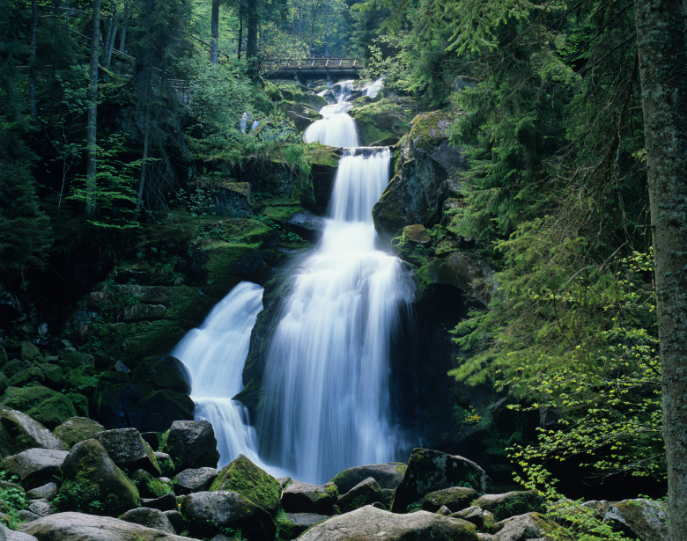
The BIGGEST organism on the Earth is actually a FUNGUS in a temperate forest!
Notes:
The biggest organism in the forest is actually located in a forest, and it is a fungus!

Slide 9
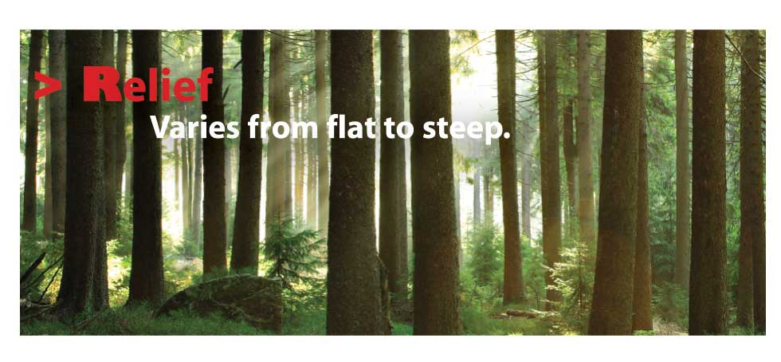
Can you think of a place that relief would be steep?
Notes:
The relief varies from very flat to very steep in the mountains.

Slide 10

Forests are Important to the Carbon Cycle
CO2 from Atmosphere
CO2 from Respiration
CO2 from Respiration
CO2 from Respiration
Tree Roots
Fallen Leaves
Animal Waste
Dead Animals
Bacteria
Worms
Soil Carbon from Living Sources
Soil Carbon from Dead Sources
Temperate forests store carbon in trees and soils, which keeps it from being released into the air.
Notes:
Forests are really useful to store carbon. Carbon cycles between the atmosphere, plants, and soil. When plants are removed, the cycle is disturbed.

Slide 11
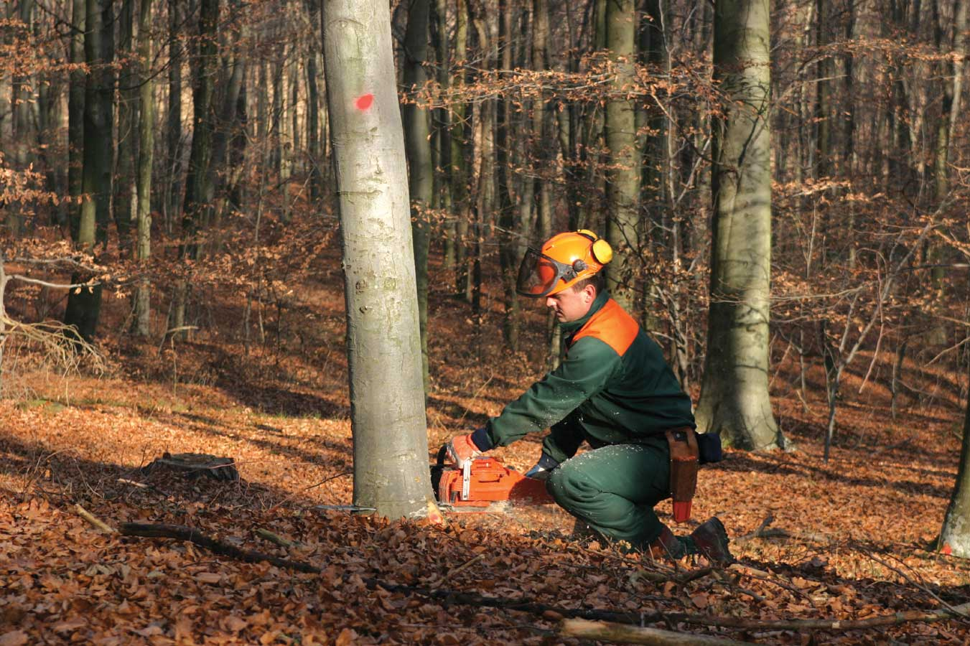
CLEAR CUTTING is removing all trees at once.
Why could this be a problem?
Notes:
Plants keep soil in place, clear cutting causes a loss of carbon, as well as soil erosion. There are several ways that trees can be harvested without doing substantial damage.

Slide 12
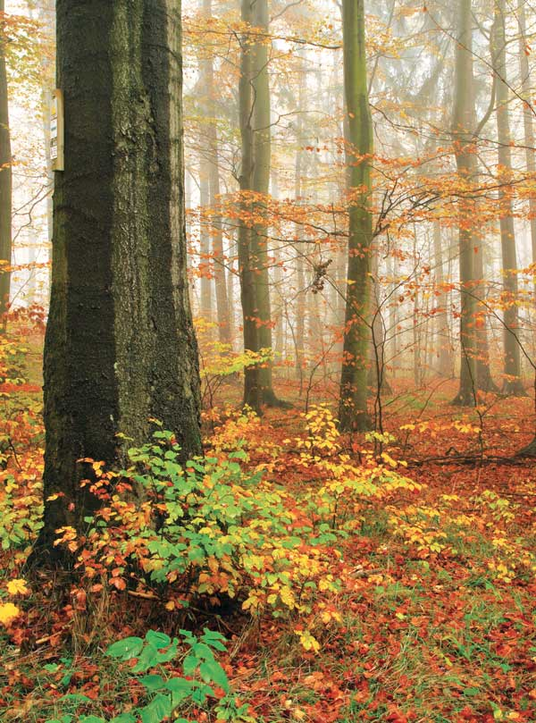
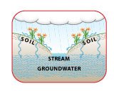
FORESTS are FILTERS.
PLANTS and SOILS work together to remove germs, extra nutrients, and other pollutants from the WATER.
Notes:
Plants and soils can work together to filer out harmful germs, extra nutrients (good for plants, but not groundwater), and other pollutants. Forests affect soil water quality and quantity in streams, rivers, and lakes. When it rains, water seeps down and travels into the hydric cycle. Every drink of water we take has to travel through space and time to get to our glass.

Slide 13
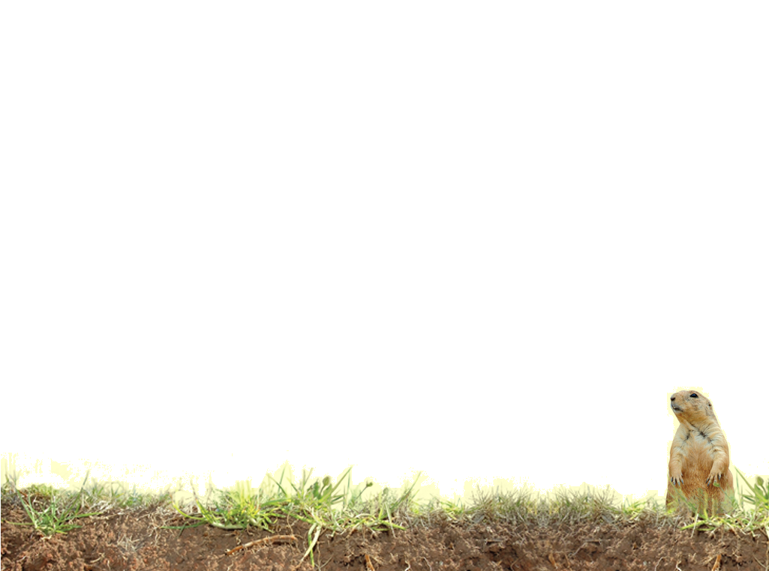
Vocabulary
E Horizon (eluviated)
Subsoils
Fungus
Leaching
Notes:
These words are defined in Soil! Get the Inside Scoop

Slide 14
Vocabulary
Spodosols – acidic, sandy forest soils under conifers
Alfisols - moderately leached soils often found in temperate forests
Respiration – animals breathing in and out generate carbon dioxide
Carbon dioxide – a greenhouse gas
Notes:
These words are not defined in Soil! Get the Inside Scoop. The definitions are below.

