Slide 1
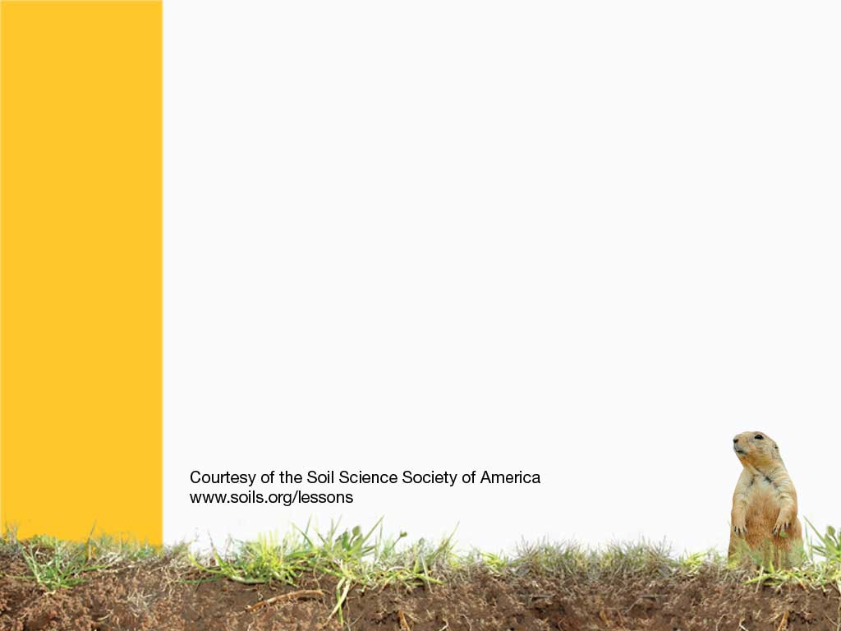
Desert Soils

Slide 2
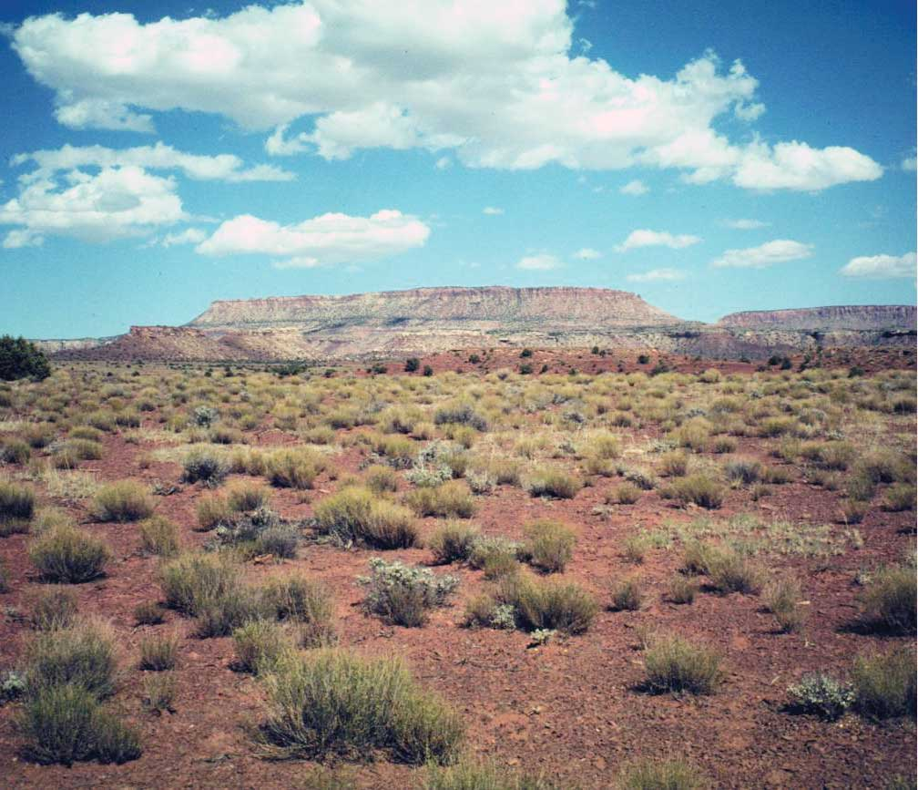
Deserts can be HOT or COLD. But they are all very DRY. All deserts have more evaporation then rainfall.
Deserts cover 20-35% of the Earth’s land surface, and 25% of the world’s people.

Slide 3
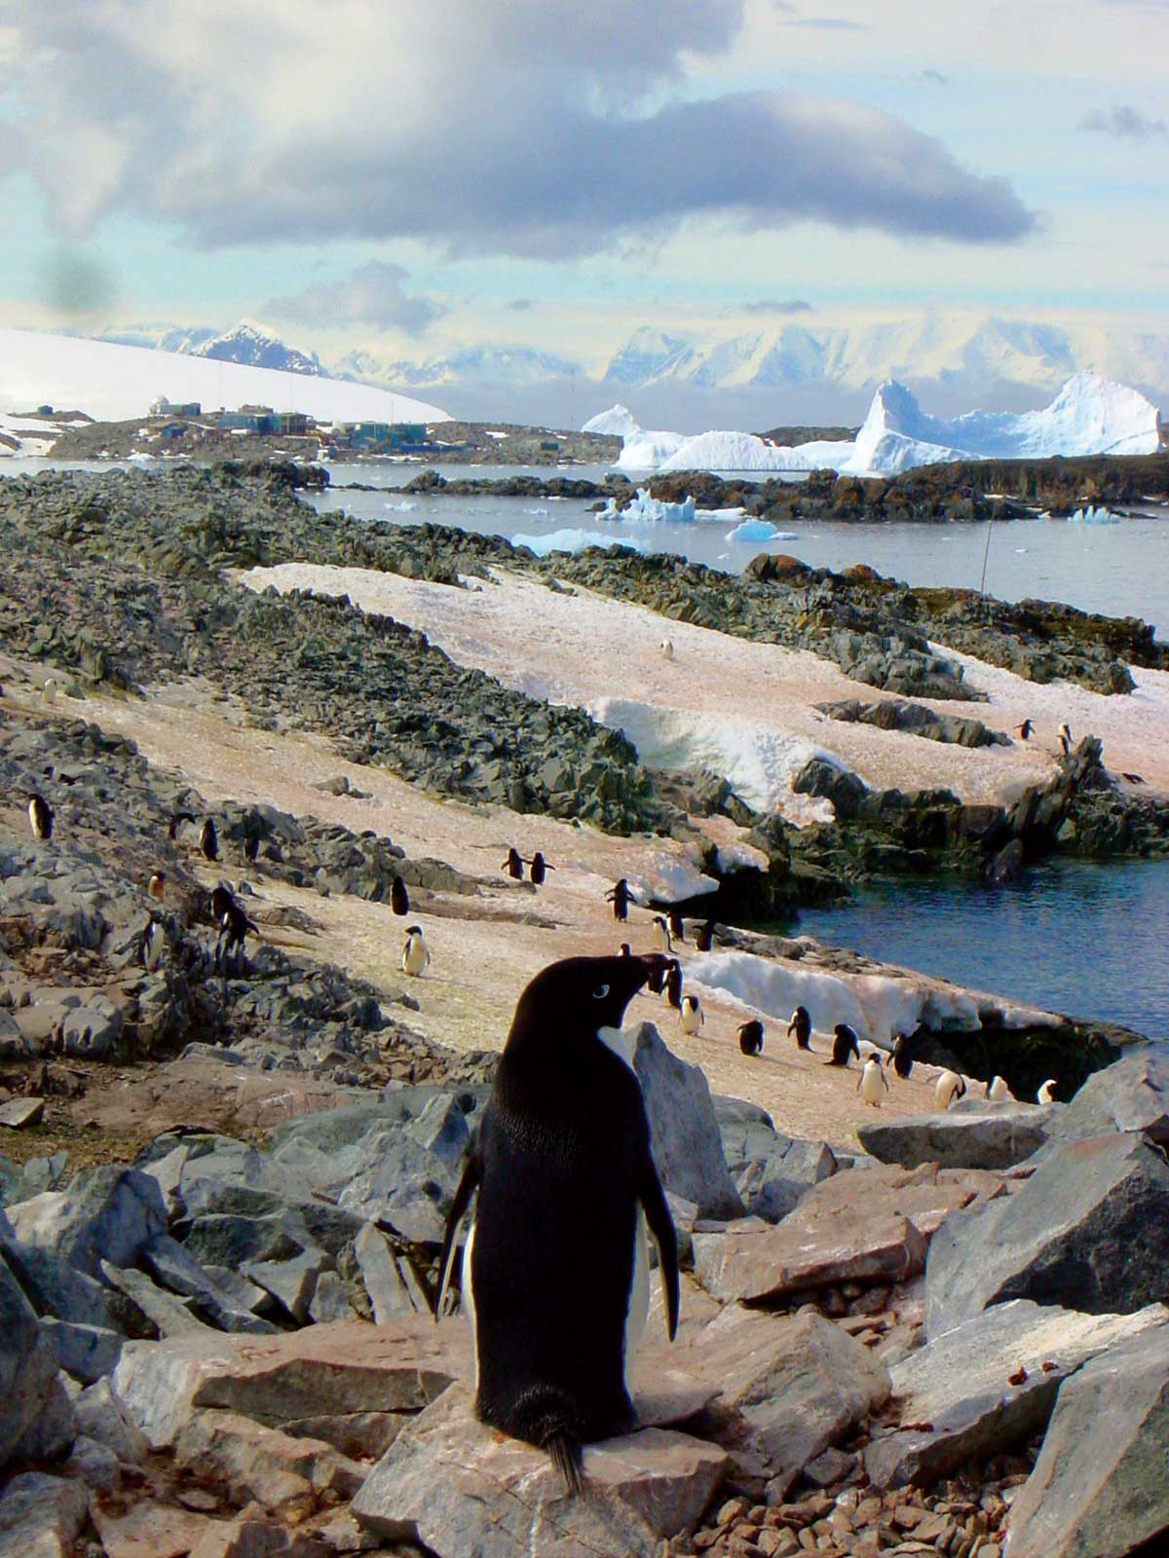
ANTARCTICA is actually a large desert

Slide 4
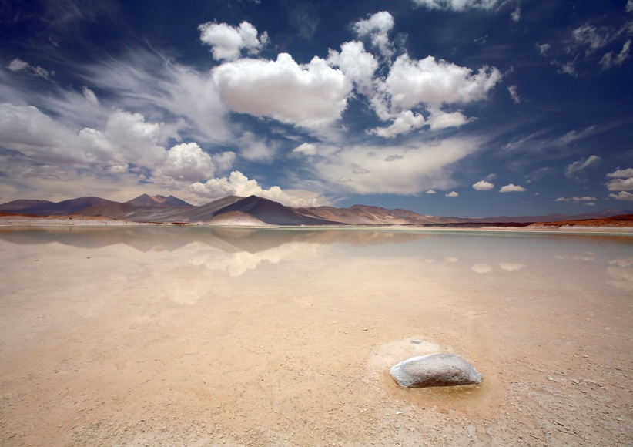
Deserts soils vary, and can be very deep, or very shallow.
They are usually lighter in color.
Do soils in the desert have a lot of organic matter?
Why or why not?
Notes:
Soils in dry areas do not have a lot of plants, and therefore, they do not have a lot of organic matter. Also, there are very little soil microbes to convert plant matter into organic matter.

Slide 5
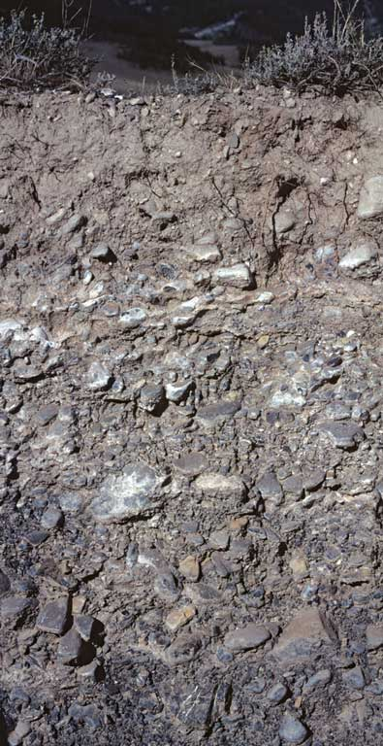
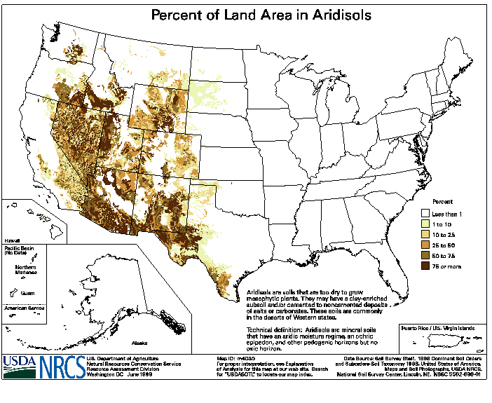
ARIDISOL
Very Dry
Notes:
Aridisols – desert soils
http://soils.cals.uidaho.edu/soilorders/aridisols.htm
Aridisols are CaCO₃-containing soils of arid regions that exhibit at least some subsurface horizon development. They are characterized by being dry most of the year and limited leaching. Aridisols contain subsurface horizons in which clays, calcium carbonate, silica, salts, and/or gypsum have accumulated. Materials such as soluble salts, gypsum, and CaCO₃ tend to be leached from soils of moister climates. Aridisols occupy ~12% of the Earth's ice-free land area and ~8.3% of the US. Aridisols are used mainly for range, wildlife, and recreation. Because of the dry climate in which they are found, they are not used for agricultural production unless irrigation water is available.

Slide 6
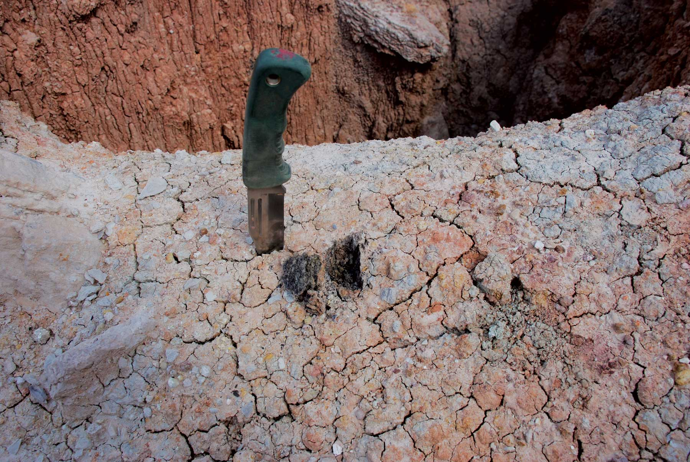
Lack of moisture keeps some minerals from leaching out. Instead, they form a cement like crust on the surface of the soil.
Notes:
Raindrops create plate like crusts on the soil surface.

Slide 7
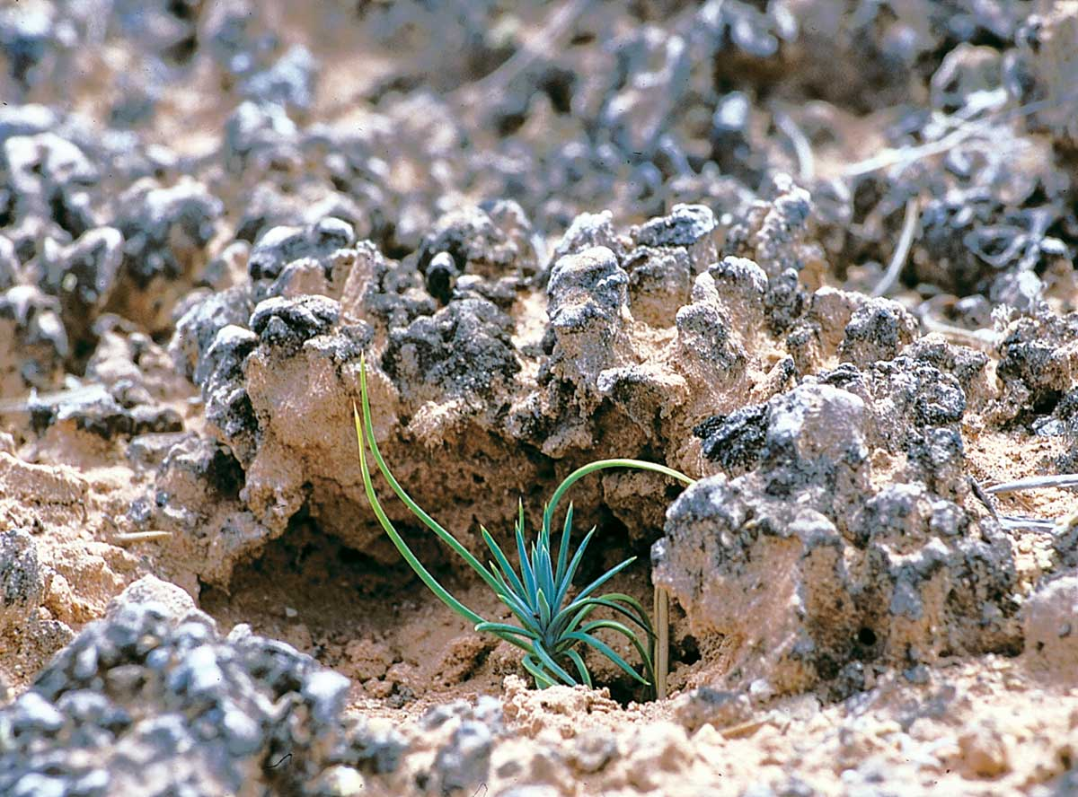
Sometimes these crusts are biological – formed by organisms like bacteria, mosses and lichens.
Notes:
Crusts don’t just form for physical reasons, like impact from raindrops they also form from biology. What do these crusts do? They protect the soil.

Slide 8
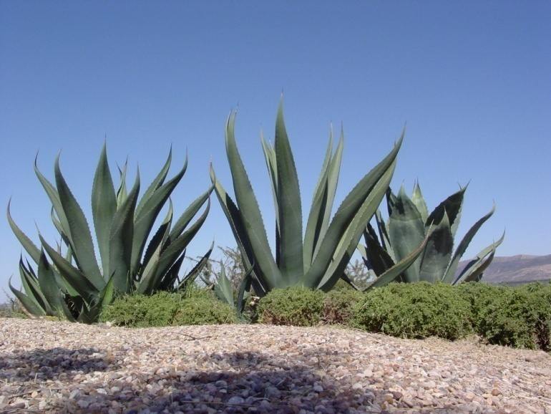
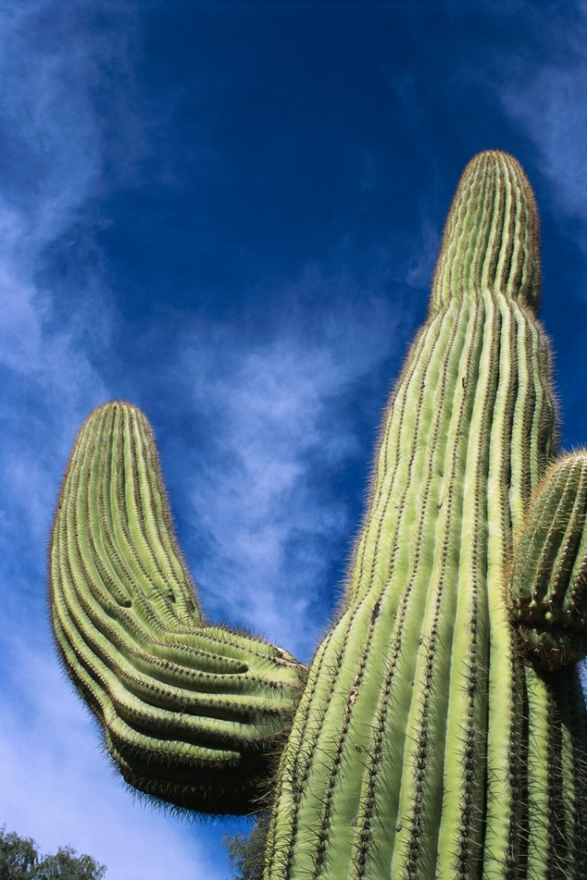
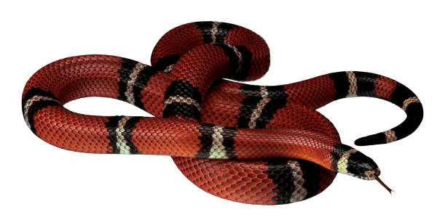
Even though deserts are DRY, they have lots of life in them.
Snakes, cacti, insects, rabbits, lichens and mosses.

Slide 9
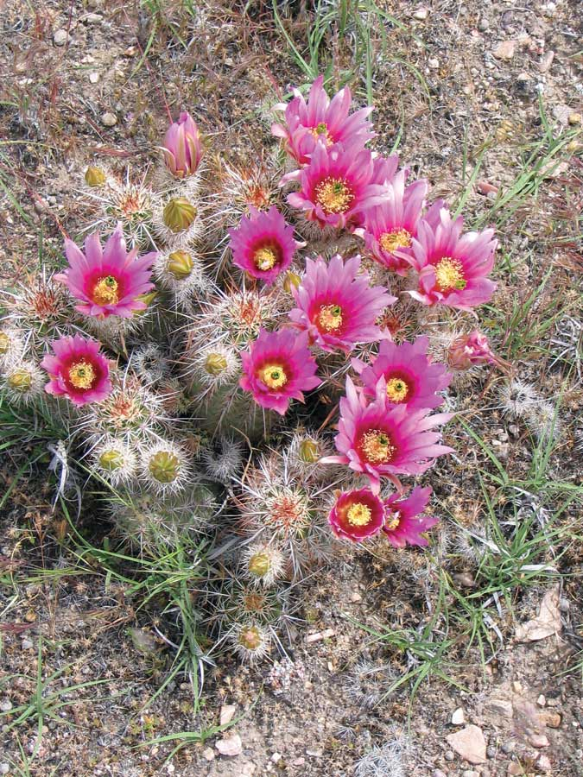
Desert Blooms
Just a few centimeters of water can trigger desert blooms, as seeds lie dormant on the ground for years.

Slide 10
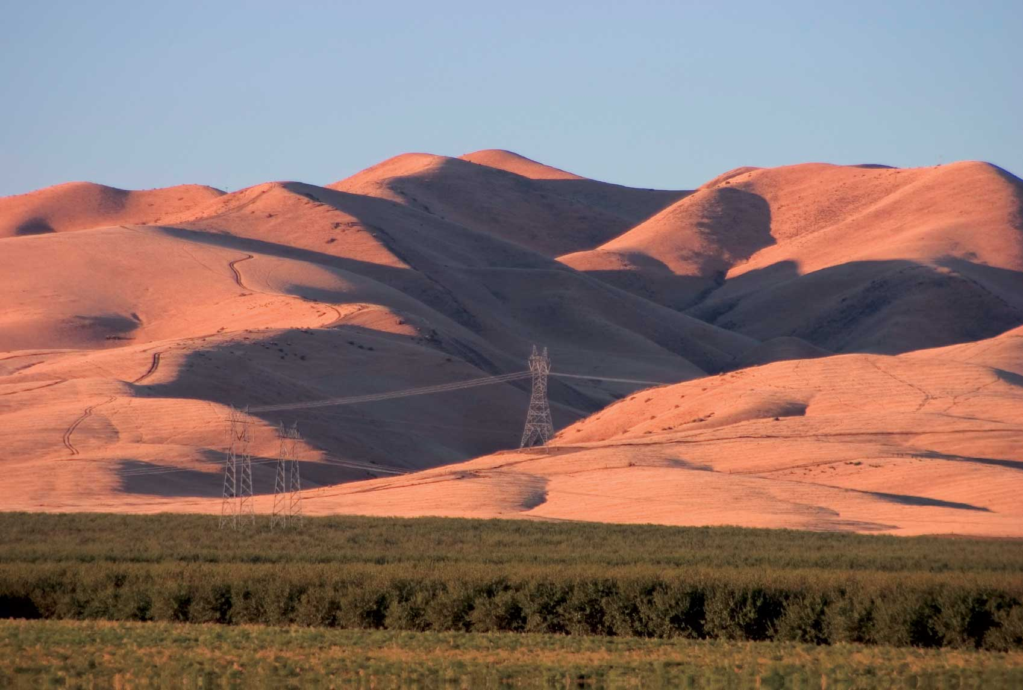
Irrigation can produce crops in the desert
Can the water be used up?

Slide 11
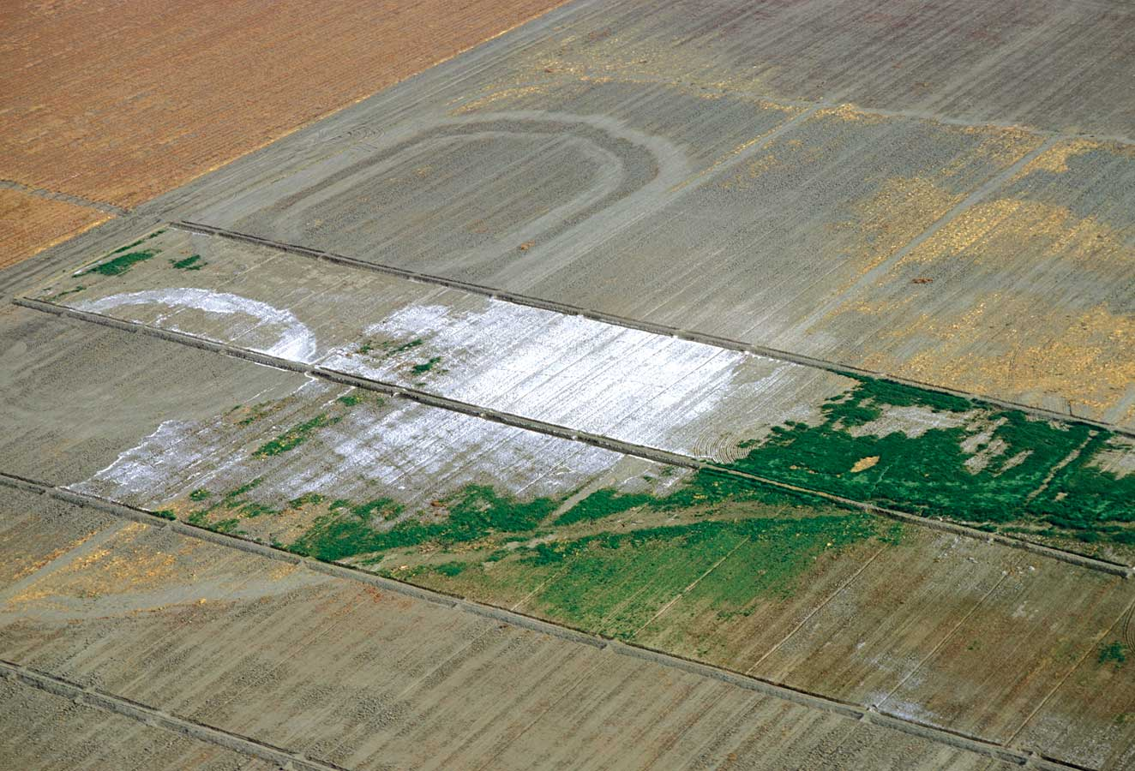
Irrigation in the desert can also produce SALT!
Where does this salt come from?
Notes:
Water, especially irrigation water, has salts in it. When water evaporates from the soil surface, the water leaves, but the salt stays behind. In dry climates, you add more water to the soil, and these salts build up over time. Plants cannot tolerate high quantities of soil.

Slide 12
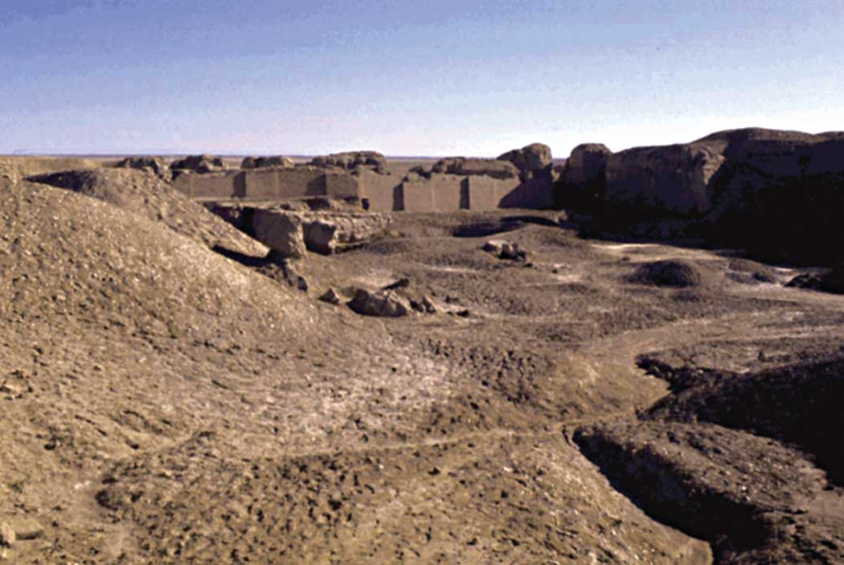
A Sumerian City from 3000 B.C. called Ur came from using sophisticated irrigation to grow crops.
The SOIL became SALTY, and crops cannot tolerate SALT.
Notes:
No city has been able to grow there since.

Slide 13
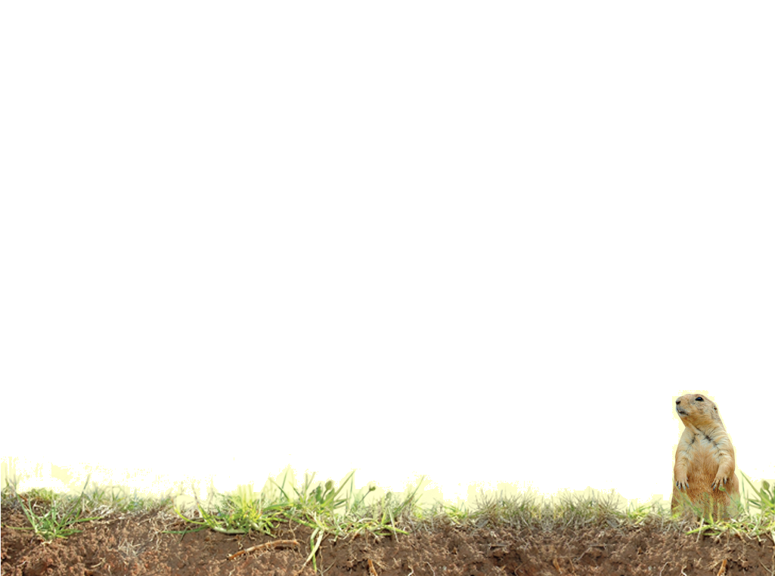
Vocabulary
Organic Matter
Salinization
Notes:
These words are defined in Soil! Get the Inside Scoop

Slide 14
Vocabulary
Irrigation - water is taken from other places to provide water to crops
Desert Blooms - the sudden blooming experienced in the desert after rainstorms when all of the dormant seeds spring to life
Biological Surface Crust - organisms like lichens, algae, and bacteria form a protective shield
Physical Surface Crust - raindrops strike the ground very hard it breaks the soil apart, and generates a crust that is platy
Notes:
These words are not defined in Soil! Get the Inside Scoop. The definitions are below.

