Slide 1
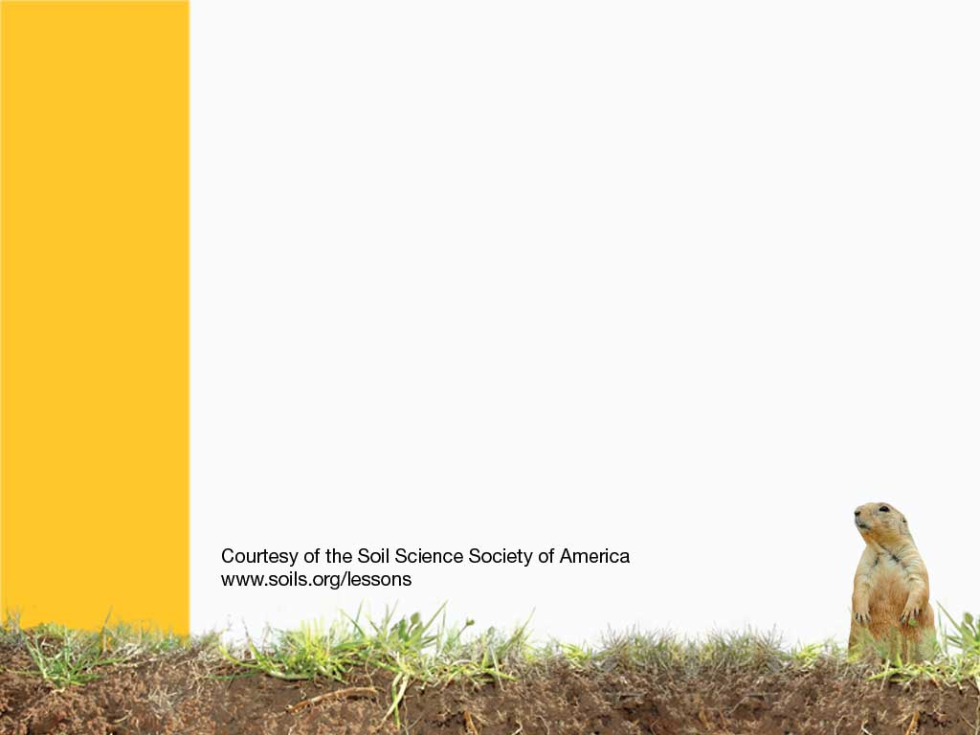
Around the World of Soils
Soil Types
Notes:
The entire section on soil orders is most appropriate for Grades 6+. It may be too much for younger grades. An exception would be to use the link below to find out what you state soil is. This is appropriate for any age group.
Soils around the world vary in color, texture, structure, and chemical, physical, and biological composition. To the uninformed, soils may appear to be quite uniform, especially at the local level, but in reality they can be very different just a few feet away. Soils are a function of the five soil-forming factors: climate, organisms, relief, parent material, and time. Each of these factors range on a continuum, so the different soils of the world number in the thousands.
1) Describe the main characteristic of each of the soil orders.
Alfisols - moderately leached soils often found in temperate forests
Andisols - soils formed in volcanic ash
Aridisols – desert soils
Entisols - soils with little or no morphological (horizon) development
Gelisols - soils with permafrost
Histosols - organic soils
Inceptisols - weakly developed soils
Mollisols - grassland soils
Spodosols – acidic, sandy forest soils under conifers
Oxisols - very weathered soils of tropical and subtropical environments
Ultisols – acidic, strongly leached, older soils
Vertisols - clayey soils that swell when wet
2) Indicate where each order can be found (in general terms).
Alfisols - temperate forests - generally east of the Mississippi
Andisols - soils formed in volcanic ash – Pacific Northwest
Aridisols – desert soils – desert southwest
Entisols - soils with little or no morphological (horizon) development – Beaches, sand dunes, and floodplains
Gelisols - soils with permafrost – tundra, Alaska
Histosols - organic soils – very wet area, parts of FL, MN, AK, MI, ME, NC
Inceptisols - weakly developed soils – almost anywhere
Mollisols - grassland soils – the Great Plains
Spodosols – acidic, sandy forest soils under conifers – Sandy areas of the North east to Minnesota, sandy areas of the Atlantic coastal plain
Oxisols - very weathered soils of tropical and subtropical environments – Puerto Rico and Hawaii
Ultisols – acidic, strongly leached, older soils – common in the Southeastern US
Vertisols - clayey soils that swell when wet – parts of Texas west to the desert southwest and east through Alabama, Mississippi Delta Region, northern Great Plains and parts of California
3) List the order(s) found in your state
see http://soils.ag.uidaho.edu/soilorders/index.htm and view each soil order to see its US exent.

Slide 2
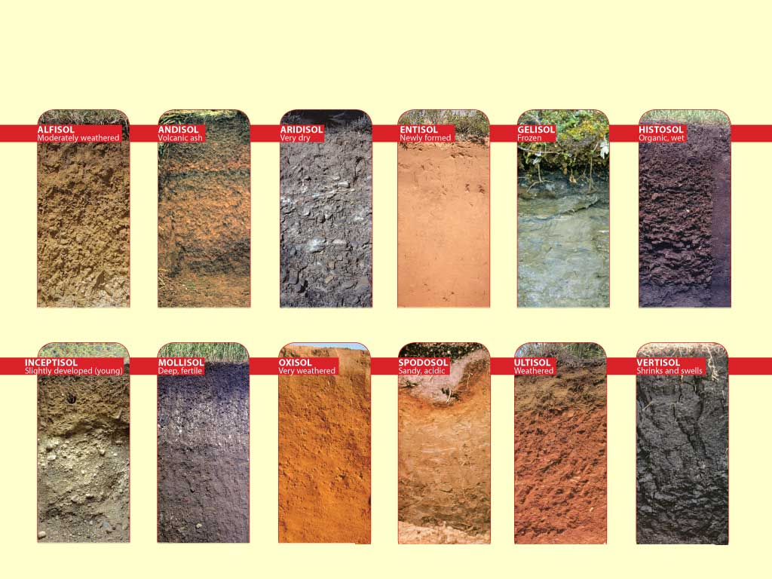
12 Soil Orders
Notes:
Soil scientists recognize 12 major orders of soils. A soil order classification is similar to the system biologists use to classify animals or plants into groups that have common properties. These orders are further refined into suborder, great groups, subgroups, families, and series. Thus, a name such as fine-loamy, mixed, mesic Typic Haplaquolls (Webster series) tells a soil scientist a great deal about the specific soil. Each state in the United States has an “official” state soil, just like each state has an official state flower or state bird. Be sure to check out the state soil in your location.
Alfisols - moderately leached soils often found in temperate forests
Andisols - soils formed in volcanic ash
Aridisols – desert soils
Entisols - soils with little or no morphological (horizon) development
Gelisols - soils with permafrost
Histosols - organic soils
Inceptisols - weakly developed soils
Mollisols - grassland soils
Spodosols – acidic, sandy forest soils under conifers
Oxisols - very weathered soils of tropical and subtropical environments
Ultisols – acidic, strongly leached, older soils
Vertisols - clayey soils that swell when wet

Slide 3
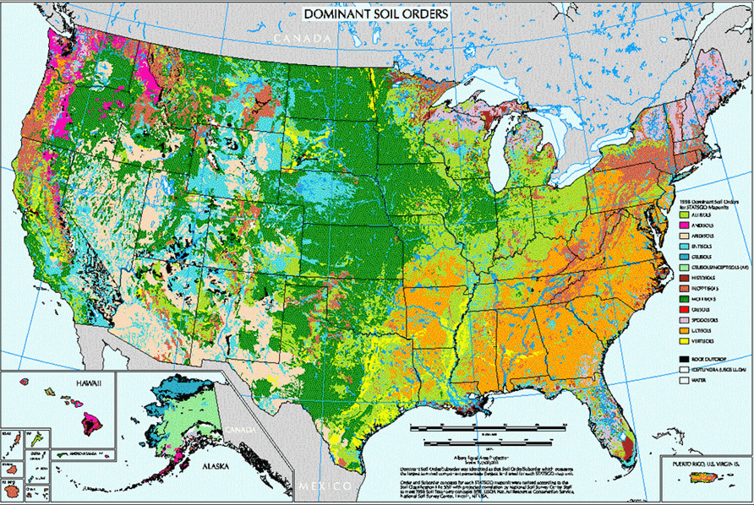
Soil Orders in US
Notes:
This map shows where the orders are fond in the US. Similar maps are available for other parts of the world. These can be found by googling for soil map and then the country or region.

Slide 4
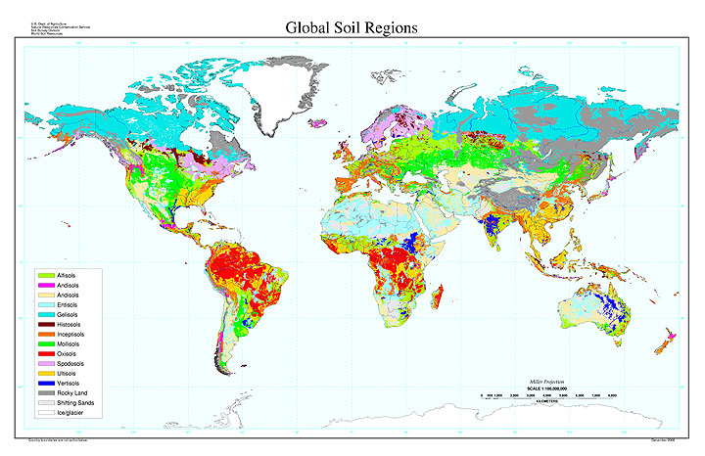
World View
Notes:
World View from http://soils.cals.uidaho.edu/soilorders/maps.htm

Slide 5
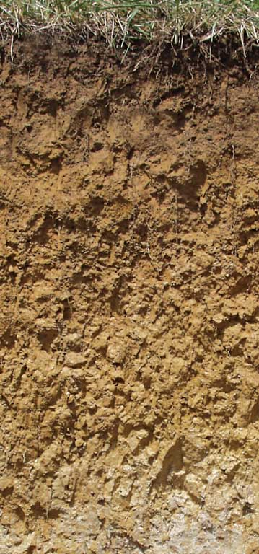
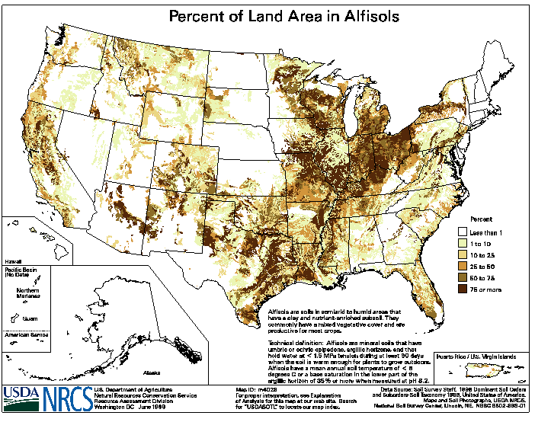
ALFISOL
Moderately Weathered
Notes:
Alfisols - moderately leached soils often found in temperate forests
http://soils.cals.uidaho.edu/soilorders/alfisols.htm
Alfisols are moderately leached soils that have relatively high native fertility. These soils have mainly formed under forest and have a subsurface horizon in which clays have accumulated. Alfisols are primarily found in temperate humid and subhumid regions of the world. Alfisols occupy ~10.1% of the global ice-free land area. In the US, they account for ~13.9% of the land area. Alfisols support about 17% of the world's population. The combination of generally favorable climate and high native fertility allows Alfisols to be very productive soils for both agricultural and silvicultural use.

Slide 6
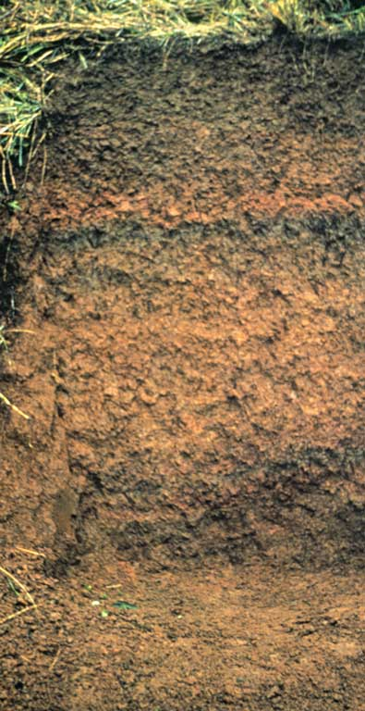
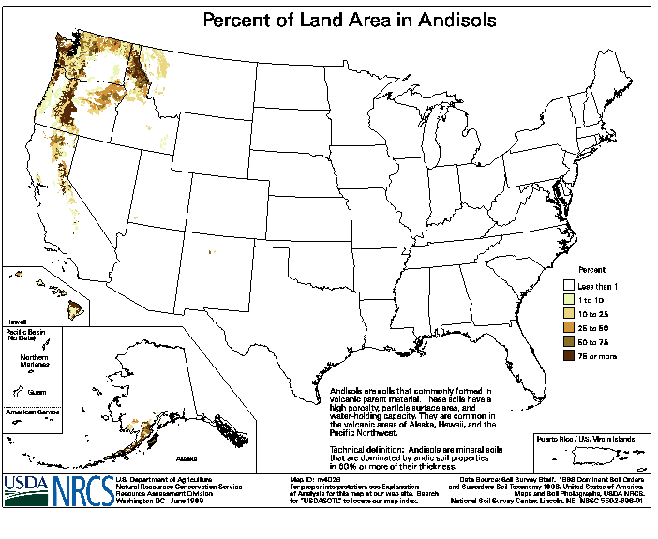
ANDISOL
Volcanic ash
Notes:
Andisols - soils formed in volcanic ash
http://soils.cals.uidaho.edu/soilorders/andisols.htm
Andisols are soils that have formed in volcanic ash or other volcanic ejecta. They differ from those of other orders in that they typically are dominated by glass and short-range-order colloidal weathering products such as allophane, imogolite, and ferrihydrite. As a result, Andisols have andic properties - unique chemical and physical properties that include high water-holding capacity and the ability to 'fix' (and make unavailable to plants) large quantities of phosphorus. Globally, Andisols are the least extensive soil order and only account for ~1% of the ice-free land area. They occupy ~1.7% of the US land area, including some very productive forests in the Pacific Northwest region.

Slide 7
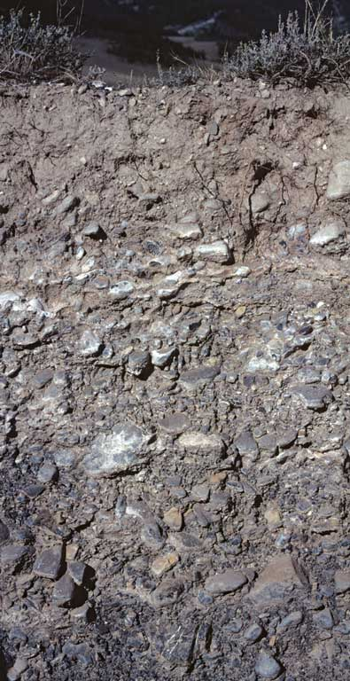
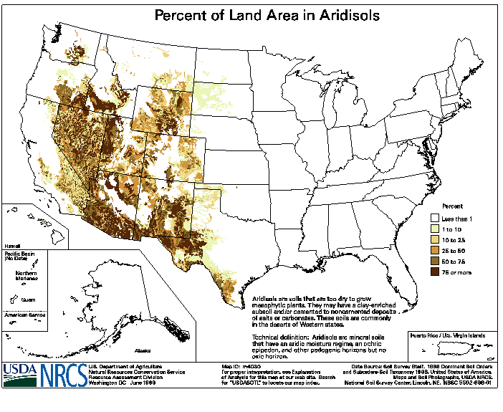
ARIDISOL
Very Dry
Notes:
Aridisols – desert soils
http://soils.cals.uidaho.edu/soilorders/aridisols.htm
Aridisols are CaCO₃-containing soils of arid regions that exhibit at least some subsurface horizon development. They are characterized by being dry most of the year and limited leaching. Aridisols contain subsurface horizons in which clays, calcium carbonate, silica, salts, and/or gypsum have accumulated. Materials such as soluble salts, gypsum, and CaCO₃ tend to be leached from soils of moister climates. Aridisols occupy ~12% of the Earth's ice-free land area and ~8.3% of the US. Aridisols are used mainly for range, wildlife, and recreation. Because of the dry climate in which they are found, they are not used for agricultural production unless irrigation water is available.

Slide 8
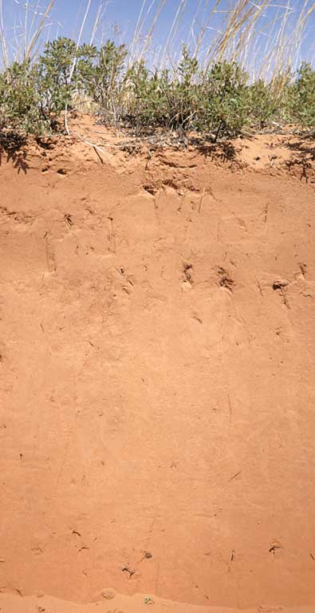
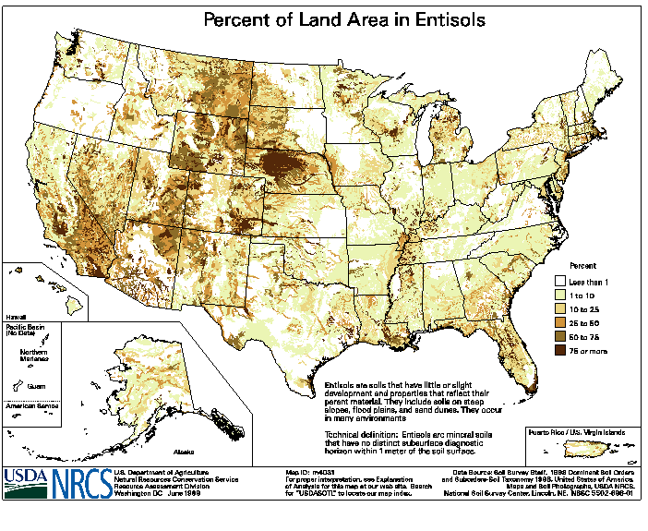
ENTISOL
Newly Formed
Notes:
Entisols - soils with little or no morphological (horizon) development
http://soils.cals.uidaho.edu/soilorders/entisols.htm
Entisols are soils of recent origin. The central concept is soils developed in unconsolidated parent material with usually no genetic horizons except an A horizon. All soils that do not fit into one of the other 11 orders are Entisols. Thus, they are characterized by great diversity, both in environmental setting and land use. Many Entisols are found in steep, rocky settings. However, Entisols of large river valleys and associated shore deposits provide cropland and habitat for millions of people worldwide. Globally Entisols are the most extensive of the soil orders, occupying ~18% of the Earth's ice-free land area. In the US, Entisols occupy ~12.3% of the land area.

Slide 9
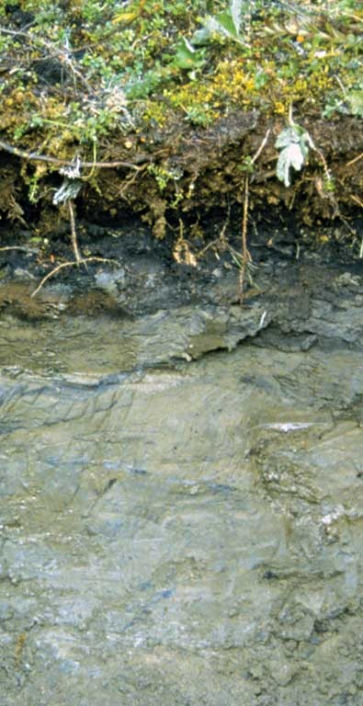
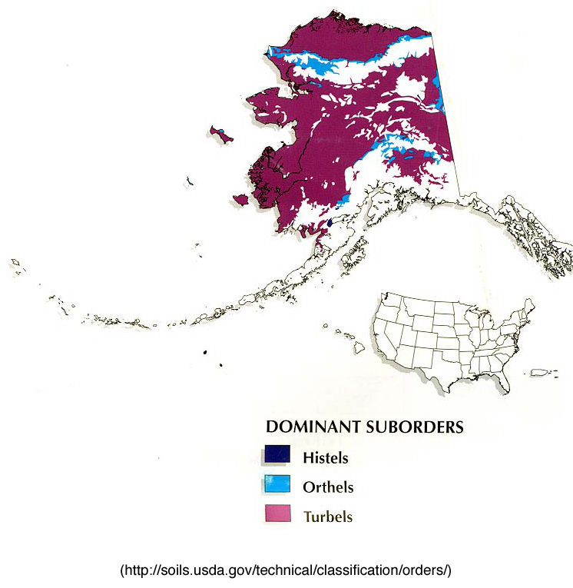
Gelisol
Frozen
Notes:
Gelisols - soils with permafrost
http://soils.cals.uidaho.edu/soilorders/gelisols.htm
Gelisols are soils of very cold climates that contain permafrost within 2 meters of the surface. These soils are limited geographically to the high-latitude polar regions and localized areas at high mountain elevations. Because of the extreme environment in which they are found, Gelisols support only ~0.4% of the world's population - the lowest percentage of any of the soil orders. Gelisols are estimated to occupy ~9.1% of the Earth's ice-free land area and ~8.7% of the US. Although some Gelisols may occur on very old land surfaces, they show relatively little morphological development. Low soil temperatures cause soil-forming processes such as decomposition of organic materials to proceed very slowly. As a result, most Gelisols store large quantities of organic carbon - only soils of wetland ecosystems contain more organic matter. Gelisols of the dry valleys of Antarctica are an exception - they occur in a desert environment with no plants and consequently contain very low quantities of organic carbon. The frozen condition of Gelisol landscapes makes them sensitive to human activities.

Slide 10
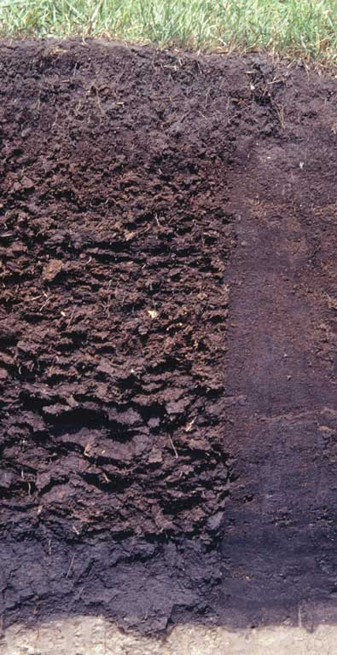
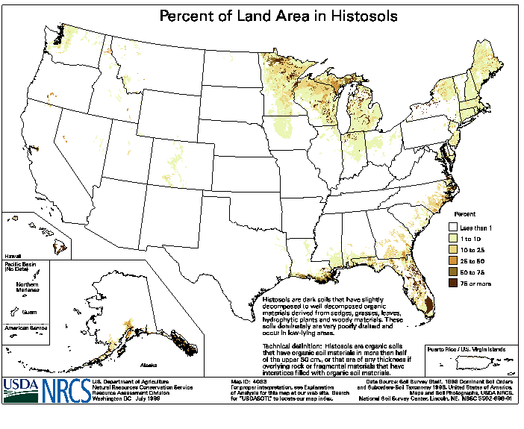
HISTOSOL
Organic, Wet
Notes:
Histosols - organic soils
http://soils.cals.uidaho.edu/soilorders/histosols.htm
Histosols are soils that are composed mainly of organic materials. They contain at least 20-30% organic matter by weight and are more than 40 cm thick. Bulk densities are quite low, often less than 0.3 g cm3. Most Histosols form in settings such as wetlands where restricted drainage inhibits the decomposition of plant and animal remains, allowing these organic materials to accumulate over time. As a result, Histosols are ecologically important because of the large quantities of carbon they contain. These soils occupy ~1.2% of the ice-free land area globally and ~1.6% of the US. Histosols are often referred to as peats and mucks and have physical properties that restrict their use for engineering purposes. These include low weight-bearing capacity and subsidence when drained. They are mined for fuel and horticultural products.

Slide 11
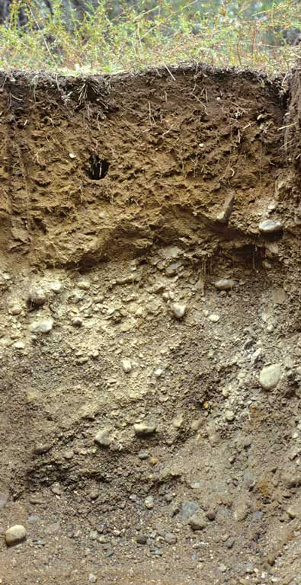
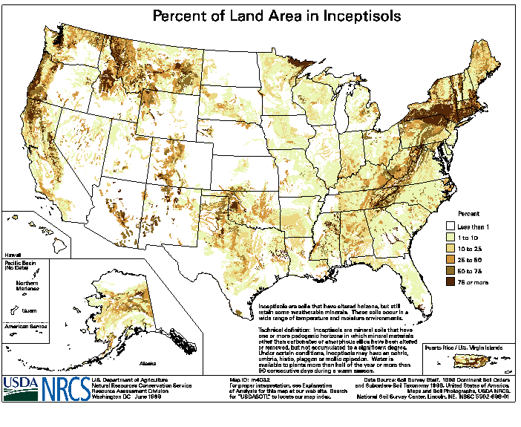
INCEPTISOL
Slightly Developed (young)
Notes:
Inceptisols - weakly developed soils
http://soils.cals.uidaho.edu/soilorders/inceptisols.htm
Inceptisols are soils that exhibit minimal horizon development. They are more developed than Entisols, but still lack the features that are characteristic of other soil orders. Although not found under aridic climate regimes, Inceptisols nevertheless are widely distributed and occur across a wide range of ecological settings.They are often found on fairly steep slopes, young geomorphic surfaces, and on resistant parent materials. Land use varies considerably with Inceptisols. A sizable percentage of Inceptisols are found in mountainous areas and are used for forestry, recreation, and watershed. Inceptisols occupy an estimated 15% of the global ice-free land area – only the Entisols are more extensive. In the US, they occupy ~9.7% of the land area. Inceptisols support ~20% of the world's population, the largest percentage of any of the soil orders.

Slide 12
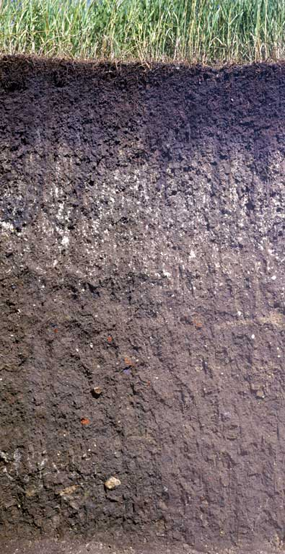
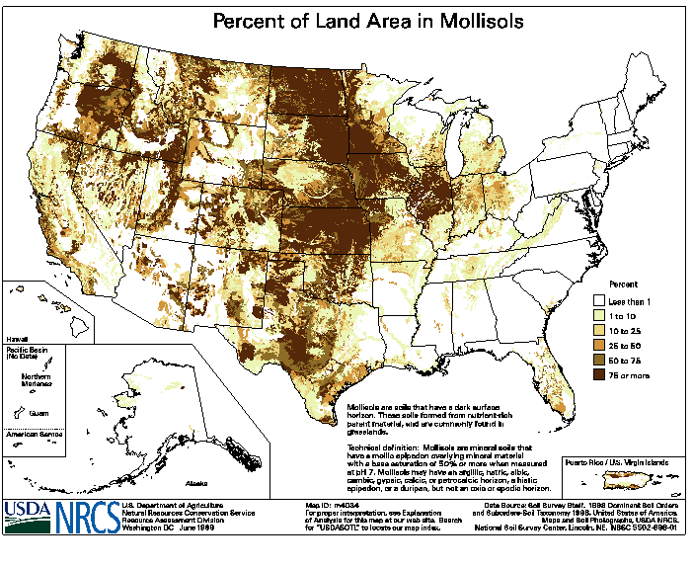
MOLLISOL
Deep, Fertile
Notes:
Mollisols - grassland soils
http://soils.cals.uidaho.edu/soilorders/mollisols.htm
Mollisols are the soils of grassland ecosystems. They are characterized by a thick, dark surface horizon. This fertile surface horizon, known as a mollic epipedon, results from the long-term addition of organic materials derived from plant roots. Mollisols primarily occur in the middle latitudes and are extensive in prairie regions such as the Great Plains of the US. Globally, they occupy ~7.0% of the ice-free land area. In the US, they are the most extensive soil order, accounting for ~21.5% of the land area. Mollisols are among some of the most important and productive agricultural soils in the world and are extensively used for this purpose.

Slide 13
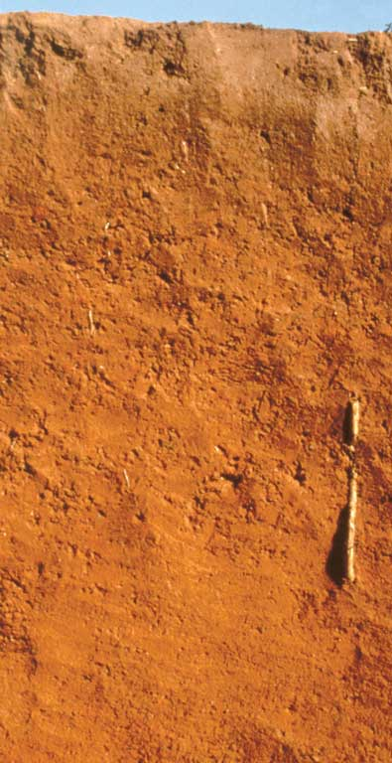
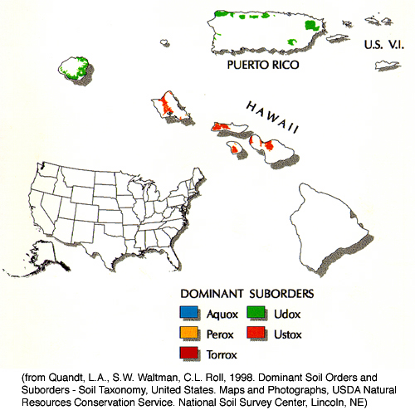
OXISOL
Very Weathered
Notes:
Oxisols - very weathered soils of tropical and subtropical environments
http://soils.cals.uidaho.edu/soilorders/oxisols.htm
Oxisols are very highly weathered soils that are found primarily in the intertropical regions of the world. These soils contain few weatherable minerals and are often rich in Fe and Al oxide minerals. Oxisols occupy ~7.5% of the global ice-free land area. In the US, they only occupy ~0.02% of the land area and are restricted to Hawaii. Most of these soils are characterized by extremely low native fertility, resulting from very low nutrient reserves, high phosphorus retention by oxide minerals, and low cation exchange capacity (CEC). Most nutrients in Oxisol ecosystems are contained in the standing vegetation and decomposing plant material. Despite low fertility, Oxisols can be quite productive with inputs of lime and fertilizers.

Slide 14
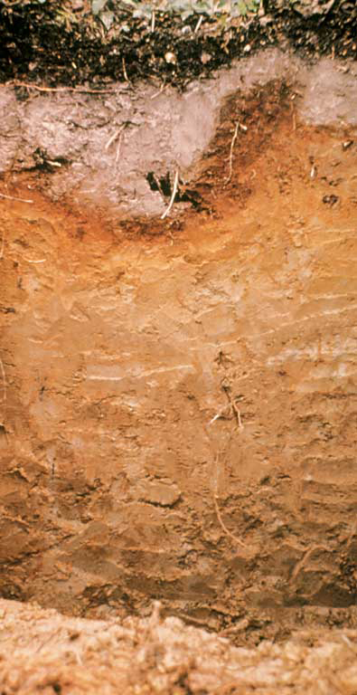
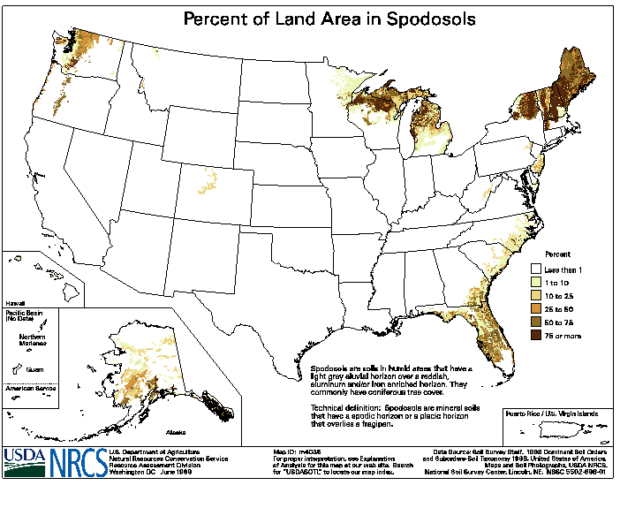
SPODOSOL
Sandy, Acidic
Notes:
Spodosols – acidic, sandy forest soils under conifers
http://soils.cals.uidaho.edu/soilorders/spodosols.htm
Spodosols are acid soils characterized by a subsurface accumulation of humus that is complexed with Al and Fe. These photogenic soils typically form in coarse-textured parent material and have a light-colored E horizon overlying a reddish-brown spodic horizon. The process that forms these horizons is known as podzolization. Spodosols often occur under coniferous forest in cool, moist climates. Globally, they occupy ~4% of the ice-free land area. In the US, they occupy ~3.5% of the land area. Many Spodosols support forest. Because they are naturally infertile, Spodosols require additions of lime in order to be productive agriculturally.

Slide 15
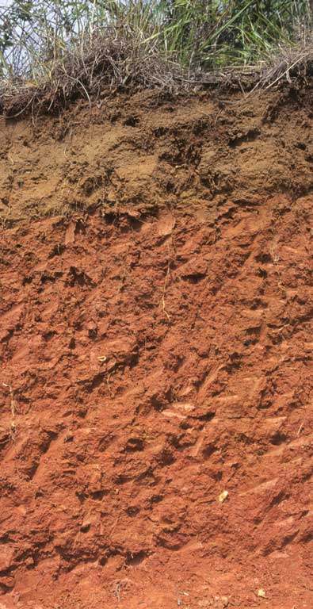
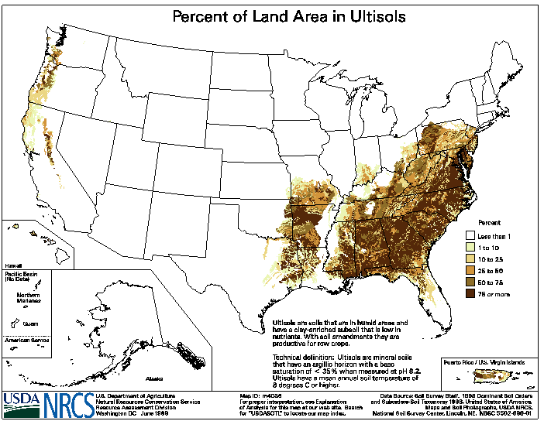
ULTISOL
Weathered
Notes:
Ultisols – acidic, strongly leached, older soils
http://soils.cals.uidaho.edu/soilorders/ultisols.htm
Ultisols are strongly leached, acid forest soils with relatively low native fertility. They are found primarily in humid temperate and tropical areas of the world, typically on older, stable landscapes. Intense weathering of primary minerals has occurred, and much Ca, Mg, and K has been leached from these soils. Ultisols have a subsurface horizon in which clays have accumulated, often with strong yellowish or reddish colors resulting from the presence of Fe oxides. The 'red clay' soils of the southeastern United States are examples of Ultisols.
Ultisols occupy ~8.1% of the global ice-free land area and support 18% of the world's population. They are the dominant soils of much of the southeastern US and occupy ~9.2% of the total US land area.
Because of the favorable climate regimes in which they are typically found, Ultisols often support productive forests. The high acidity and relatively low quantities of plant-available Ca, Mg, and K associated with most Ultisols make them poorly suited for continuous agriculture without the use of fertilizer and lime. With these inputs, however, Ultisols can be very productive.

Slide 16
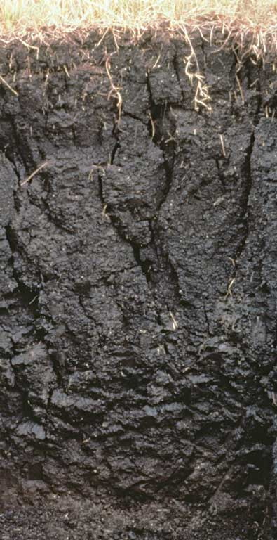
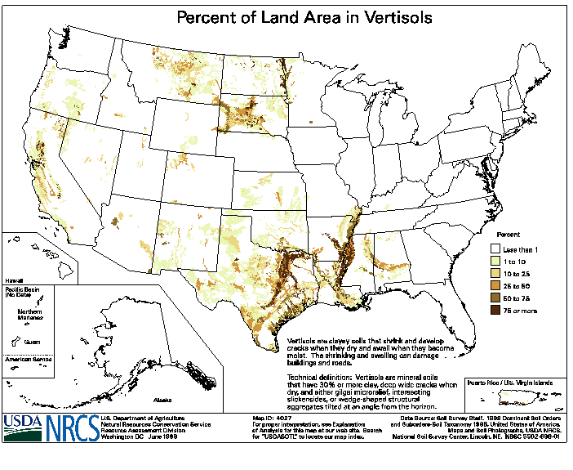
VERTISOL
Shrinks and Swells
Notes:
Vertisols - clayey soils that swell when wet
http://soils.cals.uidaho.edu/soilorders/vertisols.htm
Vertisols are clay-rich soils that shrink and swell with changes in moisture content. During dry periods, the soil volume shrinks, and deep wide cracks form. The soil volume then expands as it wets up. This shrink/swell action creates serious engineering problems and generally prevents formation of distinct, well-developed horizons in these soils.
Globally, Vertisols occupy ~2.4% of the ice-free land area. In the US, they occupy ~2.0% of the land area and occur primarily in Texas.

Slide 17
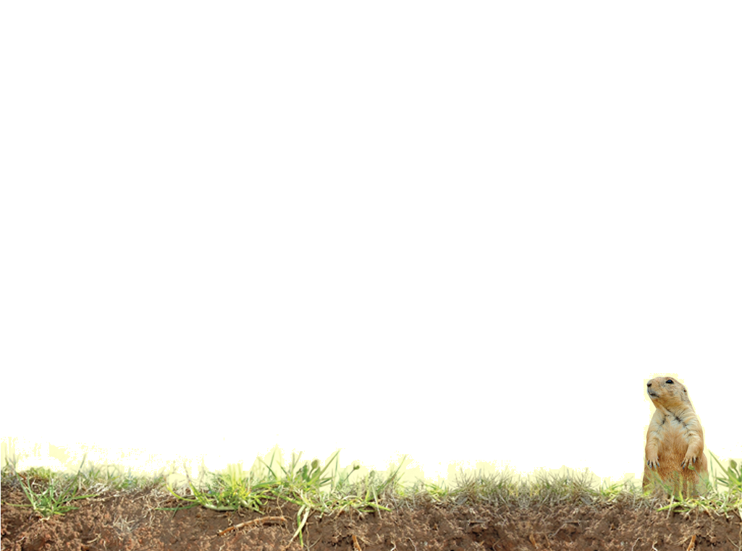
Where are the Orders found?
Alfisols - temperate forests - generally east of the Mississippi
Andisols - soils formed in volcanic ash – Pacific Northwest
Aridisols – desert soils – desert southwest
Entisols - soils with little or no morphological (horizon) development – Beaches, sand dunes, and floodplains
Gelisols - soils with permafrost – tundra, Alaska
Histosols - organic soils – very wet area, parts of FL, MN, AK, MI, ME, NC
Inceptisols - weakly developed soils – almost anywhere
Mollisols - grassland soils – the Great Plains
Spodosols – acidic, sandy forest soils under conifers – Sandy areas of the North east to Minnesota, sandy areas of the Atlantic coastal plain
Oxisols - very weathered soils of tropical and subtropical environments – Puerto Rico and Hawaii
Ultisols – acidic, strongly leached, older soils – common in the SE US
Vertisols - clayey soils that swell when wet – parts of Texas west to the desert southwest and east through Alabama, Mississippi Delta Region, northern Great Plains and parts of California
Notes:
Alfisols - temperate forests - generally east of the Mississippi
Andisols - soils formed in volcanic ash – Pacific Northwest
Aridisols – desert soils – desert southwest
Entisols - soils with little or no morphological (horizon) development – Beaches, sand dunes, and floodplains
Gelisols - soils with permafrost – tundra, Alaska
Histosols - organic soils – very wet area, parts of FL, MN, AK, MI, ME, NC
Inceptisols - weakly developed soils – almost anywhere
Mollisols - grassland soils – the Great Plains
Spodosols – acidic, sandy forest soils under conifers – Sandy areas of the North east to Minnesota, sandy areas of the Atlantic coastal plain
Oxisols - very weathered soils of tropical and subtropical environments – Puerto Rico and Hawaii
Ultisols – acidic, strongly leached, older soils – common in the Southeastern US
Vertisols - clayey soils that swell when wet – parts of Texas west to the desert southwest and east through Alabama, Mississippi Delta Region, northern Great Plains and parts of California

Slide 18
Vocabulary
Alfisols - moderately leached soils often found in temperate forests
Andisols - soils formed in volcanic ash
Aridisols – desert soils
Entisols - soils with little or no morphological (horizon) development
Gelisols - soils with permafrost
Histosols - organic soils
Inceptisols - weakly developed soils
Mollisols - grassland soils
Spodosols – acidic, sandy forest soils under conifers
Oxisols - very weathered soils of tropical and subtropical environments
Ultisols – acidic, strongly leached, older soils
Vertisols - clayey soils that swell when wet
Notes:
These definitions are not in Soil! Get the Inside Scoop

