Slide 1
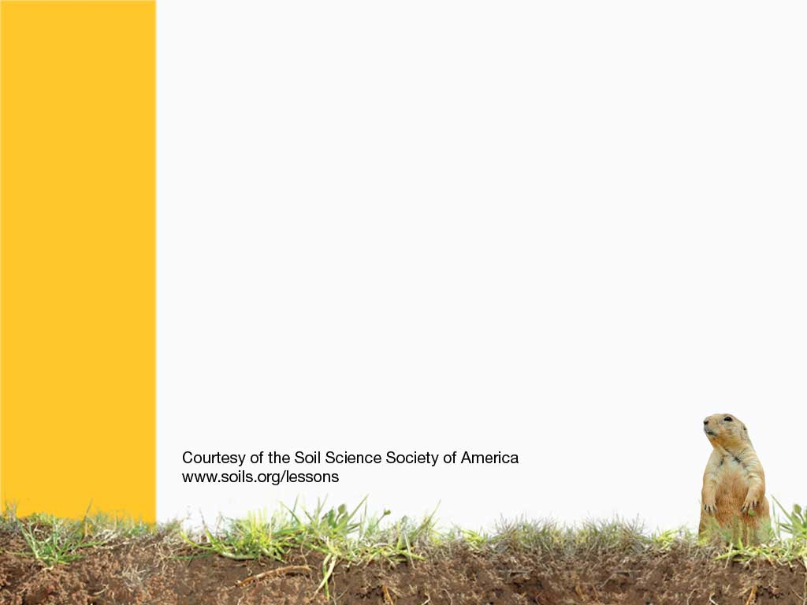
How do soils form?
Soil Profiles
Notes:
This presentation will help students be able to describe what a soil profile looks like?
They will be able to define the difference between a layer and a horizon.
Layers- are typically unweathered material
Soil Horizons – O, A, E, B, C, R have been weathered or altered by the 4 formations processes (additions ,subtractions, translocations, and transformations) that are discussed in another chapter.
They will be able to define and identify the common horizons in the soil
Soil Horizons – O, A, E, B, C, R
They will be able to see that soil horizons are different and that not all horizons may be present.
All horizons are not always present. Most typical profile is A-B-C in fields or O-A-B-C in forests. The R horizon may be very shallow or very deep.

Slide 2
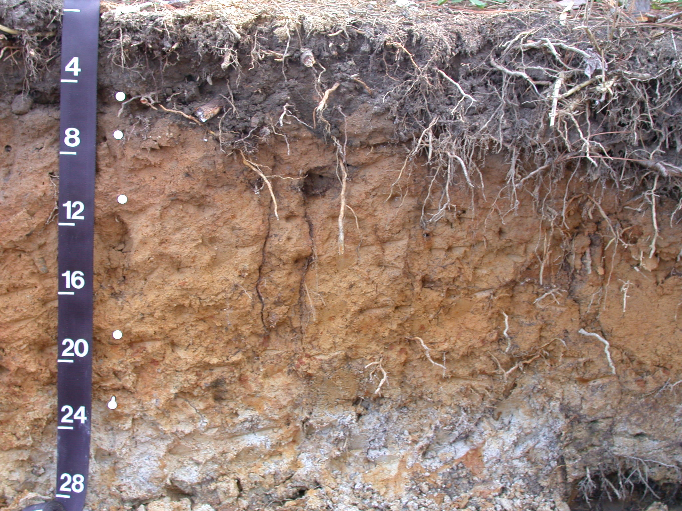
How do you start describing the soil?
What do you see?
What is different from top to bottom?
How deep do roots go?
Notes:
Ask the class these questions to generate discussion.
The changes in color, texture, etc. are due to soil processes. The resulting changes cause indentifiable Soil Horizons. It is often easy to see these changes by color but they are also observed by the feel or texture of the soil.
Some key points:
Dark color on top is due to organic matter coating the soil particles or a lot of organic material in general
Gray colors often mean the soil is wet for at least part of the year.
The depth that root grow can indicate
if the soil gets hard or
if nutrients are not present or
if the soil gets too wet or too dry for the roots to survive

Slide 3
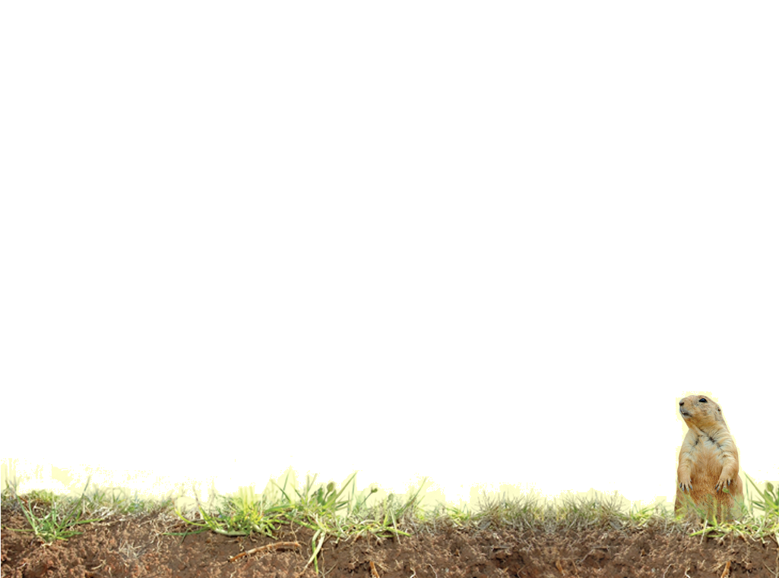
Soil Profile Descriptions
Soil Profile - A vertical section of the soil extending vertically through all its horizons and into the parent material.
Soil Horizon - A layer of soil, approximately parallel to the surface, with properties that differ from the horizons above or below it – the properties (characteristics) are produced by soil forming processes.
Soil Layer - A layer in the soil deposited by a geologic force (wind, water, glaciers, oceans, etc.) and not relating to soil forming process.
Notes:
The soil is formed from parent material (see chapter 4c for factors of formation – CLORPT).
A soil profile, horizon and layer are defined above
Each horizon has specific characteristics. Different characteristics mean different horizons or sub horizons. Putting all the horizons together make the soil profile.

Slide 4
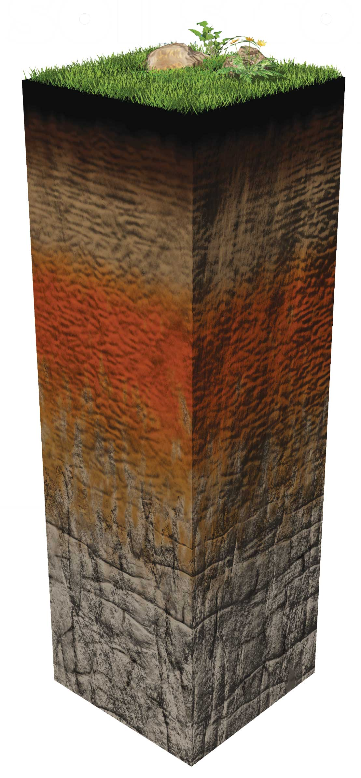
O (humus or organic)
Decomposing leaves and lots of organic matter
A (topsoil)
Contains lots of roots, and minerals for growing plants
E (eluviated layer or EXIT layer)
Materials, minerals, organic matter, and clays exit the soil profile
B (subsoil)
Minerals from upper horizons stop here
C (parent material)
Earth’s surface that soils developed from
R (bedrock)
Notes:
The idealized soil profile as a soil scientist would see it. The next 2 slides show a real soil using common terminology and the soil terminology.
What is the O horizon? Decomposing organic matter, leaves, and plant roots. Not all soils have it, in some it is very thick. What is humus?
The A horizon is where most of the minerals and nutrients for plants are.
E Horizon -Not all soils have it, but clays, minerals, and organic matter leach out of the soil. E also stands for exit. The soil is lighter in color. Not all soils have it
B- All minerals that leach down from higher up in the soil accumulate here. Not all soils have this layer either
C – This deposit is the material that soils form from
R- Bedrock, not all soils have it near enough to the surface. It may break down and create the parent material, but not always.

Slide 5
Top Soil
Subsoil
Parent Material
Notes:
These are the more common terms for the layers.

Slide 6
A Horizon
B Horizon
C Horizon
Notes:
Terms a soil scientist shall use.
Color changes show these. Changes could be due to any soil property.

Slide 7
Remember the Ideal Profile
Using this Pneumonic Device:
Our
Aunt
Ethel
Bakes
Cookies
Regularly
Notes:
Back to the idealized profile.
One could remember the horizons in order using this pneumonic:
Our Aunt Ethel Bakes Cookies Regularly
In the next set of slides each horizon shall be described. Remember that all horizons may not be present in any one soil profile due to how the soil formed and where it is located.

Slide 8
Organic (O) Horizons
O horizons or layers: Layers dominated by organic material.
Identification Criteria
>20% organic matter
Dark color (
Feels ‘Squishy”
Identifiable dead leaves, grass, etc. accumulated at surface
Notes:
The O horizon is dominated by organic matter. It is often confused with the A horizon. The best way to tell if it is an O is to feel it. The O will be squishy, or light in weight. If there are a lot of identifiable dead leaves from previous falls present this is also a good way to tell if it is an O. Living roots however do not make it an O horizon

Slide 9
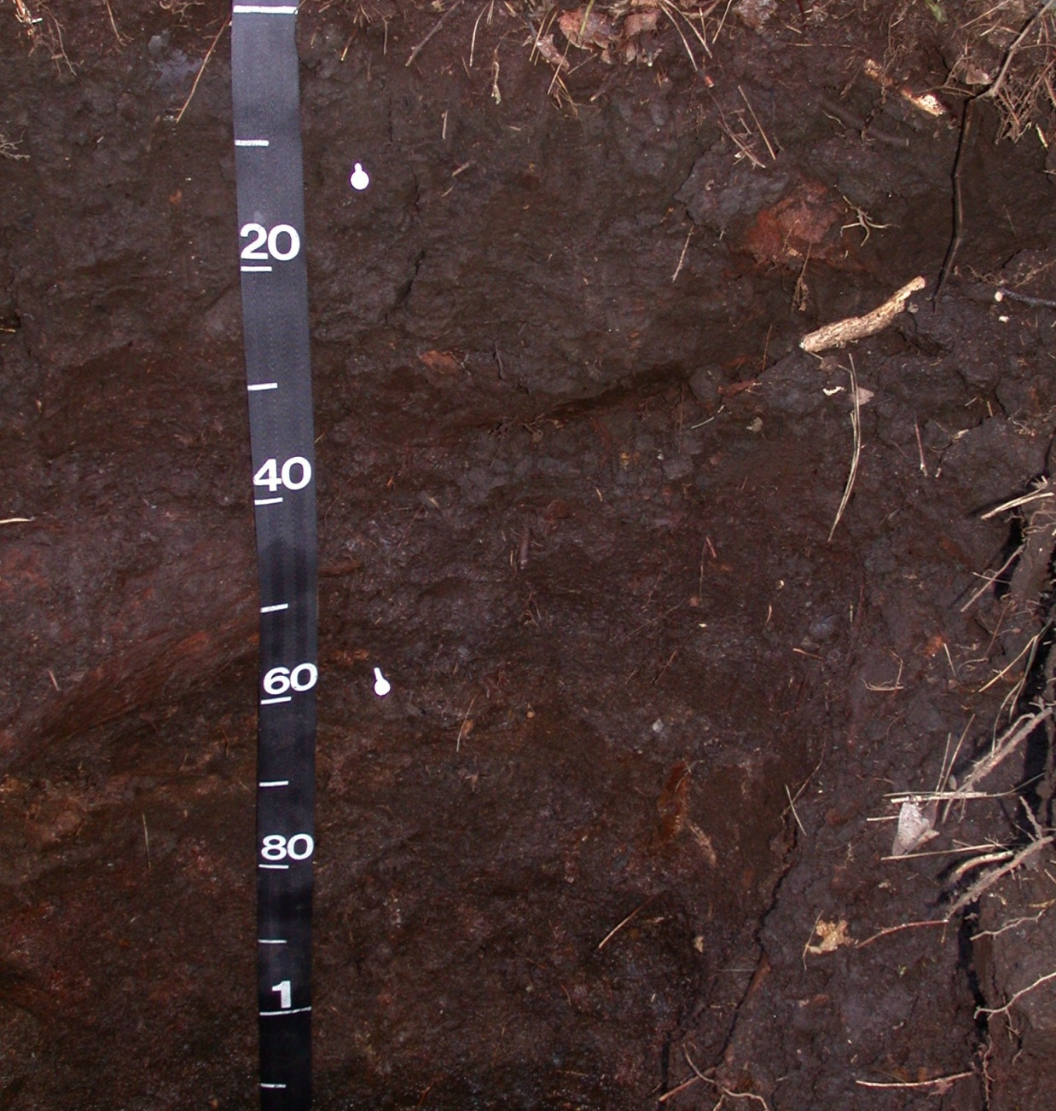
Notes:
This is a thick Organic or O horizon from peat lands in eastern North Carolina. The scale is in centimeters. The entire profile is labled as an O horizon. No other horizons are present.

Slide 10
Notes:
The leaf litter at the top of the profile and the horizon 3-5 cm below are O horizons (slightly reddish brown in color). From 3 to 20 cm it is an A horizon even though it is dark in color.
Scale is in cm.

Slide 11
A Horizons
Referred to as topsoil
Typically ranging from 6-30 centimeters thick
Mineral horizon formed at the surface or below an O horizon.
Characterized by an accumulation of well decomposed organic matter intimately mixed with the mineral fraction.
Identification Criteria
Mineral soil material
Mix of well decomposed organic matter and mineral material
Surface mineral horizon
Typically dark in color-darker than underlying horizons
Notes:
The A horizon may look like an O horizon in that it is dark. The color is due to a small amount of organic matter mixed in as well as orgainc matter coating particles.
The A horizon may feel a little greasier than the horizon below but it will not be squishy like an O horizon.
The A horizon is often referred to as Topsoil and contains many nutrients for plant growth.

Slide 12
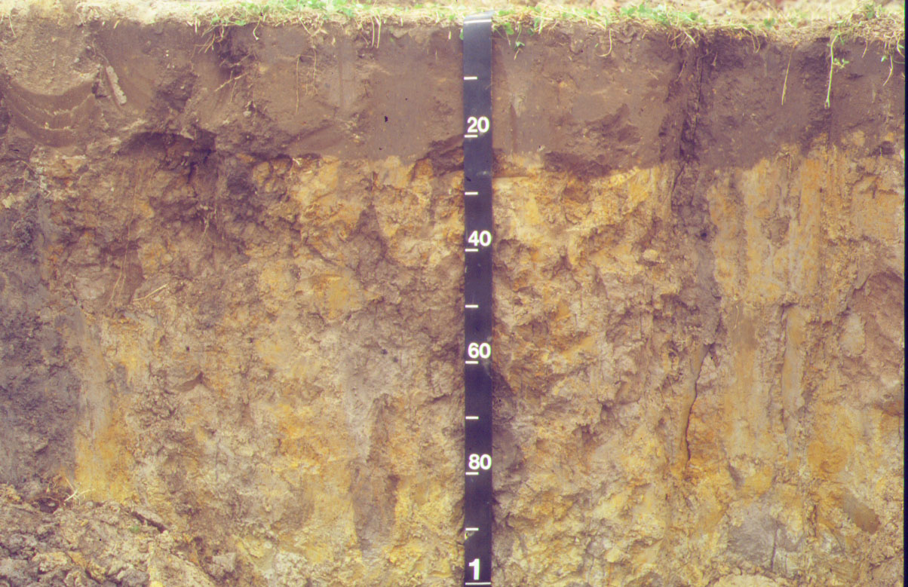
A Horizon
Notes:
A horizon (plow layer) or top soil 0-25 cm. Note how abrupt the transition is from the A to the lower horizon. This is due to plowing or tillage for agriculture. This mixes the A horizon to an even depth. In a forested or uncultivated soil the transition would be more gradual. Some soils may retain this abrupt change even after 10s of years of not being cultivated.
The horizon below is a B horizon (25-100 cm). There is no E horizon because it has been mixing in with the A horizon due to cultivation.
Yellow colors are iron oxides and the black streaks are where A horizon material has fallen in to crayfish burrows and old root channels.
Scale is in centimeters

Slide 13
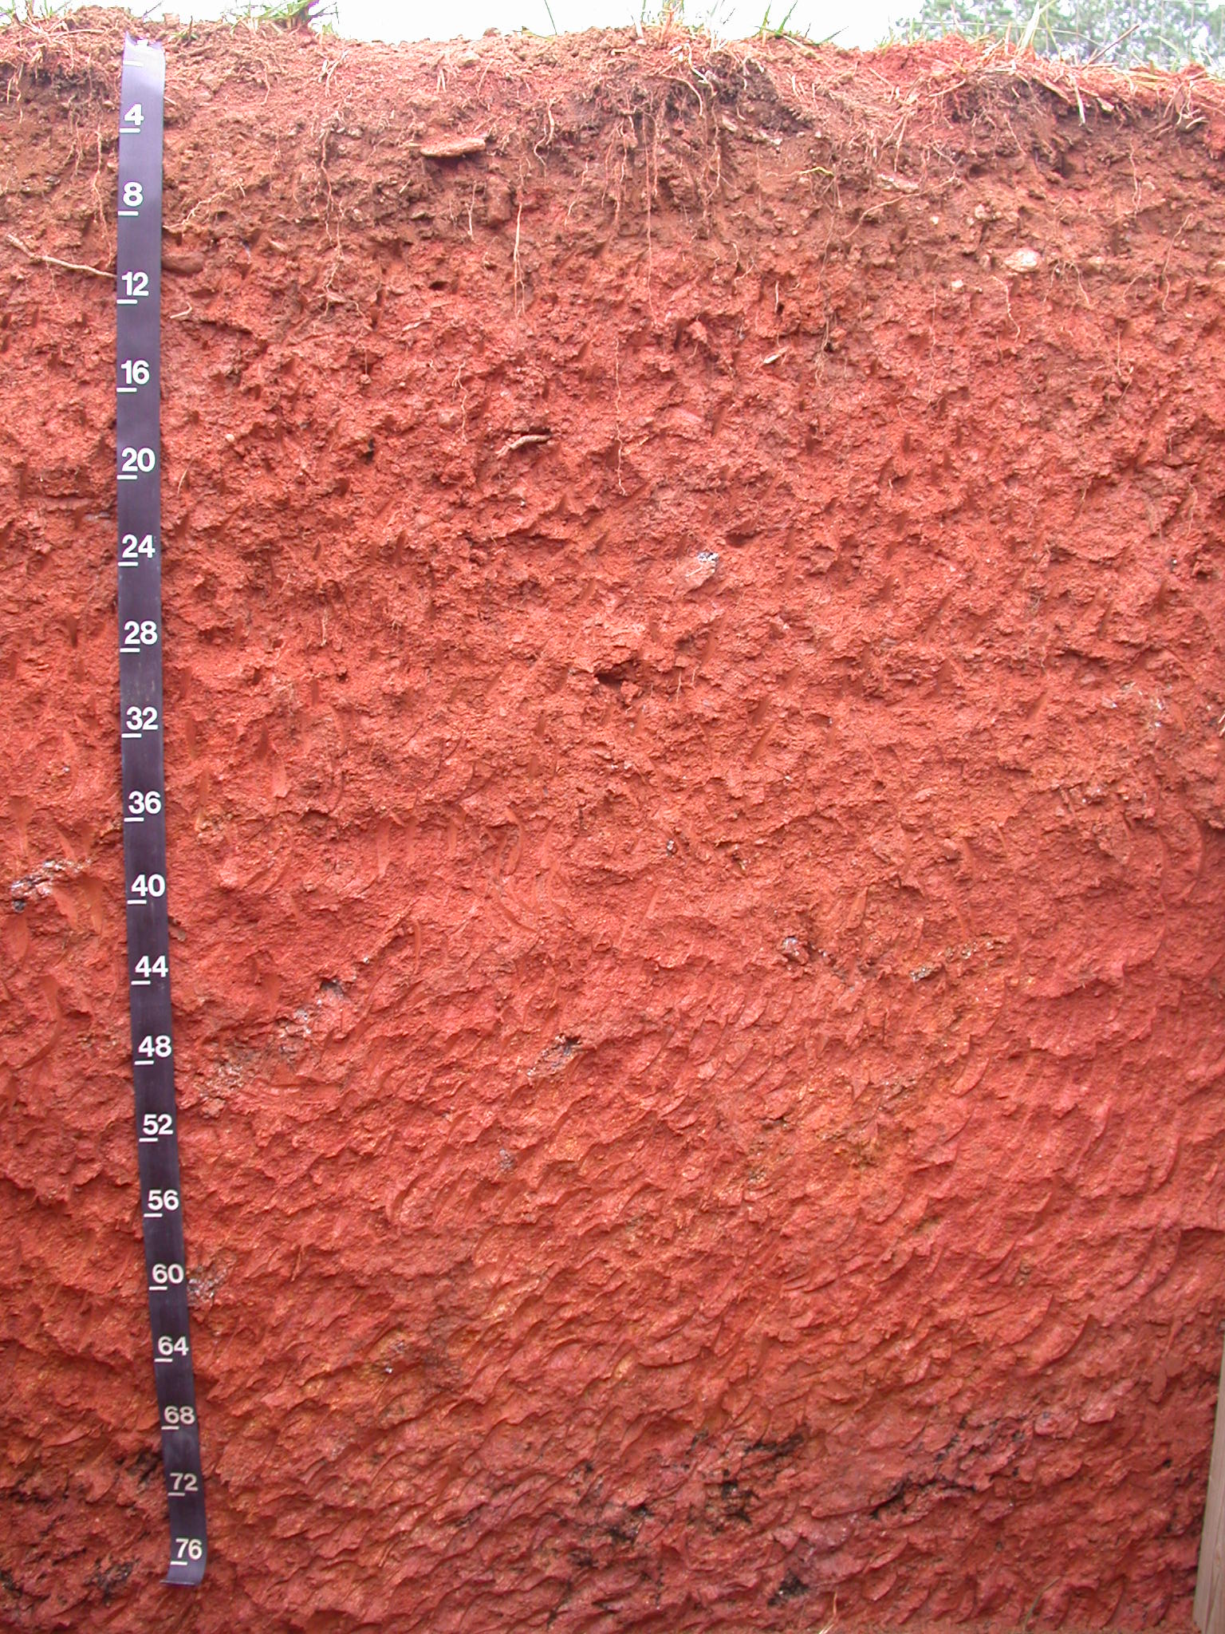
A Horizon
Notes:
A poorly defined A horizon (0-8 inches) typical of the southern US piedmont in that it is only slightly darker than the horizons below. This is often due to the farming practices that have allowed the A horizon to be eroded away and the small amount of organic material added to the soil annually.
Scale is in inches. The horizons below the A horizon are the B horizon (8-64 inches) and the C horizon (64-76+ inches)

Slide 14
E Horizons
Mineral horizon in the upper part of the soil typically underlying an O or A horizon.
Light colored, leached horizons ranging from not being present to several centimeters thick
Light color due to the natural color of the mineral grains.
Formed by weak organic acids that strip coatings from mineral grains.
Field Identification
Zone of eluviation - removal of clays, Fe, Al, and humus
Lighter in color than over or underlying horizon
Near surface, below O or A horizons and above a B horizon
Notes:
The E horizon may or may not be present. It is a zone of leaching or Eluviation.

Slide 15
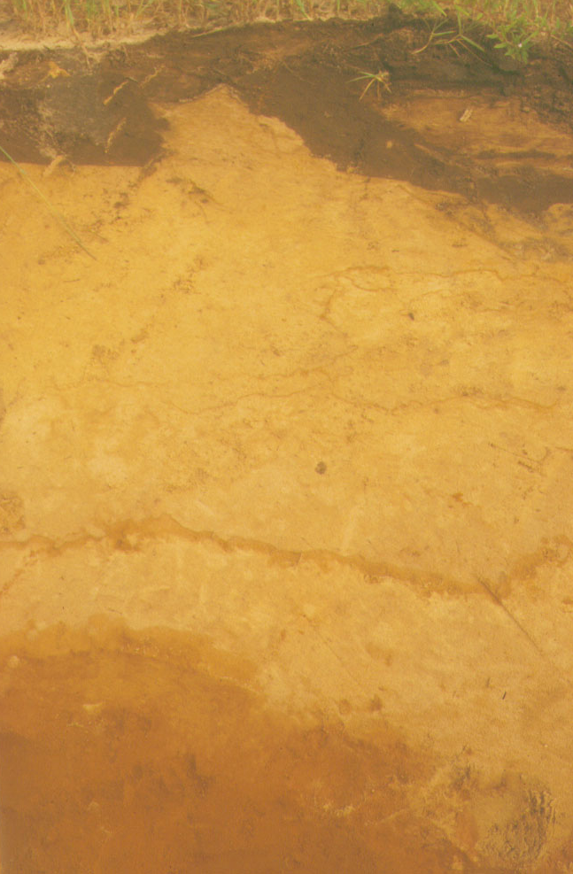
E Horizon
Notes:
Thick E horizon. The B horizon below shows a slight increase in clay.

Slide 16
E Horizon
Notes:
E horizon (10-20cm) in a wet sandy soil that has pine (conifers) vegetation growing on it. Fe and OM have been removed and translocated in the B horizon below.
There is a thin O horizon – pine needles above tape; an A horizon (0-10cm); and a B horizon (20-30+cm). Not that the A horizon boundary is not smooth nor abrupt indicating this has not been cultivated recently if ever.
You can tell the difference between an A and E horizon by remembering:
A horizons have a high OM content
E horizons have low OM content
E horizons often feel sandier (coarser) than the A horizon
E horizons are lighter in color than A horizons

Slide 17
B Horizons
Referred to as subsoil.
The zone of accumulation (or illuviation) within the soil.
Field Identification
Subsurface horizon formed below an O, A, E horizon and above the C horizon
Formed as a result of soil forming processes
Expressed often by color
Illuvial concentration-zone of accumulation
Notes:
You can tell the difference between E and B horizons by remembering:
E horizons are sandier (coarser) than B horizons
E horizons are higher in value and chroma
B horizons have more clay
B horizons have more Fe

Slide 18
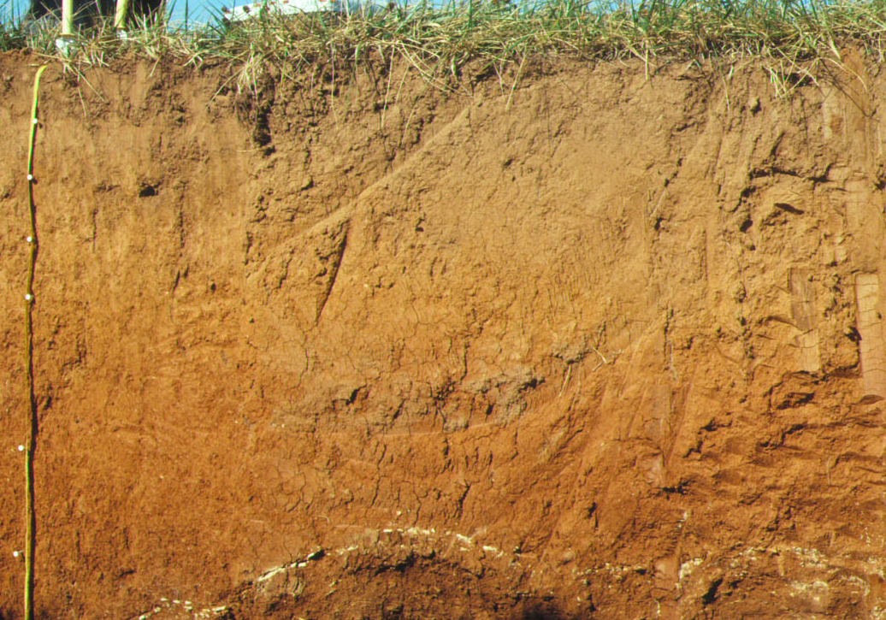
B Horizon
Notes:
Redder B under a lighter E horizon.

Slide 19
Bg Horizon
Notes:
B horizon at 40 cm and continuing to 100 cm. It has a higher clay content than the E horizon (20-40cm) above.

Slide 20
C Horizon
Referred to as parent material.
These horizons and layers are little affected by soil forming processes (unweathered geologic material).
Field Identification
Little affected by soil-forming processes
Geologic layering
Color of unweathered geologic material
Notes:
C horizon is called the parent material. Unlike the A, E, and B horizons C horizons generally lack soil structure.

Slide 21
Notes:
C horizon that looks more like rock but it offers no resistance to excavations. Note the rock-like pattern is still obvious.

Slide 22
R Horizon
Hard rock
Field Criteria
Can not dig it with a shovel or backhoe

Slide 23
Vocabulary
Decompose
Bedrock
Developed Soil
Eluviated Horizon
E Horizon
Horizon
Humus
Leaching
Minerals
Organic Matter
Organisms
Parent material
Soil
Soil Profile
Subsoil
Topsoil
Transform
Weathering
Notes:
All these words are defined in Soil! Get the inside Scoop

Slide 24
Vocabulary
A Horizon
B Horizon
C Horizon
R Horizon
O Horizon
Soil Monolith
Notes:
These are additional words with definitions below.
A Horizon – topsoil, mineral soil horizon with enough OM to make it appear darker (blacker or browner than horizons below it)
B Horizon – subsoil, zone of accumulation of material from above due to leaching or eluviation
C Horizon – a horizon composed of material that the soil has formed from
R Horizon – solid rock, bedrock
O Horizon – a horizon rich in organic mater
Soil Monolith – a physical representation (model) of a soil profile

