Slide 1
How do soils form?
Processes
Notes:
List the processes that occur in a soil? Give an example of each
Additions – rain adds water, dust adds minerals, as plants die and animals poop organic mater is added, humans also add fertilizer
Losses – evaporation, nutrient up take, leaching of nutrients and elements
Translocations – gravity pull water and dissolved materials down, OM can move in many directions due to critters, clay movement, eluviated horizon
Transformations – decomposition, weathering, iron rusting (reddening) or dissolving (graying), clay formation
Describe how a soil will change with time.
OM accumulates
A horizon forms
Horizons get thicker
May get redder if well drained or get grayer if wet
E horizon becomes more evident

Slide 2
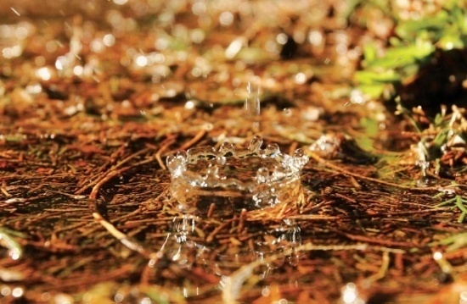
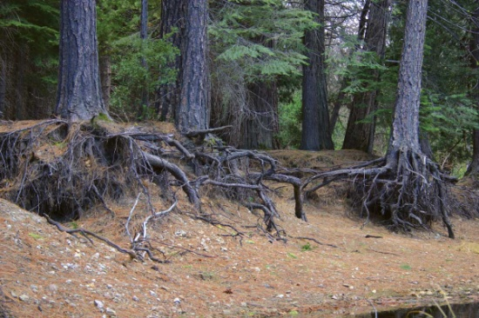
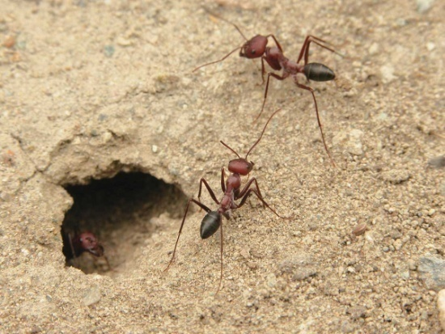
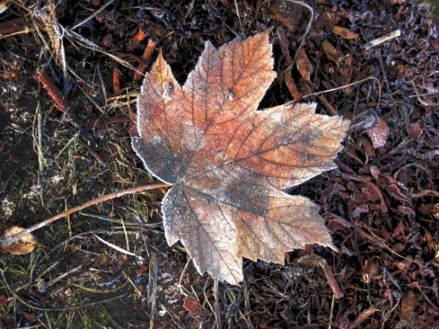
4 basic processes in the soil
ADDITIONS
LOSSES
TRANSLOCATIONS
(MOVEMENT WITHIN THE SOIL)
TRANSFORMATIONS
(ONE COMPONENT CHANGES TO ANOTHER)
Notes:
Four basic processes. Ask students to come up with more examples for each as each is discussed in the next 4 slides.

Slide 3
ADDITIONS
Rain adds WATER.
Dust adds MINERALS.
Animal waste add ORGANIC MATTER and NUTRIENTS.
Humans add FERTILIZER.
Notes:
Materials can be added to the soil in many ways. Natural ways include rainfall, dust settling, animal wastes, tree leaves in the fall etc.
Humans add wastes as well as fertilizer.

Slide 4
LOSSES
WATER evaporates into the air.
Soil particles WASH AWAY in storms.
ORGANIC MATTER may compose into carbon dioxide.
NUTRIENTS and MINERALS leach into groundwater or are taken up by plants.
Notes:
Losses are removal of components from the soil profile. Leaching can first translocate components deeper in the profile but in extreme cases where the component is removed it is referred to as a leaching loss. Erosion is another example of a loss.
Decomposition can both transform (organic material to humus) and cause a loss (organic matter to carbon dioxide which then moves to the atmosphere)

Slide 5
TRANSLOCATIONS
MOVEMENT WITHIN THE SOIL
GRAVITY pull WATER down from top to bottom.
EVAPORATING WATER draws minerals up from bottom to top
ORGANISMS carry materials every direction.
Notes:
Translocation is moving components within the soil profile but not leaving the profile
Movement is often due to water flow by gravity. Water moves minerals, nutrients, and organic matter. If these materials leave the profile it is a loss. So Loss can begin with simple translocation.
Movement is not always down as evaporation can cause minerals dissolved in water to move upwards. An example is salts on the surface of some desert or drier soils.

Slide 6
TRANSFORMATIONS
(ONE COMPONENT CHANGES TO ANOTHER)
Dead leaves decompose into HUMUS.
Hard rock WEATHERS into soft clay
Oxygen REACTS with iron, “rusting” the soil into a reddish color.
Notes:
Minerals in rock weather to clay
Rocks break in to smaller pieces
Iron in minerals turns to rust (iron oxides)
Leaves decompose to humus

Slide 7
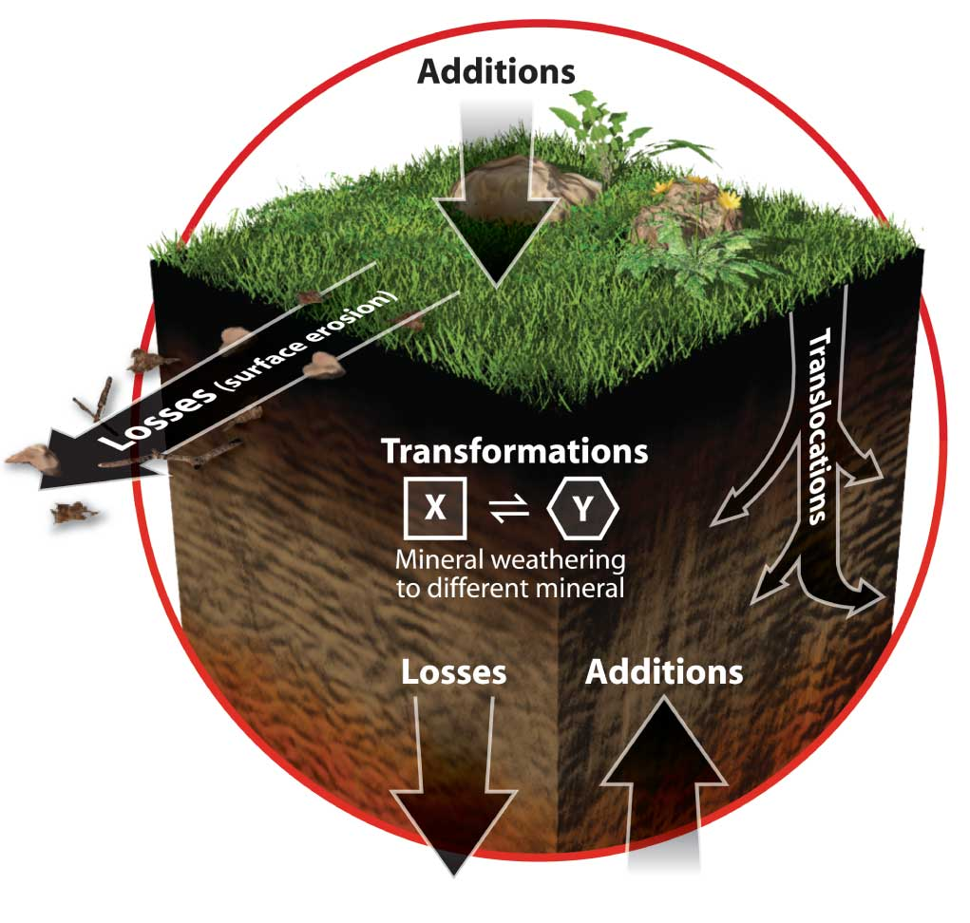
Looks Change With Age
The older a soil gets, the more different it looks from its parent material. Soil is always changing – minerals, water, air, organic matter and organisms – always change.
Notes:
Soil is constantly changing due to the 4 processes. This means soil is dynamic –in a constant state of change. This diagram may help understand better how the processes affect the soil.

Slide 8
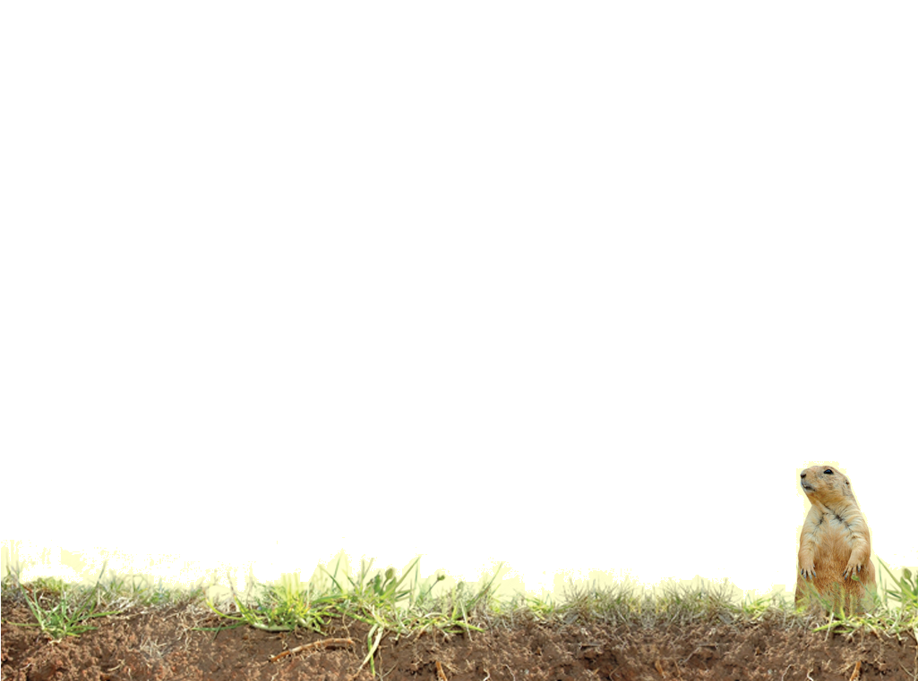
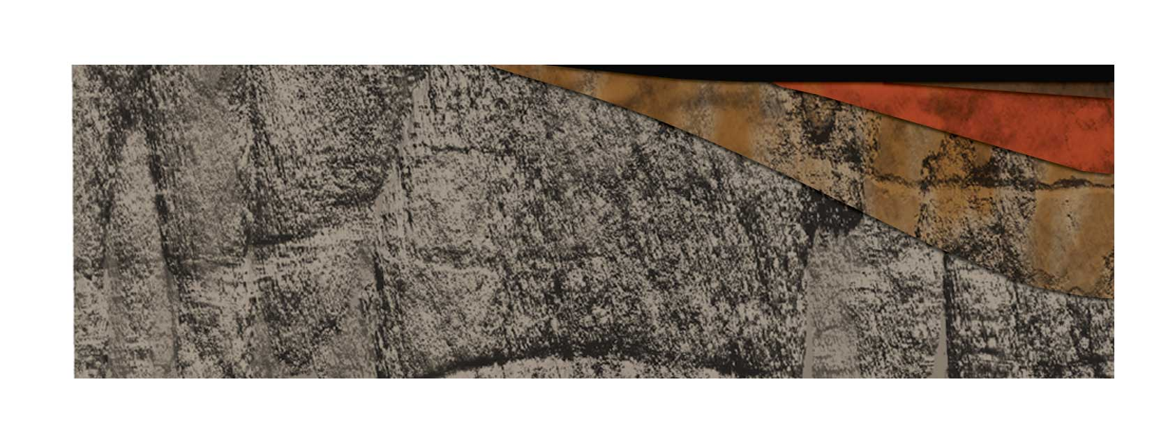
AGE IN YEARS
0
10
100
1,000
10,000
100,000
A - topsoil
E-Eluviated
B- Subsoil
C-Parent Material
R- Bedrock
A soil profile is like a snap-shot, capturing what the soil looks like NOW. In the PAST, soil looked different, and in the FUTURE, it will look different then it does now.
Notes:
The soil changes as a result of the process acting upon it. In a very general sense this diagram shows how the soil changes over time. In the next section CLORPT other factors of formation will be discussed to help further understand how a soil changes and how truly dynamic it is.
Note that a well developed soil profile will have more and thicker horizons than a less developed soil profile.

Slide 9
Vocabulary
Transform
Weathering
Decompose
Leaching
Minerals
Organic Matter
Organisms
Developed Soil
Humus
Bedrock
Notes:
These words are defined in Soil! Get the Inside Scoop.

Slide 10
Vocabulary
Additions
Losses
Translocation
Notes:
These words are not defined in Soil! Get the Inside Scoop but are defined below.
Additions – to add material or substance to the soil
Losses – to remove material or substance from the soil
Translocation – to move material or substance within the soil without adding or removing anything

